Slide 1
Best Practices in the Management of Patients With Antibiotic Allergies
AHRQ Safety Program for Improving Antibiotic Use
Ambulatory Care
AHRQ Pub. No. 17(22)-0030
September 2022

Slide 2
Objectives
Explain the importance of clarifying antibiotic allergies before prescribing antibiotics
Recognize types of reactions to antibiotics commonly prescribed in the outpatient setting
Review the cross-reactivity between antibiotic classes
Describe approaches to evaluating patients with reported antibiotic allergies

Slide 3
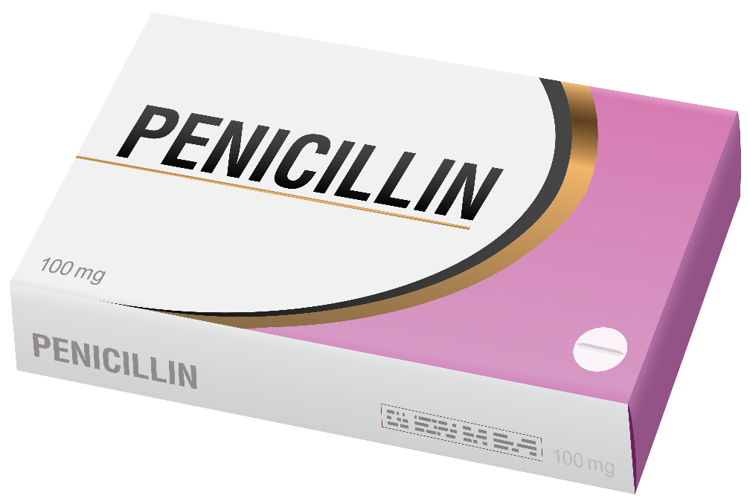
Antibiotic Allergy Prevalence¹⁻⁵
About 1 in 10 patients reports an allergy to penicillin
95% of people who report a penicillin allergy can tolerate beta-lactam antibiotics

Slide 4
Reasons for Overdiagnosis of Antibiotic Allergies¹⁻⁶
Viral exanthem misdiagnosed as drug rash because an antibiotic was given at the same time
Patients report history of allergy, and additional clarifying information is not obtained
Side effects misclassified as allergies
Patient assumes having relatives with allergies means they will have an allergy to that antibiotic

Slide 5
Importance of Assessing Antibiotic Allergies⁷⁻¹¹
Patients with reported allergies to penicillin or other beta-lactam antibiotics are more likely to receive an alternative, broader spectrum antibiotic that:
Is less effective
Is associated with more side effects
Is more expensive
Puts them at risk for future colonization or infection with antibiotic-resistant bacteria

Slide 6
Importance of Assessing Antibiotic Allergies⁷⁻¹¹
Reported penicillin allergy is associated with:
50% increased risk of surgical site infection
9% of reactions were intolerances and not allergies
23% increased odds of Clostridioides difficile infection
14% increased odds of MRSA colonization
30% increased odds of VRE colonization

Slide 7
Take Action¹²
Take the lead in properly documenting reported antibiotic allergies and side effects

Slide 8
Types of Allergic Reactions
Drug allergy: immunologically mediated response to a pharmaceutical agent in a sensitized person
Four types of immune-mediated antibiotic reactions
Type 1: IgE-mediated hypersensitivity reactions
Type 2: antibody-mediated destruction of white blood cells, red blood cells, or platelets
Type 3: IgG-immune complex deposition and complement activation
Type 4: T-cell mediated reactions (usually have skin involvement)

Slide 9
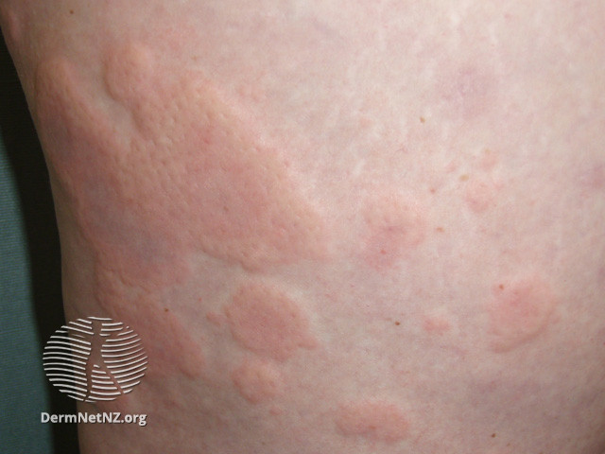
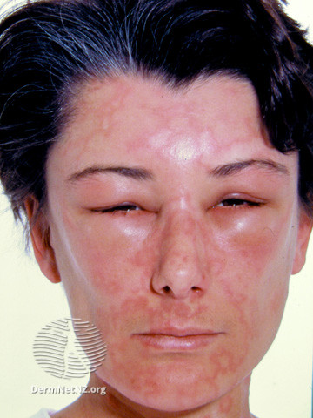
Type 1 Reactions^{6,13}
Hives
IgE-mediated hypersensitivity reactions
Manifest as urticaria (hives), angioedema, bronchospasm, and/or anaphylaxis
Occur within minutes to hours of receipt of the antibiotic
Image source: DermNetNZ.org. https://dermnetnz.org/topics/chronic-urticaria/. Creative Commons license: https://creativecommons.org/licenses/by-nc-nd/3.0/nz/legalcode.
Angioedema
Image source: DermNetNZ.org. https://dermnetnz.org/topics/urticaria-images/. Creative Commons license: https://creativecommons.org/licenses/by-nc-nd/3.0/nz/legalcode.
Notes:
Angioedema: https://dermnetnz.org/topics/angioedema/
Hives: https://dermnetnz.org/topics/chronic-urticaria/

Slide 10
Type 2 Reactions^{6,13}
Antibody-mediated destruction of white blood cells, red blood cells, or platelets
Manifest as abnormalities on complete blood count testing or evidence of hemolysis (jaundice, dark urine) or thrombocytopenia (petechiae)
Most commonly occur days or weeks into antibiotic therapy
Uncommon

Slide 11
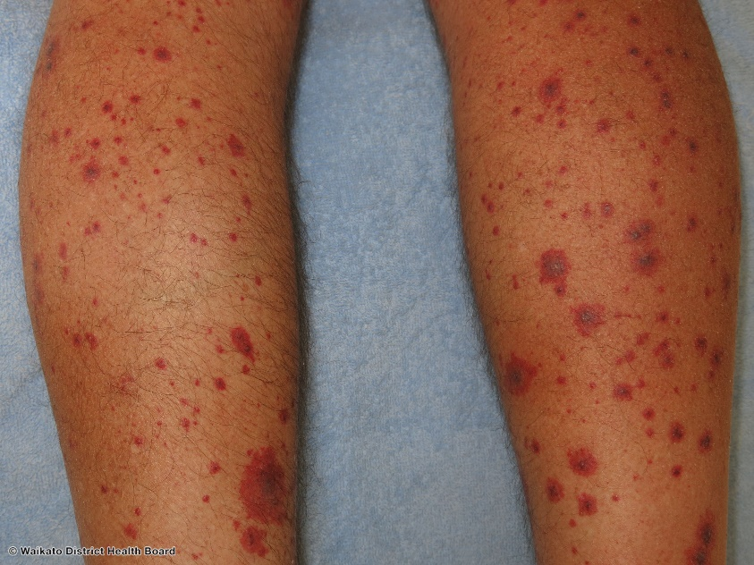
Type 3 Reactions^{6,13}
IgG-immune complex deposition and complement activation
Manifest as—
Serum sickness
Vasculitis
Palpable purpura
Joint pain
Urticaria
Lymphadenopathy
Fevers
Most commonly occur after several days of antibiotics
Uncommon
Hypersensitivity Vasculitis
Image source: DermNetNZ.org. https://dermnetnz.org/imagedetail/27493?copyright=&label. Creative Commons license: https://creativecommons.org/licenses/by-nc-nd/3.0/nz/legalcode.

Slide 12
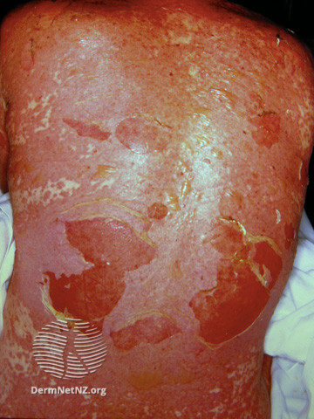
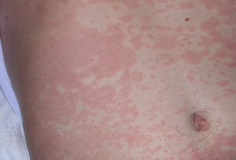
Type 4 Reactions^{6,13,14}
Result from T-cell activation
Manifest as:
Severe reactions
Stevens-Johnson syndrome
Toxic epidermal necrolysis
DRESS syndrome
Nonsevere reactions
Maculopapular/morbilliform rash
Generally occur days to weeks after antibiotics are started
Toxic epidermal necrolysis
Image source: DermNetNZ.org. https://dermnetnz.org/imagedetail/15299?copyright=&label Creative Commons license: https://creativecommons.org/licenses/by-nc-nd/3.0/nz/legalcode.
Maculopapular rash
Image source: Swick B. In: Hebert AA, Vazquez YG. Assessment of maculopapular rash. BMJ Best Practice. 7 Jan 2022. https://bestpractice.bmj.com/topics/en-gb/774. Used with permission.

Slide 13
Taking an Allergy History
Distinguish between allergies and side effects
Side effects
Nausea/vomiting
Diarrhea
Headaches
Dizziness
Fatigue
Taste alterations
Do not document side effects as allergies

Slide 14
Allergy History: Timing^{3,12}
How long after starting the antibiotic did the reaction occur?
Type 1 allergies occur after the first or second dose
Other types usually occur days later
How long ago did the reaction occur?
By 5 years, 50% of skin test-positive patients lose hypersensitivity
By 10 years, 80% of skin test-positive patients lose hypersensitivity

Slide 15
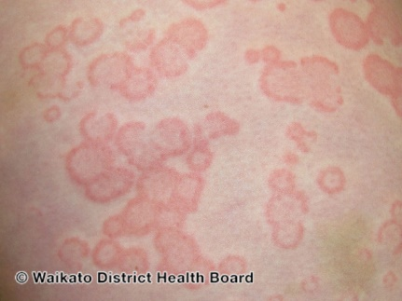
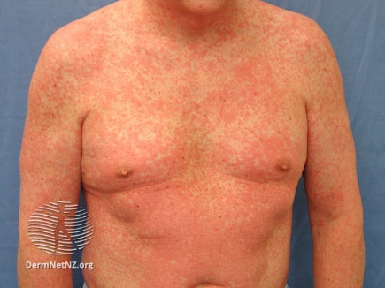
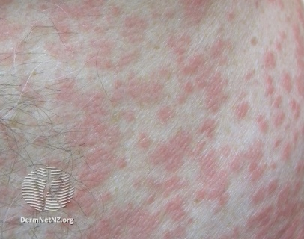
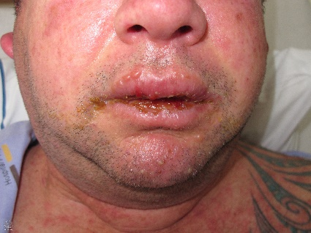
Allergy History: Defining the Rash¹⁴
Hives
Hives
Red, raised, smooth, itchy bumps often with white centers
Can be different sizes
Type 4 rashes
Maculopapular or morbilliform: red, minimally raised and rough to the touch, like fine-grit sandpaper
Blisters, skin peeling, or mucous membrane involvement
Determine severity
a.
b.
Maculopapular rash
c.
d.
Stevens-Johnson syndrome
Image sources:
a. DermNetNZ.org. https://dermnetnz.org/topics/chronic-urticaria/.
b. DermNetNZ.org. https://dermnetnz.org/topics/urticaria-images/.
c. and d. DermNetNZ.org. https://dermnetnz.org/topics/morbilliform-drug-reaction/.
e. DermNetNZ.org. https://dermnetnz.org/topics/blistering-skin-conditions/.
Creative Commons license: https://creativecommons.org/licenses/by-nc-nd/3.0/nz/legalcode.
e.
Notes:
Stevens-Johnson: https://dermnetnz.org/topics/blistering-skin-conditions/
Morbilliform rash: https://dermnetnz.org/topics/morbilliform-drug-reaction/
Hives: https://dermnetnz.org/topics/chronic-urticaria/

Slide 16
History: Evidence of a Type 1 Reaction
Swelling of the throat, tongue, lips, eyes
Difficulty breathing
Low blood pressure
Hives

Slide 17
History: Alternative Causes
Other medications at the time of the reaction
Other medical reason for abnormal labs
?

Slide 18
History: Rechallenge^{1,6}
Ask about receipt of penicillins or cephalosporins since the reaction
Provide specific names of other antibiotics
Determine if they were tolerated
Ask if the patient has seen an allergist or undergone skin testing
?

Slide 19
Documentation^{12,15}
Document specific findings
Exact nature of allergy and specific agent
Side effects
Remove the recorded allergy from the medical record if it is determined to be not an allergy
Ensure the patient knows that the allergy was removed and why it was removed

Slide 20
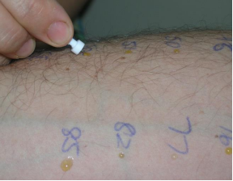
Management of Penicillin Allergies^{1,6,12,16,17}
If concern for any severe reaction, do not rechallenge, and refer for allergy evaluation
Allergists may recommend skin testing to assess for serious type 1 anaphylactic reactions
Negative skin test only rules out a type 1 reaction, NOT Stevens-Johnson syndrome, toxic epidural necrolysis, DRESS, or other severe non-hives rash
Image source: Australasian Society of Clinical Immunology and Allergy. Skin Prick Testing for the Diagnosis of Allergic Disease. Figure 3.2. March 2016. https://www.allergy.org.au/images/stories/pospapers/ASCIA_SPT_Manual_March_2016.pdf. Used with permission. (Revised guide at https://www.allergy.org.au/hp/papers/skin-prick-testing )

Slide 21
After Negative Penicillin Skin Testing^{6,12,16,17}
Same risk of reaction to penicillins as the general population

Slide 22
Cephalosporin Allergies^{6,12}
Tenfold fewer people have cephalosporin allergies than penicillin allergies (0.5–2%)
Can react to one cephalosporin and not another

Slide 23
Cephalosporins and Penicillins^{6,18-22}
Percentage of patients with a proven type 1 penicillin allergy who have a cephalosporin allergy
Percentage of patients with a chart-recorded penicillin allergy who have a cephalosporin allergy
2%–5%
0.1–0.2%

Slide 24
Trimethoprim-Sulfamethoxazole (TMP/SMX)⁶
Second most frequent cause of antibiotic allergies (4%)
Typically delayed maculopapular/morbilliform rash
Rash plus fever: risk of progression to multisystem organ involvement
STOP TMP/SMX
Less common: serum sickness, hemolytic anemia, aseptic meningitis, Stevens-Johnson syndrome, toxic epidermal necrolysis, erythema multiforme
IgE-mediated reaction uncommon
No skin testing available
Maculopapular rash
Image source: DermNetNZ.org. https://dermnetnz.org/imagedetail/15152?copyright=&label=.
Creative Commons license: https://creativecommons.org/licenses/by-nc-nd/3.0/nz/legalcode.

Slide 25
Tetracyclines⁶
Most rashes are actually sunburns from photosensitivity
Counsel patients to wear sunscreen, cover up when going outside
IgE-mediated reactions rare

Slide 26
Case 1: 50-Year-Old Patient Establishing Care
50-year-old new patient establishing care in your primary care clinic
Past medical history of depression
Intake form: penicillin allergy
What should you do?

Slide 27
Case 1: Next Step
You should ask her about her allergy history!
“I had horrible diarrhea when I was given amoxicillin-clavulanate as a teenager for sinusitis.”

Slide 28
Case 1: Next Step
Diarrhea is a side effect but not an allergy.
Remove the penicillin allergy from her chart.
Explain to her why she does not have an allergy.

Slide 29
Case 2: The Same 50-Year-Old Patient
Case 2
“Tell me about your allergy.”
“I had a rash when I was given amoxicillin as a child for a throat infection.”
What should you do?

Slide 30
Case 2: Next Steps
You need some more information.
“Tell me what you remember about getting the rash.”
A throat infection in childhood could have been caused by a virus, and the rash was actually a viral exanthema.
“Have you ever taken another antibiotic, like amoxicillin/clavulanate (Augmentin®) or cephalexin (Keflex®)?”
If she has tolerated penicillins or cephalosporin in the past, she can be rechallenged with them.
Document everything in her chart.
Explain your reasoning to her.

Slide 31
Take-Home Messages
Ensuring appropriate documentation of antibiotic allergies is an important part of antibiotic stewardship and may improve patient outcomes.
There are four main types of antibiotic allergies.
Taking a good history about the type of antibiotic allergy is important.
For concerning penicillin allergies, referral to an allergist can help clarify the type of reaction.

Slide 32
Additional Toolkit Resources
For more resources on Antibiotic Allergies, please access tools listed below, available in the AHRQ Toolkit To Improve Antibiotic Use in Ambulatory Care.
Discussion Guide: Refer to the Discussion Guide to find materials to help your practice develop a standardized approach to address patient reported antibiotic allergies.
Clinician One-Page Document: Refer to the One-Page document for a concise summary on collecting patient information regarding their penicillin allergy history.
Patient Handout: The Patient Handout explains allergic reactions to the patient, as well as the importance of sharing accurate information with their healthcare provider regarding possible antibiotic allergies. This is available in both English and Spanish.

Slide 33
Disclaimer
The findings and recommendations in this presentation are those of the authors, who are responsible for its content, and do not necessarily represent the views of AHRQ. No statement in this presentation should be construed as an official position of AHRQ or of the U.S. Department of Health and Human Services.
Any practice described in this presentation must be applied by healthcare practitioners in accordance with professional judgment and standards of care in regard to the unique circumstances that may apply in each situation they encounter. These practices are offered as helpful options for consideration by healthcare practitioners, not as guidelines.
Use of brand, manufacturer, or vendor names is for identification only and does not imply endorsement by the Agency for Healthcare Research and Quality of the U.S. Department of Health and Human Services.

Slide 34
References
Shenoy ES, Macy E, Rowe T, et al. Evaluation and management of penicillin allergy: A review. JAMA. 2019 Jan 15;321(2):188-99. PMID: 30644987.
Lee CE, Zembower TR, Fotis MA, et al. The incidence of antimicrobial allergies in hospitalized patients: Implications regarding prescribing patterns and emerging bacterial resistance. Arch Intern Med. 2000 Oct 9;160(18):2819-22. PMID: 11025792.
Evaluation and diagnosis of penicillin allergy for healthcare professionals. Centers for Disease Control and Prevention. October 2017. https://www.cdc.gov/antibiotic-use/community/for-hcp/Penicillin-Allergy.html. Accessed Jul 27,2022.
Wong A, Seger DL, Lai KH, et al. Drug hypersensitivity reactions documented in electronic health records within a large health system. J Allergy Clin Immunol Pract. 2019 Apr;7(4):1253-60.e3. PMID: 30513361.
Zhou L, Dhopeshwarkar N, Blumenthal KG, et al. Drug allergies documented in electronic health records of a large healthcare system. Allergy. 2016 Sep;71(9):1305-13. PMID: 26970431.

Slide 35
References
Joint Task Force on Practice Parameters; American Academy of Allergy, Asthma and Immunology; American College of Allergy, Asthma and immunology; et al. Drug allergy: an updated practice parameter. Ann Allergy Asthma Immunol. 2010 Oct;105(4):259-73. PMID: 20934625.
Blumenthal KG, Lu N, Zhang Y, et al. Risk of methicillin resistant Staphylococcus aureus and Clostridium difficile in patients with a documented penicillin allergy: Population based matched cohort study. BMJ. 2018 Jun 27;361:k2400. PMID: 29950489.
Blumenthal KG, Parker RA, Shenoy ES, et al. Improving clinical outcomes in patients with methicillin-sensitive Staphylococcus aureus bacteremia and reported penicillin allergy. Clin Infect Dis. 2015 Sep 1;61(5):741-9. PMID: 25991471.
MacFadden DR, LaDelfa A, Leen J, et al. Impact of reported beta-lactam allergy on inpatient outcomes: A multicenter prospective cohort study. Clin Infect Dis. 2016 Oct 1;63(7):904-10. PMID: 27402820.

Slide 36
References
Huang KG, Cluzet V, Hamilton K, et al. The impact of reported beta-lactam allergy in hospitalized patients with hematologic malignancies requiring antibiotics. Clin Infect Dis. 2018 Jun 18;67(1):27-33. PMID: 29346543.
Blumenthal KG, Ryan EE, Li Y, etal. The impact of a reported penicillin allergy on surgical site infection risk. Clin Infect Dis. 2018 Jan 18;66(3):329-36. PMID: 29361015.
Blumenthal KG, Peter JG, Trubiano JA, et al. Antibiotic allergy. Lancet. 2019 Jan 12;393(10167):183-96. PMID: 30558872.
Gell PGH, Coombs, RRA. Clinical Aspects of Immunology. Oxford: Blackwell; 1963.
Legendre DP, Muzny CA, Marshall GD, et al. Antibiotic hypersensitivity reactions and approaches to desensitization. Clin Infect Dis. 2014 Apr;58(8):1140-8. PMID: 24368623.

Slide 37
References
Rimawi RH, Shah KB, Cook PP. Risk of redocumenting penicillin allergy in a cohort of patients with negative penicillin skin tests. J Hosp Med 2013;8:615-18. PMID: 24106225.
Mill C, Primeau MN, Medoff E, et al. Assessing the diagnostic properties of a graded oral provocation challenge for the diagnosis of immediate and nonimmediate reactions to amoxicillin in children. JAMA Pediatr. 2016 Jun 6;170(6):e160033. PMID: 27043788.
Banks TA, Tucker M, Macy E. Evaluating penicillin allergies without skin testing. Curr Allergy Asthma Rep. 2019 Mar 22;19(5):27. PMID: 30903298.
Herbert ME, Brewster GS, Lanctot-Herbert M. Medical myth: ten percent of patients who are allergic to penicillin will have serious reactions if exposed to cephalosporins. West J Med. 2000 May;172(5):341. PMID: 10832430.
Goodman EJ, Morgan MJ, Johnson PA, et al. Cephalosporins can be given to penicillin-allergic patients who do not exhibit an anaphylactic response. J Clin Anesth. 2001;13(8):561-4. PMID: 11755324.

Slide 38
References
Daulat SB, Solensky R, Earl HS, et al. Safety of cephalosporin administration to patients with histories of penicillin allergy. J Allergy Clin Immunol. 2004;113(6):1220-2. PMID: 15214363.
Park MA, Koch CA, Klemawesch P, et al. Increased adverse drug reactions to cephalosporins in penicillin allergy patients with positive penicillin skin test. Int Arch Allergy Immunol. 2010;153(3):268-73. PMID: 20484925.

