Slide 1
AHRQ Safety Program for Improving Antibiotic Use
Why Should Your Practice Focus on Improving Antibiotic Prescribing?
Ambulatory Care
AHRQ Pub. No. 17(22)-0030
September 2022

Slide 2
Objectives
Explain why optimizing antibiotic prescribing is necessary for patient safety
Understand how antibiotic stewardship teams can improve antibiotic prescribing practices in the ambulatory care setting

Slide 3
The Importance of Antibiotics
Saved countless lives
Prompt administration and correct antibiotic at the right dose is critical
However, antibiotic use is associated with risks
Notes:
5
Stock photo ID:542111408

Slide 4
Antibiotic-Associated Adverse Events¹⁻⁸
Notes:
5

Slide 5
Antibiotic Overuse
30% of antibiotics prescribed in ambulatory practices are unnecessary⁹
59% of antibiotic expenditures occur in the outpatient setting⁹
Engagement in antibiotic stewardship activities can—
Ensure members of your clinic understand best practices in the diagnosis and management of common outpatient infections
Improve teamwork and communication within your practice around antibiotics
Improve patient satisfaction
Notes:
Stock photo ID:495057327

Slide 6
Clinical Case
Healthy 62-year-old man presents with 1 week of increased cough after a visit with his 3-year-old grandson.
Physical exam: vitals and chest exam, normal, afebrile
Chest imaging: slight bronchial thickening
Diagnosed with bronchitis.
Prescribed 10 days of levofloxacin.
Lingering cough; antibiotics extended for a 14-day course
Notes:
Stock photo ID:471562216

Slide 7
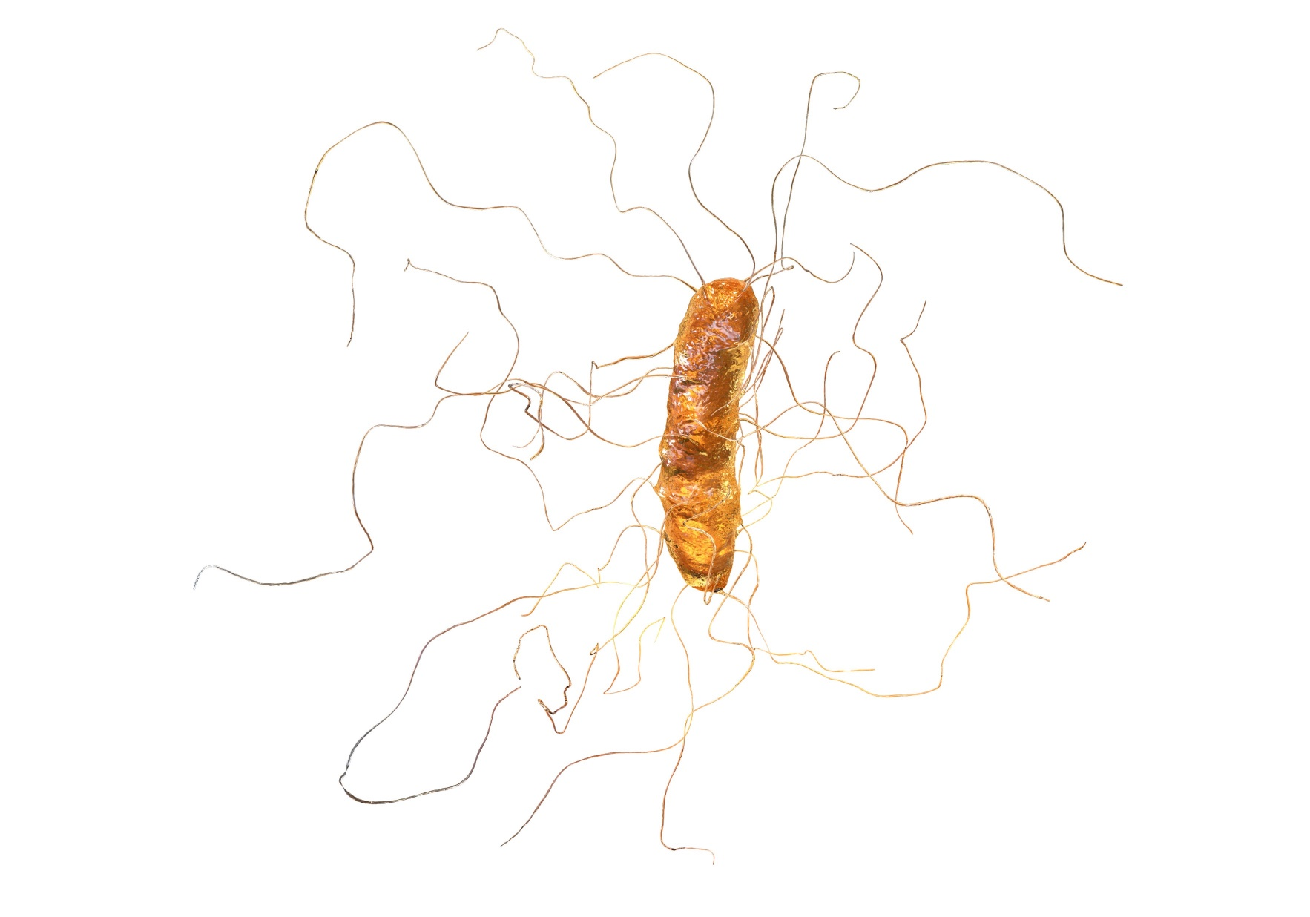
Clinical Case Continued
One week later he presented to the hospital with a severe Clostridioides difficile infection.

Slide 8
Where Are the Issues in This Case?¹⁰

Slide 9
Where Are the Issues in This Case?^{10,11}

Slide 10
Where Are the Issues in This Case?¹⁰

Slide 11
Antibiotics & Clostridioides difficile¹²
Virtually all antibiotics can increase the risk of C. difficile infections
Greatest risk
Clindamycin: 18X risk
Third-generation cephalosporins: 7X risk
Fluoroquinolones: 5X risk
Risk is still elevated up to 12 weeks later
Notes:
Stock photo ID:1140576317

Slide 12
Another Case
76-year-old female presents to her PCP for her annual visit.
She complains of difficulty falling asleep but otherwise feels well.
Urinalysis and urine culture obtained
≥10 white blood cells per high-powered field
≥100,000 colony-forming units per mL of E. coli susceptible to all tested antibiotics
7-day course of ciprofloxacin prescribed.
Notes:
Stock photo ID:1135777148

Slide 13
Case Continued
Two months later she has fevers, dysuria, and flank pain.
She presents to her local ED and is hypotensive.
Admitted and initiated on cefepime
Urine culture grows ≥100,000 CFU/mL E. coli resistant to ciprofloxacin
Completed a 7-day course of IV cefepime.

Slide 14
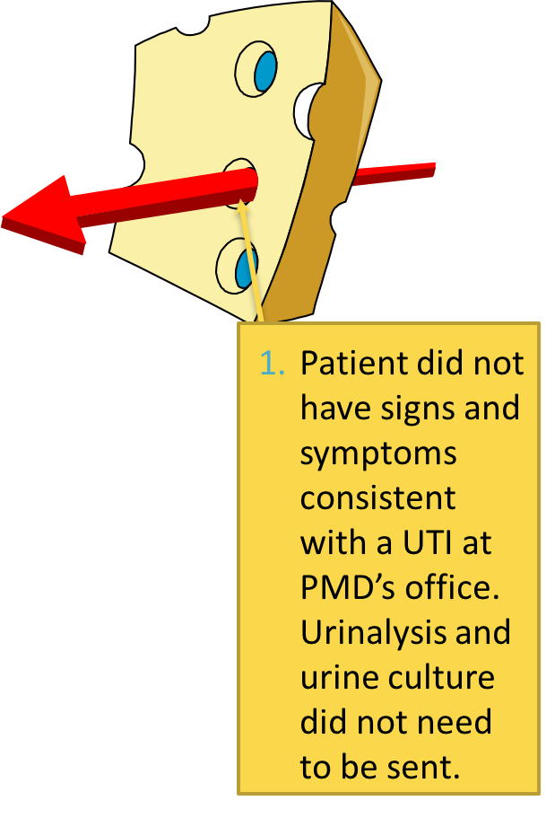
Where Are the Issues in This Case?^{10,13-15}

Slide 15
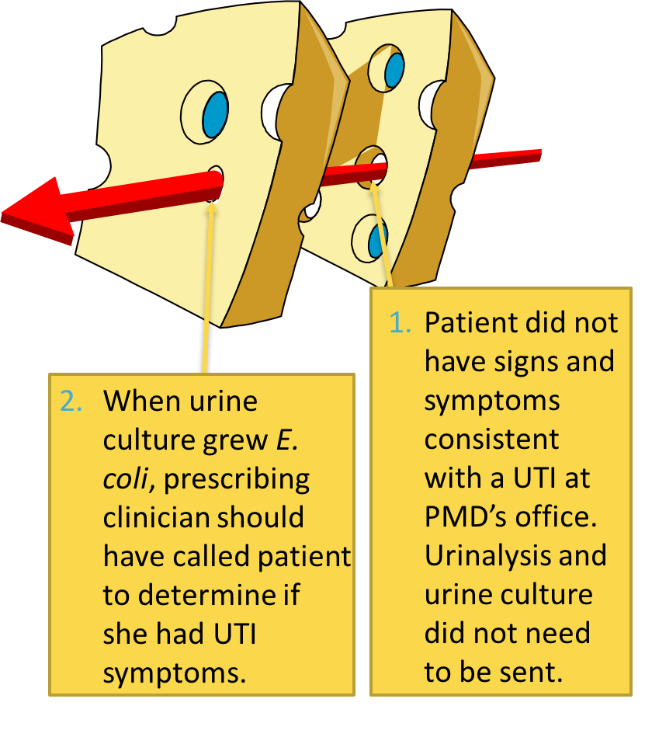
Where Are the Issues in This Case?^{10,13-15}

Slide 16
Where Are the Issues in This Case?^{10,13}

Slide 17
Social Determinants of Antibiotic Prescribing
Factors that impact antibiotic decisions include—^{16,17}
Concerns about relationships with colleagues
Concerns about relationships with patients
Antibiotic stewardship implementation can help navigate these concerns
Notes:
Stock photo ID:1147975120

Slide 18
Take-Home Messages
Antibiotics are critical for ill-appearing patients with bacterial infections, but all antibiotics also have associated harm
Promoting antibiotic stewardship can improve patient outcomes by ensuring the most effective antibiotic is prescribed for patients, and only when necessary
Organized antibiotic stewardship activities assist clinicians with—
Remaining up to date on best practices in antibiotic prescribing
Improving teamwork and communication around antibiotic prescribing
Improving patient satisfaction

Slide 19
Disclaimer
The findings and recommendations in this presentation are those of the authors, who are responsible for its content, and do not necessarily represent the views of AHRQ. No statement in this presentation should be construed as an official position of AHRQ or of the U.S. Department of Health and Human Services.
Any practice described in this presentation must be applied by health care practitioners in accordance with professional judgment and standards of care in regard to the unique circumstances that may apply in each situation they encounter. These practices are offered as helpful options for consideration by healthcare practitioners, not as guidelines.

Slide 20
References
Agah E, Habibi A, Naderi H, et al. Metronidazole-induced neurotoxicity presenting with sudden bilateral hearing loss, encephalopathy, and cerebellar dysfunction. Eur J Clin Pharmacol. 2017 Feb;73(2):249-50. PMID: 27744577.
Rijal JP, Pompa T, Giri S, et al. A case of toxic epidermal necrolysis caused by trimethoprim-sulfamethoxazole. BMJ Case Rep. 2014 Jul 9;2014:bcr2013203163. PMID: 25008332.
Lam S, Gomolin IH. Cefepime neurotoxicity: case report, pharmacokinetic considerations, and literature review. Pharmacotherapy. 2006 Aug;26(8):1169-74. PMID: 16863493.
Hammond DA, Smith MN, Li C, et al. Systematic review and meta-analysis of acute kidney injury associated with concomitant vancomycin and piperacillin/tazobactam. Clin Infect Dis. 2017 Mar 1;64(5):666-74. PMID: 27940946.
Sawada A, Kawanishi K, Morikawa S, et al. Biopsy-proven vancomycin-induced acute kidney injury: a case report and literature review. BMC Nephrol. 2018 Mar 27;19(1):72. PMID: 29587650.
Bates DE, Beaumont SJ, Baylis BW. Ototoxicity induced by gentamicin and furosemide. Ann Pharmacother. 2002 Mar;36(3):446-51. PMID: 11895059.

Slide 21
References
Francis JK, Higgins E. Permanent peripheral neuropathy: A case report on a rare but serious debilitating side-effect of fluoroquinolone administration. J Investig Med High Impact Case Rep. 2014 Jul 27;2(3):2324709614545225. PMID: 26425618.
Rosa B, Campos P, Barros A, et al. Spontaneous bilateral patellar tendon rupture: case report and review of fluoroquinolone-induced tendinopathy. Clin Case Rep. 2016 Jun 3;4(7):678-81. PMID: 27386128.
Fleming-Dutra KE, Hersh AL, Shapiro DJ, et al. Prevalence of inappropriate antibiotic prescriptions among US ambulatory care visits, 2010-2011. JAMA. 2016 May 3;315(17):1864-73. PMID: 27139059.
Reason J. Human error: models and management. BMJ. 2000 Mar 18;320(7237):768-70. PMID: 10720363.
Metlay JP, Waterer GW, Long AC, et al. Diagnosis and Treatment of Adults with Community-acquired Pneumonia. An Official Clinical Practice Guideline of the American Thoracic Society and Infectious Diseases Society of America. AM J Respir Crit Care Med. 2019 Oct 1;200(7):e45-e67. PMID: 31573350.
Brown KA, Khanafer N, Daneman N, et al. Meta-analysis of antibiotics and the risk of community-associated Clostridium difficile infection. Antimicrob Agents Chemother. 2013 May;57(5):2326-32. PMID: 23478961.

Slide 22
References
Gupta K, Hooton TM, Naber KG, et al. International clinical practice guidelines for the treatment of acute uncomplicated cystitis and pyelonephritis in women: A 2010 update by the Infectious Diseases Society of America and the European Society for Microbiology and Infectious Diseases. Clin Infect Dis. 2011 Mar 1;52(5):e103-20. PMID: 21292654.
Boscia JA, Kobasa WD, Abrutyn E, et al. Lack of association between bacteriuria and symptoms in the elderly. Am J Med. 1986 Dec;81(6):979-82. PMID: 3799658.
Nicolle LE, Bentley DW, Garibaldi R, et al. Antimicrobial use in long-term-care facilities. SHEA Long-Term-Care Committee. Infect Control Hosp Epidemiol. 2000 Aug;21(8):537-45. PMID: 10968724.
van der Geest S, Whyte SR, Hardon A. The Anthropology of Pharmaceuticals: A Biographical Approach. Annual Review of Anthropology. 1996;25:153–78.
Mehrotra A, Linder JA. Tipping the Balance Toward Fewer Antibiotics. JAMA Intern Med. 2016 Nov 1;176(11):1649-50. PMID: 27653497.

