Slide 1
AHRQ Safety Program for Improving Antibiotic Use
The “Never Antibiotics” Diagnoses:
Acute Bronchitis
Ambulatory Care
AHRQ Pub. No. 17(22)-0030
September 2022

Slide 2
Objectives
Diagnose acute bronchitis
Manage patients with acute bronchitis without antibiotics
Effectively communicate the time course of acute bronchitis to patients

Slide 3
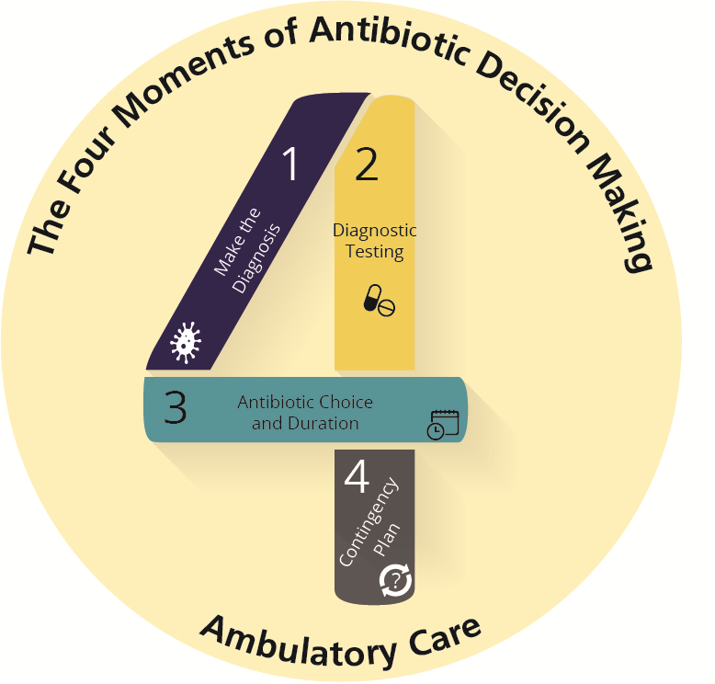
The Four Moments of Antibiotic Decision Making
Does my patient have an infection that requires antibiotics?
Do I need to order any diagnostic tests?
If antibiotics are indicated, what is the narrowest, safest, and shortest regimen I can prescribe?
Does my patient understand what to expect and the followup plan?

Slide 4
Case Presentation
54-year-old man who is a nonsmoker and has no past medical history presents with a cough that started after he had a cold 2 weeks ago
He has occasional production of white or yellow-tinged sputum
The cough is worse at night and wakes him up
No fevers or shortness of breath
On exam, he is afebrile and lungs are clear to auscultation

Slide 5
The Four Moments of Antibiotic Decision Making
Does my patient have an infection that requires antibiotics?

Slide 6
Moment 1: Acute Bronchitis
The definition of acute bronchitis is the presence of a cough that lasts less than 3 weeks, generally starting in the setting of a viral upper respiratory tract infection.
Antibiotic treatment of acute bronchitis is not recommended, regardless of the duration of the cough¹⁻³

Slide 7
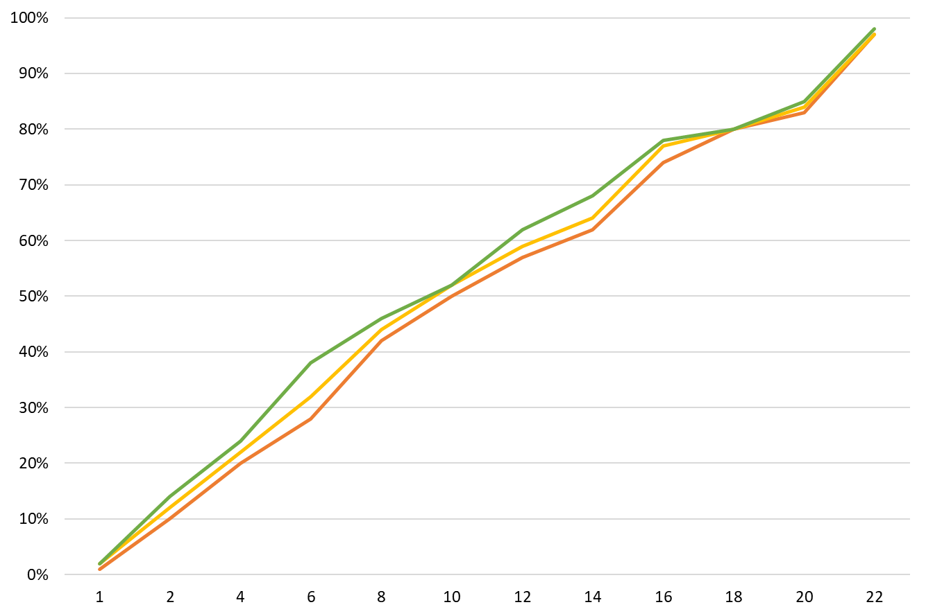
Antibiotics Do Not Improve Post-Viral Cough⁴
Proportion of Patients With Cough Resolution
Days After Initial Office Visit
No antibiotics group
Delayed antibiotics group
Immediate antibiotics groups

Slide 8
The Four Moments of Antibiotic Decision Making
Does my patient have an infection that requires antibiotics?
Do I need to order any diagnostic tests?

Slide 9
Moment 2: Diagnostic Testing in Acute Bronchitis
For patients with cough attributable to a recent viral infection, additional diagnostic testing is not indicated in the absence of other signs and symptoms of bacterial infection.

Slide 10
The Four Moments of Antibiotic Decision Making
Does my patient have an infection that requires antibiotics?
Do I need to order any diagnostic tests?
If antibiotics are indicated, what is the narrowest, safest, and shortest regimen I can prescribe?

Slide 11
Moment 3: Avoiding Antibiotics for Acute Bronchitis
Number of ED sampled visits
Number of Primary Care sampled visits
168
293
167
401
185
499
217
462
234
527
Percentage of Bronchitis Visits With Antibiotic Prescriptions
Year

Slide 12
Moment 3: Symptomatic Treatment of Acute Bronchitis^{6,7}
Over-the-counter medications⁶⁻⁸
Dextromethorphan
Honey⁹
Guaifenesin
Combination antihistamine-decongestants
Prescription medications⁶⁻⁸
Benzonatate
Codeine
Beta-agonists (if evidence of airflow obstructions)¹⁰

Slide 13
The Four Moments of Antibiotic Decision Making
Does my patient have an infection that requires antibiotics?
Do I need to order any diagnostic tests?
If antibiotics are indicated, what is the narrowest, safest, and shortest regimen I can prescribe?
Does my patient understand what to expect and the followup plan?

Slide 14
Time Course of Acute Bronchitis
Patients with acute bronchitis should be told that their cough may last for at least 3 weeks and that antibiotics will not hasten resolution of the cough.
Patients should be instructed to return to or call the clinic if they develop fever, shortness of breath or chest pain, if the cough increases in extent or frequency, or if a significant cough persists beyond three weeks.

Slide 15
Take-Home Messages
Antibiotics are not indicated for adults with acute bronchitis or for children with lingering coughs following a viral URI.
Options for symptomatic treatment can be provided to patients who are experiencing cough that interferes with daily activities or sleep, although data for their efficacy are limited.

Slide 16
Additional Toolkit Resources
For more resources on bronchitis, please access tools listed below, available in the AHRQ Toolkit To Improve Antibiotic Use in Ambulatory Care.
Discussion Guide: Refer to the Discussion Guide to help your practice develop a standardized approach to the diagnosis and management of patients with bronchitis.
Clinician One-Page Document: Refer to the One-Page document for a concise summary of the diagnosis and treatment of bronchitis.
Patient Handout: The Patient Handout explains the symptoms and symptomatic treatment of bronchitis and emphasizes that antibiotics are not always needed. It is available in both English and Spanish.

Slide 17
Disclaimer
The findings and recommendations in this presentation are those of the authors, who are responsible for its content, and do not necessarily represent the views of AHRQ. No statement in this presentation should be construed as an official position of AHRQ or of the U.S. Department of Health and Human Services.
Any practice described in this presentation must be applied by healthcare practitioners in accordance with professional judgment and standards of care in regard to the unique circumstances that may apply in each situation they encounter. These practices are offered as helpful options for consideration by healthcare practitioners, not as guidelines.

Slide 18
References
Smith MP, Lown M, Singh S, et al. Acute Cough Due to Acute Bronchitis in Immunocompetent Adult Outpatients: CHEST Expert Panel Report. Chest. 2020 May;157(5):1256-65. PMID: 32092323.
Woodhead M, Blasi F, Ewig S, et al. Guidelines for the management of adult lower respiratory tract infections—full version. Clin Microbiol Infect. 2011 Nov;17 Suppl 6:E1-59. PMID: 21951385.
Braman SS. Chronic cough due to acute bronchitis: ACCP evidence-based clinical practice guidelines. Chest. 2006 Jan;129(1 Suppl):95S-103S. PMID: 16428698.
Little P, Pumsby K, Kelly J, et al. Information leaflet and antibiotic prescribing strategies for acute lower respiratory tract infection - a randomized controlled trial. JAMA 2005. PMID: 15972565.
Barnett ML, Linder JA. Antibiotic prescribing for adults with acute bronchitis in the United States, 1996-2010. JAMA. 2014;311(19):2020-2022.
Green JL, Wang GS, Reynolds KM, et al. Safety profile of cough and cold medication use in pediatrics. Pediatrics. 2017 Jun;139(6):e20163070. PMID: 28562262.
Drugs for cough. Med Lett Drugs Ther. 2018 Dec 17;60(1562):206-8. PMID: 30625123.

Slide 19
References
Smith SM, Schroeder K, Fahey T. Over‐the‐counter (OTC) medications for acute cough in children and adults in community settings. Cochrane Database Syst Rev. 2014 Nov 24;11:CD001831. PMID: 25420096.
Oduwole O, Udoh EE, Oyo-Ita A, et al. Honey for acute cough in children. Cochrane Database Syst Rev. 2018 Apr 10;4:CD007094. PMID: 29633783.
Becker LA, Hom J, Villasis-Keever M, et al. Beta2-agonists for acute cough or a clinical diagnosis of acute bronchitis. Cochrane Database Syst Rev. 2015 Sep 3;9:CD001726. PMID: 26333656.

