Slide 1
The “Usually Antibiotics” Diagnoses: Community-Acquired Pneumonia
AHRQ Safety Program for Improving Antibiotic Use
Ambulatory Care
AHRQ Pub. No. 17(22)-0030
September 2022

Slide 2
Objectives
Describe the approach to diagnosing patients with community-acquired pneumonia, also known as “CAP”
Describe how to determine if patients with CAP warrant hospitalization
Describe treatment options for CAP in the outpatient setting
Develop followup plans for patients diagnosed with CAP

Slide 3
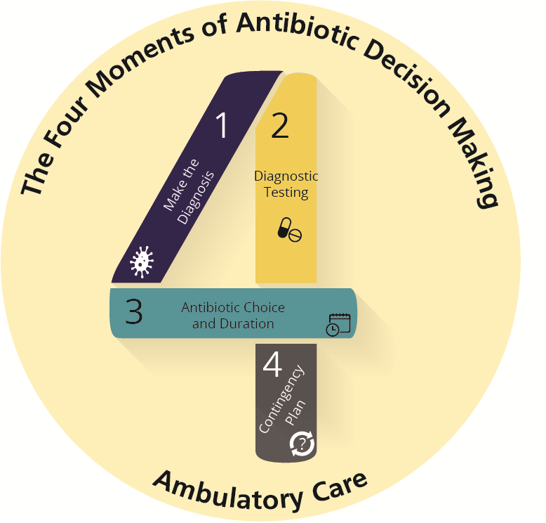
The Four Moments of Antibiotic Decision Making
Does my patient have an infection that requires antibiotics?
Do I need to order any diagnostic tests?
If antibiotics are indicated, what is the narrowest, safest, and shortest regimen I can prescribe?
Does my patient understand what to expect and the followup plan?

Slide 4
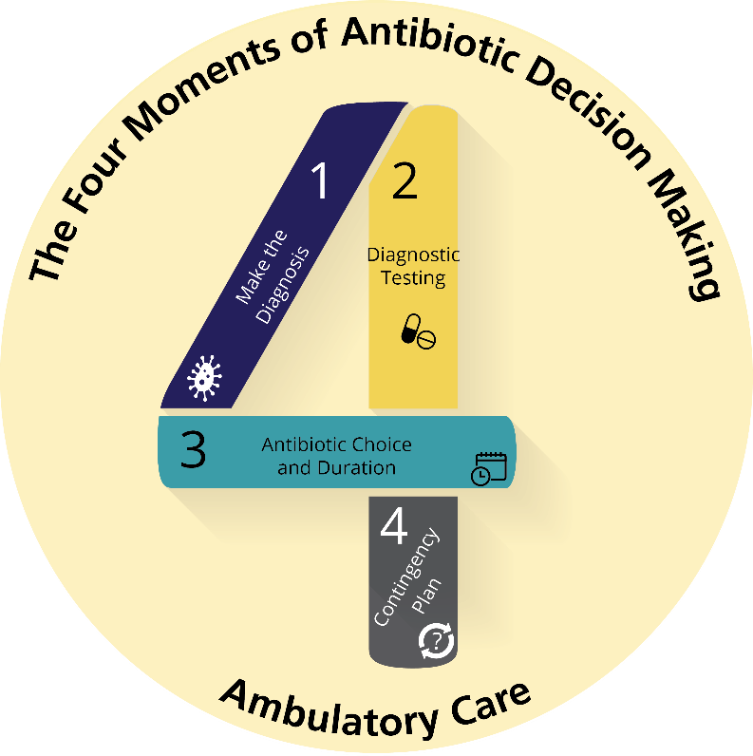
The Four Moments of Antibiotic Decision Making
Does my patient have an infection that requires antibiotics?

Slide 5
Moment 1: Diagnosis of CAP
Symptoms associated with typical bacterial pathogens (e.g., Streptococcus pneumoniae, Haemophilus influenzae):
Cough, shortness of breath, fevers, fatigue, chest pain that all occur relatively acutely
Symptoms associated with atypical bacterial pathogens:
Mycoplasma pneumoniae: low-grade fevers, malaise, headache, sore throat, and cough that linger for over a week
Legionella pneumophila: acute symptoms similar to the typical bacterial pathogens; most commonly in older adults, smokers, patients with underlying comorbidities, or patients with immunocompromise^{1,2}

Slide 6
Etiology of CAP^{3,4}
Pathogen identified in ~38% of cases
63% viral
29% bacterial
S. pneumoniae recovered in about 50% of cases where a bacteria is recovered

Slide 7
The Four Moments of Antibiotic Decision Making
Does my patient have an infection that requires antibiotics?
Do I need to order any diagnostic tests?

Slide 8
Moment 2: Chest X Ray^{5,6}
Indications for chest x ray
Diagnosis of CAP unclear
Hypoxia
Significant dyspnea
No improvement after 48–72 hours of antibiotic therapy for CAP
If no infiltrates present on chest x ray, CAP is unlikely

Slide 9
Moment 2: Viral Testing
Diagnostic testing for influenza or SARS-CoV-2 should be considered when these viruses are circulating
No antibiotic therapy needed if SARS-CoV-2 identified
If influenza identified in children, antibiotics are generally not necessary⁶
If influenza detected in adults and clinical or radiographic evidence of possible bacterial pneumonia, consider a 3- to 5-day course of antibiotic therapy⁷
Children and adults with recent flulike symptoms who were initially improving but have developed new fevers, may have developed a bacterial superinfection and a chest x ray should be considered^{6,7}

Slide 10
Triaging Decisions: CURB-65^{4,7-9}
Confusion
Uremia
BUN > 20 mg/dL
Respiratory rate
≥ 30 bpm
Low blood pressure
<90/60
≥ 65 years old

Slide 11
Triaging Decisions: Pneumonia Severity Index (PSI)⁸⁻¹²
Patients who meet all criteria below are low risk and can be treated as outpatients:
< 50 years
No history of neoplasm
No history of congestive heart failure
No history of cerebrovascular disease
No history of renal disease
No history of liver disease
No altered mental status
Pulse <125 beats per minute
Respiratory rate <30 breaths per minute
Systolic blood pressure >90
Temperature >35 degrees and <40 degrees Celsius
For all remaining patients, calculate the PSI to assess need for hospitalization.⁸

Slide 12
The Four Moments of Antibiotic Decision Making
Does my patient have an infection that requires antibiotics?
Do I need to order any diagnostic tests?
If antibiotics are indicated, what is the narrowest, safest, and shortest regimen I can prescribe?

Slide 13
Moment 3: Antibiotic Choice^{4,7,13,14}
Amoxicillin 1 g three times daily or doxycycline 100 mg twice daily
<25% local pneumococcal resistance to macrolides: azithromycin or clarithromycin
Respiratory fluoroquinolones not recommended as first-line therapy

Slide 14
Moment 3: Antibiotic Choice in Adults^{7,13}
Antibiotics in prior 3 months or comorbidities:
Beta-lactam plus a macrolide
Preferred beta-lactams: amoxicillin-clavulanate
Nonsevere beta-lactam allergy: oral second- or third-generation cephalosporin
Doxycycline can be used as alternative to a macrolide
Moxifloxacin or levofloxacin (monotherapy): if severe allergy to penicillins

Slide 15
Moment 3: Antibiotic Choice in Children⁶
Preferred: high-dose amoxicillin; amoxicillin-clavulanate if amoxicillin received in previous 30 days⁸
Nonsevere penicillin allergy: cefuroxime or cefpodoxime
Severe penicillin allergy: respiratory fluoroquinolone or macrolide
Mycoplasma pneumoniae: macrolide

Slide 16
Moment 3: Duration of Therapy^{6,15-19}
Adults
Children
3–5 days of antibiotics

Slide 17
The Four Moments of Antibiotic Decision Making
Does my patient have an infection that requires antibiotics?
Do I need to order any diagnostic tests?
If antibiotics are indicated, what is the narrowest, safest, and shortest regimen I can prescribe?
Does my patient understand what to expect and the followup plan?

Slide 18
Moment 4: What To Expect²⁰
Gradual improvement by third day of antibiotics
If not improving, consider changing antibiotics, ordering chest x ray, or referring to emergency department
Recovery takes 2–3 weeks
Some symptoms such as fatigue and cough may persist for months

Slide 19
Case Presentation
50-year-old otherwise healthy male
No past medical history
Presents with—
3 days of worsening shortness of breath
Cough productive of white sputum
Fevers of 101⁰F
Exam
Respiratory rate 12 breaths per minute
Saturation 95% on room air
Temperature 101⁰F
Rhonchi heard in the right middle lobe

Slide 20
Moment 1
Does he have an infection that requires antibiotics?
The clinical signs and symptoms of worsening shortness of breath, a productive cough, and fevers make the likelihood of bacterial CAP reasonably high.

Slide 21
Moment 2⁹
Do I need to order a diagnostic test?
Because he is likely to have pneumonia, a chest x ray is not needed
If there is uncertainty about the diagnosis, he develops significant hypoxia or dyspnea, or does not show improvement within 48–72 hours, imaging should be obtained

Slide 22
Triaging Decisions⁹
Review CURB-65 or PSI to determine if reasonable to manage patient in the ambulatory setting
C: Confusion: Not present
U: Uremia: Not confused, no tachypnea, normotensive, so likely normal BUN
R: Elevated respiratory rate: Not present
B: Low blood pressure: Not present
65: Less than 65 years old
Reasonable to manage as an outpatient

Slide 23
Moment 3¹³
If antibiotics are indicated, what is the narrowest, safest, and shortest regiment I can prescribe?
No recent antibiotics
No comorbid illnesses
Amoxicillin or doxycycline are reasonable choices
Low prevalence of macrolide-resistant pneumococcus locally: consider azithromycin or clarithromycin

Slide 24
Moment 4
Does my patient know what to expect and the followup plan?
Five days of antibiotics likely sufficient
Should expect to feel a little better by day 3
Will probably have a persistent cough or fatigue for several weeks

Slide 25
Take-Home Messages
Patients with CAP generally present with fevers, cough, and increased work of breathing.
CURB-65 or PSI criteria help determine if adults with CAP would benefit from hospitalization.
Consider amoxicillin or doxycycline for otherwise healthy adults with CAP.
Azithromycin or clarithromycin are reasonable options if local rates of macrolide-resistant pneumococcus are <25%.
Consider amoxicillin/clavulanate or a second- or third-generation cephalosporin for adults with comorbidities with CAP.
A macrolide or doxycycline should be co-administered.
Amoxicillin is preferred therapy for most children with CAP.
For both adults and children with CAP, the duration of therapy can generally be limited to no more than 5 days.

Slide 26
Additional Toolkit Resources
For more resources on community-acquired pneumonia, please access tools listed below, available in the AHRQ Toolkit To Improve Antibiotic Use in Ambulatory Care.
Discussion Guide: Refer to the Discussion Guide to help your practice develop a standardized approach to the diagnosis and management of patients with community-acquired pneumonia.
Clinician One-Page Document: Refer to the One-Page document for a concise summary of the diagnosis and treatment of community-acquired pneumonia.
Patient Handout: The Patient Handout explains the symptoms and symptomatic treatment of community-acquired pneumonia. It is available in both English and Spanish.

Slide 27
Disclaimer
The findings and recommendations in this presentation are those of the authors, who are responsible for its content, and do not necessarily represent the views of AHRQ. No statement in this presentation should be construed as an official position of AHRQ or of the U.S. Department of Health and Human Services.
Any practice described in this presentation must be applied by healthcare practitioners in accordance with professional judgment and standards of care in regard to the unique circumstances that may apply in each situation they encounter. These practices are offered as helpful options for consideration by healthcare practitioners, not as guidelines.

Slide 28
References
Herwaldt LA, Marra AR. Legionella: a reemerging pathogen. Curr Opin Infect Dis. 2018 Aug;31(4):325-33. PMID: 29794542.
Miyashita N, Higa F, Aoki Y, et al. Clinical presentation of Legionella pneumonia: Evaluation of clinical scoring systems and therapeutic efficacy. J Infect Chemother. 2017 Nov;23(11):727-32. PMID: 28951197.
Jain S, Self WH, Wunderink RG, et al. Community-acquired pneumonia requiring hospitalization among U.S. adults. N Engl J Med. 2015 Jul 30;373(5):415-27. PMID: 26172429.​
Musher DM, Thorner AR. Community-acquired pneumonia. N Engl J Med. 2014 Oct 23;371(17):1619-28. PMID: 25337751.​
Wootton D, Feldman C. The diagnosis of pneumonia requires a chest radiograph (x-ray)—yes, no or sometimes? Pneumonia. 2014 Dec 1;5:1-7.
Bradley JS, Byington CL, Shan SS, et al. Executive summary: the management of community-acquired pneumonia in infants and children older than 3 months of age: clinical practice guidelines by the Pediatric Infectious Diseases Society of America. Clin Infect Dis. 2011 Oct;52(7):617-30. PMID: 21890766.​

Slide 29
References
Metlay JP, Vaterer GW, Long AC, et al. Diagnosis and treatment of adults with community-acquired pneumonia. An official clinical practice guideline of the American Thoracic Society and Infectious Diseases Society of America. Am J Respir Drit Care Med. 2019 Oct 1;200(7):e45-67. PMID: 31573350.
Fine MJ, Auble TE, Yealy DM, et al. A prediction rule to identify low-risk patients with community-acquired pneumonia. N Engl J Med. 1997 Jan23;336(4):243-50. PMID: 8995086.​
Lim WS, van der Eeren MM, Laing R, et al. Defining community acquired pneumonia severity on presentation to hospital: an international derivation and validation study. Thorax. 2003 Mayl58(5):377-82. PMID: 12728155.​
Aujesky D, Fine MJ. Does guideline adherence for empiric therapy reduce mortality in community-acquired pneumonia? Am J Respir Crit Care Med. 2005 Sep 15;172(6)655-6. PMID: 16148192.
Carratalà J, Fernández-Sabé N, Ortega L, et al. Outpatient care compared with hospitalization for community-acquired pneumonia: a randomized trial in low-risk patients. Ann Inter Med. 2005 Feb 1;142(3):165-72. PMID: 15684204.​

Slide 30
References
Yealy DM, Auble TE, Stone RA, et al. Effect of increasing the intensity of implementing pneumonia guidelines: a randomized, controlled trial. Ann Intern Med. 2005 Dec 20;143(12):881-94. PMID: 16365469.​
Mandell LA, Wunderink RG, Anzueto A, et al. Infectious Diseases Society of America/American Thoracic Society consensus guidelines on the management of community-acquired pneumonia in adults. Clin Infect Dis. 2007 Mar 1;44 Suppl 2:S27-72. PMID: 17278083.​
FDA Drug Safety Communication: FDA updates warnings for oral and injectable fluoroquinolone antibiotics due to disabling side effects. U.S. Food and Drug Administration. Mar 8, 2018. https://www.fda.gov/drugs/drug-safety-and-availability/fda-drug-safety-communication-fda-updates-warnings-oral-and-injectable-fluoroquinolone-antibiotics. Accessed: Sep 30, 2019.​
Uranga A, España PP, Bilbao A, et al. Duration of antibiotic treatment in community-acquired pneumonia: a multicenter randomized clinical trial. JAMA Intern Med. 2016 Sep 1;176(9):1257-85. PMID: 27455166.​
Greenberg D, Givon-Lavi N, Sadaka Y, et al. Short-course antibiotic treatment for community-acquired alveolar pneumonia in ambulatory children: a double-blind, randomized, placebo-controlled trial. Pediatr Infect Dis J. 2014 Feb;33(2):136.42. PMID: 23989106.

Slide 31
References
Pernica JM, Harman S, Kam AJ, et al. Short-course antimicrobial therapy for pediatric community-acquired pneumonia: The SAFER randomized clinical trial. JAMA Pediatr. 2021 May 1;175(5):475-82. PMID: 33683325.
Williams DJ, Creech CB, Walter EB, et al. Short- vs standard-course outpatient antibiotic therapy for community-acquired pneumonia in children: The SCOUT-CAP randomized clinical trial. JAMA Pediatr. 2022 Jan 18;e215547. PMID: 35040920.
Dinh A, Roper J, Duran C, et al. Discontinuing β-lactam treatment after 3 days for patients with community-acquired pneumonia in non-critical care wards (PTC): a double-blind, randomised, placebo-controlled, non-inferiority trial. Lancet. 2021 Mar 27;397(10280):1195-203. PMID: 33773631.
Waterer G. Recovery from community acquired pneumonia: the view from the top of the iceberg. Eur Respir J. 2017 Jun 15;49(6):pii: 1700571. PMID: 28619961.

