Slide 1
The “Never Antibiotics” Diagnoses: Acute Viral Upper Respiratory Infection: the Common Cold
AHRQ Safety Program for Improving Antibiotic Use
Ambulatory Care
AHRQ Pub. No. 17(22)-0030
September 2022

Slide 2
Objectives
Describe how to diagnose a viral upper respiratory infection, also known as the common cold
Explain why antibiotic therapy is not useful in the treatment of viral upper respiratory tract infections
Describe treatment options to manage the symptoms of viral upper respiratory infections
Discuss strategies to communicate with patients the appropriate management of viral upper respiratory tract infections

Slide 3
Background¹
Approximately 500 million viral infections occur in the United States every year
About 25% of these result in a telephone or office healthcare encounter

Slide 4
Case Presentation
A healthy 30-year-old woman presents with 3 days of rhinorrhea, sore throat, and a productive cough.
She has no sinus tenderness and no cervical adenopathy.
Everyone in my office is ill.
Your temperature is 99° Fahrenheit.
My normal temperature is 97° Fahrenheit.
Azithromycin helps my symptoms.

Slide 5
Harm Associated With Antibiotics^{2,3}
Adverse drug events
Antibiotic-associated diarrhea^{4,5}
Yeast infections
Rash
Disruption of normal bacteria that colonize the intestinal and upper respiratory tract
Selection for antibiotic-resistant bacteria
Clostridioides difficile infection⁶

Slide 6
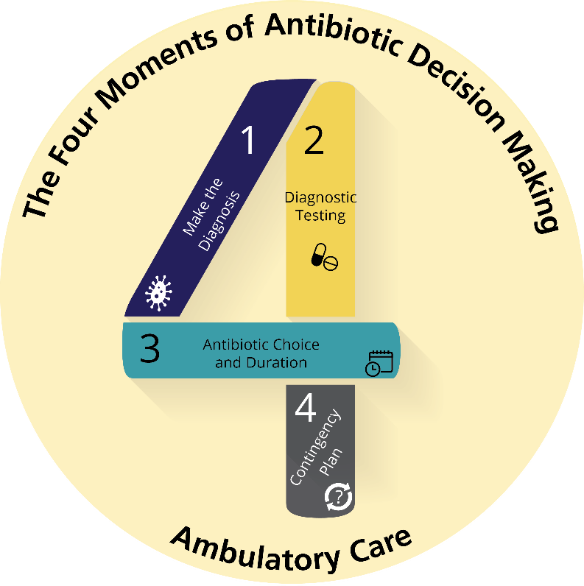
The Four Moments of Antibiotic Decision Making
Does my patient have an infection that requires antibiotics?
Do I need to order any diagnostic tests?
If antibiotics are indicated, what is the narrowest, safest, and shortest regimen I can prescribe?
Does my patient understand what to expect and the followup plan?

Slide 7
Over-the-Counter Medications⁷⁻¹⁰
Options for Symptomatic Treatment of the Common Cold
Acetaminophen
NSAIDs
Nasal decongestants
Antihistamine-decongestants
Antihistamine-decongestant- analgesics

Slide 8
Over-the-Counter Medication for Children¹¹⁻¹³
Cold medicines are not recommended for children under 6 years of age.
Honey can be used for cough in children over a year old.
Cool mist humidifiers can improve cough and congestion.
Saline nasal drops and bulb suctioning can help with congestion.
Notes:
Stock photo ID:1124476002

Slide 9
Communicating With Patients^{13,14}
Address patients’ beliefs and concerns using effective communication strategies
Common patient concerns include:
Wanting to feel that their symptoms are being taken seriously
Understanding conflicting practices among clinicians regarding provision of antibiotic prescriptions
Worries about becoming sicker or not being able to reach a clinician

Slide 10
Communication: Validate Patient Concerns
Assure patients that their symptoms are being taken seriously

Slide 11
Solution: Validate Patient Concerns
“I can see you’re feeling pretty miserable. Let’s try to fix that.”
“I am sorry to hear you are not feeling well. Let’s work on getting you feeling better.”
“Antibiotics won’t help, but here are some things that might help.”

Slide 12
Communication: Patients Getting Conflicting Messages
“The last time I had this, you were out of town, and your partner gave me an antibiotic.”
“I know this is my first time coming into this urgent care center, but my doctor always gives me a prescription for an antibiotic when I have this.”
“I have the same thing as my child, and my doctor gave me an antibiotic. Will you give my child one too?”

Slide 13
Solution: Communication and Sample Phrases
“There’s a lot of newer evidence showing antibiotics have more side effects than we used to think. We are being more careful about only prescribing antibiotics when you really need them.”
“While I can’t say for certain what you have had in the past, the good news is that this time you don’t have an infection that requires antibiotics.”
“Viral infections often last a week or so and almost always get better on their own. People often start feeling better after about 3 days which often coincides with when antibiotics were started. Even though it might seem like the antibiotic helped, you most likely experienced the natural and expected course of the viral infection.”

Slide 14
Communication: Other Patient Concerns
Feeling insecure
Concern that they have upcoming travel or commitments, and antibiotics may help get them better faster
Concern that they won’t be able to reach the clinician if they get sicker

Slide 15
Solutions: Managing Patient Expectations
A patient might say, “I have an important family commitment this weekend, and I can’t be sick!”
You could respond:
“I understand that you have important commitments this weekend, but antibiotics won’t make this go away faster. In fact, they could lead to an adverse event, like diarrhea, that could make it harder to participate in the family event.”

Slide 16
Clinicwide Protocols
Develop a practicewide approach to make sure patients have appropriate expectations around antibiotic prescriptions for the common cold.
Work together as a practice to reach a consensus on when antibiotics will and won’t be prescribed for outpatient infectious conditions and develop lists of symptomatic treatments that all members of the practice will recommend for the common cold as well as other infectious disease processes.
Consider developing approaches to manage some patients with colds over the phone so that they don’t come into the clinic and inadvertently expose other patients and healthcare workers.

Slide 17
The Four Moments of Antibiotic Decision Making
Does my patient have an infection that requires antibiotics?
Do I need to order any diagnostic tests?
If antibiotics are indicated, what is the narrowest, safest, and shortest regimen I can prescribe?
Does my patient understand what to expect and the followup plan?

Slide 18
Moment 4: What To Expect and Followup Plan
Provide patients with information about the expected symptoms and time course of their illness
It is normal for nasal discharge to change color
Cough may last 2–3 weeks
They should start to feel better within a few days, but symptoms can linger for a few weeks
Give patients recommendations for when to call or return to the clinic or to go to the emergency department
Develop a handout with specific recommendations for treatment and the followup plan.

Slide 19
Take-Home Messages
Antibiotics should not be prescribed for acute viral upper respiratory tract infections
Antibiotics don’t help and could harm patients
When talking to patients, focus on—
Acknowledgment of their symptoms and that you understand that they feel poorly
Recommendations for symptomatic therapy
Expected time course of the infection
When to call or return to medical attention
Develop communication strategies for patients, such as validating the patient’s concerns and reiterating why antibiotics are not needed (and why this is good news).
Develop a common practicewide strategy to manage patients with these infections.

Slide 20
Additional Toolkit Resources
For more resources on acute viral upper respiratory infection, please access tools listed below, available in the AHRQ Toolkit To Improve Antibiotic Use in Ambulatory Care.
Discussion Guide: Refer to the Discussion Guide to help your practice develop a standardized approach to the diagnosis and management of patients with acute viral upper respiratory infection.
Clinician One-Page Document: Refer to the One-Page document for a concise summary of the diagnosis and treatment of acute viral upper respiratory infection.
Patient Handout: The Patient Handout explains the symptoms and symptomatic treatment of acute viral upper respiratory infection. It is available in both English and Spanish.

Slide 21
Disclaimer
The findings and recommendations in this presentation are those of the authors, who are responsible for its content, and do not necessarily represent the views of AHRQ. No statement in this presentation should be construed as an official position of AHRQ or of the U.S. Department of Health and Human Services.
Any practice described in this presentation must be applied by healthcare practitioners in accordance with professional judgment and standards of care in regard to the unique circumstances that may apply in each situation they encounter. These practices are offered as helpful options for consideration by healthcare practitioners, not as guidelines.

Slide 22
References
Fendrick AM, Monto AS, Nightengale B, et al. The economic burden of non-influenza-related viral respiratory tract infection in the United States. Arch Intern Med. 2003 Feb 24;163(4):487-94. PMID: 12588210.
Petersen I, Johnson AM, Islam A, et al. Protective effect of antibiotics against serious complications of common respiratory tract infections: retrospective cohort study with the UK General Practice Research Database. BMJ. 2007 Nov 10;335(7627): 982. PMID: 1794774
Shehab N, Patel PR, Srinivasan A, et al. Emergency department visits for antibiotic-associated adverse evets. Clin Infect Dis. 2008 Sep 15;47(6):735-43. PMID: 18694344.
Elseviers MM, Camp YV, Nayaert S, et al. Prevalence and management of antibiotic associated diarrhea in general hospitals. BMC Infect Dis. 2015 Mar 17;15:129. PMID: 25888351.
Turck D, Bernet JP, Marx J, et al. Incidence and risk factors of oral antibiotic-associated diarrhea in an outpatient pediatric population. J Pediatr Gastroenterol Nutr. 2003 Jul;37(1):22-6. PMID: 12827001.

Slide 23
References
Centers for Disease Control and Prevention. Antibiotic resistance threats in the United States, 2019. Atlanta, GA: U.S. Department of Health and Human Services, CDC; 2019. Nearly half a million Americans suffered from Clostridium difficile infections in a single year. Centers for Disease Control and Prevention. CDC Newsroom. March 22, 2017. https://www.cdc.gov/media/releases/2015/p0225-clostridium-difficile.html. Accessed January 7, 2020.
De Sutter AI, Eriksson L, van Driel ML. Oral antihistamine-decongestant-analgesic combinations for the common cold. Cochrane Database Syst Rev. 2022 Jan 21;1(1):CD004976. PMID: 35060618.
Deckx L, De Sutter AI, Guo L, et al. Nasal decongestants in monotherapy for the common cold. Cochrane Database Syst Rev. 2016 Oct 17;10(10):CD009612.
Smith SM, Schroeder K, Fahey T. Over-the-counter (OTC) medications for acute cough in children and adults in community settings. Cochrane Database Syst Rev. 2014 Nov 24;2014(11):CD001831. PMID: 25420096.

Slide 24
References
Fashner J, Ericson K, Werner S. Treatment of the common cold in children and adults. Am Fam Physician. 2012 Jul 15;86(2):153-9. PMID: 22962927.
Cohen HA, Rozen J, Kristal H, et al. Effect of honey on nocturnal cough and sleep quality: a double-blind, randomized, placebo-controlled study. Pediatrics. 2012 Sep;130(3):465-71. PMID: 22869830.
Use caution when giving cough and cold products to kids. U.S. Food & Drug Administration. February 8, 2018. https://www.fda.gov/drugs/special-features/use-caution-when-giving-cough-and-cold-products-kids. Accessed April 20, 2022.
May L, Gudger G, Armstrong P, et al. Multisite exploration of clinical decision making for antibiotic use by emergency medicine providers using quantitative and qualitative methods. Infect Control Hosp Epidemiol. 2014 Sep;35(9):1114-25. PMID: 25111919.
Shi Z, Barnett ML, Jena AB, et al. Association of a clinician’s antibiotic-prescribing rate with patients’ future likelihood of seeking care and receipt of antibiotics. Clin Infect Dis. 2021 Oct 5;73(7):e1672-9. PMID: 32777032.

