Slide 1
AHRQ Safety Program for Improving Antibiotic Use
Implementing Antibiotic Stewardship in Your Practice
Ambulatory Care
AHRQ Pub. No. 17(22)-0030
September 2022

Slide 2
Objectives
Describe the role of senior leadership in promoting antibiotic stewardship activities in ambulatory practices
Establish an Antibiotic Stewardship Team
Garner support from other members of the practice for implementing antibiotic stewardship activities
Develop guidance for the management and treatment of common infectious disease syndromes seen in outpatient settings
Identify sources of antibiotic prescription data and develop effective approaches to feedback antibiotic use data to the practice

Slide 3
Importance of Antibiotic Stewardship in Ambulatory Care
Antibiotic prescribing is common with 59% of antibiotic expenditures occurring in outpatients in the United States¹
30% of all antibiotics prescribed in the ambulatory setting are likely unnecessary¹
Centers for Disease Control and Prevention’s Core Elements of Outpatient Antibiotic Stewardship note four strategies to conduct outpatient stewardship^{2,3}

Slide 4
Importance of Antibiotic Stewardship in Ambulatory Care
The Joint Commission has antibiotic stewardship requirements for accredited ambulatory practices⁴
The Centers for Medicare & Medicaid Services’ Merit-based Incentive Payment System (MIPS) assigns both penalties and rewards to clinicians and practices for quality improvement activities and for the quality of care, and some options include prescribing and diagnosis of infectious diseases conditions⁵

Slide 5
Step 1: Engage Practice Leadership⁶
Who: person or people in the organization who can support change
For example, practice owners, medical directors, or the most senior clinician in the group
Duties
Communicating that appropriate antibiotic use is a priority across the practice
Provision of resources
Protected time for stewardship leads
Access to information technology support
Decoupling patient satisfaction scores for upper respiratory tract infection visits from bonuses
Communicating with healthcare practitioners who are not compliant with stewardship efforts

Slide 6
Step 2: Establish an Antibiotic Stewardship Team⁶
Clinician lead
Who: prescribing clinician (e.g., physician, advanced practitioner)
Duties
Determine stewardship goals and interventions
Build consensus on prescribing in the practice
Communicate with senior leadership
Skill set
Knowledge and interest in infectious diseases
Interest in patient safety/quality improvement
Diplomatic, collegial, communication skills
Administrative lead
Who: a pharmacist, an office manager, or a nurse manager
Duties
Meeting agendas
Distribution of communications
Facilitate extraction of electronic data
Skill set
Strong organization skills
Comfortable interacting with members of the practice

Slide 7
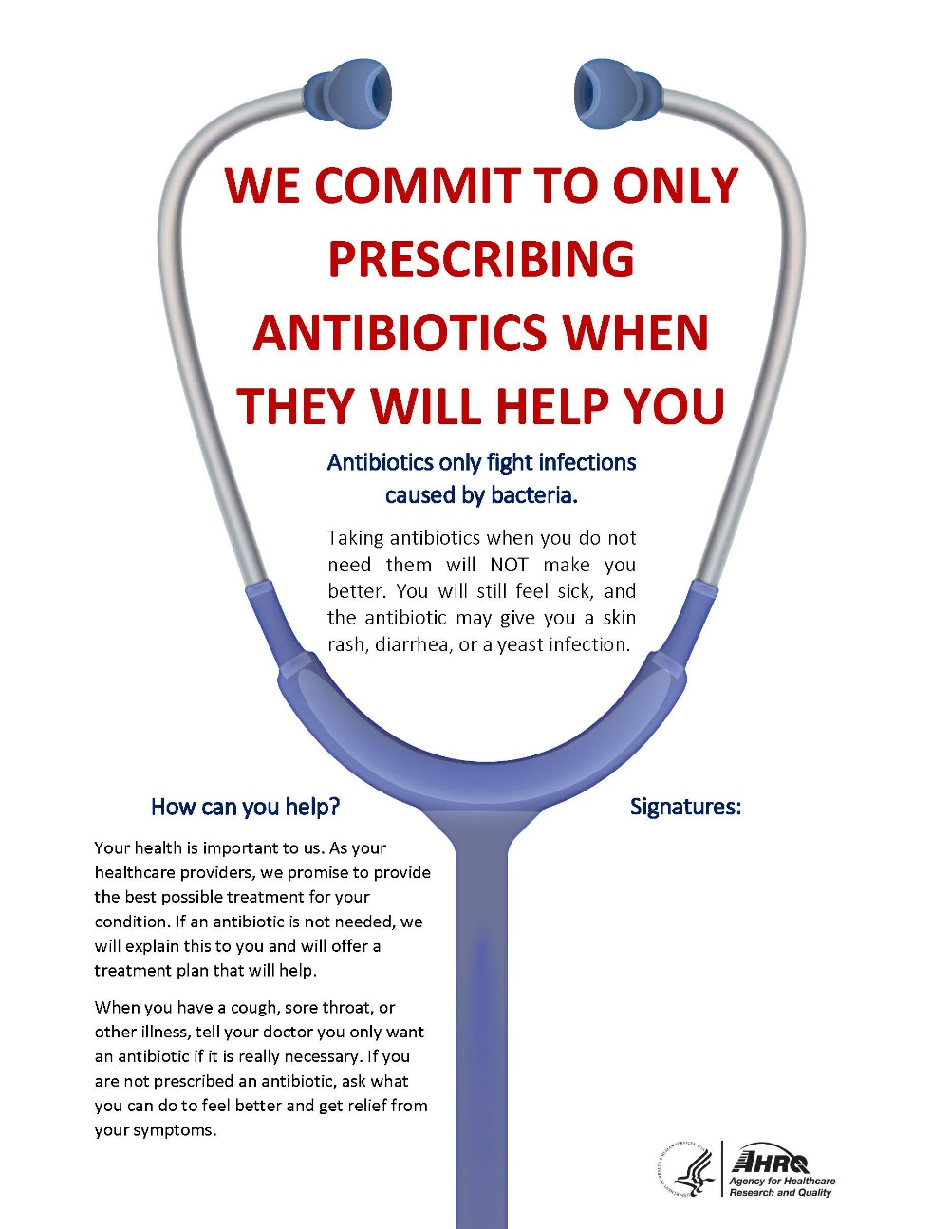
Step 3: Garner Support From Practice Members⁶
Include all practice members
Prescribers, pharmacists, nurses, medical assistants, front-desk staff
Present the rationale for stewardship to the practice
Practicewide meeting
Discuss harm associated with antibiotic and approaches to mitigate this harm via stewardship
Use commitment posters

Slide 8
Step 4: Access Antibiotic Prescribing Data^{6,7}
Important to assess areas of potential overuse and track the impact of interventions
Numerator: number of antibiotic prescriptions
Denominator: number of clinic visits
Data can be stratified by prescriber and/or ICD-10 codes
Data should be provided in the form of a rate such as the number of antibiotic prescriptions per 100 visits

Slide 9
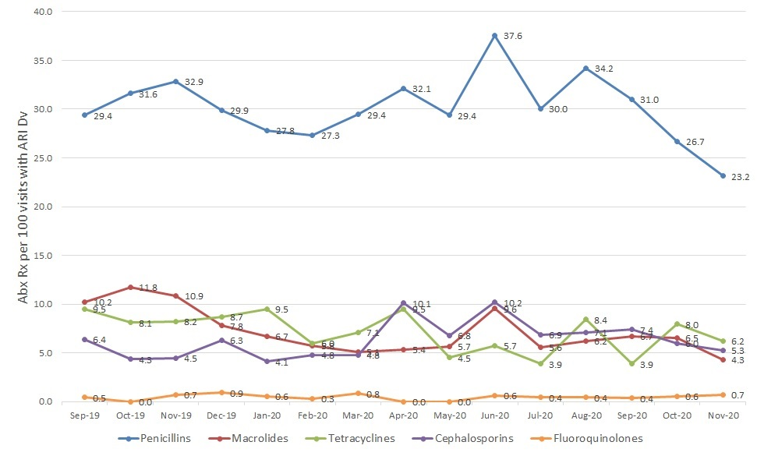
Antibiotic Prescriptions per 100 Visits with ARI Diagnosis, by Antibiotic Therapeutic Class

Slide 10
Step 5: Build Communication Skills Around Antibiotic Use⁶
Effective communication is important among practice members and between practice members and patients and families
Practice members should come to consensus on approaches to treat common infectious diseases syndromes
Avoid confusion of conflicting recommendations
Improve practice and patient satisfaction

Slide 11
Developing Guidance for Antibiotic Decision Making
Development of guidance or protocols can assist with practicewide consensus on treatment of common infectious disease syndrome
Stewardship clinician lead makes initial draft
Review at practice meetings
Begin with topics of greatest relevance to the practice first, based on review of antibiotic use data and input from practice members
Integrate guidelines into existing workflow

Slide 12
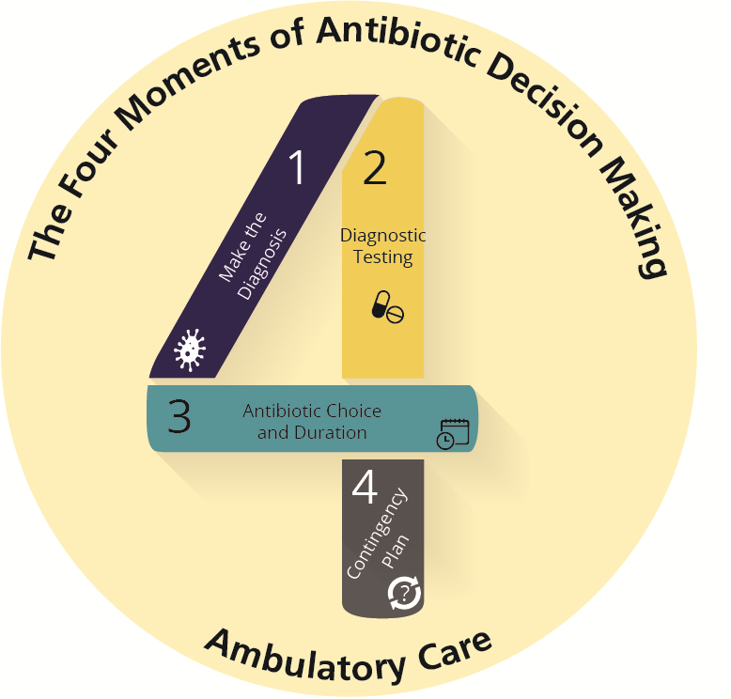
The Four Moments of Antibiotic Decision Making
Does my patient have an infection that requires antibiotics?
Do I need to order any diagnostic tests?
If antibiotics are indicated, what is the narrowest, safest, and shortest regimen I can prescribe?
Does my patient understand what to expect and the followup plan?

Slide 13
Improving Communication With Patients and Families
Develop consistent, practicewide strategies for communicating with patients and families⁸⁻¹¹
Stewardship clinician lead should review communication methods at a practicewide meeting

Slide 14
Step 6: Implement an Educational Intervention⁶
Choose an intervention target
Develop and deliver brief presentations on the topic at practice meetings
Seek consensus on management and treatment strategies
Return to the topic at subsequent practice meetings to provide feedback on progress
Maintain interest
One-on-one meetings with healthcare practitioners
Email updates

Slide 15
Step 7: Monitor Antibiotic Prescription Data⁶
Practice-level data
Determine targets for improvement for the practice
Track the progress of interventions over time
Present to the entire practice
Prescriber-level data
Peer comparisons

Slide 16
Presenting Data to the Practice ^{6,12,13}
Reports should be simple and easy to understand
Reports and emails should be presented by the stewardship leads
Data should be recent
Data should be provided at regular intervals
Include messages of appreciation and congratulation

Slide 17
Presenting Peer Comparisons¹²⁻¹⁸
Manage clinicians’ concerns about peer comparison reports
Engage them in the design of the report
Identify “top performers” and “not top performers”
Challenges
Ensure correct attribution
Ensure adequate numbers of episodes
Monitor for coding changes
You are a Top Performer You are in the top 10% of clinicians. You wrote 2 prescriptions out of 20 acute respiratory infection cases that did not warrant antibiotics.
You are not a Top Performer Your inappropriate antibiotic prescribing rate is 25%. Top performers' rate is 6%. You wrote 5 prescriptions out of 20 acute respiratory infection cases that did not warrant antibiotics.

Slide 18
Implement a Sustainability Plan
Set long-term goals
Outline month-to-month plans
Order of syndromes to focus on
Time spent on each syndrome
Frequency of prescribing review
Repeat gap analysis annually
Consider new interventions
Review with senior leadership

Slide 19
Take-Home Messages
Antibiotic stewardship activities in an ambulatory practice should be supported by senior leaders and directed by both a clinical and an administrative leader.
Stewardship activities include—
Developing guidance for management and treatment of common infectious diseases syndromes
Improving communication skills between practice members as well as between practice members and patients and families
Evaluating and reporting data
Implementing antibiotic stewardship interventions based on the needs of the practice

Slide 20
Disclaimer
The findings and recommendations in this presentation are those of the authors, who are responsible for its content, and do not necessarily represent the views of AHRQ. No statement in this presentation should be construed as an official position of AHRQ or of the U.S. Department of Health and Human Services.
Any practice described in this presentation must be applied by healthcare practitioners in accordance with professional judgment and standards of care in regard to the unique circumstances that may apply in each situation they encounter. These practices are offered as helpful options for consideration by healthcare practitioners, not as guidelines.

Slide 21
References
Suda KJ, Hicks LA, Roberts RM, et al. Antibiotic expenditures by medication, class, and healthcare setting in the United States, 2010-2015. Clin Infect Dis. 2018 Jan 6;66(2):185-90. PMID: 29020276.
Sanchez GV, Fleming-Dutra KE, Roberts RM, Hicks LA. Core elements of outpatient antibiotic stewardship. MMWR Recomm Rep. 2016 Nov 11;65(6):1-12. PMID: 27832047.
Centers for Disease Control and Prevention Core Elements of Outpatient Antibiotic Stewardship. https://www.cdc.gov/antibiotic-use/core-elements/outpatient.html. Accessed July 16, 2022.
Antimicrobial Stewardship in Ambulatory Health Care. 2019. https://www.jointcommission.org/standards/r3-report/r3-report-issue-23-antimicrobial-stewardship-in-ambulatory-health-care/. Accessed July 4, 2022.
Participation Options Overview. Quality Payment Program. https://qpp.cms.gov/mips/overview. Accessed July 16, 2022.

Slide 22
References
Keller SC, Cosgrove SE, Miller MA, et al. A framework for implementing antibiotic stewardship in ambulatory care: lessons learned from the Agency for Healthcare Research and Quality Safety Program for Improving Antibiotic Use. Antimicrobial Stewardship & Healthcare Epidemiology. 2022 July 4;2(1):e109.
MITIGATE antimicrobial stewardship toolkit: a guide for practical implementation in adult and pediatric emergency department and urgent care settings. 2018. https://stacks.cdc.gov/view/cdc/80653. Accessed July 16, 2022.
Fleming-Dutra KE, Mangione-Smith R, Hicks LA. How to prescribe fewer unnecessary antibiotics: talking points that work with patients and their families. Am Fam Physician. 2016 Aug 1;94(3):200-2. PMID: 27479620.
Heritage J, Elliott MN, Stivers T, et al. Reducing inappropriate antibiotics prescribing: the role of online commentary on physical examination findings. Patient Educ Couns. 2010 Oct;81(1):119-25. PMID: 20223616.

Slide 23
References
Mangione-Smith R, Zhou C, Robinson JD, et al. Communication practices and antibiotic use for acute respiratory tract infections in children. Ann Fam Med. 2015 May-Jun;13(3):221-7. PMID: 25964399.
Mangione-Smith R, Stivers T, Elliott M, et al. Online commentary during the physical examination: a communication tool for avoiding inappropriate antibiotic prescribing? Soc Sci Med. 2003 Jan;56(2):313-20. PMID: 12473316.
Linder JA. Moving the mean with feedback: insights from behavioural science. NPJ Prim Care Respir Med. 2016 Apr 28;26:16018. PMID: 27121229.
Meeker D, Linder JA, Fox CR, et al. Effect of behavioral interventions on inappropriate antibiotic prescribing among primary care practices: a randomized clinical trial. JAMA. 2016 Feb 9;315(6):562-70. PMID: 26864410.

Slide 24
References
Linder JA, Schnipper JL, Tsurikova R, et al. Self-reported familiarity with acute respiratory infection guidelines and antibiotic prescribing in primary care. Int J Qual Health Care. 2010 Dec;22(6):469-75. PMID: 20935008.
Linder, JA, Meeker D, Fox CR, et al. Effects of behavioral interventions on inappropriate antibiotic prescribing in primary care 12 months after stopping interventions. JAMA. 2017 Oct 10;318(14):1391-2. PMID: 29049577.
Szymczak JE, Feemster KA, Zaoutis TE, et al. Pediatrician perceptions of an outpatient antimicrobial stewardship intervention. Infect Control Hosp Epidemiol. 2014 Oct;35 Suppl 3:S69-78. PMID: 25222901.
Hemkens LG, Saccilotto R, Reyes SL, et al. Personalized prescription feedback using routinely collected data to reduce antibiotic use in primary care: a randomized clinical trial. JAMA Intern Med. 2017 Feb 1;177(2):176-83. PMID: 28027333.
Foy R, Skrypak M, Alderson S, et al. Revitalising audit and feedback to improve patient care. BMJ. 2020 Feb 27;368:m213. PMID: 32107249.

