Slide 1
AHRQ Safety Program for Improving Antibiotic Use
The “Never Antibiotics” Diagnoses:
Influenza and RSV
Ambulatory Care
AHRQ Pub. No. 17(22)-0030
September 2022

Slide 2
Objectives
Describe how to diagnose influenza
Explain the role of antivirals for treatment of influenza
Describe how to diagnose and treat RSV

Slide 3
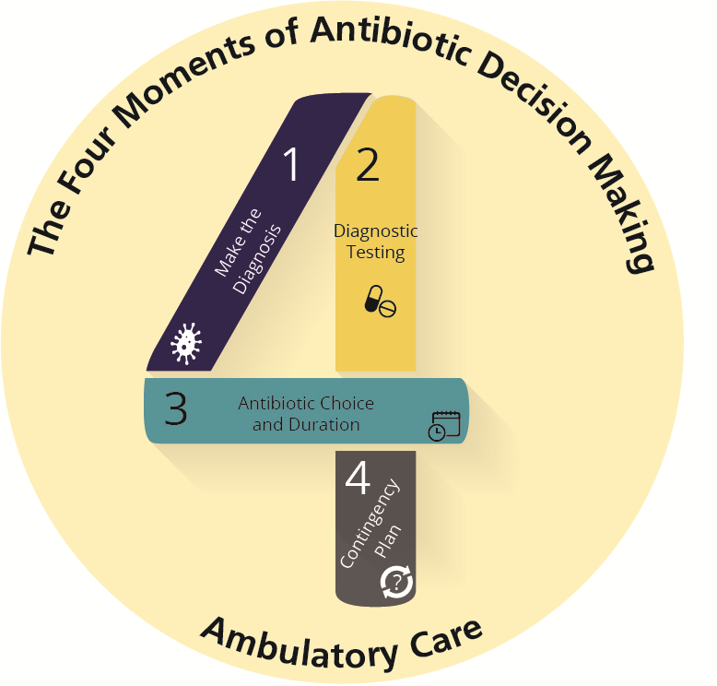
The Four Moments of Antibiotic Decision Making
Does my patient have an infection that requires antibiotics?
Do I need to order any diagnostic tests?
If antibiotics are indicated, what is the narrowest, safest, and shortest regimen I can prescribe?
Does my patient understand what to expect and the followup plan?

Slide 4
The Four Moments of Antibiotic Decision Making
Does my patient have an infection that requires antibiotics?

Slide 5
Case Presentation #1
History
35-year-old man
No past medical history
Two days of myalgias
Subjective fevers and cough
Did not get his influenza vaccination this year
Symptoms
Temperature 101ºF
Blood pressure 130/85
Pulse 74 beats per minute
Oxygen saturation= normal at 97%
Appears ill and uncomfortable
Pharyngeal erythema and diffuse rhonchi on exam of his lungs
?
What do you recommend?

Slide 6
Moment 1: Influenza
Moment 1
Does my patient have an infection that requires antibiotics?
Uncomplicated influenza does not require antibiotics.

Slide 7
Influenza Statistics
3–11% of the population has symptomatic influenza in a typical year¹
140,000–960,000 hospitalizations²
12,000–79,000 deaths per year²

Slide 8
Moment 1: Diagnosis
Suspect influenza in patients with typical symptoms when influenza is prevalent in the community—usually October–May^{2,3}
Research influenza circulating in the community⁴
www.cdc.gov/flu/weekly/index.htm
Local state Department of Public Health website

Slide 9
Moment 1: Diagnosis^{5,6}
Symptoms³
Acute onset of fever, headache, sore throat, myalgias, cough, nasal symptoms
Acute onset of cough and fever has a positive predictive value of >70% for influenza among adult outpatients, when influenza is known to be circulating
Physical exam
Identify complications from influenza, particularly bacterial pneumonia

Slide 10
The Four Moments of Antibiotic Decision Making
Does my patient have an infection that requires antibiotics?
Do I need to order any diagnostic tests?

Slide 11
Moment 2: Testing
Who should be tested for influenza?⁵
Patient Considerations | When Influenza Is Circulating Locally | During Low Influenza Activity
High-risk patients with influenzalike illness, pneumonia, or nonspecific respiratory illness for whom testing will influence management | X
Patients with the acute onset of respiratory conditions and either exacerbation of chronic conditions or a complication of influenza and testing will influence management | X
Patients not at high risk for complications with influenzalike illness, pneumonia, or nonspecific respiratory illness if you would treat with antivirals or provide prophylaxis to household contacts | Consider
Acute onset of respiratory symptoms with or without fever, especially if immunocompromised or high risk, and testing will influence management |  | Consider

Slide 12
Moment 2: Testing⁷
Appropriate specimen collection is important for best results
Nasopharyngeal sample
Use a flocked swab
Demonstration video at https://www.nejm.org/doi/full/10.1056/NEJMe0903992

Slide 13
Moment 2: Testing^{5,7,8}
Rapid Direct Antigen
Highly specific
Not very sensitive
10–15 minutes to run
Better at detecting influenza A than influenza B
Some are available as point-of-care testing
Rapid Molecular Assays
Very sensitive
Very specific
15–30 minutes to run
Some are available as point-of-care testing
May also detect RSV

Slide 14
The Four Moments of Antibiotic Decision Making
Does my patient have an infection that requires antibiotics?
Do I need to order any diagnostic tests?
If antibiotics are indicated, what is the narrowest, safest, and shortest regimen I can prescribe?

Slide 15
Moment 3: Treatment⁵
No antibiotics for uncomplicated influenza in absence of pneumonia
Secondary bacterial pneumonia can occur

Slide 16
Moment 3: Treatment
Antiviral therapy recommended for high-risk groups including—^{5,9,10}
Patients with severe or progressive illness
Patients with chronic medical conditions or immunocompromise
Children < 2 years
Adults ≥ 65 years
Pregnant women
Women within 2 weeks postpartum
For these high-risk patients, start antiviral therapy as early as possible and up to 5 days from symptom onset^{5,10,11}

Slide 17
Moment 3: Treatment
Antiviral therapy can also be prescribed to—^{5,10,11}
Household contacts of persons at risk of development of complications from influenza
Healthcare workers who care for patients at risk of developing influenza complications
Patients presenting within 48 hours of symptom onset

Slide 18
Moment 3: Treatment⁹
Antiviral options⁵
Oseltamivir
Oral medication taken for 5 days
Infants, children, and adults
Zanamivir
Inhaled medication taken for 5 days
Age 7 years and older
Baloxavir (resistance may develop)¹⁰
Oral medication taken as a single dose
Age 12 years and older

Slide 19
Antiviral Prophylaxis^{5,9}
Consider in patients with significant immunosuppression or at high risk of complications who are household contacts of influenza patients
Especially if they were not vaccinated or the match between the vaccine and the circulating strain was weak
Start on prophylaxis within 48 hours of exposure to influenza
Continue medication for 7 days after most recent exposure
Oseltamivir (oral)
Zanamivir (inhaled)

Slide 20
Influenza Symptomatic Treatment
Acetaminophen
NSAIDs
Nasal decongestants
Oral decongestants
Antihistamine-decongestants
Antihistamine-decongestant-analgesics
Dextromethorphan or guaifenesin
Beta-agonists¹²
Acute cough with airflow obstruction

Slide 21
The Four Moments of Antibiotic Decision Making
Does my patient have an infection that requires antibiotics?
Do I need to order any diagnostic tests?
If antibiotics are indicated, what is the narrowest, safest, and shortest regimen I can prescribe?
Does my patient understand what to expect and the followup plan?

Slide 22
Moment 4: Followup Plan
Prepare your patients in advance—​they will likely feel ill for at least a week
“Call the clinic if you develop a persistent high fever (above 102°F), severe headache, pain in your face or forehead, severe fatigue, or a rash”
“Go to the emergency room if you develop confusion or difficulty breathing or swallowing.”

Slide 23
RSV
Respiratory Syncytial Virus (RSV) in Children

Slide 24
The Four Moments of Antibiotic Decision Making
Does my patient have an infection that requires antibiotics?

Slide 25
Case Presentation 2
Four-month-old full-term female with decreased oral intake over the past 4 days
Temperature 101 degrees Fahrenheit
Just started coughing significantly
On exam: rhonchi with wheezing throughout
Mildly tachypneic but normal oxygen saturation

Slide 26
Moment 1
Does my patient have an infection that requires antibiotics?¹³⁻¹⁵
Patient with bronchiolitis
Inflammation and congestion in bronchioles
RSV: Common cause of bronchiolitis
Circulates in fall and spring
RSV is a virus; does not require antibiotics
RSV symptoms vary by age and comorbidities
Older children and adults: coldlike symptoms
RSV in children <2 years old: fevers, decreased appetite, progressive cough
RSV in immunosuppression, children <2 years old with heart or lung disease, infants <6 months old, premature infants: risk of severe symptoms of RSV

Slide 27
The Four Moments of Antibiotic Decision Making
Does my patient have an infection that requires antibiotics?
Do I need to order any diagnostic tests?

Slide 28
Moment 2: Diagnosis¹⁶
If it is RSV season and the infant is presenting with bronchiolitis, the likelihood that the infant has RSV is high, so testing is unnecessary
For previously healthy infants and young children with bronchiolitis, testing for RSV does not impact management
Testing is more important in patients with immune compromise

Slide 29
Moment 2: Diagnosis
Two effective methods for RSV testing, both of which involve swabbing the nasopharynx or throat¹⁷
Rapid antigen testing: best for infants and children <2
80–90% sensitivity in this age group
rRT-PCR: older children and adults
Often designed as part of a PCR assay that can detect several other respiratory viruses as well
Ask your local lab which test is available

Slide 30
The Four Moments of Antibiotic Decision Making
Does my patient have an infection that requires antibiotics?
Do I need to order any diagnostic tests?
If antibiotics are indicated, what is the narrowest, safest, and shortest regimen I can prescribe?

Slide 31
Moment 3: Treatment¹⁴
No antibiotics needed!
Supportive care: nasal bulb suctioning, ibuprofen, acetaminophen, oral rehydration solution
Not helpful: steroids, inhalers, chest physiotherapy

Slide 32
Moment 3: Treatment
Ribavirin should not be routinely used for infants or children with RSV, especially in the outpatient setting.

Slide 33
RSV Prevention
Palivizumab¹⁸
Monoclonal antibody licensed to prevent RSV complications in infants
Specifically for infants in the first 2 years of life with increased risk for severe illness
Check AAP for current indications for administration

Slide 34
The Four Moments of Antibiotic Decision Making
Does my patient have an infection that requires antibiotics?
Do I need to order any diagnostic tests?
If antibiotics are indicated, what is the narrowest, safest, and shortest regimen I can prescribe?
Does my patient understand what to expect and the followup plan?

Slide 35
Moment 4: Followup Plan
Does my patient know what to expect and the followup plan?¹⁸
Expectations:
Symptoms peak around the fifth day of illness and should start to improve by 7 to 10 days of illness.
Followup plan:
Give parents specific reasons to return or call. For example, you could say: “Call the clinic if the baby isn’t improving by the 10th day of illness.”
You could say “Call emergency services if the baby is having trouble breathing or isn’t making wet diapers or isn’t drinking.”

Slide 36
Take-Home Messages
Influenza:
Know the local prevalence and the patient's symptoms to decide who to test and who to treat with antivirals
Critical groups of patients who should be treated: those with severe or progressing illness, those with chronic medical conditions, including immunocompromise, children <2 years, adults age 65 years and older, pregnant women and women within 2 weeks postpartum
RSV:
Antibiotics are not indicated
May get worse through day 5 before getting better

Slide 37
Additional Toolkit Resources
For more resources on influenza and RSV, please access the tools listed below, available in the AHRQ Toolkit To Improve Antibiotic Use in Ambulatory Care.
Discussion Guide: Refer to the Discussion Guide to help your practice develop a standardized approach to the diagnosis and management of patients with influenza and RSV.
Clinician One-Page Document: Refer to the One-Page document for a concise summary of the diagnosis and treatment of influenza and RSV.
Patient Handout: The Patient Handout explains the symptoms and symptomatic treatment of influenza and RSV. It is available in both English and Spanish.

Slide 38
Disclaimer
The findings and recommendations in this presentation are those of the authors, who are responsible for its content, and do not necessarily represent the views of AHRQ. No statement in this presentation should be construed as an official position of AHRQ or of the U.S. Department of Health and Human Services.
Any practice described in this presentation must be applied by healthcare practitioners in accordance with professional judgment and standards of care in regard to the unique circumstances that may apply in each situation they encounter. These practices are offered as helpful options for consideration by healthcare practitioners, not as guidelines.

Slide 39
References
Tokars JI, Olsen SJ, Reed C. Seasonal incidence of symptomatic influenza in the United States. Clin Infect Dis. 2018 May 1;66(10):1511-8. PMID: 29206909.
The Flu Season. Centers for Disease Control and Prevention, Influenza (Flu). September 28, 2021. https://www.cdc.gov/flu/about/season/flu-season.htm. Accessed June 22, 2022.
Flu Symptoms & Diagnosis. Centers for Disease Control and Prevention: Influenza (Flu). November 18, 2021. https://www.cdc.gov/flu/symptoms/index.html. Accessed June 22, 2022.
Weekly U.S. Influenza Surveillance Report-FluView. Centers for Disease Control and Prevention, Influenza (Flu). June 17, 2022. https://www.cdc.gov/flu/weekly/index.htm. Accessed June 22, 2022.
Uyeki TM, Bernstein HH, Bradley JS, et al. Clinical practice guidelines by the Infectious Diseases Society of America: 2018 Update on diagnosis, treatment, chemoprophylaxis, and institutional outbreak management of seasonal influenza. Clin Infect Dis. 2019 Mar 5;68-(6):e1-47. PMID: 30566567.
Osterholm MT, Kelley NS, Sommer A, et al. Efficacy and effectiveness of influenza vaccines: a systematic review and meta-analysis. Lancet Infect Dis. 2012 Jan;12(1):36-44. PMID: 22032844.

Slide 40
References
Baden LR, Drazen JM, Kritek PA, et al. H1N1 influenza A disease—information for health professionals. N Engl J Med. 2009 Jun 18;360(25):2666-7. PMID: 19423873.
Rothberg MB, Bellantonio S, Rose DN. Management of influenza in adults older than 65 years of age: cost-effectiveness of rapid testing and antiviral therapy. Ann Intern Med. 2003 Sep 2;139(5 Pt 1):321-9. PMID: 12965940.
Influenza Antiviral Medications: Summary for Clinicians. Centers for Disease Control and Prevention. Influenza. June 13, 2022. https://www.cdc.gov/flu/professionals/antivirals/summary-clinicians.htm. Accessed June 22, 2022.
Uehara T, Hayden FG, Kawaguchi K, et al. Treatment-emergent influenza variant viruses with reduced baloxavir susceptibility: impact on clinical and virologic outcomes in uncomplicated influenza. J Infect Dis. 2019 Jul 16. PMID: 31309975.
CDC Responds to Approval of New Flu Antiviral Drug. Centers for Disease Control and Prevention: Influenza (Flu), Seasonal Influenza (Flu), Flu News and Spotlights. December 3, 2018. https://www.cdc.gov/flu/spotlights/cdc-responds-approval-new-flu-drug.htm. Accessed June 22, 2022.

Slide 41
References
Becker LA, Hom J, Villasis-Keever M, et al. Beta2-agonists for acute bronchitis. Cochrane Database Syst Rev. 2011 Jul 6;(7):CD001726. PMID: 21735384.
Meissner HC. Viral bronchiolitis in children. N Engl J Med. 2016 May 5;374(18):1793-4. PMID: 27144864.
Ralston SL, Lieberthal AS, Meissner HC, et al. American Academy of Pediatrics. Clinical practice guideline: the diagnosis, management, and prevention of bronchiolitis. Pediatrics. 2015 Oct;136(4):782. PMID: 26430140.
Diagnosis and management of bronchiolitis. AAFP clinical practice guideline. 2019. https://www.aafp.org/family-physician/patient-care/clinical-recommendations/all-clinical-recommendations/bronchiolitis.html. Accessed June 22, 2022.
Stollar F, Alcoba G, Gervaix A, et al. Virologic testing in bronchiolitis: does it change management decisions and predict outcomes? Eur J Pediatr. 2014 Nov;173(11):1429–35. PMID: 24858463.

Slide 42
References
Brady MT, Byington CL, Davies HD. Updated guidance for palivizumab prophylaxis among infants and young children at increased risk of hospitalization for respiratory syncytial virus infection. Pediatrics. 2014 Aug;134(2):415-20. PMID: 25070304.
Kimberlin DW, Brady MT, Jackson MA, et al. Committee on Infectious Diseases; American Academy of Pediatrics. Red Book Online. 2018-2021. Respiratory syncytial virus. https://redbook.solutions.aap.org/chapter.aspx?sectionid=189640170&bookid=2205 Accessed November 23, 2021.

