Slide 1
AHRQ Safety Program for Improving Antibiotic Use
The “Sometimes Antibiotics”
Diagnoses: Pharyngitis
Ambulatory Care
AHRQ Pub. No. 17(22)-0030
September 2022

Slide 2
Objectives
Review common infectious causes of pharyngitis
Identify criteria for determining whether to test for streptococcal pharyngitis
Describe the treatment of streptococcal pharyngitis

Slide 3
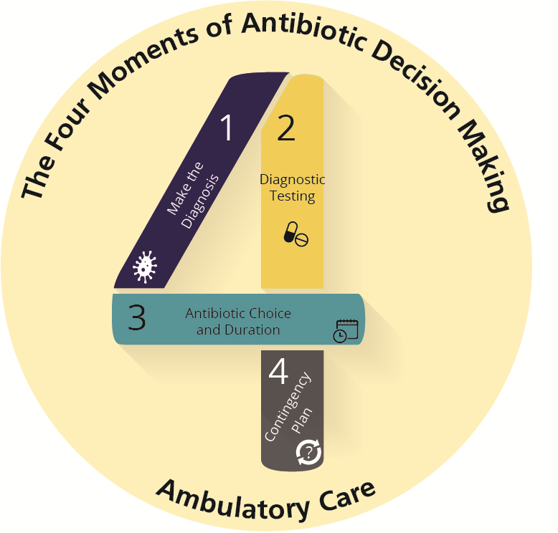
The Four Moments of Antibiotic Decision Making
Does my patient have an infection that requires antibiotics?
Do I need to order any diagnostic tests?
If antibiotics are indicated, what is the narrowest, safest, and shortest regimen I can prescribe?
Does my patient understand what to expect and the followup plan?

Slide 4
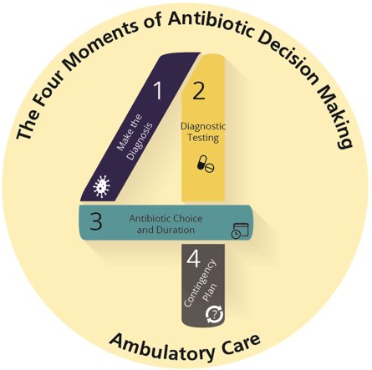
The Four Moments of Antibiotic Decision Making
Does my patient have an infection that requires antibiotics?

Slide 5
Moment 1: Does My Patient Have an Infection That Requires Antibiotics?
Most pharyngitis is caused by viruses in children and adults^{1,2}
Patients with viral pharyngitis have other signs and symptoms suggesting a viral infection such as low-grade fever, malaise, fatigue, rhinorrhea, cough, and conjunctivitis³
Patients with bacterial pharyngitis have a sore throat with tonsillar exudates, fever, and cervical lymphadenopathy without typical viral symptoms
Most commonly caused by group A streptococcus
Mononucleosis is a viral cause of pharyngitis that can be confused with streptococcal pharyngitis^{4,5}

Slide 6
Other Nonstreptococcal Causes of Bacterial Pharyngitis
Arcanobacterium haemolyticum pharyngitis³
Uncommon cause of pharyngitis in adolescents and young adults
Scarlatiniform rash in 50% of patients
Does not require antibiotic therapy; if considerable throat pain, consider 3–5 days of azithromycin
Fusobacterium necrophorum pharyngitis^{6,7}
Uncommon cause of pharyngitis in adolescents and young adults
Antibiotics may not reduce symptoms or prevent Lemierre syndrome
Refer ill-appearing patients to the emergency department
Gonococcal pharyngitis²
Consider in sexually active adolescents or adults
Send pharyngeal swab for nucleic acid amplification test
Administer a single intramuscular dose of ceftriaxone 500 mg (or 1 gram if the patient weighs ≥ 150 kilograms)
Consider presumptive treatment for chlamydia and screen for other sexually transmitted infections

Slide 7
Moment 1: Pharyngitis: Centor Criteria⁸⁻¹⁰
Centor Criteria:
Fever
Tonsillar exudate or swelling
Tender anterior cervical lymphadenopathy
Absence of cough
Add the Criteria:
0 or 1 | No testing, no antibiotics needed
2 or 3 | Obtain a rapid strep test. If positive, treat with antibiotics
4 | Treat with antibiotics ± rapid strep test

Slide 8
Case Presentation
50-year-old man who babysits his 5-year-old grandchild
3 days of sore throat and a dry cough without fever
On exam: sinus tenderness, an erythematous posterior oropharynx, normal-appearing tonsils, and no cervical lymphadenopathy
A. Check rapid strep test
B. Prescribe amoxicillin
C. Prescribe amoxicillin-clavulanate
D. Recommend analgesics

Slide 9
Case Presentation
Same patient but with a fever and tender anterior cervical lymphadenopathy
A. Check rapid strep test
B. Prescribe amoxicillin
C. Prescribe amoxicillin-clavulanate
D. Recommend analgesics

Slide 10
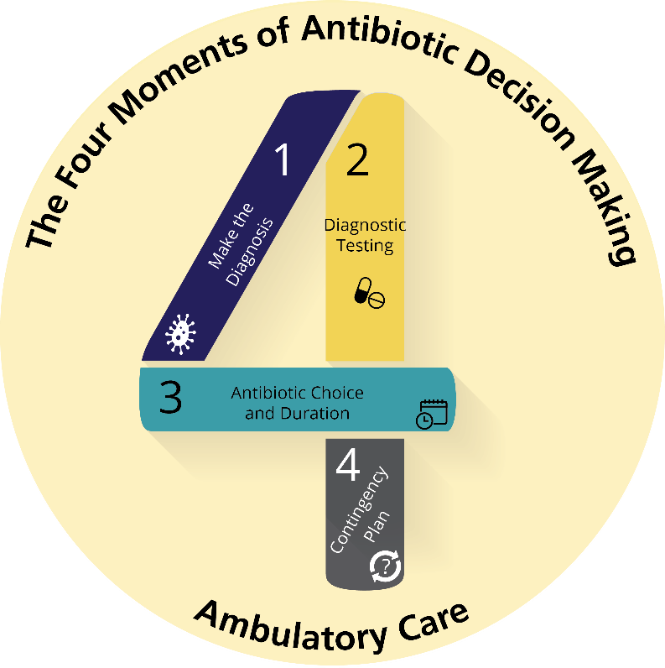
The Four Moments of Antibiotic Decision Making
Does my patient have an infection that requires antibiotics?
Do I need to order any diagnostic tests?

Slide 11
Moment 2: Do I Need To Order a Diagnostic Test?^{11,12}
Collecting a throat specimen:
Swab the tonsils and posterior pharynx
Avoid contact with the tongue and uvula to minimize risk of contamination with normal oral flora
If the rapid strep test is negative, the lab may perform a reflex bacterial culture
Useful in children where the prevalence of group A streptococcal pharyngitis is high
Not needed for adults
Not needed if the rapid test is a molecular test

Slide 12
Moment 2: Do I Need To Order a Diagnostic Test
Adolescent with fever, tonsillar exudate, and fatigue may have mononucleosis¹³
Send a heterophile antibody test (Monospot test) or EBV serologies
Antibiotics not indicated
Amoxicillin can lead to a rash

Slide 13
The Four Moments of Antibiotic Decision Making
Does my patient have an infection that requires antibiotics?
Do I need to order any diagnostic tests?
If antibiotics are indicated, what is the narrowest, safest, and shortest regimen I can prescribe?

Slide 14
Moment 3: Narrowest, Safest, and Shortest Regimen¹²
Penicillin or amoxicillin is first line in children and adults
No reported resistance
Mild penicillin allergy
First generation cephalosporins such as cephalexin or cefadroxil
No reported resistance
Severe penicillin allergy
Clindamycin or azithromycin
Resistance occurs and is increasing
The duration of antibiotic therapy for strep throat for both children and adults is 10 days (5 days for azithromycin)

Slide 15
Moment 3: Additional Considerations
A test of cure at the end of therapy is not recommended because some patients, particularly children, remain asymptomatically colonized with this organism, and this does not pose any known harm
Group C or group G strep in throat cultures¹²
No consensus if antibiotic therapy is necessary
Consider treating with antibiotics if the patient is experiencing severe symptoms
No association with rheumatic fever
Penicillin or amoxicillin are first line but consider shorter course—such as 5 days instead of 10 days

Slide 16
Symptomatic Relief
Warm tea
Honey
Throat lozenges
Analgesics: acetaminophen or ibuprofen

Slide 17
The Four Moments of Antibiotic Decision Making
Does my patient have an infection that requires antibiotics?
Do I need to order any diagnostic tests?
If antibiotics are indicated, what is the narrowest, safest, and shortest regimen I can prescribe?
Does my patient understand what to expect and the followup plan?

Slide 18
Moment 4: Followup Plan
Fever and sore throat typically resolve within 1 to 3 days
Antibiotics can potentially reduce symptom duration of bacterial pharyngitis and the risk of purulent complications such as peritonsillar or retropharyngeal abscess
Persistent fever or worsening throat pain should trigger a return to medical care for evaluation of these complications
Patients with active EBV infection should avoid contact sports for 3 to 6 weeks from symptom onset due to risk for splenic ruture¹³

Slide 19
Take-Home Messages
Use the Centor criteria to guide diagnostic testing for pharyngitis
Consider EBV in adolescents or young adults
Penicillin and amoxicillin are first-line treatments for streptococcal pharyngitis
Patients should be instructed to return to medical care if they have continued fevers or worsening throat pain, as these may indicate a peritonsillar or retropharyngeal abscess

Slide 20
Additional Toolkit Resources
For more resources on pharyngitis, please access tools listed below, available on the AHRQ Toolkit To Improve Antibiotic Use in Ambulatory Care.
Discussion Guide: Refer to the Discussion Guide to help your practice develop a standardized approach to the diagnosis and management of patients with pharyngitis.
Clinician One-Page Document: Refer to the One-Page document for a concise summary of the diagnosis and treatment of pharyngitis.
Patient Handout: The Patient Handout explains the symptoms and symptomatic treatment of pharyngitis and emphasizes that antibiotics are not always needed. It is available in both English and Spanish.

Slide 21
Disclaimer
The findings and recommendations in this presentation are those of the authors, who are responsible for its content, and do not necessarily represent the views of AHRQ. No statement in this presentation should be construed as an official position of AHRQ or of the U.S. Department of Health and Human Services.
Any practice described in this presentation must be applied by healthcare practitioners in accordance with professional judgment and standards of care in regard to the unique circumstances that may apply in each situation they encounter. These practices are offered as helpful options for consideration by healthcare practitioners, not as guidelines.

Slide 22
References
Bisno AL. Acute pharyngitis. N Engl J Med. 2001 Jan 18;344(3):205-11. PMID: 11172144.
Sexually transmitted infections treatment guidelines, 2021. Centers for Disease Control and Prevention. 2022. https://www.cdc.gov/std/treatment-guidelines/STI-Guidelines-2021.pdf. Accessed April 13, 2022.
Sayad E, Zeid CA, Hajjar RE, et al. The burden of Arcanobacterium haemolyticum pharyngitis: A systematic review and management algorithm. Int J Pediatr Otorhinolaryngol. 2021 Jul;146:110759. PMID: 34038812.
Luzuriaga K, Sullivan JL. Infectious mononucleosis. N Engl J Med. 2010 May 27;362(21):1993-2000. PMID: 20505178.
Heath CW Jr, Brodsky AL, Potolsky AI. Infectious mononucleosis in a general population. Am J Epidemiol. 1972 Jan;95(1):46-52. PMID: 5007364.
Centor RM, Atkinson P, Ratliff AE, et al. The clinical presentation of Fusobacterium-positive and streptococcal-positive pharyngitis in a university health clinic: a cross-sectional study. Ann Intern Med. 2015 Feb 17;162(4):241-7. PMID: 25686164.

Slide 23
References
Linder J. Sore throat: Avoid overcomplicating the uncomplicated. Ann Intern Med. 2015 Jun 16;162(12):878-9. PMID: 26075770.
Centor RM, Witherspoon JM, Dalton, HP, et al. The diagnosis of strep throat in adults in the emergency room. Med Decis Making. 1981;1(3):239-46. PMID: 6763125.
Choby BA. Diagnosis and treatment of streptococcal pharyngitis. Am Fam Physician. 2009 Mar 1;79(5):383-90. PMID: 19275067.
Kalra MG, Higgins KE, Perez ED. Common questions about streptococcal pharyngitis. Am Fam Physician. 2016 Jul 1;94(1):24-31. PMID: 27386721.
Felsenstein S, Faddoul D, Sposto R, et al. Molecular and clinical diagnosis of group A streptococcal pharyngitis in children. J Clin Microbiol. 2014 Nov;52(11): 3884-9. PMID: 25143573.
Shulman ST, Bisno AL, Clegg HW, et al. Clinical practice guideline for the diagnosis and management of group A streptococcal pharyngitis: 2012 update by the Infectious Diseases Society of America. Clin Infect Dis. 2012 Nov 15;55(10):1279-82. PMID: 23091044.

Slide 24
References
Womack J, Jimenez M. Common questions about infectious mononucleosis. Am Fam Physician. 2015 Mar 15;91(6):372-6. PMID: 25822555.

