Slide 1
AHRQ Safety Program for Improving Antibiotic Use
The “Sometimes Antibiotics”
Diagnoses: Sinusitis
Ambulatory Care
AHRQ Pub. No. 17(22)-0030
September 2022

Slide 2
Objectives
Explain how to diagnose sinusitis
Explain when to treat sinusitis with antibiotics
Describe the non-antibiotic management of sinusitis

Slide 3
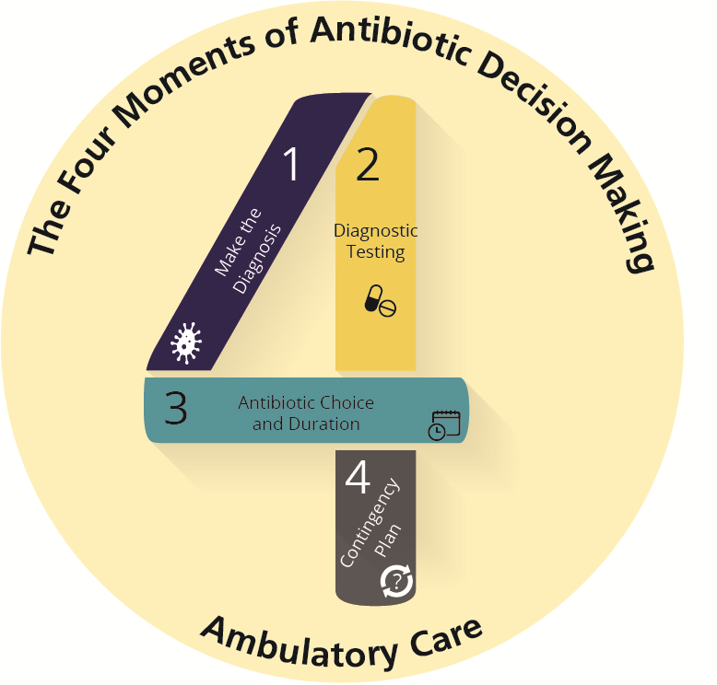
The Four Moments of Antibiotic Decision Making
Does my patient have an infection that requires antibiotics?
Do I need to order any diagnostic tests?
If antibiotics are indicated, what is the narrowest, safest, and shortest regimen I can prescribe?
Does my patient understand what to expect and the followup plan?

Slide 4
The Four Moments of Antibiotic Decision Making
Does my patient have an infection that requires antibiotics?

Slide 5
Sinusitis Case
40-year-old female with 3 days of headache, cough, subjective fever, yellow nasal discharge, and facial pain and pressure.
She is uncomfortable and frustrated with the duration of her symptoms.

Slide 6
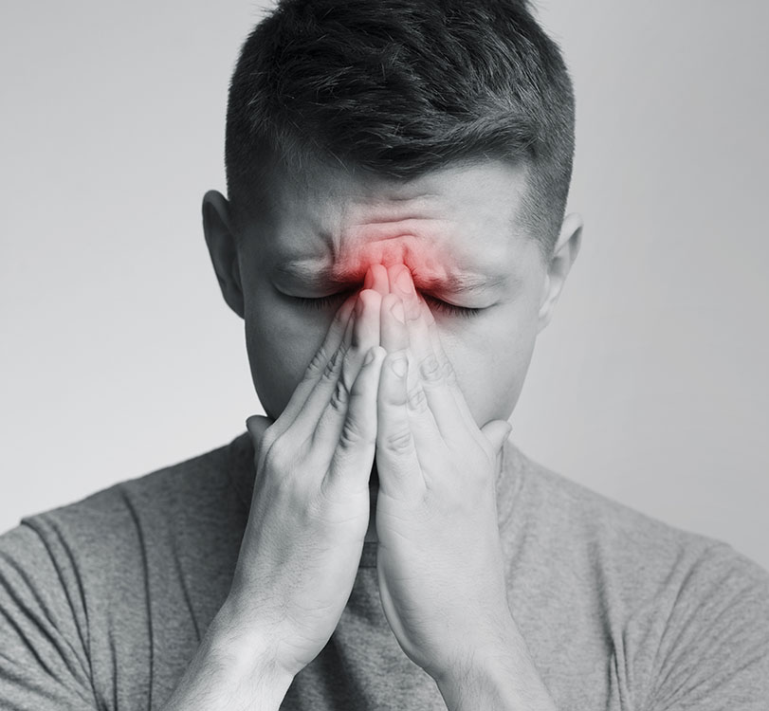
Moment 1: Does My Patient Have an Infection That Requires Antibiotics?^{1,2}
Common symptoms:
Purulent nasal discharge
Facial pain or pressure
Nasal congestion
Reduced sense of taste or smell
Headache
Ear pain or pressure
Bad breath
Dental pain

Slide 7
Moment 1: Indications for Antibiotics²⁻⁵
10 days without improvement
3-4 days of fever ≥ 102°F and either purulent nasal discharge or facial pain
Initial improvement of a viral URI followed by worsening after 5–6 days, with new onset of fever ≥ 102°F, headache, or increased nasal discharge
Severe
Persistent
Worsening
It has been estimated that only 0.5–2% of cases of viral sinusitis are complicated by bacterial infection.
The presence of low-grade fever, facial or dental pain, and the color of nasal discharge are not accurate predictors of a bacterial etiology in patients who do not meet these criteria.

Slide 8
Case Presentation
Would you…
A. Prescribe amoxicillin
B. Prescribe amoxicillin-clavulanate
C. Prescribe azithromycin
D. Prescribe or recommend decongestants

Slide 9
Treatment
Antibiotics are not indicated because the patient does meet any of the three criteria that suggest a bacterial infection.
Treatment should be directed at relief of symptoms such as with decongestants.
Sinusitis in children⁶
Viruses are also the most common etiology.
Diagnosis and treatment recommendations are the same as in adults.
Decongestants not suggested in children under 12 years and should be avoided in children under 6 years of age.

Slide 10
The Four Moments of Antibiotic Decision Making
Does my patient have an infection that requires antibiotics?
Do I need to order any diagnostic tests?

Slide 11
Moment 2: Diagnostic Testing^{2,4,7,8}
Cultures or swabs of nasal discharge are not indicated.
Imaging is not indicated in most patients with sinusitis.
Patients with sinusitis who have or develop evidence of spread of infection to the orbits or the central nervous system should be referred to the emergency department for further evaluation including imaging.
Symptoms suggestive of orbital cellulitis or central nervous system infection include–
Limited ocular movements
Acute vision changes
Proptosis
Confusion
Unilateral weakness

Slide 12
The Four Moments of Antibiotic Decision Making
Does my patient have an infection that requires antibiotics?
Do I need to order any diagnostic tests?
If antibiotics are indicated, what is the narrowest, safest, and shortest regimen I can prescribe?

Slide 13
Moment 3: Choice of Antibiotic Regimen^{9,10}
First-line for adults and children
Amoxicillin/clavulanate
Nonsevere penicillin allergy¹¹
Doxycycline or an oral third-generation cephalosporin ± clindamycin
Severe penicillin allergy and cannot take doxycycline
Levofloxacin or moxifloxacin
5- to 7-day treatment course for adults²
Although 10 days is traditionally prescribed for children, 5–7 days can also be considered
Trimethoprim/sulfamethoxazole, azithromycin, and clarithromycin are not recommended because of increasing S. pneumoniae resistance

Slide 14
Symptomatic Treatment⁴
Analgesic/antipyretic
Decongestants (≥ 12 years of age)
Oxymetazoline nasal spray
Pseudoephedrine
Nasal saline irrigation¹²
Intranasal corticosteroids^{13,14}

Slide 15
The Four Moments of Antibiotic Decision Making
Does my patient have an infection that requires antibiotics?
Do I need to order any diagnostic tests?
If antibiotics are indicated, what is the narrowest, safest, and shortest regimen I can prescribe?
Does my patient understand what to expect and the followup plan?

Slide 16
Moment 4: Followup Plan²
Patients should return to clinic for—
Persistent symptoms that last 10 days and do not improve
Increasing severity: Fever of at least 102°F and purulent nasal discharge for at least 3–4 consecutive days
Sudden onset of worsening symptoms after 5–6 days

Slide 17
Case Presentation: 1 Week Later
Sinus tenderness, but not as severe
She has green nasal discharge
No longer having fevers
CORRECT ANSWER: D
A. Prescribe amoxicillin
B. Prescribe amoxicillin-clavulanate
C. Prescribe azithromycin
D. Prescribe or recommend decongestants

Slide 18
Case Presentation: 3 Days Later
Increasing sinus pain and pressure
CORRECT ANSWER: B
A. Prescribe amoxicillin
B. Prescribe amoxicillin-clavulanate
C. Prescribe azithromycin
D. Prescribe or recommend decongestants

Slide 19
Take-Home Messages
Most cases of sinusitis are viral
Only consider treating sinusitis with antibiotics if symptoms are persistent, severe, or worsening
Amoxicillin-clavulanate is first-line treatment for bacterial sinusitis, and treatment is 5–7 days
Recommendations for symptomatic therapy should be provided to patients
Patient should return to medical attention if they develop persistent, severe, or progressive symptoms

Slide 20
Additional Toolkit Resources
For more resources on sinusitis, please access tools listed below, available in the AHRQ Toolkit To Improve Antibiotic Use in Ambulatory Care.
Discussion Guide: Refer to the Discussion Guide to help your practice develop a standardized approach to the diagnosis and management of patients with sinusitis.
Clinician One-Page Document: Refer to the One-Page document for a concise summary of the diagnosis and treatment of sinusitis.
Patient Handout: The Patient Handout explains the symptoms and symptomatic treatment of sinusitis and emphasizes that antibiotics are not always needed. It is available in both English and Spanish.

Slide 21
Disclaimer
The findings and recommendations in this presentation are those of the authors, who are responsible for its content, and do not necessarily represent the views of AHRQ. No statement in this presentation should be construed as an official position of AHRQ or of the U.S. Department of Health and Human Services.
Any practice described in this presentation must be applied by healthcare practitioners in accordance with professional judgment and standards of care in regard to the unique circumstances that may apply in each situation they encounter. These practices are offered as helpful options for consideration by healthcare practitioners, not as guidelines.

Slide 22
References
Meltzer EO, Hamilos DL, Hadley JA, et al. Rhinosinusitis: establishing definitions for clinical research and patient care. Otolarygol Head Neck Surg. 2004 Dec;131(6 Suppl):S1-62. PMID: 15577816.
Chow AW, Benninger MS, Brook I, et al. IDSA clinical practice guideline for acute bacterial rhinosinusitis in children and adults. Clin Infect Dis. 2012 Apr;54(8):e72-e112. PMID: 22438350.
Gwaltney, MJ . Acute community acquired sinusitis. Clin Infect Dis. 1996;23:1209-23. PMID: 8953061.
Rosenfeld RM, Piccirillo JF, Chandrasekhar SS, et al. Clinical practice guideline (update): adult sinusitis. Otolaryngol Head Neck Surg. 2015 Apr;152(2 Suppl):S1-S39. PMID: 25832968.
Hauer, AJ, Luiten, EL, van Erp, NF. No evidence for distinguishing bacterial from viral acute rhinosinusitis using fever and facial/dental pain: a systematic review of the evidence base. Otolaryngol Head Neck Surg. 2014;150:28-33. PMID: 24357394.

Slide 23
References
Wald ER, Applegate KE, Bordley C. et al. Clinical practice guideline for the diagnosis and management of acute bacterial sinusitis in children aged 1 to 18 years. Pediatrics. 2013 Jul;132(1):e262-80. PMID: 23796742.
Ziegler, A., Patadia, M. & Stankiewicz, J. Neurological Complications of Acute and Chronic Sinusitis. Curr Neurol Neurosci Rep 18, 5 (2018). PMID: 29404826.
Arnstead N, Chan Y, Kilty S, et al. Choosing Wisely Canada rhinology recommendations. J Otolaryngol Head Neck Surg. 2020 Feb 28;49(1):10. PMID: 32111259.
Patel ZM, Hwang PH. Uncomplicated acute sinusitis and rhinosinusitis in adults: Treatment. UpToDate. April 2022. https://www.uptodate.com/contents/uncomplicated-acute-sinusitis-and-rhinosinusitis-in-adults-treatment. Accessed May 12, 2022.

Slide 24
References
Active bacterial core surveillance (ABCs) report emerging infections program network Streptococcus pneumoniae, 2019. Centers for Disease Control and Prevention. Mar 2021. https://www.cdc.gov/abcs/downloads/SPN_Surveillance_Report_2019.pdf. Accessed May 12, 2022.
Todd SR, Dahlgren FS, Traeger MS, et al. No visible dental staining in children treated with doxycycline for suspected Rocky Mountain spotted fever. J Pediatr. 2015 May;166(5):1246-51. PMID: 25794784.
Kassel JC, King D, Spurling G. Saline nasal irrigation for acute upper respiratory tract infections. Cochrane Database Syst Rev. 2010 Mar 17;(3):CD006821. PMID: 20238351.
Hayward G, Heneghan C, Perrera R, et al. Intranasal corticosteroids in management of acute sinusitis: a systematic review and meta-analysis. Ann Fam Med. 2012 May-Jun;10(3):241-9. PMID: 22585889.
Trestioreanu A, Yaphe J. Intranasal steroids for acute sinusitis. Cochrane Database Syst Rev. 2013 Dec 2;2013(12):CD005149. PMID: 24293353.

