Slide 1
Best Practices in the Diagnosis and
Treatment of Cellulitis and Skin and
Soft Tissue Abscesses
AHRQ Safety Program for Improving Antibiotic Use
Ambulatory Care
AHRQ Pub. No. 17(22)-0030
September 2022

Slide 2
Objectives
Describe the approach to diagnose cellulitis and distinguish it from mimicking conditions
Describe the microbiology of cellulitis and how that informs empiric therapy
Identify empiric antibiotic regimens for cellulitis that minimize adverse events
Discuss reasonable durations of antibiotic therapy for cellulitis
Discuss the expected time course of a case of cellulitis and when patients should return for followup

Slide 3
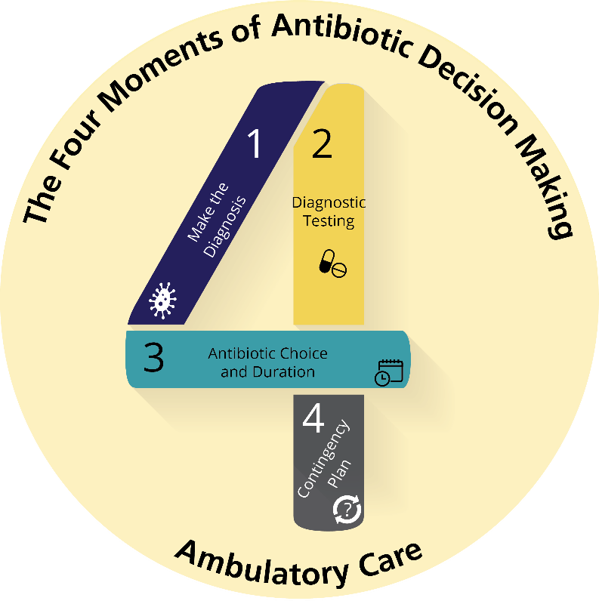
The Four Moments of Antibiotic Decision Making
Does my patient have an infection that requires antibiotics?
Do I need to order any
diagnostic tests?
If antibiotics are indicated, what is the narrowest, safest, and shortest regimen I can prescribe?
Does my patient understand what to expect and the
followup plan?

Slide 4
The Four Moments of Antibiotic Decision Making
Does my patient have an infection that requires antibiotics?

Slide 5
Moment 1: Diagnosis of Cellulitis^{1,2}
Redness, warmth, tenderness, and swelling of skin
Relatively rapid onset/progression
Almost always unilateral
Can be associated with fever
Associated with skin surface disruption:
  Recent trauma
  Tinea pedis
  Cutaneous ulcer
  Saphenous venectomy
  Impaired venous and lymphatic drainage

Slide 6

Moment 1: Cellulitis Mimics
In a study of 145 patients³ hospitalized for cellulitis, 41 (28%)
had alternative diagnoses including:
  Venous stasis dermatitis (37%)
  Trauma-related inflammation (5%)
  Deep vein thrombosis (5%)
  Nonspecific dermatitis (5%)
  Thrombophlebitis (5%)
Several noninfectious conditions are commonly misdiagnosed as cellulitis.

Slide 7
Moment 1: Mimics – Venous Stasis Dermatitis^{1,3}
  Often bilateral
  Usually present for a long period of time
  Associated with chronic skin hyperpigmentation
  Associated with pitting edema and serous drainage
  Itchiness and scaling may be present
  Less pain than cellulitis
  No fever
  Treat with compression, topical steroids
Image source: Keller EC, Tomecki KJ, Alraies MC. Distinguishing cellulitis from its mimics. Cleve Clin J Med. 2012 Aug;79(8):547-52. PMID: 22854433. Copyright © 2012 Cleveland Clinic Foundation. All rights reserved. Used with permission.

Slide 8
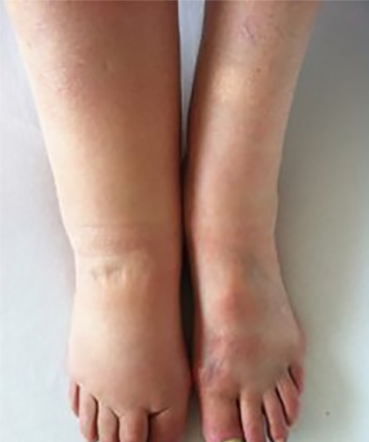
Moment 1: Mimics – Lymphedema^{1,3}
Results from disruption of lymphatic drainage
  Can be congenital but usually related to obesity or lymph node dissection
Usually unilateral
Diffuse nontender erythema
Erythema improves with elevation
Minimal warmth
No fever
Image source: Sarhan, Abdullah. Lymphedema in lower limb. https://commons.wikimedia.org/w/index.php?curid=48487226. Creative Commons license: https://creativecommons.org/licenses/by-sa/4.0/deed.en.

Slide 9
Moment 1: Other Mimics^{1,3}
Peripheral arterial disease
  Can present with dependent rubor—erythema that can be bright or dusky red—that goes away when the leg is elevated
  Can be associated with pain when patients have severe arterial insufficiency, but is not associated with warmth or edema
Contact dermatitis or other allergic reaction
  Lesions of contact dermatitis are usually confined to the site of contact with the allergen
Deep venous thrombosis
  Skin not generally involved, although can have swelling of the extremity with associated erythema and some warmth
Gout
  Skin surrounding involved joint(s) can mimic cellulitis with warmth, erythema, and pain

Slide 10
The Four Moments of Antibiotic Decision Making
Does my patient have an infection that requires antibiotics?
Do I need to order any
diagnostic tests?

Slide 11
Moment 2: Microbiologic Diagnosis²
If purulence or abscess is present, consider obtaining a wound culture
  Wound cultures should be obtained in patients presenting with recurrence or in those with immunocompromise or foreign material in place, or being admitted to the hospital
  Send pus in a sterile container rather than a swab of pus
No indication for aspiration of cellulitis margin or routine punch biopsy

Slide 12
The Four Moments of Antibiotic Decision Making
Does my patient have an infection that requires antibiotics?
Do I need to order any
diagnostic tests?
If antibiotics are indicated, what is the narrowest, safest, and shortest regimen I can prescribe?

Slide 13
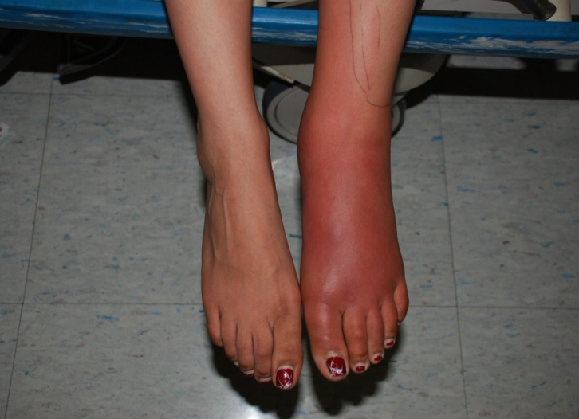
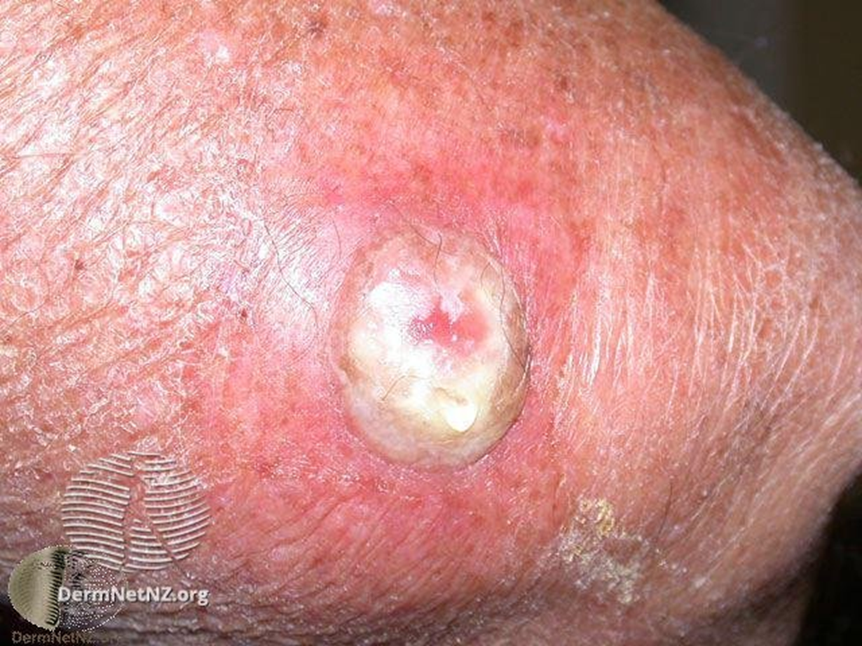
Moment 3: Diagnosis of Type of Cellulitis²
Nonpurulent
Purulent
Above image courtesy of H. Boucher
Image source: Eells SJ, Chira S, David CG. Non-suppurative cellulitis: risk factors and its association with Staphylococcus aureus colonization in an area of endemic community-associated methicillin-resistant S. aureus infections. Epidemiol Infect. 2011 Apr;139(4):606-12. PMID: 205613898. © 2010 Cambridge University Press. Used with permission.​
Image source: Wound infection after cryotherapy. DermNetNZ.org. https://dermnetnz.org/topics/wound-infections. Creative Commons license: https://creativecommons.org/licenses/by-nc-nd/3.0/nz/.

Slide 14
Moment 3: Decisions Around Antibiotic Prescription^{2,4,5}
Nonpurulent
Caused by beta-hemolytic strep
  Usually group A strep
  Sometimes group B, C, or G
  All are penicillin susceptible
    Clindamycin resistance increasing⁶
MSSA estimated to be the cause of only ~10% of cases⁷
Treatment⁸⁻¹⁰
  Oral first-generation cephalosporin
  Oral amoxicillin/clavulanate
  Severe PCN allergy: doxycycline, trimethoprim/sulfamethoxazole, clindamycin (with caution), linezolid (for more severe cases)
Purulent
Caused by S. aureus
  Risk for MRSA
Drainage strongly recommended
Ultrasound may help detect abscess or phlegmon in cases where physical exam is equivocal
Treatment: Cover for MRSA^{2,5}
  Doxycycline, trimethoprim/sulfamethoxazole, clindamycin
    Check local susceptibility data before using clindamycin
  Linezolid for more severe cases

Slide 15
Moment 3: MRSA Coverage in Nonpurulent Cellulitis
Randomized controlled trial of outpatients older than 12 years with uncomplicated cellulitis 2009–2012¹¹
  All patients had ultrasound to confirm absence of an abscess
  Patients received either cephalexin alone or cephalexin plus trimethoprim/sulfamethoxazole for 7 days
  Proportions of patients with prior MRSA infection (4%) and diabetes (~10%) similar in both arms
  Clinical cure rates in patients who complied with the protocol: 86% in cephalexin group versus 84% in the combination group
MRSA coverage is generally not needed in patients with nonpurulent cellulitis

Slide 16
Moment 3: Role of Antibiotics for Skin Abscesses With Minimal Cellulitis
The primary treatment for cutaneous abscesses is drainage
A recent study suggests modest benefit of antibiotics for adult outpatients with drained abscesses ≥ 2 cm¹²
  Clinical cure in evaluable population: 95% for trimethoprim/sulfamethoxazole and 86% for placebo (p < 0.001)
Antibiotic use can be associated with adverse events¹³
Weigh the benefit of a modestly higher cure rate with risk of antibiotic adverse events

Slide 17
Moment 3: Indications for Antibiotics for Skin Abscesses
Signs and symptoms of systemic illness
Underlying immunosuppression
  Diabetes, AIDS, malignancy
Extremes of age
Location of abscess in area that makes complete drainage difficult or that can be associated with septic phlebitis of a major vessel
Lack of response to initial I & D
Extensive surrounding cellulitis

Slide 18
Moment 3: Treatment of Other Types of Skin and Soft Tissue Infections
Human and animal bites⁵
  Amoxicillin/clavulanate (not oral first-generation cephalosporins)
  PCN allergy: moxifloxacin or doxycycline
Cellulitis in people with diabetes¹⁴
  Gram-negative coverage not needed in most cases
    Treat using usual cellulitis regimens
  Diabetic ulcers with associated cellulitis
    Gram-positive organisms are the most common colonizing organisms
    Consider adding Gram-negative coverage in patients with longstanding ulcers or prior receipt of multiple antibiotic courses

Slide 19

Non-Antibiotic Therapy
Elevate the affected extremity
Assess for and treat tinea pedis
Manage venous stasis and lymphedema

Slide 20
Moment 3: Duration of Therapy for Uncomplicated Cellulitis¹⁵⁻¹⁷
RCT of 5 versus 10 days of therapy¹⁵
  All patients received antibiotics for 5 days
  On day 5, patients who had at least minimal improvement (could still have warmth, erythema, tenderness, edema) were randomized to receive either 5 more days of placebo or 5 more days of antibiotics
  Primary outcome: resolution by day 14 and no recurrence by day 28
  98% of patients in both groups were treated successfully

Slide 21
The Four Moments of Antibiotic Decision Making
Does my patient have an infection that requires antibiotics?
Do I need to order any
diagnostic tests?
If antibiotics are indicated, what is the narrowest, safest, and shortest regimen I can prescribe?
Does my patient understand what to expect and the followup plan?

Slide 22
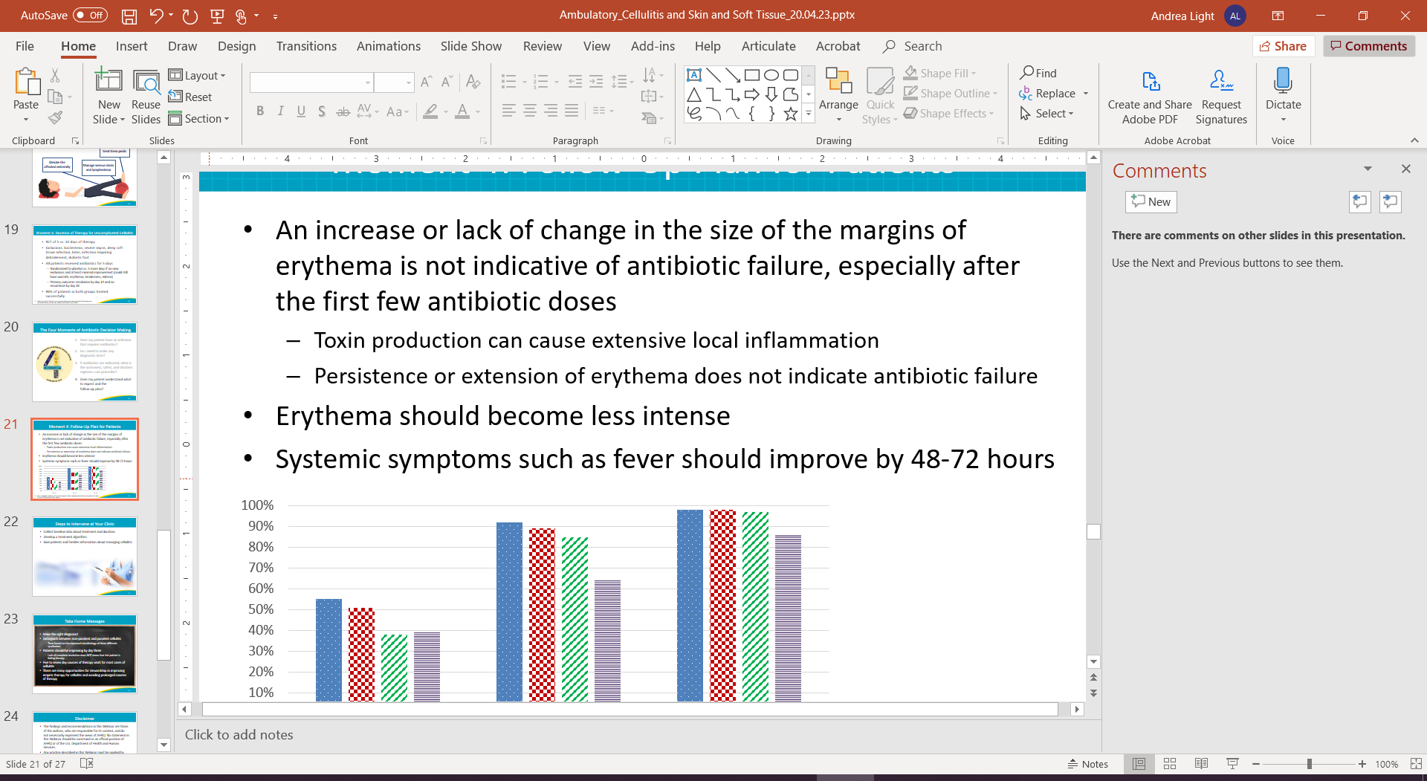
Moment 4: Followup Plan for Patients¹⁸
An increase or lack of change in the size of the margins of erythema is not indicative of antibiotic failure, especially after the first few antibiotic doses
  Toxin production can cause extensive local inflammation
  Persistence or extension of erythema does not indicate antibiotic failure
Erythema should become less intense
Systemic symptoms such as fever should improve by 48–72 hours
Cessation of lesion spread
Improvement of local inflammation
Cessation of lesion spread and improvement of local inflammation
Defervescence

Slide 23

Take-Home Messages
Distinguish between nonpurulent and purulent cellulitis
  Treat based on the expected microbiology of these different syndromes
Patients should be improving by day three
  Lack of complete resolution does NOT mean that the patient is failing therapy
  If patients have no improvement or worsening symptoms by day three, they should be re-evaluated.
Five- to seven-day courses of therapy are sufficient for most cases of cellulitis

Slide 24
Additional Toolkit Resources
For more resources on cellulitis and skin and soft tissue abscesses, access tools listed below, available in the AHRQ Toolkit To Improve Antibiotic Use in Ambulatory Care.
Discussion Guide: Refer to the Discussion Guide to help your practice develop a standardized approach to the diagnosis and management of patients with cellulitis and skin and soft tissue abscesses.
Clinician One-Page Document: Refer to the One-Page document for a concise summary of the diagnosis and treatment of cellulitis and skin and soft tissue abscesses.
Patient Handout: The Patient Handout explains the symptoms and symptomatic treatment of cellulitis and skin and soft tissue abscesses. It is available in both English and Spanish.

Slide 25
Disclaimer
The findings and recommendations in this presentation are those of the authors, who are responsible for its content, and do not necessarily represent the views of AHRQ. No statement in this presentation should be construed as an official position of AHRQ or of the U.S. Department of Health and Human Services.
Any practice described in this presentation must be applied by healthcare practitioners in accordance with professional judgment and standards of care in regard to the unique circumstances that may apply in each situation they encounter. These practices are offered as helpful options for consideration by healthcare practitioners, not as guidelines.

Slide 26
References
Hirschmann JV, Raugi GJ. Lower limb cellulitis and its mimics: Part 1. J Am Acad Dermatol. 2012; Aug;67(2):163.e1-12. PMID: 22794815.
Bystritsky R, Chambers H. Cellulitis and soft tissue infections. Ann Intern Med. 2018 Feb 6;168(3):ITC17-32. PMID: 29404597.
David CV, Chira S, Eells SJ, et al. Diagnostic accuracy in patients admitted to hospitals with cellulitis. Dermatol Online J. 2011 Mar 15;17(3):1. PMID: 21426867.
Jeng A, Beheshti M, Nathan R. The role of beta-hemolytic streptococci in causing diffuse, nonculturable cellulitis: a prospective investigation. Medicine (Baltimore). 2010 Jul; 89(4):217-26. PMID: 20616661.
Stevens DL, Bisno AL, Chambers HF, et al. Practice guidelines for the diagnosis and management of skin and soft tissue infections: 2014 update by the Infectious Diseases Society of America. Clin Infect Dis. 2014 Jul 15;59(2):147-59. PMID: 24947530.

Slide 27
References
Active Bacterial Core surveillance (ABCs): ABCs Bact Facts Interactive Data Dashboard. Centers for Disease Control and Prevention. June 2021. https://www.cdc.gov/abcs/bact-facts-interactive-dashboard.html. Accessed Jan 20, 2022.
Khamash DF, Voskertchian A, Tamma PD, et al. Increasing clindamycin and trimethoprim-sulfamethoxazole resistance in pediatric staphylococcus aureus infections. J Pediatric Infect Dis Soc. 2019 Sep 25;8(4):351-3. PMID: 30011009.
Miller LG, Daum RS, Creech CB, et al. Clindamycin versus trimethoprim-sulfamethoxazole for uncomplicated skin infections. N Engl J Med. 2015 Mar 19;372(12):1093-103. PMID: 25785967.
Bowen AC, Carapetis JR, Currie BJ, et al. Sulfamethoxazole-trimethoprim (cotrimoxazole) for skin and soft tissue infections including impetigo, cellulitis, and abscess. Open Forum Infect Dis. 2017 Nov 2;4(4):ofx232. PMID: 29255730.

Slide 28
References
Todd SR, Dahlgren FS, Traeger MS, et al. No visible dental staining in children treated with doxycycline for suspected rocky mountain spotted fever. J Pediatr. 2015 May;166(5):1246-51. PMID: 25794784.
Moran GJ, Krishnadasan A, Mower WR, et al. Effect of cephalexin plus trimethoprim-sulfamethoxazole vs cephalexin alone on clinical cure of uncomplicated cellulitis: a randomized clinical trial. JAMA. 2017 May; 317(20):2088-96. PMID: 28535235.
Talan DA, Mower WR, Krishnadasan A, et al. Trimethoprim-sulfamethoxazole versus placebo for uncomplicated skin abscess. N Engl J Med. 2016 Mar 3; 374(9):823-32. PMID: 26962903.
Pulia M, Fox B. Antibiotics should not be routinely prescribed after incision and drainage of uncomplicated abscesses. Ann Emerg Med. 2019 Apr;73(4):377-8. PMID: 30902165.
Lipsky BA, Senneville E, Abbas ZG, et al. Guidelines on the diagnosis and treatment of foot infection in persons with diabetes (IWGDF 2019 update). Diabetes Metab Res Rev. 2020 Mar;36 Suppl 1:e3280. PMID: 32176444.

Slide 29
References
Hepburn MJ, Dooley DP, Skidmore PJ, et al. Comparison of short-course (5 days) and standard (10 days) treatment for uncomplicated cellulitis. Arch Intern Med. 2004 Aug 9;164(15):1669-74. PMID: 15302637.
Prokocimer P, De Anda C, Fang E, et al. Tedizolid phosphate vs linezolid for treatment of acute bacterial skin and skin structure infections: the ESTABLISH-1 randomized trial. JAMA. 2013 Feb 13;309(6):559-69. PMID: 23403680.
Moran GJ, Fang E, Corey GR, et al. Tedizolid for 6 days versus linezolid for 10 days for acute bacterial skin and skin-structure infections (ESTABLISH-2): a randomised, double-blind, phase 3, non-inferiority trial. Lancet Infect Dis. 2014 Aug;14(8):696-705. PMID: 24909499.
Bruun T, Oppegaard O, Hufthammer KO, et al. Early response in cellulitis: a prospective study of dynamics and predictors. Clin Infect Dis. 2016 Oct 15;63(8):1034-41. PMID: 27402819.

