Slide 1
AHRQ Safety Program for Improving Antibiotic Use
AHRQ Safety Program for Improving Antibiotic Use
Sustaining Antibiotic Stewardship Efforts
Ambulatory Care
AHRQ Pub. No. 17(22)-0030
September 2022

Slide 2
Objectives
Develop sustainability plans to determine month to month antibiotic stewardship activities over the next 1–2 years
Identify targets for future antibiotic stewardship efforts based on antibiotic prescribing patterns
Understand the importance of completing a gap analysis on an annual basis

Slide 3
Looking Ahead
A step-by-step approach to implementing antibiotic stewardship in an outpatient practice generally takes approximately 2 years.
After the initial steps of establishing an antibiotic stewardship team have been accomplished, it is important to keep practice members and the stewardship team engaged.

Slide 4
Implementation Steps¹
Step one: Obtain support from senior leadership.
Step two: Identify a clinician lead and administrative lead.
Step three: Make a case for stewardship to others in the practice.
Step four: Determine how to access antibiotic prescription data.
Step five: Improve communication between practice members and between practice members and patients.
Step six: Discuss best practices in the diagnosis and treatment of common infectious processes with practice members.
Step seven: Monitor and report back antibiotic prescription data to practice.
Step eight: Develop a sustainability plan.

Slide 5
Sustainability Plan
Initial Sustainability Plan
An approximate outline of the month to month plans during the first 1–2 years
Order of infectious conditions to focus on
Approximate amount of time that will be spent on each condition
Frequency of antibiotic prescription review and feedback
Frequency of practicewide meetings
Review with senior leadership and practice members
Subsequent Sustainability Plans
Update on an annual basis
Determine if previous steps need to be revisited or if new targets should be identified
Review with senior leadership and practice members

Slide 6
Cluster-Randomized Trial²
Intervention Arm
Control Arm
1-hour education session focusing on upper respiratory tract infections and sinusitis
Quarterly review of antibiotic prescribing rates in comparison to other practices
No educational session
No review of antibiotic prescribing rates with practice members
Practices in the intervention arm experienced a 50% reduction in the use of guideline noncompliant antibiotic use compared with the control arm.

Slide 7
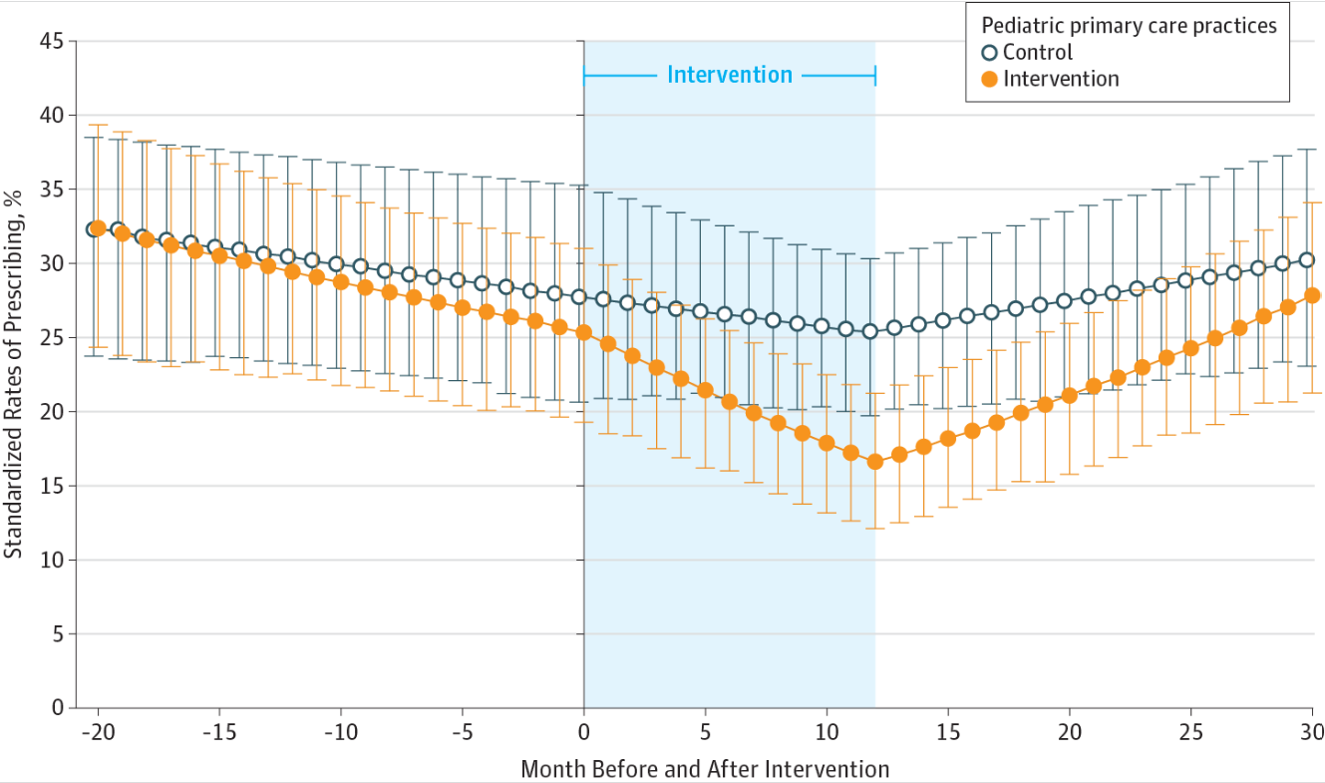
Post-Intervention³
Source: Gerber JS, Prasad PA, Fiks AG, et al. Durability of benefits of an outpatient antimicrobial stewardship intervention after discontinuation of audit and feedback. JAMA. 2014 Dec 17;312(23):2569-70. ©2014 American Medical Association, all rights reserved. Used with permission.

Slide 8
Hypothetical Proportion of Visits With an Antibiotic Prescription

Slide 9
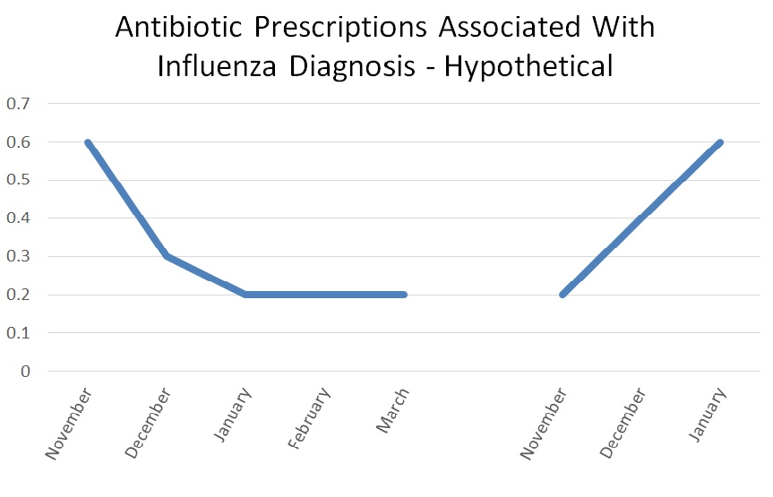
The Iterative Nature of Stewardship

Slide 10
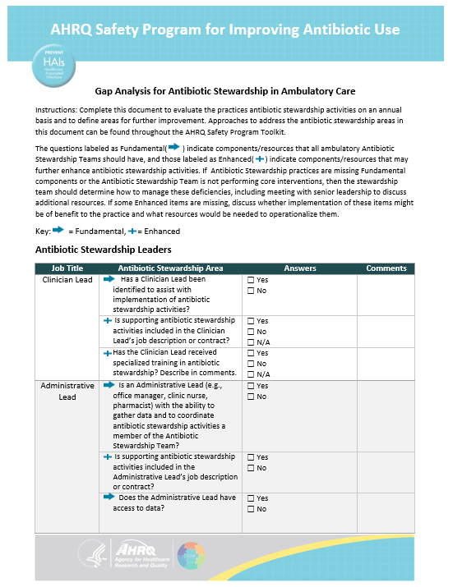
Gap Analysis

Slide 11
Take-Home Messages
1–2 years are generally required to establish an antibiotic stewardship team in outpatient practices.
After this period, ongoing antibiotic stewardship efforts are needed to continue to observe optimal antibiotic prescribing.
After the first 1–2 years, an annual sustainability plan should be developed.
Completion of an annual gap analysis can inform ongoing or new stewardship efforts to include in the sustainability plan.

Slide 12
Disclaimer
The findings and recommendations in this presentation are those of the authors, who are responsible for its content, and do not necessarily represent the views of AHRQ. No statement in this presentation should be construed as an official position of AHRQ or of the U.S. Department of Health and Human Services.
Any practice described in this presentation must be applied by healthcare practitioners in accordance with professional judgment and standards of care in regard to the unique circumstances that may apply in each situation they encounter. These practices are offered as helpful options for consideration by healthcare practitioners, not as guidelines.

Slide 13
References
Keller SC, Cosgrove SE, Miller MA, et al. A framework for implementing antibiotic stewardship in ambulatory care: lessons learned from the Agency for Healthcare Research and Quality Safety Program for Improving Antibiotic Use. Antimicrobial Stewardship & Healthcare Epidemiology. 2022 July 4;2(1):e109.
Gerber JS, Prasad PA, Fiks AG, et al. Effect of an outpatient antimicrobial stewardship intervention on broad-spectrum antibiotic prescribing by primary care pediatricians: a randomized trial. JAMA. 2013 Jun 12;309(22): 2345-52. PMID: 23757082.
Gerber JS, Prasad PA, Fiks AG, et al. Durability of benefits of an outpatient antimicrobial stewardship intervention after discontinuation of audit and feedback. JAMA. 2014 Dec 17;312(23):2569-70. PMID: 25317759.

