Slide 1
Best Practices in the Diagnosis and Treatment of Asymptomatic Bacteriuria and Urinary Tract Infections
AHRQ Safety Program for Improving Antibiotic Use
Ambulatory Care
AHRQ Pub. No. 17(22)-0030
September 2022

Slide 2
Objectives
Distinguish asymptomatic bacteriuria (ASB) from urinary tract infection (UTI)
Discuss indications for sending urine cultures
Discuss empiric antibiotic options for UTIs that are effective and minimize adverse events
Discuss recommended durations of antibiotic therapy for UTIs

Slide 3
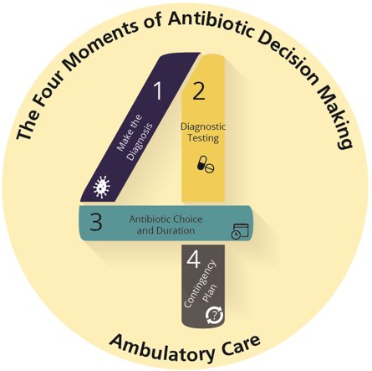
The Four Moments of Antibiotic Decision Making
Does my patient have an infection that requires antibiotics?
Do I need to order any diagnostic tests?
If antibiotics are indicated, what is the narrowest, safest, and shortest regimen I can prescribe?
Does my patient understand what to expect and the followup plan?

Slide 4
The Four Moments of Antibiotic Decision Making
Does my patient have an infection that requires antibiotics?

Slide 5
Symptoms of Urinary Tract Infections
Cystitis: infection of the bladder
Symptoms: dysuria, frequency, urgency, and suprapubic pain
Pyelonephritis: infection of the kidney
Symptoms: fever and flank pain (in addition to the symptoms of cystitis)

Slide 6
UTI Diagnosis in Children and Adolescents
Children ≥4 years of age and adolescents Symptoms of cystitis and pyelonephritis identical to adults
Children <4 years of age Consider UTI diagnosis in febrile and irritable children without an alternative explanation

Slide 7
Asymptomatic Bacteriuria (ASB)
The presence of significant colony counts of bacteria in the urine from a person without symptoms of a UTI.
ASB does not indicate a UTI.¹⁻⁴
Urine cultures should only be obtained from patients with symptoms of a UTI.
Urine from patients with ASB may contain white blood cells (WBC)—their presence also does not indicate a UTI in the absence of urinary symptoms

Slide 8
Asymptomatic Bacteriuria^{2,5}
ASB is COMMON.
Population | Prevalence
Healthy premenopausal women | 1–5%
Women 65–90 years old | 11–16%
Female long-term care residents | 25–50%
Male long-term care residents | 15–50%
Women with diabetes | 9–27%
Men with diabetes | 1–11%
People receiving hemodialysis | 25%
People with indwelling urinary catheters | > 90%

Slide 9
Treatment of Asymptomatic Bacteriuria May Cause Harm
ASB does not require treatment
Randomized controlled trials have not shown that antibiotic treatment of ASB reduces subsequent risk of UTI⁶⁻⁸
Treatment of ASB is associated with—
Avoidable antibiotic-associated adverse events ^{9,10}
An increased risk of subsequent UTIs that may be increasingly difficult to treat due to the development of antibiotic resistance^{9,11}

Slide 10
Mental Status Changes and Asymptomatic Bacteriuria
Bacteriuria and delirium are each independently common in the elderly.^{12,13}
Although patients with a symptomatic UTI may present with delirium, falls, or confusion, these symptoms are unlikely to be the result of a UTI in the absence of urinary symptoms.
If a patient has signs of systemic infection and delirium, empiric antibiotic therapy is likely warranted.

Slide 11
When Is Screening/Treating for ASB Indicated?²
Guidelines recommend screening and treating for ASB in two situations:
Early in pregnancy
May prevent pyelonephritis, preterm labor, and low birth-weight infants
Impending urologic procedure in which mucosal bleeding is expected
May prevent urosepsis

Slide 12
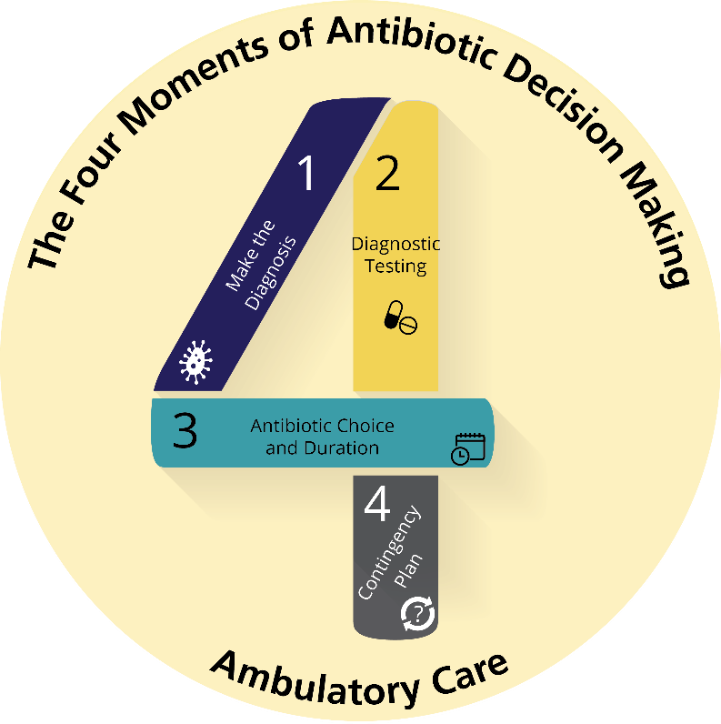
The Four Moments of Antibiotic Decision Making
Does my patient have an infection that requires antibiotics?
Do I need to order any diagnostic tests?

Slide 13
Moment 2: Urinalysis and Urine Cultures¹
Adolescent females and women with acute symptoms of cystitis generally do not need a urinalysis (UA) or urine culture to diagnose UTIs.
Send UA and culture if—
Young child where diagnosis is uncertain
Risk factors for antibiotic-resistant organisms
Treatment failure
History of multiple UTIs or concern for a recurrent UTI
Recent antibiotic use
Complicated UTI suspected
Symptoms of pyelonephritis

Slide 14
UTI in Males¹⁴
UTIs in males (adolescents and adults) are considered complicated because they are generally associated with obstructive pathology such as—
Renal stones
Ureteral strictures
Enlarged prostate
Other causes of urinary symptoms in males: prostatitis, epididymitis, sexually transmitted infections

Slide 15
Collecting Urine Samples
Adults and toilet-trained children: provide clear instructions for how to obtain a clean-catch specimen.
Clean the perineum, start the flow of urine, and catch the flow of urine in a cup
Children who are not sufficiently toilet trained:
Urine catheterization preferred
If catheterization is difficult, obtain a clean-catch urine sample
If significant quantities of bacteria and WBCs are observed, follow with a catheterized specimen

Slide 16
Moment 2: Urinalysis and Cultures^{1,15}
Abnormal Urinalysis (UA)
≥ 10 WBC per high-power field
Leukocyte esterase indicates presence of WBCs
Nitrites indicates the presence of certain bacteria in the urine
Clinical correlation is needed for all of these test results, as the presence of any or all of them does not indicate a UTI if relevant symptoms are not present and sufficient quantities of bacteria are not identified
Positive urine culture: ≥ 10,000–100,000 CFU/mL of a urinary pathogen

Slide 17
The Four Moments of Antibiotic Decision Making
Does my patient have an infection that requires antibiotics?
Do I need to order any diagnostic tests?
If antibiotics are indicated, what is the narrowest, safest, and shortest regimen I can prescribe?

Slide 18
Empiric Therapy: Uncomplicated Cystitis¹
Preferred therapy
Nitrofurantoin
Trimethoprim-sulfamethoxazole (TMP-SMX)
Alternative therapy
Oral cephalosporins
Fluoroquinolones no longer recommended due to their associated adverse events
Review local susceptibility data, patient’s previous urine culture results and associated susceptibility data, as well as antibiotic adverse event profile when selecting therapy

Slide 19
Moment 3: Uncomplicated Cystitis Treatment^{1,16}
Drug | Duration Studied
Nitrofurantoin | 5 days
TMP/SMX | 3 days
Cephalexin | 7 days
Cefadroxil | 7 days
Cefaclor | 5 days
Cefpodoxime | 3 days
Cefdinir | 5 days
Most patients can be treated for 3–5 days.

Slide 20
Moment 3: Uncomplicated Pyelonephritis Treatment
Empiric therapy
Fluoroquinolones or TMP-SMX preferred given excellent penetration into kidney^{1,17,18}
Oral cephalosporins are alternative agents but associated with more clinical failure than fluoroquinolones or TMP-SMX
Review local susceptibility data, patient’s previous urine culture results and associated susceptibility data, as well as antibiotic adverse event profile when selecting therapy

Slide 21
Moment 3: Duration of Treatment
Drug | Duration Studied^{19–23}
Levofloxacin | 5 days total therapy
Ciprofloxacin | 7 days total therapy
TMP-SMX | 7–14 days total therapy
Oral cephalosporin | 10–14 days total therapy

Slide 22
Moment 3: Complicated UTIs^{24,25}
Complicated UTIs: UTIs in males (adolescent or adult), catheter-associated UTIs, UTIs occurring in the presence of urologic abnormalities or renal stones
Management of the underlying obstruction should occur
Duration of therapy
Use of fluoroquinolones or TMP-SMX AND patient afebrile: 7 days of therapy
Use of oral cephalosporins OR systemically ill: 10–14 days of therapy

Slide 23
The Four Moments of Antibiotic Decision Making
Does my patient have an infection that requires antibiotics?
Do I need to order any diagnostic tests?
If antibiotics are indicated, what is the narrowest, safest, and shortest regimen I can prescribe?
Does my patient understand what to expect and the followup plan?

Slide 24
Moment 4: Patient Followup
May take 1–2 days for improvement to occur²⁴
Cystitis: seek medical care if symptoms not improving by day 3 or if developing back pain, flank pain, or fevers
Pyelonephritis or complicated UTIs: seek medical care if fevers persist by day 3, rigors develop, or if generally feeling more ill at any time

Slide 25
Moment 4: Clinician Followup
Review the urinalysis results (within 1 day), urine culture results (1–2 days), and antibiotic susceptibilities (2–3 days)
Determine if a change in the antibiotic therapy is warranted based on urine culture results and clinical symptoms

Slide 26
Take-Home Messages
Send urinalysis and urine cultures only when you suspect UTIs based on clinical symptoms.
Asymptomatic bacteriuria is common and should not be treated in the vast majority of patients.
Select appropriate durations of therapy for cystitis, pyelonephritis, and complicated urinary tract infections.
For uncomplicated cystitis this is generally 3–5 days.
For uncomplicated pyelonephritis this is generally 7 days.
For complicated UTIs, this is generally 7 days if the patient is not systemically ill and a fluoroquinolone or trimethoprim-sulfamethoxazole was prescribed; otherwise, 10–14 days of antibiotics may be warranted.

Slide 27
Additional Toolkit Resources
For more resources on asymptomatic bacteriuria and urinary tract infections, please access tools listed below, available in the AHRQ Toolkit To Improve Antibiotic Use in Ambulatory Care.
Discussion Guide: Refer to the Discussion Guide to help your practice develop a standardized approach to the diagnosis and management of patients with ASB and UTI.
Clinician One-Page Document: Refer to the One-Page document for a concise summary of the diagnosis and treatment of ASB and UTI.
Patient Handout: The Patient Handout explains the symptoms and symptomatic treatment of ASB and UTI. It is available in both English and Spanish.

Slide 28
Disclaimer
The findings and recommendations in this presentation are those of the authors, who are responsible for its content, and do not necessarily represent the views of AHRQ. No statement in this presentation should be construed as an official position of AHRQ or of the U.S. Department of Health and Human Services.
Any practice described in this presentation must be applied by healthcare practitioners in accordance with professional judgment and standards of care in regard to the unique circumstances that may apply in each situation they encounter. These practices are offered as helpful options for consideration by healthcare practitioners, not as guidelines.

Slide 29
References
Gupta K, Hooton TM, Naber KG, et al. International clinical practice guidelines for the treatment of acute uncomplicated cystitis and pyelonephritis in women: a 2010 update by the Infectious Diseases Society of America and the European Society for Microbiology and Infectious Diseases. Clin Infect Dis. 2011 Mar 1;52(5):e103-20. PMID: 21292654.
Nicolle LE, Gupta K, Bradley SF, et al. Clinical practice guideline for the management of asymptomatic bacteriuria: 2019 update by the Infectious Diseases Society of America. Clin Infect Dis. 2019 May 2;68(10):1611-5. PMID: 31506700.
Nicolle LE, Bradley S, Colgan R, et al. Infectious Diseases Society of America guidelines for the diagnosis and treatment of asymptomatic bacteriuria in adults. Clin Infect Dis. 2005 Mar 1;40(5):643-54. PMID: 15714408.​
Hooton T, Bradley SF, Cardenas, et al. Diagnosis, prevention, and treatment of catheter-associated urinary tract infection in adults: 2009 International Clinical Practice Guidelines from the Infectious Diseases Society of America. Clin Infectious Dis. 2010 Mar;50(5):625-63. PMID: 20175247.

Slide 30
References
Taweel I, Beatty N, Duarte A, et al. Significance of bacteriuria in patients with end-stage renal disease on hemodialysis. Avecenna J Med. 2018 Apr-Jun;8(2):51-4. PMID: 29682478.
Cai T, Mazzoli S, Mondaini N, et al. The role of asymptomatic bacteriuria in young women with recurrent urinary tract infections: to treat or not to treat? Clin Infect Dis. 2012 Sep;55(6):771-7. PMID: 22677710.
Harding GK, Zhanel GG, Nicolle LE, et al. Antimicrobial treatment in diabetic women with asymptomatic bacteriuria. N Engl J Med. 2002 Nov 14;347(20):1576-83. PMID: 12432044.
Origüen J, López-Medrano F, Fernández-Ruiz M, et al. Should asymptomatic bacteriuria be systematically treated in kidney transplant recipients? Results from a randomized controlled trial. Am J Transplant. 2016 Oct;16(10):2943-53. PMID: 27088545.
Warren JW, Anthony WC, Hoopes JM, et al. Cephalexin for susceptible bacteriuria in afebrile, long-term catheterized patients. JAMA. 1982 Jul 23;248(4):454-8. PMID: 7045440.

Slide 31
References
Nicolle LE, Mayhew WJ, Bryan L. Prospective randomized comparison of therapy and no therapy for asymptomatic bacteriuria in institutionalized elderly women. Am J Med. 1987 Jul;83(1):27-33. PMID: 3300325.
Cai T, Nesi G, Mazzoli S, et al. Asymptomatic bacteriuria treatment is associated with a higher prevalence of antibiotic resistant strains in women with urinary tract infections. Clin Infect Dis. 2015 Dec 1;61(11):1655-61. PMID: 26270684.
McKenzie R, Stewart MT, Bellantoni MF, et al. Bacteriuria in individuals who become delirious. Am J Med. 2014 Apr;127(4):255-7. PMID: 24439075.
Boscia JA, Kobasa WD, Abrutyn E, et al. Lack of association between bacteriuria and symptoms in the elderly. Am J Med. 1986 Dec;81(6):979-82. PMID: 3799658.
Krieger JN, Ross SO, Simonsen JM. Urinary tract infections in healthy university men. J Urol. 1993 May;149(5):1046-8. PMID: 8483206.
Subcommittee on Urinary Tract Infection, Steering Committee on Quality Improvement and Management, Roberts KB. Urinary tract infection: clinical practice guideline for the diagnosis and management of the initial UTI in febrile infants and children 2 to 24 months. Pediatrics. 2011 Sep;128(3):595-610. PMID: 21873693.

Slide 32
References
Greenburg RN, Reilly MR, Weinandt WJ, et al. Randomized study of single-dose, three-day, and seven-day treatment of cystitis in women. J Infect Dis. 1986 Feb;153(2):277-82. PMID: 3484773.
Talan DA, Stamm WE, Hooton TM, et al. Comparison of ciprofloxacin (7 days) and trimethoprim-sulfamethoxazole (14 days) for acute uncomplicated pyelonephritis pyelonephritis in women: a randomized trial. JAMA. 2000 Mar 22-29;283(12):1583-90. PMID: 10735395.
Talan DA, Klimberg IW, Nicolle LE, et al. Once daily, extended release ciprofloxacin for complicated urinary tract infections and acute uncomplicated pyelonephritis. J Urol. 2004 Feb;171(2 Pt 1):734-9. PMID: 14713799.
Sandberg T, Skoog G, Hermansson AB, et al. Ciprofloxacin for 7 days versus 14 days in women with acute pyelonephritis: a randomised, open-label and double-blind, placebo-controlled, non-inferiority trial. Lancet. 2012 Aug 4;380(9840):484-90. PMID: 22726802.
Peterson J, Kaul S, Khashab M, et al. A double-blind, randomized comparison of levofloxacin 750 mg once-daily for five days with ciprofloxacin 400/500 mg twice-daily for 10 days for the treatment of complicated urinary tract infections and acute pyelonephritis. Urology. 2008 Jan;71(1):17-22. PMID: 18242357.

Slide 33
References
Moustafa F, Nguyen G, Mathevon T, et al. Evaluation of the efficacy and tolerance of a short 7 day third-generation cephalosporin treatment in the management of acute pyelonephritis in young women in the emergency department. J Antimicrob Chemother. 2016 Jun;71(6):1660-4. PMID: 26903277.
Fox MT, Melia MT, Same RG, et al. A seven-day course of TMP-SMX may be as effective as a seven-day course of ciprofloxacin for the treatment of pyelonephritis. Am J Med. 2017 Jul;130(7):842-5. PMID: 28216442.
Fox MT, Amoah J, Hsu AJ, et al. Comparative effectiveness of antibiotic treatment duration in children with pyelonephritis. JAMA Netw Open. 2020 May 1;3(5):e203951. PMID: 32364593.
Grigoryan L, Trautner BW, Gupta K. Diagnosis and management of urinary tract infections in the outpatient setting: a review. JAMA 2014 Oct 22-29;312(16):1677-84. PMID: 25335150.
Dekonja DM, Trautner B, Amundson C, et al. Effect of 7 vs 14 days of antibiotic therapy on resolution of symptoms among afebrile men with urinary tract infection: A randomized clinical trial. JAMA. 2021 Jul 27;326(4):324-31. PMID: 34313686.

