Slide 1
Best Practices in the Diagnosis and Treatment of Hospital-Acquired Pneumonia
AHRQ Safety Program for Improving Antibiotic Use
Acute Care
AHRQ Pub. No. 17(20)-0028-EF
November 2019

Slide 2
Objectives
Discuss the approach to diagnosing hospital-acquired pneumonia (HAP)
Discuss empiric treatment recommendations for HAP
Discuss opportunities for de-escalation of antibiotic therapy for HAP after additional clinical and microbiological data are available
Discuss reasonable durations of antibiotic therapy for HAP

Slide 3
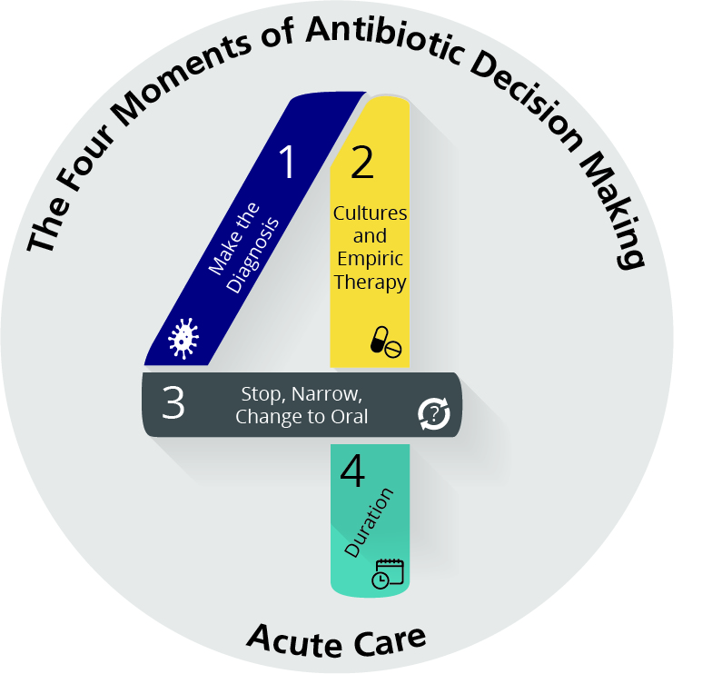
The Four Moments of Antibiotic Decision Making
Does my patient have an infection that requires antibiotics?
Have I ordered appropriate cultures before starting antibiotics? What empiric therapy should I initiate?
A day or more has passed. Can I stop antibiotics? Can I narrow therapy or change from IV to oral therapy?
What duration of antibiotic therapy is needed for my patient's diagnosis?

Slide 4
The Four Moments of Antibiotic Decision Making
Does my patient have an infection that requires antibiotics?

Slide 5
Moment 1: Diagnosing HAP
Not associated with mechanical ventilation at the time of onset in a hospitalized patient
Includes clinical symptoms of pneumonia PLUS hypoxia PLUS a new radiographic infiltrate that develops at least 48 hours after hospitalization

Slide 6
The Four Moments of Antibiotic Decision Making
Does my patient have an infection that requires antibiotics?
Have I ordered appropriate cultures before starting antibiotics? What empiric therapy should I initiate?

Slide 7
Moment 2: Diagnostic Tests for HAP
HAP can be caused by either community-associated or healthcare-associated pathogens
e.g., Streptococcus pneumoniae, Haemophilus influenzae, Staphylococcus aureus, Gram-negative enteric bacteria, Pseudomonas aeruginosa
Atypical organisms are uncommon
Obtain sputum Gram stain and culture
Obtain blood cultures for severely ill patients
Legionella urine antigen should be considered
Viral respiratory testing should be considered during respiratory virus season
Enterococci and Candida species are commonly isolated from sputum and are highly likely to be colonizers and not causes of pneumonia

Slide 8
Moment 2: Empiric Therapy for HAP¹
Cefepime (± aminoglycoside or ciprofloxacin or levofloxacin if severely ill) ± vancomycin or linezolid
Piperacillin-tazobactam (± aminoglycoside or ciprofloxacin or levofloxacin if severely ill) ± vancomycin or linezolid
Recent receipt of cefepime or piperacillin-tazobactam or recovery of pathogens resistant to these agents: anti-pseudomonal carbapenems (meropenem, imipenem) ± vancomycin or linezolid
Severe penicillin allergy: aztreonam (± aminoglycoside or ciprofloxacin or levofloxacin) + vancomycin or linezolid
Concern for legionella: add azithromycin to regimens that do not contain fluoroquinolones

Slide 9
Meta-analyses Evaluating Combination Therapy for Pseudomonas Infections
Study | Design | Clinical outcomes* OR/RR (95% CI)
Paul 2003² Cochrane | 68 RCTs | Mortality: 0.87 (0.34–2.24) Clinical failure: 1.41 (0.90–2.22)
Paul 2003³ BMJ | 47 RCTs | Mortality: 0.78 (0.24–2.56) Clinical failure: 1.46 (0.23–9.41)
Paul 2004⁴ BMJ | 64 RCTs | Mortality: 1.50 (0.70–32.84) Clinical failure: 1.01 (0.68–1.49)
Paul 2006⁵ Cochrane | 64 RCTs, observational | Clinical failure: 1.02 (0.68–1.51)
Marcus 2011⁶ J Antimicrob Ag | 52 RCTs | Mortality: 3.18 (0.49–20.65) Clinical failure: 1.55 (1.24–1.93)
*Comparing monotherapy to combination therapy in adult patients

Slide 10
Moment 2: Empiric MRSA Therapy for HAP
When should I add anti-MRSA coverage on an empiric basis?⁷⁻¹¹
Elevated local prevalence of MRSA
Known history of MRSA colonization or infection
A negative MRSA nasal surveillance swab suggests a low likelihood of MRSA infection during the same hospitalization
Intravenous drug use
Necrotizing pneumonia
Ill-appearing patient with a recent stay in a
nursing home or skilled nursing facility
Hemodialysis patients
Prolonged hospitalization with unknown
MRSA colonization status

Slide 11
Vancomycin Versus Linezolid?
Both vancomycin and linezolid are reasonable options for MRSA coverage for pulmonary infections.¹²⁻¹⁵
At least 4 meta-analyses of randomized controlled trials have shown use of vancomycin versus linezolid for the treatment of MRSA pulmonary infections yield similar outcomes.
Daptomycin is inactivated by pulmonary surfactant and is not a suitable option for the treatment of pneumonia.

Slide 12
The Four Moments of Antibiotic Decision Making
Does my patient have an infection that requires antibiotics?
Have I ordered appropriate cultures before starting antibiotics? What empiric therapy should I initiate?
A day or more has passed. Can I stop antibiotics? Can I narrow therapy or change from IV to oral therapy?

Slide 13
Moment 3: De-escalation of HAP Therapy
In patients for whom an alternate diagnosis is identified, stop HAP-targeted therapy
If HAP is the likely diagnosis, use sputum culture results to narrow therapy

Slide 14
Moment 3: Oral Step-Down Therapy for HAP¹⁶
Consider oral therapy after patient shows clinical improvement and the ability to tolerate oral medications
De-escalation should be guided by culture results
If pseudomonal coverage is needed:
Consider ciprofloxacin or levofloxacin
If pseudomonal coverage is not needed:
Consider second- or third-generation oral cephalosporin, amoxicillin-clavulanate
Severe penicillin allergy: respiratory fluoroquinolone

Slide 15
The Four Moments of Antibiotic Decision Making
Does my patient have an infection that requires antibiotics?
Have I ordered appropriate cultures before starting antibiotics? What empiric therapy should I initiate?
A day or more has passed. Can I stop antibiotics? Can I narrow therapy or change from IV to oral therapy?
What duration of antibiotic therapy is needed for my patient's diagnosis?

Slide 16
A Week of Antibiotic Therapy Is Sufficient¹⁶
A week of antibiotic therapy is sufficient for the treatment of HAP.
In a double-blind clinical trial conducted in 51 French ICUs, patients were randomized to 8 or 15 days of antibiotic therapy.
There was no difference in all-cause mortality or length of ICU stay comparing the 8-day and 15-day groups
Multidrug-resistant bacteria emerged less frequently in patients who received 8 days of antibiotics compared with those who received 15 days.

Slide 17
Improving Management of HAP in Your Hospital
Sputum cultures should be sent for all patients with suspected HAP, whenever possible
If MRSA nasal surveillance swab data is not available, nasal swabs for MRSA should be considered for patients for whom anti-MRSA coverage has been initiated to assist with de-escalation
Stratify local HAP guidelines to identify patients with suspected pneumonia at low risk of infection with Pseudomonas or other resistant Gram-negative pathogens
Includes patients who developed HAP early in their hospitalization who are otherwise healthy
Ceftriaxone or ampicillin/sulbactam are reasonable treatment options for low-risk patients
Moxifloxacin can be considered for patients with serious penicillin allergies

Slide 18
Take-Home Points for HAP
Obtain a sputum culture whenever possible
Determine if risk factors for Pseudomonas are present to direct empiric therapy
Determine if risk factors for MRSA are present that warrant the addition of anti-MRSA coverage
Remember to narrow or stop therapy after 48–72 hours
Change to oral therapy after clinical improvement is seen and when patient can tolerate PO
Seven days of therapy is generally sufficient

Slide 19
Disclaimer
The findings and recommendations in this presentation are those of the authors, who are responsible for its content, and do not necessarily represent the views of AHRQ. No statement in this presentation should be construed as an official position of AHRQ or of the U.S. Department of Health and Human Services.
Any practice described in this presentation must be applied by health care practitioners in accordance with professional judgment and standards of care in regard to the unique circumstances that may apply in each situation they encounter. These practices are offered as helpful options for consideration by health care practitioners, not as guidelines.

Slide 20
References
Kalil AC, Metersky ML, Klompas M, et al. Management of adults with hospital-acquired and ventilator-associated pneumonia: 2016 Clinical Practice Guidelines by the Infectious Diseases Society of America and the American Thoracic Society. Clin Infect Dis. 2016 Sep 1;63(5):e61-e111. PMID: 27418577.
Paul M, Soares-Weiser K, Grozinsky S, et al. Beta-lactam versus beta-lactam-aminoglycoside combination therapy in cancer patients with neutropaenia. Cochrane Database Syst Rev. 2003;(2):CD003038. PMID: 12076467.
Paul M, Soares-Weiser K, Leibovici L. Beta lactam monotherapy versus beta lactam-aminoglycoside combination therapy for fever with neutropenia: systematic review and meta-analysis. BMJ. 2003 May 24;326(7399):1111. PMID: 12763980.
Paul M, Benuri-Silbiger I, Soares-Weiser K, et al. Beta lactam monotherapy versus beta lactam-aminoglycoside combination therapy for sepsis in immunocompetent patients: systematic review and meta-analysis of randomised trials. BMJ. 2004 Mar 20;328(7441):668. PMID: 14996699.
Paul M, Silbiger I, Grozinsky S, et al. Beta lactam antibiotic monotherapy versus beta lactam-aminoglycoside antibiotic combination therapy for sepsis. Cochrane Database Syst Rev. 2006 Jan 25;(1):CD003344. PMID: 16437452.

Slide 21
References
Marcus R, Paul M, Elphick H, et al. Clinical implications of β-lactam-aminoglycoside synergism: systematic review of randomised trials. Int J Antimicrob Agents. 2011 Jun;37(6):491-503. PMID: 21292449.
Wooten DA, Winston LG. Risk factors for methicillin-resistant Staphylococcus aureus in patients with community-onset and hospital-onset pneumonia. Respir Med. 2013 Aug;107(8):1266-70. PMID: 23756035.
Robicsek A, Suseno M, Beaumont JL, et al. Prediction of methicillin-resistant Staphylococcus aureus involvement in disease sites by concomitant nasal sampling. J Clin Microbiol. 2008 Feb;46(2):588-92. PMID: 18057132.
Dangerfield B, Chung A, Webb B, et al. Predictive value of methicillin-resistant Staphylococcus aureus (MRSA) nasal swab PCR assay for MRSA pneumonia. Antimicrob Agents Chemother. 2014;58(2):859-64. PMID: 24277023.
Parente DM, Cunha CB, Mylonakis E, et al. The clinical utility of methicillin resistant Staphylococcus aureus (MRSA) nasal screening to rule out MRSA pneumonia: A diagnostic meta-analysis with antimicrobial stewardship implications. Clin Infect Dis. 2018 Jun 18;67(1):1-7. PMID: 29340593.

Slide 22
References
Chostiprasitsakul D, Tamma PD, Gadala A, et al. The role of negative methicillin-resistant Staphylococcus aureus nasal surveillance swabs in predicting the need for empiric vancomycin therapy in intensive care unit patients. Infect Control Hosp Epidemiol. 2018 Mar;39(3):290-6. PMID: 29374504.
Vardakas KZ, Mavros MN, Roussos N, et al. Meta-analysis of randomized controlled trials of vancomycin for the treatment of patients with gram-positive infections: focus on the study design. Mayo Clin Proc. 2012 Apr;87(4):349-63. PMID: 22469348.
Walkey AJ, O'Donnell MR, Wiener RS. Linezolid vs glycopeptide antibiotics for the treatment of suspected methicillin-resistant Staphylococcus aureus nosocomial pneumonia: a meta-analysis of randomized controlled trials. Chest. 2011 May;139(5):1148-1155. PMID: 20864609.
Kalil AC, Klompas M, Haynatzki G, et al. Treatment of hospital-acquired pneumonia with linezolid or vancomycin: a systematic review and meta-analysis. BMJ Open. 2013 Oct 14;3(10):e003912. PMID: 24127058.
Kalil AC, Murthy MH, Hermsen ED, et al. Linezolid versus vancomycin or teicoplanin for nosocomial pneumonia: a systematic review and meta-analysis. Crit Care Med. 2010 Sep;38(9):1802-8. PMID: 20639754.

Slide 23
References
Chastre J, Wolff M, Fagon JY, et al. Comparison of 8 vs 15 days of antibiotic therapy for ventilator-associated pneumonia in adults: a randomized trial. JAMA. 2003 Nov 19;290(19):2588-98. PMID: 14625336.

