Slide 1
Best Practices in the Diagnosis and Treatment of Ventilator-Associated Pneumonia
AHRQ Safety Program for Improving Antibiotic Use
Acute Care
AHRQ Pub. No. 17(20)-0028-EF
November 2019

Slide 2
Objectives
Discuss the approach to diagnosing ventilator-associated pneumonia (VAP)
Discuss empiric treatment recommendations for VAP
Discuss opportunities for de-escalation of antibiotic therapy for VAP after additional clinical and microbiological data are available
Discuss reasonable durations of antibiotic therapy for VAP

Slide 3
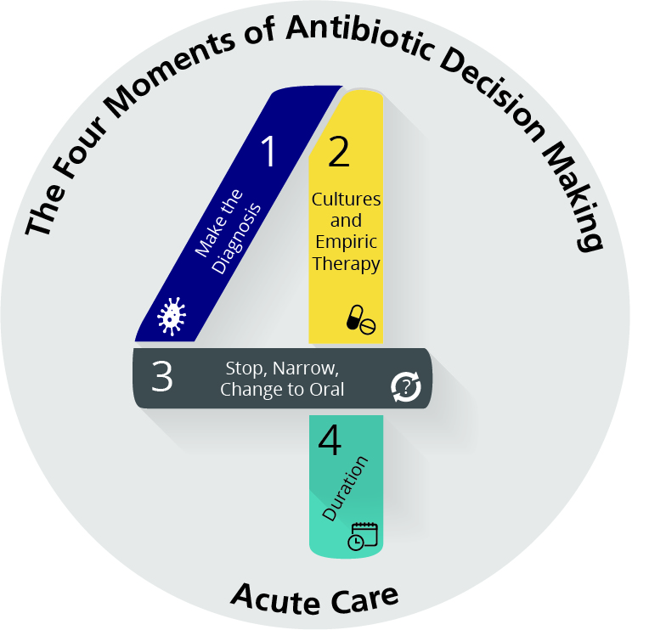
The Four Moments of Antibiotic Decision Making
1. Does my patient have an infection that requires antibiotics?
2. Have I ordered appropriate cultures before starting antibiotics? What empiric therapy should I initiate?
3. A day or more has passed. Can I stop antibiotics? Can I narrow therapy or change from IV to oral therapy?
4. What duration of antibiotic therapy is needed for my patient's diagnosis?

Slide 4
The Four Moments of Antibiotic Decision Making
1. Does my patient have an infection that requires antibiotics?

Slide 5
Moment 1: Diagnosing VAP
VAP: pneumonia occurring 48 hours or more after endotracheal intubation¹
Increased, purulent tracheal secretions
New infiltrate on chest imaging
Worsening oxygenation
Usually with fever/hypothermia and leukocytosis

Slide 6
The Four Moments of Antibiotic Decision Making
1. Does my patient have an infection that requires antibiotics?
2. Have I ordered appropriate cultures before starting antibiotics? What empiric therapy should I initiate?

Slide 7
Moment 2: Diagnosing VAP
Common organisms include:
Staphyloccocus aureus, Pseudomonas aeruginosa, and other Gram-negative bacilli
Role of other organisms
Legionella should be considered, particularly in immunocompromised patients or severely ill patients
Enterococci and Candida species are often isolated from the sputum but generally represent contaminants and should not be treated with anti-infectives
Remember: If patients develop pneumonia within 48 hours of intubation, they do not have VAP.
Common organisms: Streptococcus pneumoniae, Haemophilus influenzae

Slide 8
Moment 2: Diagnostic Tests for VAP
Noninvasive culture techniques such as endotracheal aspirate are recommended over invasive techniques like bronchoscopy¹
Send respiratory specimen for Gram stain and culture
VAP is unlikely with bacterial burdens below the following thresholds
Protected specimen brush <1,000 CFU/mL
Bronchoscopic alveolar lavage fluid <10,000 CFU/mL
Endotracheal aspirate <100,000 CFU/mL
Blood cultures may be positive in up to 15% of patients
Obtain Legionella urinary antigen if concerns for Legionella

Slide 9
Moment 2: Empiric Therapy for VAP
Consider:
Cefepime (± aminoglycoside or ciprofloxacin or levofloxacin if severely ill) ± vancomycin or linezolid¹
Piperacillin-tazobactam (± aminoglycoside or ciprofloxacin or levofloxacin if severely ill) ± vancomycin or linezolid¹
Recent receipt of cefepime or piperacillin-tazobactam or recovery of pathogens resistant to these agents: anti-pseudomonal carbapenems (meropenem, imipenem) ± vancomycin or linezolid¹
Severe penicillin allergy: Aztreonam or ciprofloxacin or levofloxacin (+ vancomycin or linezolid if aztreonam or ciprofloxacin are used)¹
Concern for Legionella: add azithromycin only to regimens that do not contain fluoroquinolones

Slide 10
Moment 2: Empiric Therapy for VAP
When should I add anti-MRSA coverage on an empiric basis?
High local prevalence of MRSA
Known patient history of MRSA colonization or infection^{2,3}
Intravenous drug use
Necrotizing pneumonia
Ill-appearing patient with a recent stay in a nursing home or skilled nursing facility
Prolonged hospitalization with unknown MRSA colonization status

Slide 11
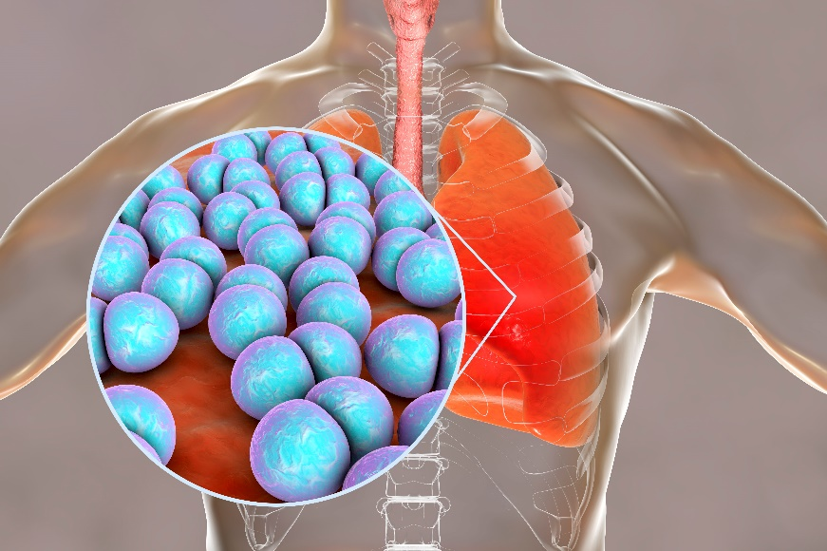
Vancomycin vs. Linezolid?
Both vancomycin and linezolid are reasonable options for MRSA coverage for pulmonary infections^{4,5,6,7}
At least 4 meta-analyses of randomized controlled trials have shown that use of vancomycin versus linezolid for the treatment of MRSA pulmonary infections yields similar outcomes
Daptomycin is inactivated by pulmonary surfactant and is not a suitable option for the treatment of pneumonia

Slide 12
The Four Moments of Antibiotic Decision Making
1. Does my patient have an infection that requires antibiotics?
2. Have I ordered appropriate cultures before starting antibiotics? What empiric therapy should I initiate?
3. A day or more has passed. Can I stop antibiotics? Can I narrow therapy or change from IV to oral therapy?

Slide 13
Moment 3: De-escalation of VAP Therapy
In patients for whom an alternate diagnosis is identified, stop VAP-targeted therapy
If VAP is the likely diagnosis, use respiratory culture results to narrow therapy

Slide 14
Reassessing the Decision To Treat for VAP
Serial evaluations of ventilator settings can assist with determining when to discontinue antibiotic therapy⁸

Slide 15
Meta-analyses Evaluating Combination Therapy for Pseudomonas Infections
Study | Design | Clinical outcomes* OR/RR (95% CI)
Paul 2002⁹ Cochrane | 68 RCTs | Mortality: 0.87 (0.34–2.24) Clinical failure: 1.41 (0.90–2.22)
Paul 2003¹⁰ BMJ | 47 RCTs | Mortality: 0.78 (0.24–2.56) Clinical failure: 1.46 (0.23–9.41)
Paul 2004¹¹ BMJ | 64 RCTs | Mortality: 1.50 (0.70–32.84) Clinical failure: 1.01 (0.68–1.49)
Paul 2006¹² Cochrane | 64 RCTs, observational | Clinical failure: 1.02 (0.68–1.51)
Marcus 2011¹³ J Antimicrob Ag | 52 RCTs | Mortality: 3.18 (0.49–20.65) Clinical failure: 1.55 (1.24–1.93)
Safdar 2004¹⁴ Lancet Infect Dis | 17 observational | Mortality: 1.50 (1.30–1.79)
*Comparing monotherapy with combination therapy in adult patients

Slide 16
Moment 3: Oral Step-Down Therapy for VAP
After patient shows clinical improvement and the ability to tolerate oral medications
If pseudomonal coverage is needed: consider ciprofloxacin or levofloxacin (based on susceptibility results)
If pseudomonal coverage is not needed: consider second- or third- generation oral cephalosporin or amoxicillin-clavulanate (based on susceptibility results)
Severe penicillin allergy: respiratory fluoroquinolone
If MRSA coverage is needed: clindamycin, trimethoprim/sulfamethoxazole, or linezolid (based on susceptibility results)

Slide 17
The Four Moments of Antibiotic Decision Making
1. Does my patient have an infection that requires antibiotics?
2. Have I ordered appropriate cultures before starting antibiotics? What empiric therapy should I initiate?
3. A day or more has passed. Can I stop antibiotics? Can I narrow therapy or change from IV to oral therapy?
4. What duration of antibiotic therapy is needed for my patient's diagnosis?

Slide 18
A Week of Antibiotic Therapy Is Sufficient¹⁵
A week of antibiotic therapy is sufficient for the treatment of VAP.
In a double-blind clinical trial conducted in 51 French ICUs, patients were randomized to 8 or 15 days of antibiotic therapy.
There was no difference in all-cause mortality or length of ICU stay comparing the 8-day and 15-day groups.
Multidrug-resistant bacteria emerged less frequently in patients receiving 8 days of antibiotics compared with those receiving 15 days.

Slide 19
Improving VAP Management at Your Hospital
Respiratory cultures should be sent for all patients with suspected VAP, whenever possible.
If MRSA nasal surveillance swab data are not available, they should be considered for patients for whom anti-MRSA coverage has been initiated to assist with de-escalation.
Ceftriaxone or ampicillin/sulbactam are reasonable treatment options for low-risk patients.
Moxifloxacin can be considered for patients with serious penicillin allergies.

Slide 20
Take-Home Points for VAP
Always obtain respiratory cultures
Determine if risk factors for MRSA exist that warrant the addition of anti-MRSA coverage
Reassess your patient on a daily basis to determine if antibiotics are still warranted
Remember to narrow or stop therapy after 48–72 hours
Change to oral therapy after clinical improvement is seen and when able to tolerate oral agents
Seven days of therapy is generally sufficient

Slide 21
Disclaimer
The findings and recommendations in this presentation are those of the authors, who are responsible for its content, and do not necessarily represent the views of AHRQ. No statement in this presentation should be construed as an official position of AHRQ or of the U.S. Department of Health and Human Services.
Any practice described in this presentation must be applied by health care practitioners in accordance with professional judgment and standards of care in regard to the unique circumstances that may apply in each situation they encounter. These practices are offered as helpful options for consideration by health care practitioners, not as guidelines.

Slide 22
References
Kalil AC, Metersky ML, Klompas M, et al. Executive Summary: Management of adults with hospital-acquired and ventilator-associated pneumonia: 2016 Clinical Practice Guidelines by the Infectious Diseases Society of America and the American Thoracic Society. Clin Infect Dis. 2016 Sep 1;63(5):e61-e111. PMID: 27418577.
Parente DM, Cunha CB, Mylonakis E, et al. The clinical utility of methicillin resistant Staphylococcus aureus (MRSA) nasal screening to rule out MRSA pneumonia: a diagnostic meta-analysis with antimicrobial stewardship implications. Clin Infect Dis. 2018 Jun 18;67(1):1-7. PMID: 29340593.
Wooten DA, Winston LG. Risk factors for methicillin-resistant Staphylococcus aureus in patients with community-onset and hospital-onset pneumonia. Respir Med. 2013 Aug;107(8):1266-70. PMID: 23756035.
Vardakas KZ, Mavros MN, Roussos N, et al. Meta-analysis of randomized controlled trials of vancomycin for the treatment of patients with gram-positive infections: focus on the study design. Mayo Clin Proc. 2012 Apr;87(4):349-63. PMID: 22469348.

Slide 23
References
Walkey AJ, O’Donnell MR, Wiener RS. Linezolid vs glycopeptide antibiotics for the treatment of suspected methicillin-resistant Staphylococcus aureus nosocomial pneumonia: a meta-analysis of randomized controlled trials. Chest. 2011 May;139(5):1148-1155. PMID: 20864609.
Kalil AC, Klompas M, Haynatzki G, et al. Treatment of hospital-acquired pneumonia with linezolid or vancomycin: a systematic review and meta-analysis. BMJ Open. 2013 Oct 14;3(10):e003912. PMID: 24127058.
Kalil AC, Murthy MH, Hermsen ED, et al. Linezolid versus vancomycin or teicoplanin for nosocomial pneumonia: a systematic review and meta-analysis. Crit Care Med. 2010 Sep;38(9):1802-8. PMID: 20639754.
Klompas M, Li L, Menchaca JT, et al. Ultra-short-course antibiotics for patients with suspected ventilator-associated pneumonia but minimal and stable ventilator settings. Clin Infect Dis. 2017 Apr 1;64(7):870-6. PMID: 28034888.
Paul M, Soares-Weiser K, Grozinsky S, et al. Beta-lactam versus beta-lactam-aminoglycoside combination therapy in cancer patients with neutropaenia. Cochrane Database Syst Rev. 2002;(2):CD003038. PMID: 12076467.

Slide 24
References
Paul M, Soares-Weiser K, Leibovici L. Beta lactam monotherapy versus beta lactam-aminoglycoside combination therapy for fever with neutropenia: systematic review and meta-analysis. BMJ. 2003 May 24;326(7399):1111. PMID: 12763980.
Paul M, Benuri-Silbiger I, Soares-Weiser K, et al. Beta lactam monotherapy versus beta lactam-aminoglycoside combination therapy for sepsis in immunocompetent patients: systematic review and meta-analysis of randomised trials. BMJ. 2004 Mar 20;328(7441):668. PMID: 14996699.
Paul M, Silbiger I, Grozinsky S, et al. Beta lactam antibiotic monotherapy versus beta lactam-aminoglycoside antibiotic combination therapy for sepsis. Cochrane Database Syst Rev. 2006 Jan 25;(1):CD003344. PMID: 16437452.
Marcus R, Paul M, Elphick H, et al. Clinical implications of β-lactam-aminoglycoside synergism: systematic review of randomised trials. Int J Antimicrob Agents. 2011 Jun;37(6):491-503. PMID: 21292449.
Safdar N, Handelsman J, Maki DG. Does combination antimicrobial therapy reduce mortality in Gram-negative bacteraemia? A meta-analysis. Lancet Infect Dis. 2004 Aug;4(8):519-27. PMID: 15288826.

Slide 25
References
Chastre J, Wolff M, Fagon JY, et al. Comparison of 8 vs 15 days of antibiotic therapy for ventilator-associated pneumonia in adults: a randomized trial. JAMA. 2003 Nov 19;290(19):2588-98. PMID: 14625336.

