Slide 1
Best Practices in the Diagnosis and Treatment of Bacteremia
AHRQ Safety Program for Improving Antibiotic Use
Acute Care
AHRQ Pub. No. 17(20)-0028-EF
November 2019

Slide 2
Objectives
Review recommendations for appropriate blood culture collection.
Develop organism-specific management recommendations for Gram-negative and Gram-positive bacteremia.
Discuss opportunities for de-escalation of antibiotic therapy for bacteremia.
Discuss reasonable durations of antibiotic therapy for common organisms causing bacteremia.

Slide 3
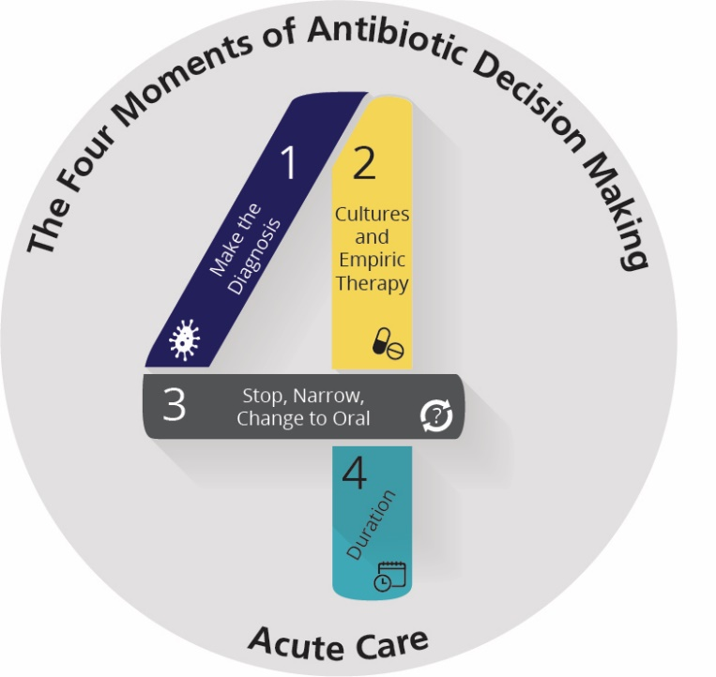
The Four Moments of Antibiotic Decision Making
Does my patient have an infection that requires antibiotics?
Have I ordered appropriate cultures before starting antibiotics? What empiric therapy should I initiate?
A day or more has passed. Can I stop antibiotics? Can I narrow therapy or change from IV to oral therapy?
What duration of antibiotic therapy is needed for my patient's diagnosis?

Slide 4
Obtaining Appropriate Blood Cultures^{1,2}
Severe sepsis upon admission
Cholangitis, meningitis, pyelonephritis, severe pneumonia, suspected endocarditis or endovascular infection, vertebral osteomyelitis/discitis, severe skin and soft tissue infections, systemic infection and asplenia, suspected catheter-related bloodstream infection
Two sets of peripheral BC (each set with one aerobic and one anaerobic bottle)
New fever (T≥38.5◦C [>101.2◦F]), suspected infection and no previous blood cultures (BC) within 48 hours
New infectious process not meeting above criteria
BC are not indicated since low yield
If known source, culture suspected source
Persistent fever and two sets of negative BC within 48 hours
BC likely not warranted
For low grade fever or leukocytosis only, consider monitoring first and assessing for other contributing factors
Isolated tachycardia, leukocytosis, hypotension, fever

Slide 5
Interpretation of Positive Blood Cultures
Example organisms | Classification | What to do
Staphylococcus aureus Gram-negative rods Candida spp. | Extremely unlikely to be a contaminant | ALWAYS treat
Coagulase-negative staphylococci Corynebacterium spp. Diphtheroids | Usually a contaminant | Usually do not treat Exception: indwelling hardware, signs of infection, & > 1 positive blood culture
Viridans group streptococci, Enterococcus spp. | A contaminant about half the time | Evaluate for possible source (e.g., oral, gastrointestinal, endocarditis), signs of infection, & > 1 positive blood culture

Slide 6
Enterobacteriaceae Bacteremia: Diagnosis
Enterobacteriaceae = most common organisms include E. coli, Klebsiella spp., Enterobacter spp., Serratia spp., Citrobacter spp.
Generally identified as lactose fermenters in laboratory reports
Always identify the source of bacteremia
Commonly urine, intra-abdominal, pulmonary (in hospitalized patients)
Translocation from the gut due to gut disruption or procedure
Catheter-related if central line in place

Slide 7
Enterobacteriaceae Bacteremia: Antibiotic Therapy
Narrow therapy based on susceptibility results
Considerations for IV to PO conversion:³
Patient has an appropriate clinical response
Appropriate source control preferred
Patient needs to be able to take and absorb oral antibiotics
Active oral antibiotic needs to have adequate oral bioavailability
Fluoroquinolones, trimethoprim/sulfamethoxazole

Slide 8
Enterobacteriaceae Bacteremia: Duration of Therapy
Traditional treatment duration has been 10–14 days
Randomized controlled trial including 604 patients with Gram-negative bacteremia randomized to receive either 7 days or 14 days of treatment^{4,5}
Most of the organisms were Enterobacteriaceae
For patients who were afebrile, hemodynamically stable, and achieved appropriate source control, 1 week of antibiotic therapy was sufficient.

Slide 9
Enterobacteriaceae Bacteremia: Followup Cultures
Minimal role for followup blood cultures in Gram-negative bacteremia
Study evaluating 500 episodes of bacteremia⁶
77% had at least one followup blood culture
Only eight cultures grew Gram-negative rods
Do not need to obtain routinely
Consider if persistent symptoms despite source control or suspicion of endovascular infection

Slide 10
Extended-Spectrum Beta-Lactamases
Most commonly seen in E. coli, Klebsiella spp., Proteus spp.
Many microbiology laboratories are not performing ESBL confirmation testing
Agents of first choice for invasive infections are carbapenems, based on the results of a multicenter randomized trial⁷
Can consider fluoroquinolones or trimethoprim/ sulfamethoxazole if susceptible
Can consider piperacillin/tazobactam, if susceptible, for milder infections like cystitis
Ceftriaxone, cefepime, and aztreonam not recommended

Slide 11
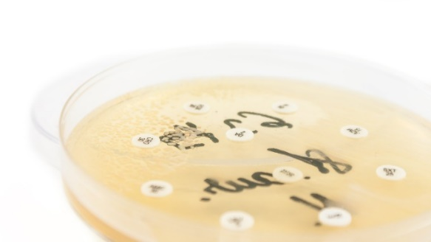
AmpC Beta-Lactamases
Most commonly seen in Enterobacter species
Induced by exposure to third-generation cephalosporins: do NOT use these agents to treat Enterobacter species even if reported as susceptible
Microbiology laboratories do not test for AmpC beta-lactamases
For invasive Enterobacter species infections, avoidance of third-generation cephalosporins is recommended
Consider cefepime,^{8,9} carbapenems, fluoroquinolones, or trimethoprim/ sulfamethoxazole, if susceptible

Slide 12
Carbapenem-Resistant Enterobacteriaceae
CRE are resistant to at least one carbapenem
e.g., ertapenem, meropenem, imipenem/cilastatin, or doripenem
About half the time they produce carbapenemase enzymes¹⁰
KPC carbapenemases are the most common carbapenemases in the United States
Consult infectious diseases for treatment recommendations
Some general rules:¹¹⁻¹⁴
Beta-lactam/beta-lactamase inhibitor combination agents (e.g., ceftazidime/avibactam, meropenem/vaborbactam), generally have good activity against CRE and are the preferred treatment
Must obtain susceptibility testing
Other options if CRE-active beta-lactam/beta-lactamase inhibitor combination agents are not available: extended-infusion meropenem or imipenem/cilastatin therapy if MIC is ≤8 mcg/mL PLUS a second agent based on in vitro susceptibility results

Slide 13
Pseudomonas Bacteremia¹²
Blood cultures growing oxidase-positive, non-lactose-fermenting Gram-negative rods
Determine the source
Commonly pulmonary, catheter/hardware, urine, wound
Source control whenever possible
Antibiotic therapy¹²
Piperacillin/tazobactam, cefepime, ceftazidime, carbapenems (not ertapenem), fluoroquinolones (not moxifloxacin), aminoglycosides
Data do not support the use of combination therapy over monotherapy
Aminoglycoside monotherapy not recommended (Exception: lower urinary tract infections)
If isolate is multidrug-resistant, consider infectious diseases consult
Duration: 10–14 days in most cases

Slide 14
Staphylococcus aureus Bacteremia: Diagnosis
Determining the source of S. aureus bacteremia and whether there has been metastatic spread are of critical importance¹⁵
Based on history and physical exam, imaging should be obtained
Concomitant vertebral osteomyelitis/discitis/epidural abscesses are not uncommon

Slide 15
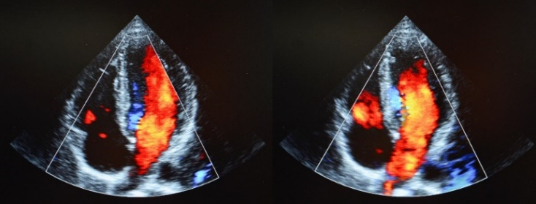
Staphylococcus aureus Bacteremia: Diagnosis¹³
All patients must have echocardiography to assess for endocarditis
Transesophageal echocardiogram (TEE) is more sensitive than transthoracic echocardiogram (TTE) in detecting smaller vegetations¹⁶
Most patients should receive TEE¹⁵
Patients at low risk for endocarditis in whom short-course therapy is desired
Patient at high risk for cardiac complications (e.g., prosthetic valves, permanent cardiac devices, cardiac conduction abnormalities, prolonged bacteremia or fever)

Slide 16
Staphylococcus aureus Bacteremia: Management
Blood cultures should be obtained to demonstrate clearance of bacteremia¹⁵
Source control is essential
Remove hardware
Debride abscesses
Infectious diseases consultation¹⁷

Slide 17
Staphylococcus aureus Bacteremia: Management
Uncomplicated¹⁵
Endocarditis excluded with a TEE
In select cases a very good quality TTE suffices
No implanted prosthetic devices
Followup blood cultures are negative for S. aureus
Patient defervesces within 72 hours of initiating effective therapy
Patient has no localizing signs or symptoms of metastatic staphylococcal infection
MSSA
Complicated
All other cases

Slide 18
MSSA Bacteremia: Management
MSSA should be treated with anti-staphylococcal penicillins (oxacillin, nafcillin) or cefazolin
Cefazolin is associated with fewer side effects but patients with deep-seated infections may develop resistance^{18,19}
Vancomycin is associated with a higher failure rate and should not be used for convenience^{20,21}
Strongly consider desensitization for patients with serious penicillin allergies who cannot tolerate cephalosporins

Slide 19
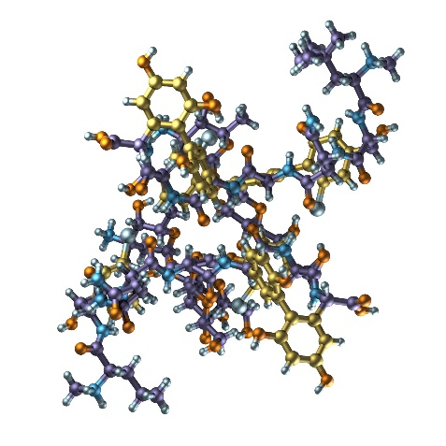
MRSA Bacteremia: Management
Vancomycin still considered by most to be the agent of first choice²²
Daptomycin can be considered in patients with renal toxicity due to vancomycin or if the vancomycin MIC is greater than 1.5 mcg/mL²³
Higher doses recommended
If bacteremia persists despite source control for more than 5–7 days or if patient is deteriorating clinically, salvage regimens may be required

Slide 20
S. aureus Bacteremia: Management^{18,20}
The addition of gentamicin is not recommended for S. aureus bacteremia or native valve endocarditis^{22,24}
It is associated with nephrotoxicity in the absence of clinical benefit²⁵
The routine addition of rifampin is not recommended for S. aureus bacteremia or native valve endocarditis^{22,26}
Consider in consultation with infectious disease specialists when the source of bacteremia is a prosthetic joint or spinal hardware
Rifampin should not be initiated until after blood cultures have cleared
The addition of gentamicin and rifampin is recommended for prosthetic valve endocarditis²²

Slide 21
S. aureus Bacteremia: Duration of Therapy
All durations should be calculated from the day of the first negative blood culture or obtainment of source control, whichever is later
Uncomplicated S. aureus bacteremia: 14 days
Complicated S. aureus bacteremia: 28–42 days
Osteomyelitis: 42 days at a minimum
Right-sided endocarditis
Injecting drug users with MSSA and minimal comorbidities, no hardware, no embolic disease other than septic pulmonary emboli: 14 days oxacillin/nafcillin
Everyone else: 28–42 days
Left-sided endocarditis: 42 days (or more)

Slide 22
Enterococcal Bacteremia: Diagnosis
Microbiology
E. faecalis
Community-acquired infections
Almost universally susceptible to ampicillin
E. faecium
Hospital-acquired infections
Often ampicillin and vancomycin resistant (VRE)
Enterococci spp. are generally of low virulence but can form biofilms and persist on catheters and prosthetic material

Slide 23
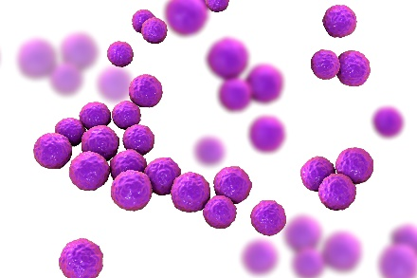
Enterococcal Bacteremia: Diagnosis
Enterococcus growing in the blood falls into four general categories
Contaminant (likely from skin)
Bacteremia from translocation in a patient post-procedure (usually biliary) or with gut disruption (e.g., mucositis)
Bacteremia related to an infected source: commonly UTI/prostatitis and biliary tract infection
Endocarditis²⁷
Consider in settings of persistent bacteremia, prosthetic valves, or presentations consistent with endocarditis
Source control whenever possible
Minimal role for followup blood cultures if source is known and controlled

Slide 24
E. faecalis Bacteremia: Management
Ampicillin (1st line) and vancomycin (2nd line) are not bactericidal
Combination therapy with gentamicin is bactericidal
Newer data suggest combination of ampicillin and ceftriaxone is bactericidal
When is combination therapy needed?^{28,29}
Endocarditis: yes
Failure rates up to 40% with monotherapy
4–6 weeks of IV therapy
Other infections: no evidence of benefit
Infectious diseases consultation is recommended for endocarditis due to E. faecalis

Slide 25
E. faecium Bacteremia: Management
Treat with ampicillin or vancomycin if susceptible
Treat with linezolid or daptomycin if not susceptible to ampicillin or vancomycin
Infectious diseases consult recommended for VRE bacteremia or endocarditis

Slide 26
Summary
The diagnosis and treatment of bacteremia varies based on the causative organism
Ensure appropriate blood culture collection criteria are being used
Always identify the likely source and proceed with source control if a lingering source has been identified, whenever possible
Select the narrowest spectrum agents and shortest duration of therapy that has been shown to be efficacious

Slide 27
Disclaimer
The findings and recommendations in this presentation are those of the authors, who are responsible for its content, and do not necessarily represent the views of AHRQ. No statement in this presentation should be construed as an official position of AHRQ or of the U.S. Department of Health and Human Services.
Any practice described in this presentation must be applied by health care practitioners in accordance with professional judgment and standards of care in regard to the unique circumstances that may apply in each situation they encounter. These practices are offered as helpful options for consideration by health care practitioners, not as guidelines.

Slide 28
References
Towns ML, Jarvis WR, Hsueh PR. Guidelines on blood cultures. J Microbiol Immunol Infect. 2010 Aug;43(4):347-9. PMID: 20688297.
Lee A, Mirrett S, Reller LB, et al. Detection of bloodstream infections in adults: how many blood cultures are needed? J Clin Microbiol. 2007 Nov;45(11):3546-8. PMID: 17881544.
Tamma PD, Conley AT, Cosgrove SE, et al. Association of 30-day mortality with oral step-down vs continued intravenous therapy in patients hospitalized with Enterobacteriaceae bacteria. JAMA Intern Med. 2019 Jan 22. [Epub ahead of print] PMID: 30667477.
Chotiprasitsakul D, Han JH, Cosgrove SE, et al. Comparing the outcomes of adults with Enterobacteriacea bacteremia receiving short-course versus prolonged-course antibiotic therapy in a multicenter, propensity score-matched cohort. Clin Infect Dis. 2018 Jan 6;66(2):172-7. PMID: 29190320.
Yahav D, Franceschini E, Koppel F, et al. Seven versus fourteen days of antibiotic therapy for uncomplicated Gram-negative bacteremia: a non-inferiority randomized controlled trial. Clin Infect Dis. 2018 Dec 11. [Epub ahead of print] PMID: 30535100.
28

Slide 29
References
Canzoneri CN, Akhavan BJ, Tosur Z, et al. Follow-up blood cultures in Gram-negative bacteremia: are they needed? Clin Infect Dis. 2017 Nov;65(11):1776-9. PMID: 29020307.
Harris PNA, Tambyah PA, Lye DC, et al. Effect of piperacillin-tazobactam vs meropenem on 30-Day mortality for patients with E. coli or Klebsiella pneumoniae bloodstream infection and ceftriaxone resistance: a randomized clinical trial. JAMA. 2018 Sep;320(10):984-94. PMID: 30208454.
Tamma PD, Girdwood SC, Gopaul R, et al. The use of cefepime for treating AmpC β-lactamase-producing Enterobacteriaceae. Clin Infect Dis. 2013 Sep;57(6):781-8. PMID: 23759352.
Siedner MJ, Galar A, Guzmán-Suarez BB, et al. Cefepime vs other antibacterial agents for the treatment of Enterobacter species bacteremia. Clin Infect Dis. 2014 Jun;58(11):1554-63. PMID: 24647022.
Guh AY, Bulens SN, Mu Y, et al. Epidemiology of carbapenem-resistant Enterobacteriaceae in 7 US communities, 2012-2013. JAMA. 2015 Oct;31(14):1479-87. PMID: 26436831.
29

Slide 30
References
Morrill HJ, Pogue JM, Kaye KS, et al. Treatment options for carbapenem-resistant Enteriobacteriaceae infections. Open Forum Infect Dis. 2015 May;2(2):ofv050. PMID: 26125030.
Kaye KS, Pogue JM. Infections caused by resistant Gram-negative bacteria: epidemiology and management. Pharmacotherapy. 2015 Oct;35(10):949-62. PMID: 26497481.
Wunderink RG, Giamarellos-Bourboulis EJ, Rahav G, et al. Effect and safety of meropenem-vaborbactam versus best-available therapy in patients with carbapenem-resistant Enterobacteriaceae infections: The TANGO II randomized clinical trial. Infect Dis Ther. 2018 Dec;7(4):439-55. PMID: 30270406.
Tumbarello M, Trecarichi EM, Corona A, et al. Efficacy of ceftazidime-avibactam salvage therapy in patients with infections caused by Klebsiella pneumoniae carbapenemase-producing K. pneumoniae. Clin Infect Dis. 2019 Jan 18;68(3):355-64. PMID: 29893802.
Cosgrove SE, Fowler VG Jr. Optimizing therapy for methicillin-resistant Staphylococcus aureus bacteremia. Semin Respir Crit Care Med. 2007 Dec;28(6):624-31. PMID: 18095226.
30

Slide 31
References
Reynolds HR, Jagen MA, Tunick PA, et al. Sensitivity of transthoracic versus transesophageal echocardiography for the detection of native valve vegetations in the modern era. J Am Soc Echocardiogr. 2003 Jan;16(1):67-70. PMID: 12514637.
Bai AD, Showler A, Burry L, et al. Impact of infectious disease consultation of quality of care, mortality, and length of stay in Staphylococcus aureus bacteremia: results from a large multicenter cohort study. Clin Infect Dis. 2015 May 15;60(10):1451-61. PMID: 2501854.
Li J, Echevarria KL, Hughes DW, et al. Comparison of cefazolin versus oxacillin for treatment of complicated bacteremia caused by methicillin-susceptible Staphylococcus aureus. Antimicrob Agents Chemother. 2014 Oct;58(10):5117-24. PMID: 24936596.
Lee S, Choe PG, Song KH, et al. Is cefazolin inferior to nafcillin for treatment of methicillin-susceptible Staphylococcus aureus bacteremia? Antimicrob Agents Chemother. 2011 Nov;55(11):5122-6. PMID: 21825299.
Chang FY, Peacock JE Jr, Musher DM, et al. Staphylococcus aureus bacteremia: recurrence and the impact of antibiotic treatment in a prospective multicenter study. Medicine (Baltimore). 2003 Sep;82:333-9. PMID: 14530782.
31

Slide 32
References
Stryjewski ME, Szczech LA, Benjamin DK Jr, et al. Use of vancomycin or first-generation cephalosporins for the treatment of hemodialysis-dependent patients with methicillin-susceptible Staphylococcus aureus bacteremia. Clin Infect Dis. 2007 Jan;44(2):190-6. PMID: 17173215.
Liu C, Bayer A, Cosgrove SE, et al. Clinical practice guidelines by the Infectious Diseases Society of America for the treatment of methicillin-resistant Staphylococcus aureus infections in adults and children. Clin Infect Dis. 2011 Feb;52(3): e18-55. PMID: 21208910.
Fowler VG Jr, Boucher HW, Corey GR, et al. Daptomycin versus standard therapy for bacteremia and endocarditis caused by Staphylococcus aureus. N Engl J Med 2006 Aug;355(7): 653-65. PMID: 16914701.
Baddour LM, Wilson WR, Bayer AS, et al. Infective endocarditis in adults: diagnosis, antimicrobial therapy, and management of complications: a scientific statement for healthcare professionals from the American Heart Association. Circulation. 2015 Oct;132(15):1435-86. PMID: 26373316.
Cosgrove SE, Vigliani GE, Fowler VG, et al. Initial low-dose gentamicin for Staphylococcus aureus bacteremia and endocarditis is nephrotoxic. Clin Infect Dis. 2009 Mar;48(6):713-21. PMID: 19207079.
32

Slide 33
References
Thwaites GE, Scarborough M, Szubert A, et al. Adjunctive rifampicin for Staphylococcus aureus bacteraemia (ARREST): a multicentre, randomized, double-blind, placebo-controlled trial. Lancet. 2018 Feb;391(10121):668-78. PMID: 29249276.
Anderson DJ, Murdoch DR, Sexton DJ, et al. Risk factors for infective endocarditis in patients with Enterococcal bacteremia: a case-control study. Infection. 2004 Apr;32(2):72-7. PMID: 15057570.
Beganovic M, Luther MK, Rice LB, et al. A review of combination therapy for Enterococcus faecalis bloodstream infections and infective endocarditis. Clin Infect Dis. 2018 Jul 2;67(2):303-9. PMID: 29390132.
Graninger W, Ragette R. Nosocomial bacteremia due to Enterococcus faecalis without endocarditis. Clin Infect Dis. 1992 Jul;15(1):49-57. PMID: 1617073.
33

