Slide 1
Best Practices in the Diagnosis and Treatment of Cellulitis and Skin and Soft Tissue Infections
AHRQ Safety Program for Improving Antibiotic Use
Acute Care
AHRQ Pub. No. 17(20)-0028-EF
November 2019

Slide 2
Objectives
Describe the approach to diagnosing cellulitis.
Describe the microbiology of cellulitis and how that informs empiric therapy.
Describe empiric treatment options for cellulitis.
Discuss the role of antibiotic therapy for skin abscesses.
Discuss opportunities for de-escalation of antibiotic therapy for cellulitis.
Discuss reasonable durations of antibiotic therapy for cellulitis.

Slide 3
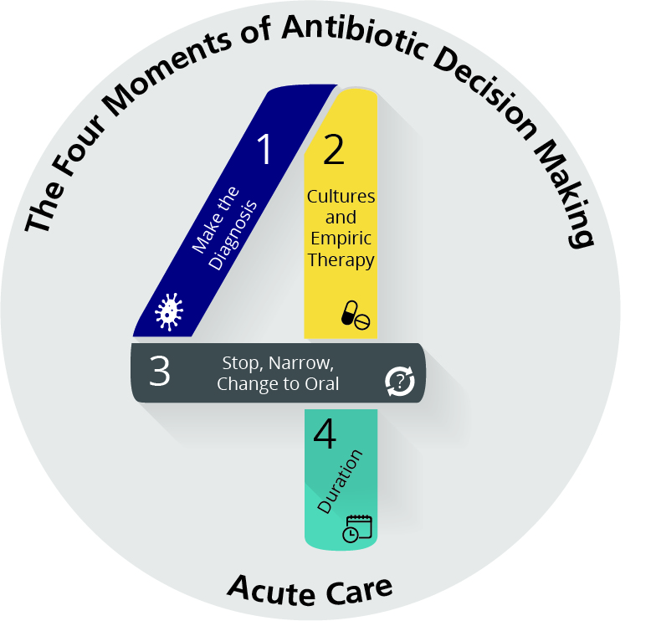
The Four Moments of Antibiotic Decision Making
Does my patient have an infection that requires antibiotics?
Have I ordered appropriate cultures before starting antibiotics? What empiric therapy should I initiate?
A day or more has passed. Can I stop antibiotics? Can I narrow therapy or change from IV to oral therapy?
What duration of antibiotic therapy is needed for my patient's diagnosis?

Slide 4
The Four Moments of Antibiotic Decision Making
Does my patient have an infection that requires antibiotics?

Slide 5
Moment 1: Diagnosis of Cellulitis^{1,2}
Redness, warmth, tenderness, and swelling of skin
Relatively rapid onset/progression
Almost always unilateral
Fever in 20–70% of patients
Elevated inflammatory markers in 60–90% of patients
Leukocytosis in 35–50% of patients
Associated with skin surface disruption
Recent trauma
Tinea pedis
Cutaneous ulcer
Saphenous venectomy
Impaired venous and lymphatic drainage

Slide 6
Moment 1: Cellulitis Mimics
Several noninfectious conditions are commonly misdiagnosed as cellulitis.
In one study of 145 patients hospitalized for cellulitis, 41 (28%) had alternative diagnoses including:³
Venous stasis dermatitis (37%)
Trauma-related inflammation (5%)
Deep vein thrombosis (5%)
Nonspecific dermatitis (5%)
Thrombophlebitis (5%)

Slide 7
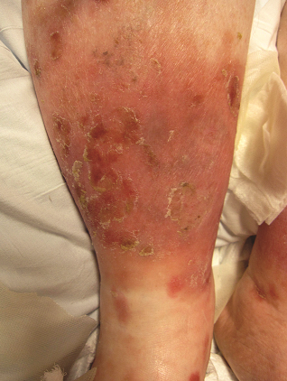
Moment 1: Cellulitis Mimics
Venous stasis dermatitis⁴
Often bilateral
Usually present for a long time
Associated with chronic skin hyperpigmentation
Associated with pitting edema and/or serous drainage
Itchiness and scaling may be present
Less painful than cellulitis
No fever or significant leukocytosis
Treat with elevation, compression, topical steroids
Reprinted with permission from Keller EC, Tomecki KJ, Alraies MC. Distinguishing cellulitis from its mimics. Cleve Clin J Med. 2012 Aug;79(8):547-52. Copyright © 2012 Cleveland Clinic Foundation. All rights reserved.

Slide 8
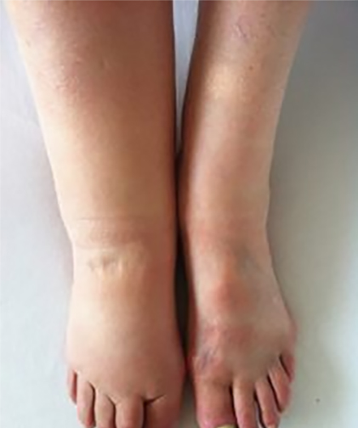
Moment 1: Cellulitis Mimics
Lymphedema⁴
Results from disruption of lymphatic drainage
Can be congenital but usually related to obesity or lymph node dissection
Usually unilateral
Diffuse nontender erythema
Erythema improves with elevation
Minimal warmth
No fever
By Abdullah Sarhan - Own work, CC-BY-SA-4.0. https://commons.wikimedia.org/w/index.php?curid=48487226.

Slide 9
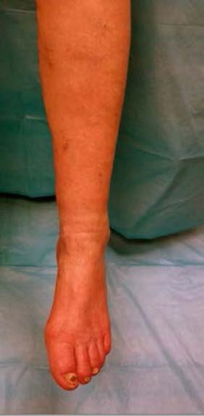
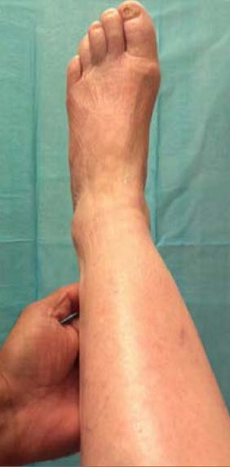
Moment 1: Cellulitis Mimics
Peripheral arterial disease⁴
Can present with dependent rubor
Erythema that goes away when the leg is elevated
Can be associated with pain when patients have severe arterial insufficiency, but not warmth or edema
Pannu R, Dean SM. History and physical exam of chronic critical limb ischemia. In: Critical Limb Ischemia. Copyright © 2017 Springer International Publishing Switzerland. All rights reserved. Used with permission.

Slide 10
Moment 1: Cellulitis Mimics⁴
Contact dermatitis
Lesions usually confined to the site of contact with the allergen
Ask about potential exposures
Deep venous thrombosis
Skin not generally involved, although can have swelling of the extremity with associated erythema and some warmth
Gout
Skin surrounding involved joint(s) can mimic cellulitis with warmth, erythema, and pain

Slide 11
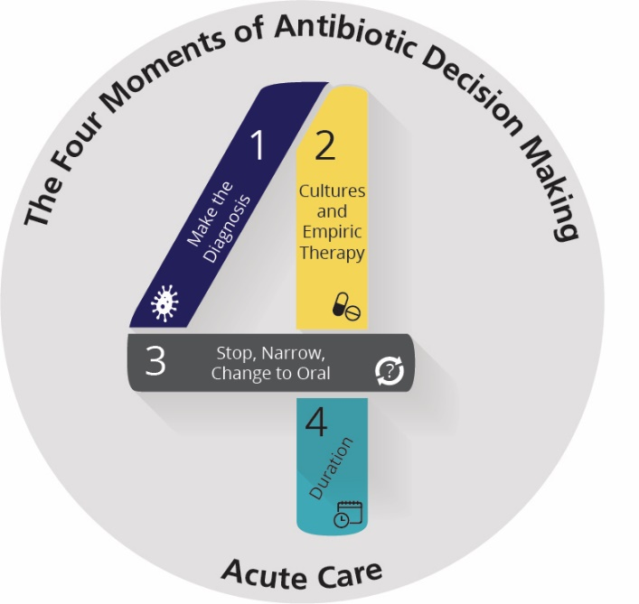
The Four Moments of Antibiotic Decision Making
Does my patient have an infection that requires antibiotics?
Have I ordered appropriate cultures before starting antibiotics? What empiric therapy should I initiate?

Slide 12
Moment 2: Microbiologic Diagnosis
Blood cultures positive in < 5% of cases, not routinely recommended
Blood cultures recommended in—
Severely ill patients
Immunocompromised or neutropenic patients
Certain exposures (e.g., salt water leading to possible Vibrio infection)
If purulence is present, cultures should be obtained
Best to send pus, not a swab of pus
No indication for routine punch biopsy or aspiration of cellulitis margin

Slide 13
Moment 2: Diagnosis of Type of Cellulitis
Nonpurulent
Purulent
Eells SJ, Chira S, David CG, et al. Non-suppurative cellulitis: risk factors and its association with Staphylococcus aureus colonization in an area of endemic. community-associated methicillin-resistant S. aureus infections. Epidemiol Infect. 2011 Apr;139(4):606-12 [Epub 2010 Jun 21]. ©Cambridge University Press 2010. Reproduced with permission.
Image courtesy of DermNetNZ.org; via Creative Commons license Attribution-NonCommerdial-NoDerivs 3.0 New Zealand. https://creativecommons.org/licenses/by-nc-nd/3.0/nz/legalcode.

Slide 14
Moment 2: Nonpurulent Versus Purulent
Nonpurulent
Caused by beta-hemolytic strep⁵
Usually group A strep
Sometimes group B, C, G
All are penicillin susceptible
Clindamycin resistance 10–20% in B, C, G
MSSA estimated to be the cause of only ~10% of cases
Treatment:
Penicillin G IV or amoxicillin PO
Cefazolin or ampicillin/sulbactam IV
Oral first-generation cephalosporin or amoxicillin/clavulanate PO
Purulent
Caused by S. aureus
Risk for MRSA
Debridement required whenever possible
Ultrasound may be helpful to detect abscess or phlegmon in cases where physical exam is equivocal
Treatment: Cover for MRSA
Trimethoprim/sulfamethoxazole (TMP/SMX), doxycycline, clindamycin*
Vancomycin or linezolid for more severe cases
*When using clindamycin, check local resistance.

Slide 15
Moment 2: Etiology of Nonpurulent Cellulitis in the MRSA Era Is NOT MRSA
Randomized controlled trial (RCT) of outpatients older than 12 years with uncomplicated cellulitis 2009–2012⁶
All patients had ultrasound to confirm no abscess present
Patients received either cephalexin or cephalexin and trimethoprim/sulfamethoxazole for 7 days
Proportions of patients with prior MRSA infection (4%) and diabetes (~10%) similar in both arms
Clinical cure in patients who complied with the protocol: 86% in cephalexin group vs 84% in the combination group

Slide 16
Skin Abscesses With Minimal Cellulitis
The primary treatment for cutaneous abscesses is drainage
The role of adjunctive antibiotic therapy after drainage is unclear
A recent study suggests modest benefit for adult outpatients with drained abscesses ≥ 2 cm⁷
617 patients received trimethoprim/sulfamethoxazole, and 630 patients received placebo for 7 days
Baseline patient and lesion characteristics similar
8% with prior MRSA infection
11% with diabetes
Median abscess dimension 2.5 cm
S. aureus isolated in > 60% of cases (mainly MRSA)
Clinical cure in evaluable population: 95% for TMP/SMX and 86% for placebo (p < 0.001)
TMP/SMX associated with adverse events in ~10% of patients

Slide 17
Indications for Antibiotics in Skin Abscesses
Signs and symptoms of systemic illness
Underlying immunosuppression
Diabetes, AIDS, malignancy
Extremes of age
Location of abscess in area that makes complete drainage difficult or that can be associated with septic phlebitis of a major vessel
Lack of response to initial incision & drainage
Extensive surrounding cellulitis

Slide 18
Moment 2: Gram-Negative Coverage in Cellulitis
Gram-negative organisms are generally not the cause of either purulent or nonpurulent cellulitis; thus, routine Gram-negative coverage is not indicated in the normal host⁸
Patients with diabetes who have cellulitis do not need Gram-negative coverage in most cases
Consider if associated with an ulcer that may have become colonized with a Gram-negative organism
Other indications for Gram-negative coverage:
Severely ill patient
Neutropenic or severely immunocompromised patient
Concern for necrotizing infection
Peri-rectal infection
Bites
Aquatic injury
Severe surgical site infection involving the groin or abdominal wall

Slide 19
Moment 2: Nonantibiotic Therapy
Elevate the affected extremity
Assess for and treat tinea pedis
Manage venous stasis and lymphedema

Slide 20
The Four Moments of Antibiotic Decision Making
Does my patient have an infection that requires antibiotics?
Have I ordered appropriate cultures before starting antibiotics? What empiric therapy should I initiate?
A day or more has passed. Can I stop antibiotics? Can I narrow therapy or change from IV to oral therapy?

Slide 21
Moment 3: Narrowing and Converting to Oral Therapy
An increase or lack of change in the size of the margins of erythema is not indicative of antibiotic failure⁹
Toxin production can cause extensive local inflammation
Persistence or extension of erythema does not indicate antibiotic failure
Erythema should become less intense
Systemic symptoms such as fever should improve by 48–72 hours

Slide 22
Moment 3: Narrowing and Converting to Oral Therapy
Most patients can be converted to oral therapy and have therapy narrowed after 3 days.
Stop therapy specifically directed at Gram-negative organisms unless there is evidence of Gram-negative infection
Convert vancomycin therapy to an oral regimen based on cellulitis type
Nonpurulent cellulitis: beta-lactam (penicillin allergy: clindamycin)
Purulent cellulitis: TMP/SMX, doxycycline, linezolid
Consider extending IV therapy in obese patients if there is concern that adequate tissue levels cannot be obtained

Slide 23
The Four Moments of Antibiotic Decision Making
Does my patient have an infection that requires antibiotics?
Have I ordered appropriate cultures before starting antibiotics? What empiric therapy should I initiate?
A day or more has passed. Can I stop antibiotics? Can I narrow therapy or change from IV to oral therapy?
What duration of antibiotic therapy is needed for my patient's diagnosis?

Slide 24
Moment 4: Duration of Therapy for Uncomplicated Cellulitis
RCT of 5 vs. 10 days of therapy¹⁰
Exclusions: bacteremia, severe sepsis, deep soft tissue infection, bites, infection requiring debridement, diabetic foot
All patients received antibiotics for 5 days
Randomized to placebo vs. 5 more days and at least minimal improvement (could still have warmth, erythema, tenderness, edema)
Primary outcome: resolution by day 14 and no recurrence by day 28
98% of patients in both groups treated successfully

Slide 25
Moment 4: Duration of Therapy for Skin and Skin Soft Tissue Infection
RCT of tedizolid for 6 days versus linezolid for 10 days for treatment of cellulitis/erysipelas, major cutaneous abscess, or wound infection surrounded by erythema¹¹
Exclusions: uncomplicated infection, associated with a vascular catheter site, thrombophlebitis, or non-clean surgery
Syndrome
Cellulitis/erysipelas: 274 patients
Major cutaneous abscess: 198 patients
Wound infection: 198 patients
Cure at investigator assessment 7–14 days after treatment: 85% versus 86%

Slide 26
Improving Prescribing for Cellulitis and Skin and Soft Tissue Infections at Your Hospital
Changing practices of antibiotic prescribing for cellulitis and skin and soft tissue infections can be challenging
Some reasons may include frequent lack of culture data to guide decisions and the persistence of clinical signs and symptoms on exam
Approaches to change prescribing practices include¹²
Development of clinical guidelines, protocols, and order set that are available at the point of care
Engagement of all clinicians who treat these infections
Emergency department, medicine, surgery, orthopedic surgery, plastic surgery
Use of the Four Moments of Antibiotic Decision Making framework to support colleagues in making evidence-based treatment and management plans

Slide 27
Take-Home Messages
Make the right diagnosis!
Distinguish between nonpurulent and purulent cellulitis
Treat based on the expected microbiology of these different syndromes
Patients should be improving by day 3
Lack of complete resolution does NOT mean that treatment is not working
Five- to seven-day courses of therapy work for most cases of cellulitis
There are many opportunities for stewardship in improving empiric therapy for cellulitis and avoiding prolonged courses of therapy

Slide 28
Disclaimer
The findings and recommendations in this presentation are those of the authors, who are responsible for its content, and do not necessarily represent the views of AHRQ. No statement in this presentation should be construed as an official position of AHRQ or of the U.S. Department of Health and Human Services.
Any practice described in this presentation must be applied by health care practitioners in accordance with professional judgment and standards of care in regard to the unique circumstances that may apply in each situation they encounter. These practices are offered as helpful options for consideration by health care practitioners, not as guidelines.

Slide 29
References
Hirschmann JV, Raugi GJ. Lower limb cellulitis and its mimics: Part 1. J Am Acad Dermatol. 2012;Aug;67(2):163.e1-12. PMID: 22794815.
Bystritsky R, Chambers H. Cellulitis and soft tissue infections. Ann Intern Med. 2018 Feb 6;168(3):ITC17-32. PMID: 29404597.
David CV, Chira S, Eells SJ, et al. Diagnostic accuracy in patients admitted to hospitals with cellulitis. Dermatol Online J. 2011 Mar 15;17(3):1. PMID: 21426867.
Keller EC, Tomecki KJ, Alraies MC. Distinguishing cellulitis from its mimics. Cleve Clin J Med. 2012 Aug;79(8):547-52. PMID: 22854433.
Jeng A, Beheshti ,M Nathan R. The role of beta-hemolytic streptococci in causing diffuse, nonculturable cellulitis: a prospective investigation. Medicine (Baltimore). 2010 Jul;89(4):217-26. PMID: 20616661.
Moran GJ, Krishnadasan A, Mower WR, et al. Effect of cephalexin plus trimethoprin-sulfamethoxazole vs cephalexin alone on clinical cure of uncomplicated cellulitis: a randomized clinical trial. JAMA. 2017 May; 317(20):2088-96. PMID: 28535235.

Slide 30
References
Talan DA, Mower WR, Krishnadasan A, et al. Trimethoprim-sulfametozazole versus placebo for uncomplicated skin abscess. N Engl J Med. 2016 Mar 3;374(9):823-32. PMID: 26962903.
Stevens DL, Bisno AL, Chambers HF, et al. Practice Guidelines for the diagnosis and management of skin and soft tissue infections: 2014 update by the Infectious Diseases Society of America. Clin Infect Dis. 2014 Jul 15;59(2):e10-52. PMID: 24973422.
Bruun T, Oppegaard O, Hufthammer KO, et al. Early response in cellulitis: a prospective study of dynamics and predictors. Clin Infect Dis. 2016 Oct 15;63(8):1034-41. PMID: 27402819.
Hepburn MJ, Dooley DP, Skidmore PJ, et al. Comparison of short-course (5 days) and standard (10 days) treatment for uncomplicated cellulitis. Arch Intern Med. 2004 Aug 9;164(15):1669-74. PMID: 15302637.

Slide 31
References
Prokocimer P, De Anda C, Fang E, et al. Tedizolid phosphate vs linezolid for treatment of acute bacterial skin and skin structure infections: the ESTABLISH-1 randomized trial. JAMA. 2013 Feb 13;309(6):559-69. PMID: 23403680.
Jenkins TC, Knepper BC, Sabel AL, et al. Decreased antibiotic utilization after implementation of a guideline for inpatient cellulitis and cutaneous abscess. Arch Intern Med. 2011 Jun 27;171(12):1072-9. PMID: 21357799.

