Slide 1
Best Practices in the Diagnosis and Treatment of Diverticulitis and Biliary Tract Infections
AHRQ Safety Program for Improving Antibiotic Use
Acute Care
AHRQ Pub. No. 17(20)-0028-EF
November 2019

Slide 2
Objectives
Describe the approach to the diagnosis of diverticulitis and biliary tract infections
Identify options for empiric antibiotic therapy for diverticulitis and biliary tract infections
Discuss the importance of source control in the management of intra-abdominal infections
Identify options for antibiotic therapy for diverticulitis and biliary tract infections after additional clinical data are known
Describe the optimal duration of therapy for diverticulitis and biliary tract infections

Slide 3
Diverticulitis

Slide 4
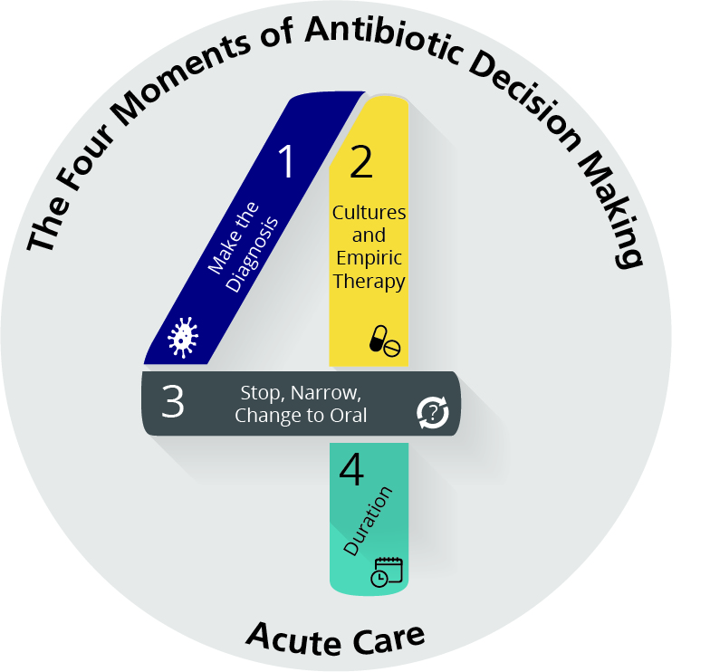
The Four Moments of Antibiotic Decision Making
Does my patient have an infection that requires antibiotics?
Have I ordered appropriate cultures before starting antibiotics? What empiric therapy should I initiate?
A day or more has passed. Can I stop antibiotics? Can I narrow therapy or change from IV to oral therapy?
What duration of antibiotic therapy is needed for my patient's diagnosis?

Slide 5
The Four Moments of Antibiotic Decision Making
Does my patient have an infection that requires antibiotics?

Slide 6
Moment 1: Diagnosis of Diverticulitis¹
Inflammation of one or more diverticula
Mild inflammation to colonic perforation and sepsis
~5% of patients with diverticulosis will develop diverticulitis
Most patients with diverticulitis are > 60 years of age
Presentation
Abdominal pain (~90%)
Most common left lower quadrant but can be in the right lower quadrant
Low-grade fever (~90%)
Mass may be palpated in the abdomen (20%)
Leukocytosis
History of constipation or prior episodes of similar abdominal pain
CT of abdomen sensitive and specific²
Detects abscess, phlegmon, perforation, microperforation, fistula

Slide 7
The Four Moments of Antibiotic Decision Making
Does my patient have an infection that requires antibiotics?
Have I ordered appropriate cultures before starting antibiotics? What empiric therapy should I initiate?

Slide 8
Moment 2: Microbiologic Diagnosis and Empiric Therapy
Microbiologic data available if abscess present and drained
Blood cultures low yield unless sepsis present
Common organisms: E. coli, K. pneumoniae, B. fragilis
Empiric therapy depends on severity of illness and degree of complication, options include:^{2–5}
IV fluids and pain control
Uncomplicated: no antibiotics; oral amoxicillin/clavulanic acid or oral cephalosporin PLUS metronidazole; cefazolin or cefuroxime IV or ceftriaxone all PLUS metronidazole; ampicillin/sulbactam
Complicated (associated with abscess, fistula, obstruction, perforation):
IV options above based on local E. coli susceptibility data
Complicated with associated sepsis:
Piperacillin/tazobactam; cefepime PLUS metronidazole
Severe PCN allergy: moxifloxacin; ciprofloxacin or levofloxacin or aztreonam all PLUS metronidazole

Slide 9
Moment 2: Are Antibiotics Needed for Uncomplicated Diverticulitis?
Multicenter RCT of antibiotics vs. no antibiotics for CT-verified acute left-sided uncomplicated diverticulitis (n = 623)⁶
Antibiotics given for at least 7 days and included:
Cephalosporin/metronidazole, carbapenem, piperacillin/tazobactam
Ciprofloxacin step down
Baseline characteristics balanced between both arms
On presentation, 97% with abdominal pain, 90% with fever, mean WBC 12.5 cells/mL
Chabok A, Påhlman L, Hjern F, et al. Randomized clinical trial of antibiotics in acute uncomplicated diverticulitis. Br J Surg. 2012 Apr;99(4):532-9. Used with permission.
Complications (perforation, abscess formation) in 2% who did not and 1% who did receive antibiotics

Slide 10
Moment 2: When To Call the Surgeon^{2,3}
Acute surgical intervention for perforation, peritonitis, obstruction, failure of medical therapy
Percutaneous drain for abscess ≥ 5 cm (if can be reached) with subsequent elective surgery
If abscess is small (3–4 cm), medical management
If abscess is large and not reachable, surgery
Fistula/stricture: elective or semi-elective surgery

Slide 11
Moment 2: Source Control
Source control:⁷
“Mechanical process that contains, restricts and eradicates from the peritoneal cavity microbial pathogens, inflammatory exudates and necrotic tissue that drive the systemic septic response”
Essential to control most intra-abdominal infections
Cannot be obtained by antibiotics alone

Slide 12
The Four Moments of Antibiotic Decision Making
Does my patient have an infection that requires antibiotics?
Have I ordered appropriate cultures before starting antibiotics? What empiric therapy should I initiate?
A day or more has passed. Can I stop antibiotics? Can I narrow therapy or change from IV to oral therapy?

Slide 13
Moment 3: Narrowing and Converting to Oral Therapy
Narrow therapy based on available culture data if available
If no culture data, switch to oral therapy when the patient has clinical improvement
Patients undergoing medical management should show improvement by 48 hours
Oral regimens include:
Oral cephalosporin PLUS metronidazole
Trimethoprim/ sulfamethoxazole PLUS metronidazole
Amoxicillin/clavulanate
Moxifloxacin
Ciprofloxacin or levofloxacin PLUS metronidazole

Slide 14
The Four Moments of Antibiotic Decision Making
Does my patient have an infection that requires antibiotics?
Have I ordered appropriate cultures before starting antibiotics? What empiric therapy should I initiate?
A day or more has passed. Can I stop antibiotics? Can I narrow therapy or change from IV to oral therapy?
What duration of antibiotic therapy is needed for my patient's diagnosis?

Slide 15
Moment 4: Duration of Therapy
Uncomplicated: 0-4 days
RCT in which patients were randomized at day 4 to stop therapy or continue for 3 more days showed 94% vs 96% cure at one month⁸
Complicated:^{5,9}
Medical management: suggest 5–10 days based on clinical response and re-imaging
Surgical management or drainage: 4 days after source control

Slide 16
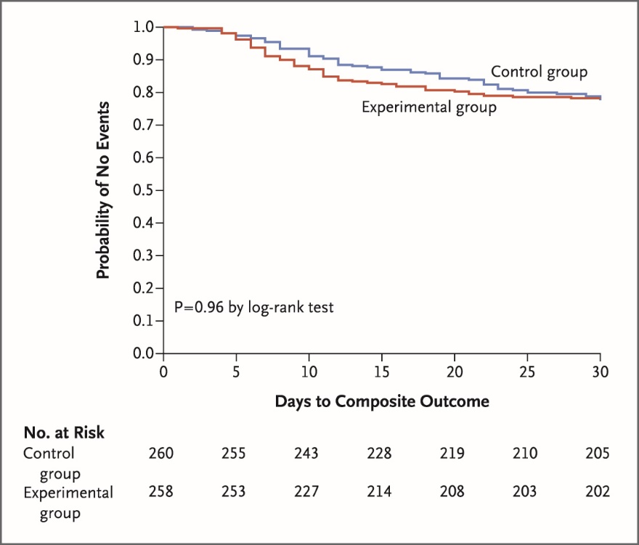
Moment 4: Duration of Therapy
STOP-IT trial: 518 patients with intra-abdominal infection randomized to receive either 4 days or up to 10 days (median was 8) of antibiotic therapy after source control¹⁰
Primary outcome: surgical site infection (SSI), recurrent intra-abdominal process and/or death
22% vs. 22%
Time to diagnosis of SSI:
9 vs. 15 days
Time to diagnosis of recurrent intra-abdominal process:
11 vs. 15 days
From N Eng J Med, Sawyer RG, Claridge JA, Nathens AB, et al. Trial of short-course antimicrobial therapy for intraabdominal infection. 372:1996-2005.©2015 Massachusetts Medical Society. Reprinted with permission from Massachusetts Medical Society.

Slide 17
Biliary Tract Infection
Biliary infections
Acute cholangitis
Acute cholecystitis

Slide 18
The Four Moments of Antibiotic Decision Making
Does my patient have an infection that requires antibiotics?
Have I ordered appropriate cultures before starting antibiotics? What empiric therapy should I initiate?
A day or more has passed. Can I stop antibiotics? Can I narrow therapy or change from IV to oral therapy?
What duration of antibiotic therapy is needed for my patient's diagnosis?

Slide 19
The Four Moments of Antibiotic Decision Making
Does my patient have an infection that requires antibiotics?

Slide 20
Moment 1: Diagnosis of Acute Cholangitis
Acute cholangitis
Inflammation and infection of the bile ducts resulting from obstruction
Increased intra-ductal pressure often leads to translocation of bacteria into bloodstream
Clinical presentation
Right upper quadrant pain (80% of patients)*
Fever (80% of patients)*
Jaundice (60% of patients)*
Hypotension
Altered mental status
Nausea and vomiting
If no signs of acute infection, the presence of jaundice and/or nonobstructing stones are not indications for antibiotics
*Charcot’s triad (present in 50–75%)

Slide 21
Moment 1: Diagnosis of Acute Cholecystitis
Acute cholecystitis
Inflammation of the gallbladder usually associated with gallstones
Right upper quadrant (RUQ) pain
Fever
Nausea and vomiting
Distinguish from biliary colic, which presents with intermittent RUQ pain and no fever and does not require antibiotic therapy

Slide 22
Moment 1: Diagnosis of Biliary Tract Infection
Imaging
Acute cholangitis: ultrasound, magnetic resonance cholangiopancreatography (MRCP), endoscopic retrograde cholangiopancreatography (ERCP), endoscopic ultrasound
Acute cholecystitis: ultrasound, hepatobiliary iminodiacetic acid (HIDA) scan

Slide 23
The Four Moments of Antibiotic Decision Making
Does my patient have an infection that requires antibiotics?
Have I ordered appropriate cultures before starting antibiotics? What empiric therapy should I initiate?

Slide 24
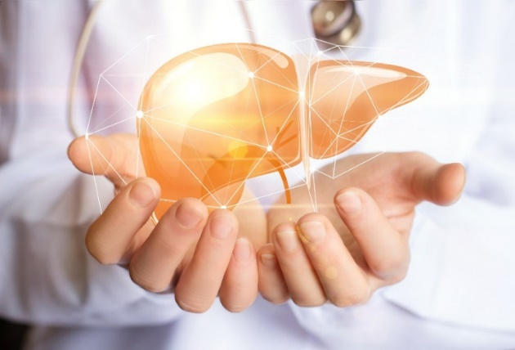
Moment 2: Microbiologic Diagnosis
Acute cholangitis
Blood cultures often grow (~50%) and should be obtained
Cultures of bile during ERCP
For patients with prior procedures, use previous culture data to guide therapy
Acute cholecystitis
Lower yield for blood cultures
Common organisms¹¹
E. coli, K. pneumoniae, Enterococcus spp.
Anaerobes should not be in the biliary tract unless there has been previous disruption
Other Enterobacteriaceae, particularly Enterobacter spp. and Pseudomonas spp. in patients with hospital-acquired infections or multiple prior procedures

Slide 25
Moment 2: Empiric Therapy
Empiric therapy depends on severity of illness and degree of complication^{4,5}
Community-acquired and uncomplicated:
Cefazolin, cefuroxime, or ceftriaxone
Associated sepsis, hospital-acquired, or multiple prior biliary procedures:
Piperacillin/tazobactam, cefepime plus metronidazole
Severe penicillin allergy:
Community-acquired and uncomplicated:
Moxifloxacin
Ciprofloxacin or levofloxacin (plus metronidazole)
Associated sepsis, hospital-acquired, or multiple prior biliary procedures:
Aztreonam (plus metronidazole and vancomycin)

Slide 26
The Four Moments of Antibiotic Decision Making
Does my patient have an infection that requires antibiotics?
Have I ordered appropriate cultures before starting antibiotics? What empiric therapy should I initiate?
A day or more has passed. Can I stop antibiotics? Can I narrow therapy or change from IV to oral therapy?

Slide 27
Moment 3: Narrowing and Converting to Oral Therapy
Remember:
Source control is critical
Drainage of the biliary tree by removing stone and/or stent placement
Cholecystectomy or percutaneous drainage
Narrow therapy based on available culture data if possible
Switch to oral therapy when the patient has clinical improvement
Oral regimens include:
Oral cephalosporin (plus metronidazole)
Trimethoprim/sulfamethoxazole (plus metronidazole)
Amoxicillin/clavulanate
Moxifloxacin
Ciprofloxacin or levofloxacin (plus metronidazole)

Slide 28
The Four Moments of Antibiotic Decision Making
Does my patient have an infection that requires antibiotics?
Have I ordered appropriate cultures before starting antibiotics? What empiric therapy should I initiate?
A day or more has passed. Can I stop antibiotics? Can I narrow therapy or change from IV to oral therapy?
What duration of antibiotic therapy is needed for my patient's diagnosis?

Slide 29
Moment 4: Duration of Therapy
Acute cholangitis
Biliary drainage achieved and patient improving (e.g., afebrile):
3 days of antibiotics after ERCP^{12,13}
Concomitant bacteremia: 7 days with an agent that has good oral bioavailability^{14,15}
Longer courses may be needed if there is poor clinical response
If additional procedures are needed, the patient should receive pre-procedure antibiotics

Slide 30
Moment 4: Duration of Therapy
Acute cholecystitis
Medical management
Suggest 5-10 days based on clinical response^{5,9}
Surgical management and uncomplicated
No antibiotics after surgery
RCT demonstrated similar proportion of post-op infections in patients who did and did not receive post-op antibiotics (15% vs 17%)¹⁶
Surgical management and complicated disease
(e.g., perforation, fistula):
4 days after source control⁷

Slide 31
Moment 4: Short-Course Therapy for GN Bacteremia
Three-center retrospective cohort study of patients with monomicrobial Enterobacteriaceae bacteremia¹⁴
Prolonged course 11–16 days
Median 15 days
Short course 6–10 days
Median 8 days
Propensity score matching resulted in 385 well- balanced matched pairs
No difference in mortality
Trend towards less emergence of MDR Gram-negative bacteria in the short course group (OR 0.59, p = 0.09)

Slide 32
Improving Prescribing for Intra-Abdominal Infections at Your Hospital
Use newer data to guide shorter treatment courses in patients with source control
Recognize that many of these studies involved surgical patients and were performed by surgeons
Develop approaches to integrate shorter antibiotic courses into practice
Order sets with preset antibiotic durations
Evaluation of need for oral antibiotics at discharge
Recognize the challenges of management of patients with incomplete source control
Multidisciplinary approach needed

Slide 33
Take-Home Messages
Uncomplicated diverticulitis can be managed with either a short course of antibiotics or no antibiotics
Complicated diverticulitis requires a source control procedure in most cases
Antibiotics for 4 days after source control
Acute cholangitis requires timely antibiotic administration after blood cultures are obtained and source control followed by a short course of antibiotics
Avoid prolonged antibiotic courses when treating acute cholecystitis medically
No need for antibiotics after a cholecystectomy unless complicated—then 4 days after source control

Slide 34
Disclaimer
The findings and recommendations in this presentation are those of the authors, who are responsible for its content, and do not necessarily represent the views of AHRQ. No statement in this presentation should be construed as an official position of AHRQ or of the U.S. Department of Health and Human Services.
Any practice described in this presentation must be applied by health care practitioners in accordance with professional judgment and standards of care in regard to the unique circumstances that may apply in each situation they encounter. These practices are offered as helpful options for consideration by health care practitioners, not as guidelines.

Slide 35
References
Etzioni DA, Mack TM, Beart RW Jr, et al. Diverticulitis in the United States: 1998-2005: changing patterns of disease and treatment. Ann Surg. 2009 Feb;249(2):210-7. PMID: 19212172.
Stollman N, Smalley W, Hirano I, et al. American Gastroenterological Association Institute Guideline on the management of acute diverticulitis. Gastroenterology. 2015 Dec;149(7):1944-9. PMID: 26453777.
Feingold D, Steele SR, Lee S, et al. Practice parameters for the treatment of sigmoid diverticulitis. Dis Colon Rectum. 2014 Mar;57(3):284-94. PMID: 24509449.
Marcus G, Levy S, Salhab G, et al. Intra-abdominal infections: the role of anaerobes, enterococci, fungi, and multidrug-resistant organisms. Open Forum Infect Dis. 2016 Dec 20;3(4):ofw232. PMID: 28018930.
Solomkin JS, Mazuski JE, Bradley JS, et al. Diagnosis and management of complicated intra-abdominal infection in adults and children: guidelines by the Surgical infection Society and the Infectious Diseases Society of America. Clin Infect Dis. 2010 Jan 15;50(2):133-64. PMID:20034345.

Slide 36
References
Chabok A, Påhlman L, Hjern F, et al. Randomized clinical trial of antibiotics in acute uncomplicated diverticulitis. Br J Surg. 2012 Apr;99(4):532-9. PMID: 22290281.
Bohnen JM, Marshall JC, Fry DE, et al. Clinical and scientific importance of source control in abdominal infections: summary of a symposium. Can J Surg. 1999 Apr;42(2):122-6. PMID: 10223073.
Schug-Pass C, Geers P, Hügel O, et al. Prospective randomized trial comparing short-term antibiotic therapy versus standard therapy for acute uncomplicated sigmoid diverticulitis. Int J Colorectal Dis. 2010 Jun;25(6):751-9. PMID: 20140619.
Mazuski JE, Tessier JM, May AK, et al. The Surgical Infection Society revised guidelines on the management of intra-abdominal infection. Surg Infect (Larchmt). 2017 Jan;18(1):1-76. PMID: 28085573.
Sawyer RG, Claridge JA, Nathens AB, et al. Trial of short-course antimicrobial therapy for intraabdominal infection. N Engl J Med. 2015 May 21;372(21):1996-2005. PMID: 25992746.
Weber A, Schneider J, Wagenpfeil S, et al. Spectrum of pathogens in acute cholangitis in patients with and without biliary endoprosthesis. J Infect. 2013 Aug;67(2):111-21. PMID: 23603487.

Slide 37
References
van Lent AU, Bartelsman JF, Tytgat GN, et al. Duration of antibiotic therapy for cholangitis after successful endoscopic drainage of the biliary tract. Gastrointest Endosc. 2002 Apr;55(4):518-22. PMID: 11923764.
Kogure H, Tsujino T, Yamamoto K, et al. Fever-based antibiotic therapy for acute cholangitis following successful endoscopic biliary drainage. J Gastroenterol. 2011 Dec;46(12):1411-7. PMID: 21842232.
Chotiprasitsakul D, Han JH, Cosgrove SE, et al. Comparing the outcomes of adults with Enterobacteriaceae bacteremia receiving short-course versus prolonged-course antibiotic therapy in a multicenter, propensity score-matched cohort. Clin Infect Dis. 2017 Oct. PMID: 29190320.
Yahav D, Franceschini E, Koppel F, et al. Seven versus fourteen days of antibiotic therapy for uncomplicated gram-negative bacteremia: a non-inferiority randomized controlled trial. Clin Infect Dis. 2018 Dec. [Epub ahead of print]. PMID: 30535100. ​
Regimbeau JM, Fuks D, Pautrat K, et al. Effect of postoperative antibiotic administration on postoperative infection following cholecystectomy for acute calculous cholecystitis: a randomized clinical trial. JAMA. 2014 Jul;312(2):145-54. PMID: 25005651.

