Slide 1
Best Practices in the Diagnosis and Treatment of Community-Associated Lower Respiratory Tract Conditions
AHRQ Safety Program for Improving
Antibiotic Use
Acute Care
AHRQ Pub. No. 17(20)-0028-EF
November 2019

Slide 2
Objectives
Discuss the approach to diagnosing community-acquired pneumonia (CAP), chronic obstructive pulmonary disease (COPD) exacerbations, and aspiration events.
Discuss empiric treatment recommendations for CAP, COPD exacerbations, and aspiration pneumonia.
Discuss opportunities for de-escalation of antibiotic therapy for CAP after additional clinical data are available.
Discuss reasonable durations of antibiotic therapy for CAP after additional clinical data are available.

Slide 3
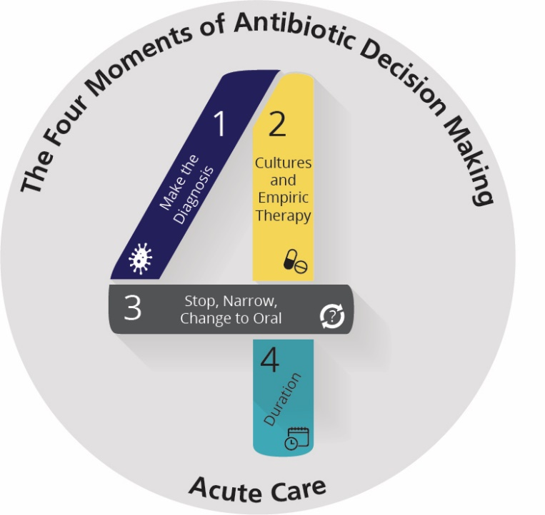
The Four Moments of Antibiotic Decision Making
Does my patient have an infection that requires antibiotics?
Have I ordered appropriate cultures before starting antibiotics? What empiric therapy should I initiate?
A day or more has passed. Can I stop antibiotics? Can I narrow therapy or change from IV to oral therapy?
What duration of antibiotic therapy is needed for my patient's diagnosis?

Slide 4
The Four Moments of Antibiotic Decision Making
Does my patient have an infection that requires antibiotics?

Slide 5
Moment 1: Diagnosing CAP
Common signs and symptoms:¹
Cough and/or sputum production (90%)
Fever (>90%)
Less common in older patients
Chills (50%)
Tachypnea (45%)
Pleuritic chest pain (30%)
Crackles during chest auscultation

Slide 6
Moment 1: Diagnosing CAP
If common signs and symptoms are present, obtain chest x ray
No infiltrates – indicates pneumonia not present
Presence of infiltrate without respiratory symptoms is unlikely to be CAP

Slide 7
The Four Moments of Antibiotic Decision Making
Does my patient have an infection that requires antibiotics?
Have I ordered appropriate cultures before starting antibiotics? What empiric therapy should I initiate?

Slide 8
Moment 2: Diagnostic Tests¹
Test | Notes
Blood cultures | Recommended for patients who are moderately to severely ill or with chest imaging findings of an abscess or parapneumonic effusion
Sputum Gram stain and culture | Recommended for making the diagnosis of CAP
Respiratory viral panel | Provides an alternate explanation for the presentation
Streptococcus pneumoniae urinary antigen | Recommended, if available, to assist with narrowing antibiotic therapy
Legionella urinary antigen | Consider for patients with moderate to severe illness, smokers, or patients over 50 years of age Only detects L. pneumophilia serogroup 1 (70–80% of Legionella infections)
Bronchoscopy | Severely ill or immunocompromised patient not responding to therapy and no clear etiology

Slide 9
Moment 2: Empiric Therapy¹
Therapy | Notes
Ampicillin-sulbactam PLUS azithromycin (or doxycycline) | For children, otherwise healthy adults, or those with mild disease, consider ampicillin instead of ampicillin/sulbactam Azithromycin has been associated with prolonged QTc intervals Observational studies have suggested that doxycycline may be protective against the development of Clostridioides difficile infection (CDI)
Ceftriaxone PLUS azithromycin (or doxycycline) | Ceftriaxone is associated with development of CDI Can be used in nonsevere penicillin (PCN) allergy
Respiratory fluoroquinolone (levofloxacin or moxifloxacin) | Strongly associated with development of CDI Associated with prolonged QTc intervals, tendinopathies and altered mental status especially in the elderly Consider for severe PCN allergy

Slide 10
Moment 2: Empiric Therapy¹
Therapy | Notes
Anti-MRSA therapy ± Ceftriaxone | In patients with recent respiratory viral infections presenting with bacterial pneumonia, consider coverage for Staphylococcus aureus, including MRSA, in addition to standard CAP antibiotics
Anti-pseudomonal therapy (e.g., cefepime PLUS azithromycin) | Risk factors include: bronchiectasis, recent broad-spectrum antibiotic use or prolonged hospitalization, admitted from or residing in a skilled nursing facility or nursing home within the past 3 months, immunocompromised

Slide 11
The Four Moments of Antibiotic Decision Making
Does my patient have an infection that requires antibiotics?
Have I ordered appropriate cultures before starting antibiotics? What empiric therapy should I initiate?
A day or more has passed. Can I stop antibiotics? Can I narrow therapy or change from IV to oral therapy?

Slide 12
Moment 3: Antibiotic Selection
Convert your patient to oral antibiotics as soon as clinical improvement is observed and the patient is able to tolerate oral therapy.
When can I narrow to amoxicillin?
If the sputum culture grows an amoxicillin or ampicillin-susceptible organism
If the streptococcal urinary antigen test is positive and the proportion of S. pneumoniae isolates in your hospital that are penicillin resistant is low
3 days of azithromycin is sufficient given its long half life

Slide 13
Moment 3: If NO Results Are Positive….
Consider:
Amoxicillin-clavulanate
Oral second- or third-generation cephalosporins
Respiratory fluoroquinolones

Slide 14
The Four Moments of Antibiotic Decision Making
Does my patient have an infection that requires antibiotics?
Have I ordered appropriate cultures before starting antibiotics? What empiric therapy should I initiate?
A day or more has passed. Can I stop antibiotics? Can I narrow therapy or change from IV to oral therapy?
What duration of antibiotic therapy is needed for my patient's diagnosis?

Slide 15
Moment 4: Duration of Therapy
5 days of antibiotic therapy is sufficient for most patients with CAP
Consider prolonging therapy to at least 7 days if—
The patient is immunocompromised
The patient has underlying structural lung disease (not including asthma)
The patient did not have an adequate clinical response to therapy within 72 hours
If the patient has a nontraditional CAP pathogen such as Legionella, Pseudomonas aeruginosa, or S. aureus, longer durations of therapy are usually required, particularly if there is associated bacteremia
A lingering cough and chest x-ray abnormalities may take several weeks to improve

Slide 16
5 Days of Antibiotics Is Sufficient for CAP
At least five randomized-controlled trials (RCTs) have shown that antibiotic treatment for 5 days is as safe and effective as longer treatment courses²⁻⁸
One RCT even showed therapy as short as 3 days was sufficient
Data from bronchoscopy samples demonstrate 95% of patients with bacterial pneumonia eradicate pathogen after 3 days of therapy
Two meta-analyses have also shown short courses of antibiotic therapy are effective for the treatment of CAP^{9,10}
22 RCTs with > 8,000 patients

Slide 17
COPD Exacerbations
EXACERBATIONS

Slide 18
The Four Moments of Antibiotic Decision Making
Does my patient have an infection that requires antibiotics?

Slide 19
Moment 1: Distinguishing a COPD Exacerbation From CAP
Distinguishing COPD and CAP in a patient with a known history of COPD can be challenging.
If a chest x ray does not show evidence of a new infiltrate, he/she is more likely to have a COPD exacerbation.
Although not all patients with a COPD exacerbation need antibiotics, patients requiring hospitalization for COPD are likely to have a moderate to severe COPD exacerbation for which antibiotic therapy is recommended.
Antibiotics do not improve outcomes in patients with asthma exacerbations and should not be given unless there is also evidence of concomitant CAP.

Slide 20
The Four Moments of Antibiotic Decision Making
Does my patient have an infection that requires antibiotics?
Have I ordered appropriate cultures before starting antibiotics? What empiric therapy should I initiate?
A day or more has passed. Can I stop antibiotics? Can I narrow therapy or change from IV to oral therapy?
What duration of antibiotic therapy is needed for my patient's diagnosis?

Slide 21
Moments 2–4: Management of COPD Exacerbations
Common bacteria associated with COPD exacerbations include H. influenzae and S. pneumoniae
Sputum Gram stain and culture are not needed in many cases of COPD exacerbation, but can be considered for patients with extensive prior antibiotic exposure or a severe COPD exacerbation
Most patients can be treated with 3 days of azithromycin^{11,12}
If a patient is already taking azithromycin, consider doxycycline, amoxicillin/clavulanate, or cefuroxime for a 5-day course^{11,12}
Avoid use of fluoroquinolones unless prior or current microbiology indicates infection with organisms resistant to standard therapy

Slide 22
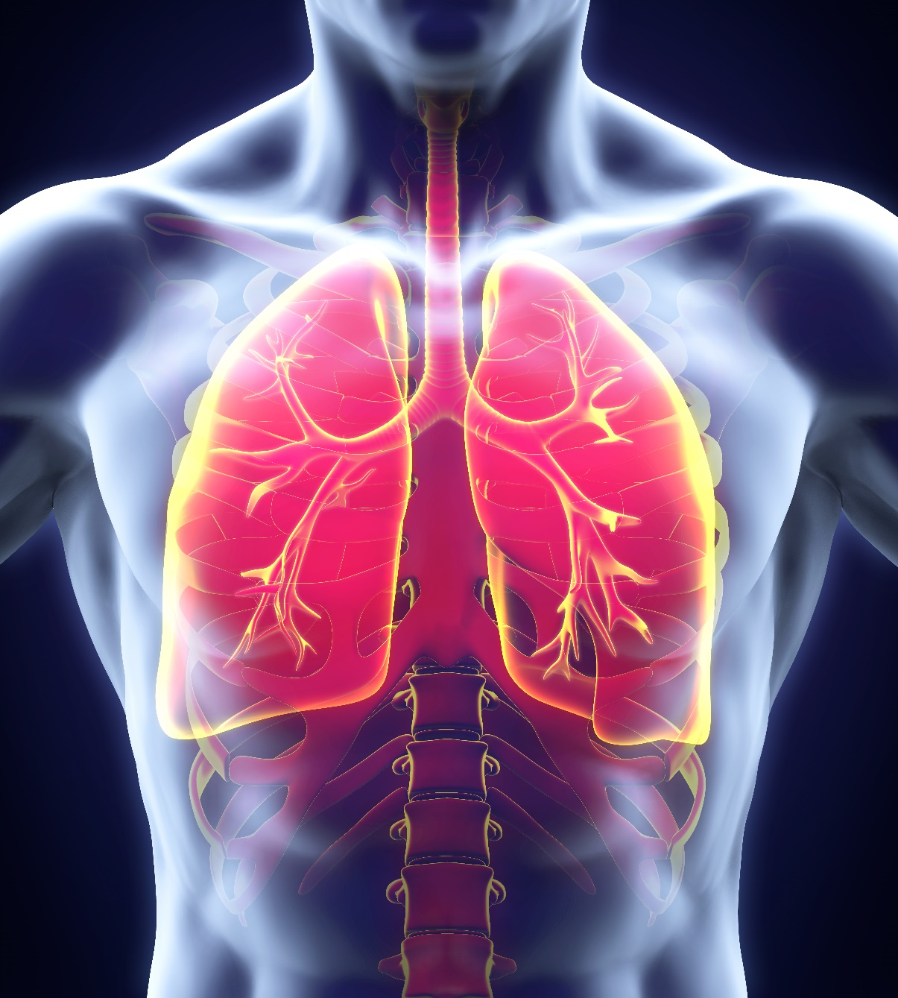
Aspiration Events and Aspiration Pneumonia

Slide 23
The Four Moments of Antibiotic Decision Making
Does my patient have an infection that requires antibiotics?

Slide 24
Moment 1: Aspiration Event
Pneumonitis is an abrupt chemical injury caused by inhalation of sterile gastric contents¹³⁻¹⁵
Progresses quickly to respiratory failure followed by rapid improvement ≤48 hours of the event
Chest x rays can look very concerning
Supportive care is the mainstay of therapy
Prophylactic antibiotics have NOT been shown to be helpful in preventing pneumonia

Slide 25
Moment 1: Distinguishing Aspiration Event From Aspiration Pneumonia
Aspiration pneumonia
Generally occurs 48 hours after the aspiration event
A portion of patients with aspiration events (20–25%) develop bacterial pneumonia the ensuing 2 to 7 days
Becomes apparent because of new fevers and a worsening respiratory status after initial clinical improvement

Slide 26
Observational Data
Evaluation of 50 patients observed by a physician to aspirate gastric contents¹⁴
Initial symptoms
Fever (94%), tachypnea (78%), diffuse rales (72%), cyanosis (32%), cough (36%), wheezing (32%), apnea (30%), shock (24%)
Chest x rays revealed diffuse or localized infiltrates which progressed over next 24 hours
13 (26%) progressed to bacterial pneumonia
Treatment with antibiotics at time of the aspiration event did not appear to impact clinical outcomes

Slide 27
Antibiotics and Aspiration Pneumonitis
Observational study evaluating 200 patients with aspiration pneumonitis¹⁵
76 (38%) received prophylactic antibiotics
124 (62%) received supportive care only
Baseline characteristics were similar between groups
After adjustment for patient-level predictors of mortality:
In hospital mortality similar between both groups (25% vs. 25%)
Transfer to ICU similar between both groups (5% vs. 6%)

Slide 28
The Four Moments of Antibiotic Decision Making
Does my patient have an infection that requires antibiotics?
Have I ordered appropriate cultures before starting antibiotics? What empiric therapy should I initiate?

Slide 29
Moment 2: To Culture or Not To Culture?
Patients with aspiration events are usually unlikely to produce significant sputum, making the utility of sputum cultures low.
Sputum Gram stain and culture should be considered when the diagnosis is unclear or purulent sputum is being produced.

Slide 30
Moment 2: Empiric Therapy for Aspiration Events
Antibiotics are not indicated for most aspiration events.
It is reasonable to consider antibiotics for hemodynamically unstable patients, but frequent reevaluation of the continued need for antibiotics is necessary.
Treat as community-acquired pneumonia if the event occurred within 72 hours of admission to a healthcare facility.
Treat as healthcare-associated pneumonia if the event occurred after 72 hours of admission to a healthcare facility.
Not necessary to add additional anaerobic coverage.

Slide 31
The Four Moments of Antibiotic Decision Making
Does my patient have an infection that requires antibiotics?
Have I ordered appropriate cultures before starting antibiotics? What empiric therapy should I initiate?
A day or more has passed. Can I stop antibiotics? Can I narrow therapy or change from IV to oral therapy?

Slide 32
Moment 3: Adjusting Therapy for Aspiration Events/Pneumonia
For patients initially started on antibiotics early with a favorable clinical response:
Rapid improvement in clinical status is anticipated within 48 hours of the aspiration event.
If rapid improvement occurs, antibiotics can be discontinued.
For patients not initially started on antibiotics without improvement within 48 hours:
Treat as community-acquired pneumonia if the event occurred within 72 hours of admission to a health care facility.
Treat as healthcare-associated pneumonia if the event occurred after 72 hours of admission to a health care facility.
Not necessary to add additional anaerobic coverage.

Slide 33
The Four Moments of Antibiotic Decision Making
Does my patient have an infection that requires antibiotics?
Have I ordered appropriate cultures before starting antibiotics? What empiric therapy should I initiate?
A day or more has passed. Can I stop antibiotics? Can I narrow therapy or change from IV to oral therapy?
What duration of antibiotic therapy is needed for my patient's diagnosis?

Slide 34
Moment 4: Duration of Therapy for Aspiration Pneumonia
Based on clinical response and organisms isolated
Most patients: 5–7 days

Slide 35
Take-Home Points
CAP
Before prescribing antibiotics for patients with signs and symptoms suggestive of CAP, obtain chest x ray and sputum Gram stain with culture.
Oral step-down therapy recommended after improvement observed.
Most patients can be treated for a 5-day course.
COPD Exacerbations
3 days of azithromycin are generally sufficient if antibiotics indicated.
Fluoroquinolones are not necessary for most patients.
Aspiration Pneumonitis
For hemodynamically stable patients, antibiotics are not needed and supportive care is the mainstay of therapy.
Prophylactic antibiotics have not been shown to be helpful in improving outcomes.

Slide 36
Disclaimer
The findings and recommendations in this presentation are those of the authors, who are responsible for its content, and do not necessarily represent the views of AHRQ. No statement in this presentation should be construed as an official position of AHRQ or of the U.S. Department of Health and Human Services.
Any practice described in this presentation must be applied by health care practitioners in accordance with professional judgment and standards of care in regard to the unique circumstances that may apply in each situation they encounter. These practices are offered as helpful options for consideration by health care practitioners, not as guidelines.

Slide 37
References
Metlay JP, Waterer GW, Long AC, et al. Diagnosis and treatment of adults with community-acquired pneumonia. An official clinical practice guideline of the American Thoracic Society and Infectious Diseases Society of America. Am J Respir Crit Care Med. 2019 Oct 1;200(7):e45-e67. PMID: 31573350.
Dunbar LM, Khasab MM, Kahn JB, et al. Efficacy of 750-mg, 5-day levofloxacin in the treatment of community-acquired pneumonia caused by atypical pathogens. Curr Med Res Opin. 2004 Apr;20(4):555-63. PMID: 15119993.
Dunbar LM, Wunderink RG, Habib MP, et al. High-dose, short-course levofloxacin for community-acquired pneumonia: a new treatment paradigm. Clin Infect Dis. 2003 Sep 15;37(6):752-60. PMID: 12955634.
File TM Jr, Mandell LA, Tillotson G, et al. Gemifloxacin once daily for 5 days versus 7 days for the treatment of community-acquired pneumonia: a randomized, multicenter, double-blind study. J Antimicrob Chemother. 2007 Jul;60(1):112-20. PMID: 17537866.

Slide 38
References
Léophonte P, Zuck P, Perronne C, et al. Routine use of extended-release clarithromycin tablets for short-course treatment of acute exacerbations of non-severe COPD. Med Mal Infect. 2008 Sep;38(9):471-6. PMID: 18722065.
el Moussaoui R, de Borgie CA, van den Broek P, et al. Effectiveness of discontinuing antibiotic treatment after three days versus eight days in mild to moderate-severe community acquired pneumonia: randomized, double blind study. BMJ. 2006 Jun 10;332(7554):1355. PMID: 16763247.
Montravers P, Fagon JY, Chasstre J, et al. Follow-up protected specimen brushes to assess treatment in nosocomial pneumonia. Am Rev Respir Dis. 1993 Jan;147(1):38-44. PMID: 8420428.

Slide 39
References
Uranga A, España PP, Bilbao A, et al. Duration of antibiotic treatment in community-acquired pneumonia: a multicenter randomized clinical trial. JAMA Intern Med. 2016 Sep 1;176(9):1257-65. PMID: 27455166.
Li JZ, Winston LG, Moore DH, et al. Efficacy of short-course antibiotic regimens for community-acquired pneumonia: a meta-analysis. Am J Med. 2007 Sep;120(9):783-90. PMID: 17765048.
Dimopoulos G, Matthaiou DK, Karageorgopoulos DE, et al. Short-versus long-course antibacterial therapy for community-acquired pneumonia: a meta-analysis. Drugs. 2008;68(13):1841-54. PMID: 18729535.
Bach PB, Brown C, Gelfand SE, et al. Management of acute exacerbations of chronic obstructive pulmonary disease: a summary and appraisal of published evidence. Ann Intern Med. 2001 Apr 3;134(7):600-20. PMID: 11281745.

Slide 40
References
El Moussaoui R, Roede BM, Speelman P, et al. Short-course antibiotic treatment in acute exacerbations of chronic bronchitis and COPD: a meta-analysis of double-blind studies. Thorax. 2008 May;63(5):415-22. PMID: 18234905.
Murray HW. Antimicrobial therapy in pulmonary aspiration. Am J Med. 1979 Feb;66(2):188-90. PMID: 425963.
Bynum LJ, Pierce AK. Pulmonary aspiration of gastric contents. Am Rev Respir Dis. 1976 Dec;114(6):1129-36. PMID: 1008348.
Dragan V, Wei Y, Elligsen M, et al. Prophylactic antimicrobial therapy for acute aspiration pneumonitis. Clin Infect Dis. 2018 Aug 1;67(4):513-8. PMID 29438467.

