Slide 1
Antibiotic Stewardship Program Development: Part 1
AHRQ Safety Program for Improving
Antibiotic Use
Acute Care
AHRQ Pub. No. 17(20)-0028-EF
November 2019

Slide 2
Objectives
By the end of this presentation, participants will be able to—
Understand the key personnel involved in developing an Antibiotic Stewardship Program (ASP)
Understand how to work with a senior executive to further program goals
Understand the importance of and approaches to developing guidelines

Slide 3
Key Personnel and Essential Relationships

Slide 4
Essential Team Members
Member | Role | Qualification
Physician | Physician leadership critical as most interactions are with medical staff Determining program goals Settling differences of opinion between other ASP members and prescribers Bridge to executive leadership | Ideally trained in infectious diseases Interest in antibiotic use and patient safety Diplomatic and collegial
Pharmacist | Interventions Determining program goals Coordination of data needs Bridge to department of pharmacy | Same as for physician Comfortable advising physicians and other providers

Slide 5
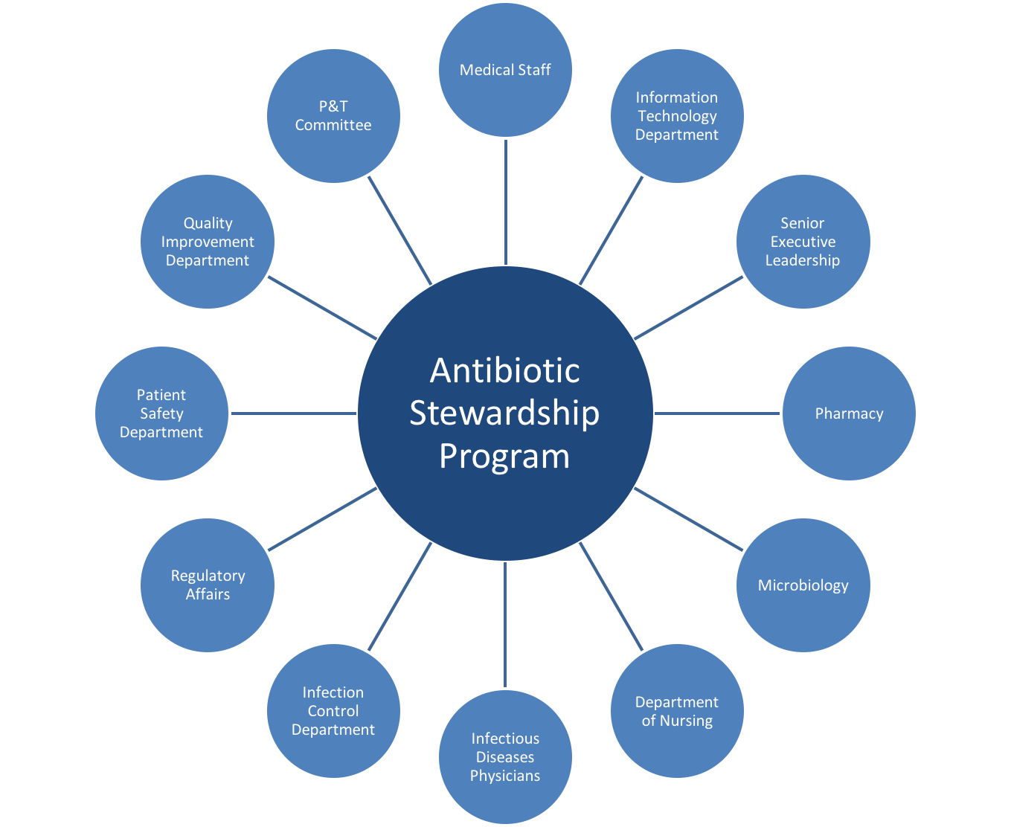
Groups and Departments
Notes:
17

Slide 6
Essential Partners: the Senior Executive
Member | Role
Senior executive | Assists ASP with aligning program’s goals with the organization’s strategic goals Identifies financial resources for the ASP and its activities Connects ASP to stakeholders across the institution Ensures the ASP leadership is included in high-level meetings Assists with reducing barriers to progress “Outlier” clinician prescribing practices Demonstrates to The Joint Commission that senior leadership supports ASP efforts

Slide 7
Engaging Senior Executives
Invite an executive to join the hospital antibiotic stewardship (AS) committee.
Invite executives to periodically attend unit meetings where antibiotic prescribing issues are discussed.
Provide the executive regular summaries of the ASP’s work.
Schedule a standing meeting between the ASP and the executive.
Show appreciation for resources provided.

Slide 8
Essential Partners: Pharmacy and P&T
Member | Role
Department of Pharmacy | Enforces prescribing policies Generates data on antibiotic use Identifies prescribing trends Assists with some AS interventions (non-stewardship pharmacists) IV to oral conversion protocols Therapeutic antibiotic monitoring protocols
Pharmacy and Therapeutics (P&T) Committee | Decisions regarding formulary and restriction status of antibiotics Endorsement of guidelines and restriction policies Some AS programs/committees report to P&T

Slide 9
Essential Partners: Medical and ID Staff
Member | Role
Medical Staff | Source of clinical champions Collaborators in development of guidelines and policies Management of outlier prescribers
Other Infectious Diseases Physicians | Collaborators in development of guidelines and policies Endorse guidelines in their practice Perform consults for patients with complicated infectious disease problems or for patients receiving certain antibiotics Their buy-in is important to prevent them from undermining the ASP

Slide 10
Essential Partners: IT and Microbiology
Member | Role
Information Technology (IT) | Assist with collating antibiotic, microbiology, and clinical data to facilitate identification of cases for intervention Provide antibiotic use data for the institution and for reporting to the CDC NHSN AUR module Ensure ASP involvement in relevant decisions regarding electronic health records and other software
Microbiology Laboratory | Practical interpretation of microbiology data Antibiogram development Selective reporting of susceptibility testing Selection and implementation of rapid diagnostic tests

Slide 11
Essential Partners: Infection Control and Nursing
Member | Role
Infection Control Department | Knowledge of trends regarding resistant organisms, Clostridioides difficile, and clinician behaviors in the institution Familiarity with acquiring, tabulating, and disseminating data
Department of Nursing | Engagement of nurses regarding their role in antibiotic stewardship Indication and duration of antibiotic therapy Adverse event detection Appropriate microbiology specimen collection Timing of therapeutic drug level acquisition

Slide 12
Essential Partners: Regulatory Bodies, QI, and Patient Safety
Member | Role
Regulatory Affairs | Collaboration to ensure compliance with The Joint Commission Standard and other regulations
Quality Improvement Department | Collaboration to ensure optimal compliance with quality metrics while ensuring rational antibiotic use (e.g., Sepsis Core Measure)
Patient Safety Department | Resources for interventions to improve antibiotic use or laboratory testing

Slide 13
Establishing an AS Committee
Membership
ASP team
Senior executive
Pharmacy
Medical staff representing different departments
Infectious diseases
Microbiology
Infection control
Nursing
Information technology
Regulatory affairs
QI and patient safety
Meetings
Monthly or quarterly
Minutes
Take and distribute

Slide 14
Establishing an AS Committee: Activities
Review antibiotic use data, the antibiogram, and CDI rates and recommend areas for improvement interventions.
Perform proactive risk assessments to determine areas in which harm related to antibiotic prescribing could be avoided with intervention.
Review guidelines and practices developed to optimize antibiotic prescribing in the facility.
Review materials for patient and health care worker education regarding optimal antibiotic prescribing.
Review ASP responses to antibiotic shortages.
Review approaches employed by the microbiology lab for reporting culture and susceptibility data.
Assure ASP and its procedures and policies meet relevant regulations.

Slide 15
Development of Institutional Guidelines for Antibiotic Use
Why are guidelines important?
Evidence-based and standardized recommendations based on local data
Adherence to the use of formulary drugs
Basis for ASP daily interventions
Engagement of thought leaders in their development

Slide 16
Approach to Development of Guidelines
Select common conditions that contribute significantly to antibiotic prescribing in your institution
Community-acquired pneumonia
Urinary tract infections/asymptomatic bacteriuria
Healthcare-associated pneumonia/ventilator-associated pneumonia
Skin and soft tissue infections
Intra-abdominal infections
Prioritize syndrome-based over antibiotic-based guidelines
Consider guidelines for select antibiotics
Those that are expensive, highly toxic, and/or used for specific indications
Provide recommendations for interpretation of microbiology data and rapid diagnostic tests

Slide 17
Approaches to Development of Guidelines, Continued
Identify collaborators who are subject matter experts
Review national guidelines and guidelines from other institutions
Use the Four Moments of Antibiotic Decision Making approach
Diagnostic criteria for infection
Appropriate cultures and empiric therapy
Narrowing and IV to oral conversion
Duration
Be succinct!
Determine how to get guidelines to the point of care
Electronic, handbook, pocket card, available in EHR

Slide 18
Summary
ASPs should have a designated physician leader and pharmacist leader who form the core AS team.
The core AS team should develop relationships with relevant stakeholders including an executive and physician thought leaders who inform the ASP and support its work across the institution.
The ASPs should lead an AS committee that meets at least quarterly.
The ASP should develop guidelines for management and treatment of common infectious diseases syndromes.
The presentation Antibiotic Stewardship Program Development, part 2, will examine how to choose interventions, how to evaluate a stewardship program, and how to implement stewardship activities.

Slide 19
Disclaimer
The findings and recommendations in this presentation are those of the authors, who are responsible for its content, and do not necessarily represent the views of AHRQ. No statement in this presentation should be construed as an official position of AHRQ or of the U.S. Department of Health and Human Services.
Any practice described in this presentation must be applied by health care practitioners in accordance with professional judgment and standards of care in regard to the unique circumstances that may apply in each situation they encounter. These practices are offered as helpful options for consideration by health care practitioners, not as guidelines.

