Slide 1
Sustaining Stewardship Activities
AHRQ Safety Program for Improving Antibiotic Use
Acute Care
AHRQ Pub. No. 17(20)-0028-EF
November 2019

Slide 2
Objectives
Review the goals of an antibiotic stewardship program in the first 1–2 years after its formation
Discuss approaches to show the continued value of your stewardship program to both administrators and prescribers

Slide 3
Checklist for Stewardship Programs
Physician and pharmacist lead identified (ideally)
Mission statement of program is clear to clinicians, patients, and administrators
Local guidelines developed for common infections
Community-acquired pneumonia
Hospital-acquired pneumonia/ventilator-associated pneumonia
Urinary tract infections
Skin and soft tissue infections
Intra-abdominal infections

Slide 4
Checklist for Stewardship Programs
Method in place for restricting certain broad-spectrum, costly, or toxic agents
Depending on resources, there can be preauthorization or post-prescription review with feedback – performed daily, once a week, etc.
Method in place for extracting and reviewing antibiotic usage data at least quarterly
Multidisciplinary antibiotic stewardship committee meeting at least quarterly

Slide 5
Checklist for Stewardship Programs
Clinicians understand the importance of and continue to perform a daily “time out” for patients receiving antibiotics
Will ensure appropriate antibiotic treatment plans are being developed for patients being discharged from the hospital
Continue monthly or twice monthly in-person meeting with the units
Can use the Team Antibiotic Review Form or discuss cases without the form
Continue to assess for potential harm associated with antibiotic use and develop improvement strategies
Attend unit safety/quality improvement meetings from time to time to address stewardship issues

Slide 6
Focusing on Administrators
Ensure you are compliant with antibiotic stewardship-related regulatory requirements and/or meet criteria in checklists for agencies ranking hospitals
The Joint Commission
Centers for Medicare & Medicaid Services
U.S. News & World Report (pediatric facilities)

Slide 7
Focusing on Administrators
Periodically develop brief summaries of requirements for administrators and remind them how your facility is compliant
Make sure to include any recent, local successes related to your program
Monetary gains with the program may be apparent initially but then may plateau

Slide 8
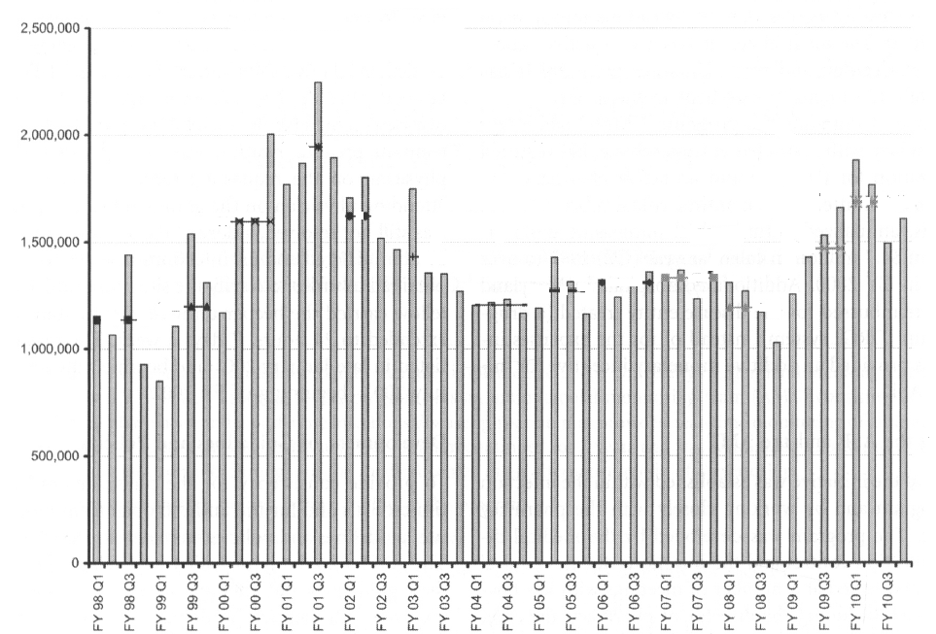
Removal of a Stewardship Program¹
Start of Stewardship Program
End of Stewardship Program
Antibiotic Expenditures
Standiford HC, Chan S, Tripoli M, etal. Antimicrobial stewardship at a large tertiary care academic medical center: cost analysis before, during, and after a 7-year program. Infect Control Hosp Epidemiol. 2012 Apr;33(4):338-45. PMID: 22418628.

Slide 9
What Outcomes Appeal to Clinicians?
Focusing on Clinicians
Most clinicians want to see improvements in patient-centered outcomes
Reduction in antibiotic use is usually not enough
Clinicians want to know if existing practices are harming patients, necessitating a change in practice, or that a new treatment approach will not worsen clinical outcomes
Refrain from focusing on cost-savings
Consider selecting at least 1 intervention annually

Slide 10
Example Intervention²
Goals
To decrease the duration of therapy prescribed for community-acquired pneumonia (CAP) from a median of 9 days to 5 days
Approach
Updated CAP guidelines were user-friendly and available at the point of care
Provided educational sessions on the diagnosis and management of CAP
Prospective audit and feedback provided for patients admitted for CAP to the medicine service Monday through Friday

Slide 11
Results²
Outcome | Baseline | Intervention | P-value
Median duration of therapy | 9 days | 6 days | <0.01
Readmission | 7% | 4% | 0.08
Mortality | 2% | 1% | 0.23
Patient characteristics were similar between the two periods.
Intervention showed that a decrease in antibiotic therapy was successful, without negatively impacting patient outcomes.

Slide 12
Take-Home Points
Remember to know your audience when discussing stewardship goals and achievements
Refrain from focusing on reductions in antibiotic usage and cost savings with clinicians
Consider focusing on specific infectious syndromes for your stewardship interventions to garner support from clinicians
Be creative in keeping your program exciting for both you and your clinicians!

Slide 13
Disclaimer
The findings and recommendations in this presentation are those of the authors, who are responsible for its content, and do not necessarily represent the views of AHRQ. No statement in this presentation should be construed as an official position of AHRQ or of the U.S. Department of Health and Human Services.
Any practice described in this presentation must be applied by health care practitioners in accordance with professional judgment and standards of care in regard to the unique circumstances that may apply in each situation they encounter.

Slide 14
References
Standiford HC, Chan S, Tripoli M, et al. Antimicrobial stewardship at a large tertiary care academic medical center: cost analysis before, during, and after a 7-year program. Infect Control Hosp Epidemiol. 2012 Apr;33(4):338-45. PMID: 22418628.
Foolad F, Huang AM, Nguyen CT, et al. A multicenter stewardship initiative to decrease excessive duration of antibiotic therapy for the treatment of community-acquired pneumonia. J Antimicrob Chemother. 2018 Feb 16 (Epub ahead of print). PMID: 29462306.

