Slide 1
Improving Antibiotic Use Is a Patient Safety Issue
AHRQ Safety Program for Improving Antibiotic Use
Long-Term Care
AHRQ Pub. No. 17(21)-0029
June 2021

Slide 2
Objectives
Discuss the potential harms associated with antibiotic use
Recognize that patient harm is largely preventable
Recognize that changes to the system, not just to the behavior of individuals, lead to sustained improvements

Slide 3
The Importance of Antibiotics
Revolutionized modern medicine
Saved countless lives
However, antibiotics have risks and may cause harm
Notes:
5

Slide 4
Antibiotic Development is on the Decline¹

Slide 5
Antibiotic Overuse^{2,3}
4.1 million Americans are admitted to nursing homes each year.
70% of nursing home residents will receive at least one course of antibiotics every year.
Up to 75% of these courses are inappropriate or unnecessary.
Imagine this scenario!
We’re not sure if you have hypertension, but…we’re going to put you on lisinopril just in case you do.

Slide 6
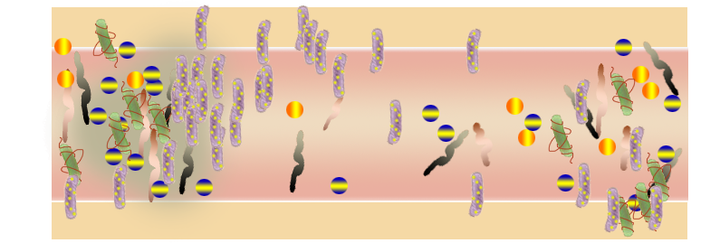
Antibiotics Alter the Bacteria in the Gut⁴
Susceptible Bugs
Resistant Bugs
Bacterial Cell Number
Detection Threshold
Antibiotic Treatment
End of Antibiotic Treatment
Time
Adapted from: Jernberg C, Löfmark S, Edlund C, et al. Long-term impacts of antibiotic exposure on the human intestinal microbiota. ​ Microbiology. 2010 Nov;156(Pt 11):3216-23. PMID: 20705661. doi:10.1099/mic.0.040618-0. Used with permission.​

Slide 7
Antibiotics & Clostridioides difficile
Increased risk of getting Clostridioides difficile infection (CDI) occurs^{5,6}
While taking antibiotics or
Up to 12 weeks afterward
Over 90% of the deaths associated with CDI occur in people over the age of 65.^{7,8}
One in 9 older adults with CDI die within 30 days of diagnosis.

Slide 8
The Next Infection…⁹

Slide 9
Social Factors Influence Antibiotic Prescribing¹⁰
Medicine is an art, not an exact science.
Social influences include
Fears, risks, fatigue
Other prescribers outside of long-term care facilities
Communication among staff
Family pressure

Slide 10
Program Goals
Improve the culture of safety.
Provide tools and support for frontline staff.
Strive to reduce preventable harm by identifying problems that cause harm to residents.
Problems can be behavioral, technical, or both.
Think about problems as opportunities for improvement.

Slide 11
5 Steps for Improving the Culture of Patient Safety
Engage leadership for support and collaboration.
Understand the science of safety.
Improve teamwork and communication.
Recognize current practices that may lead to patient harm.
Develop system-based solutions to improve patient safety.
11

Slide 12
The Science of Safety – Step 1
There are three basic principles of safe design.
Standardize care and eliminate unnecessary steps.
Use standard protocols, order sets, and communication tools.

Slide 13
The Science of Safety – Step 2
There are three basic principles of safe design.
Standardize care and eliminate unnecessary steps.
Create independent checks to reduce potential harm.
Seek input from prescribers and nonprescribers (including infection preventionists, nurses, nurse aides, and pharmacists).
Ask the antibiotic stewardship team for help.

Slide 14
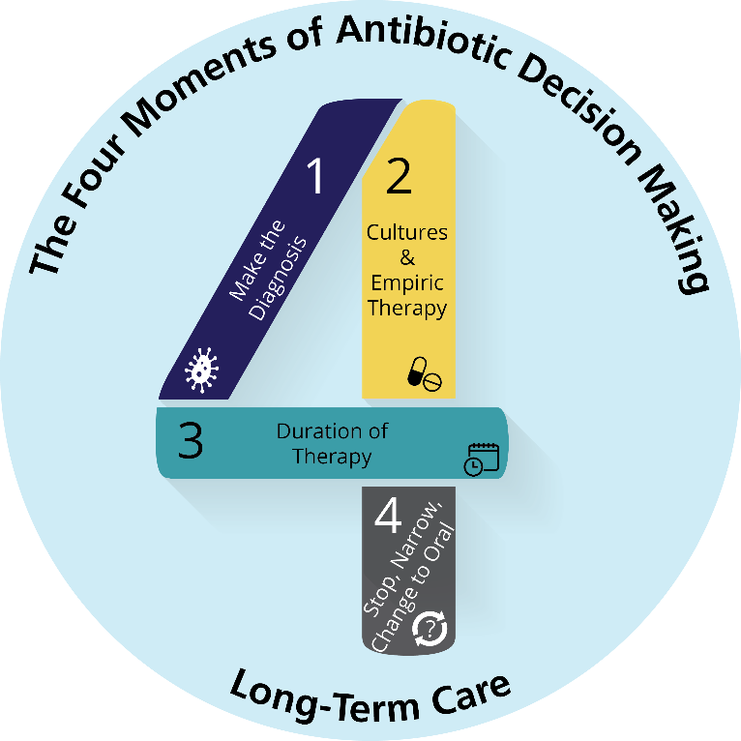
The Four Moments of Antibiotic Decision Making
Does the resident have symptoms that suggest an infection? Can we try symptomatic treatment and active monitoring?
What type of infection is it? Have we collected appropriate cultures and diagnostic tests before starting antibiotics? What empiric therapy should we initiate?
What duration of antibiotic therapy is needed for the resident’s diagnosis?
It’s been 2–3 days since we started antibiotics. Re-evaluate the resident and review results of diagnostic tests. Can we stop antibiotics? Can we narrow therapy?

Slide 15
The Science of Safety
There are three basic principles of safe design.
Standardize care and eliminate unnecessary steps.
Create independent checks.
Learn from problems.
What happened?
Why did it happen?
How can you reduce the risk for next time?
How will know that your changes worked?

Slide 16
Clinical Case
Saturday—Nurse aide noted a 76-year-old woman in the facility did not eat breakfast and just picked at her lunch.
The on-call clinician asked for a urine culture.
Sunday—The resident was back to baseline and eating well.
Monday—The lab faxes over the results:
≥100,000 CFU/mL of a pan-susceptible E. coli
The daytime clinician sees the urine culture results and prescribes a 7-day course of ciprofloxacin.

Slide 17
Clinical Case (continued)
Two months later: The resident developed fevers, dysuria, and flank pain.
The resident was sent to the emergency department.
She was admitted with hypotension and started on cefepime.
Her urine culture grew ≥100,000 CFU/mL E. coli resistant to ciprofloxacin but susceptible to a number of other β-lactams.
She completed a 7-day course of cefepime.

Slide 18
Where Are the Problems in This Case?¹¹
Image credit: Reason J. Human Error. Cambridge: Cambridge University Press; 1990.

Slide 19
Where Are the Problems in This Case? (continued)¹¹
1. The resident did not have signs and symptoms consistent with a UTI. Urine culture did not need to be sent.
Image credit: Reason J. Human Error. Cambridge: Cambridge University Press; 1990.

Slide 20
Where Are the Problems in This Case? (continued)¹¹
2. When urine culture grew E. coli, prescribing clinician should have evaluated resident to determine if she had UTI symptoms.
1. The resident did not have signs and symptoms consistent with a UTI. Urine culture did not need to be sent.
3. A narrower agent than ciprofloxacin would have been a better choice.
Image credit: Reason J. Human Error. Cambridge: Cambridge University Press; 1990.

Slide 21
Where Are the Problems in This Case? (continued)¹¹
The resident has a drug-resistant bacteria. She spread the bacteria to other residents.
2. When urine culture grew E. coli, prescribing clinician should have evaluated resident to determine if she had UTI symptoms.
1. The resident did not have signs and symptoms consistent with a UTI. Urine culture did not need to be sent.
4. Oral antibiotics were possible, which could have avoided painful IVs and helped her return to the LTC facility sooner.
3. A narrower agent than ciprofloxacin would have been a better choice.
Image credit: Reason J. Human Error. Cambridge: Cambridge University Press; 1990.

Slide 22
Apply the Science of Safety
Principle of Safe Design | Nonclinical Example | Opportunities From Case
Standardize care |  | Order sets for when to order urine studies. Communication forms for sharing urine culture results.
Independent checks |  | Are order sets being used or followed?
Learn from problems |  | Post diagnostic criteria for a UTI at nurses stations and common areas.

Slide 23
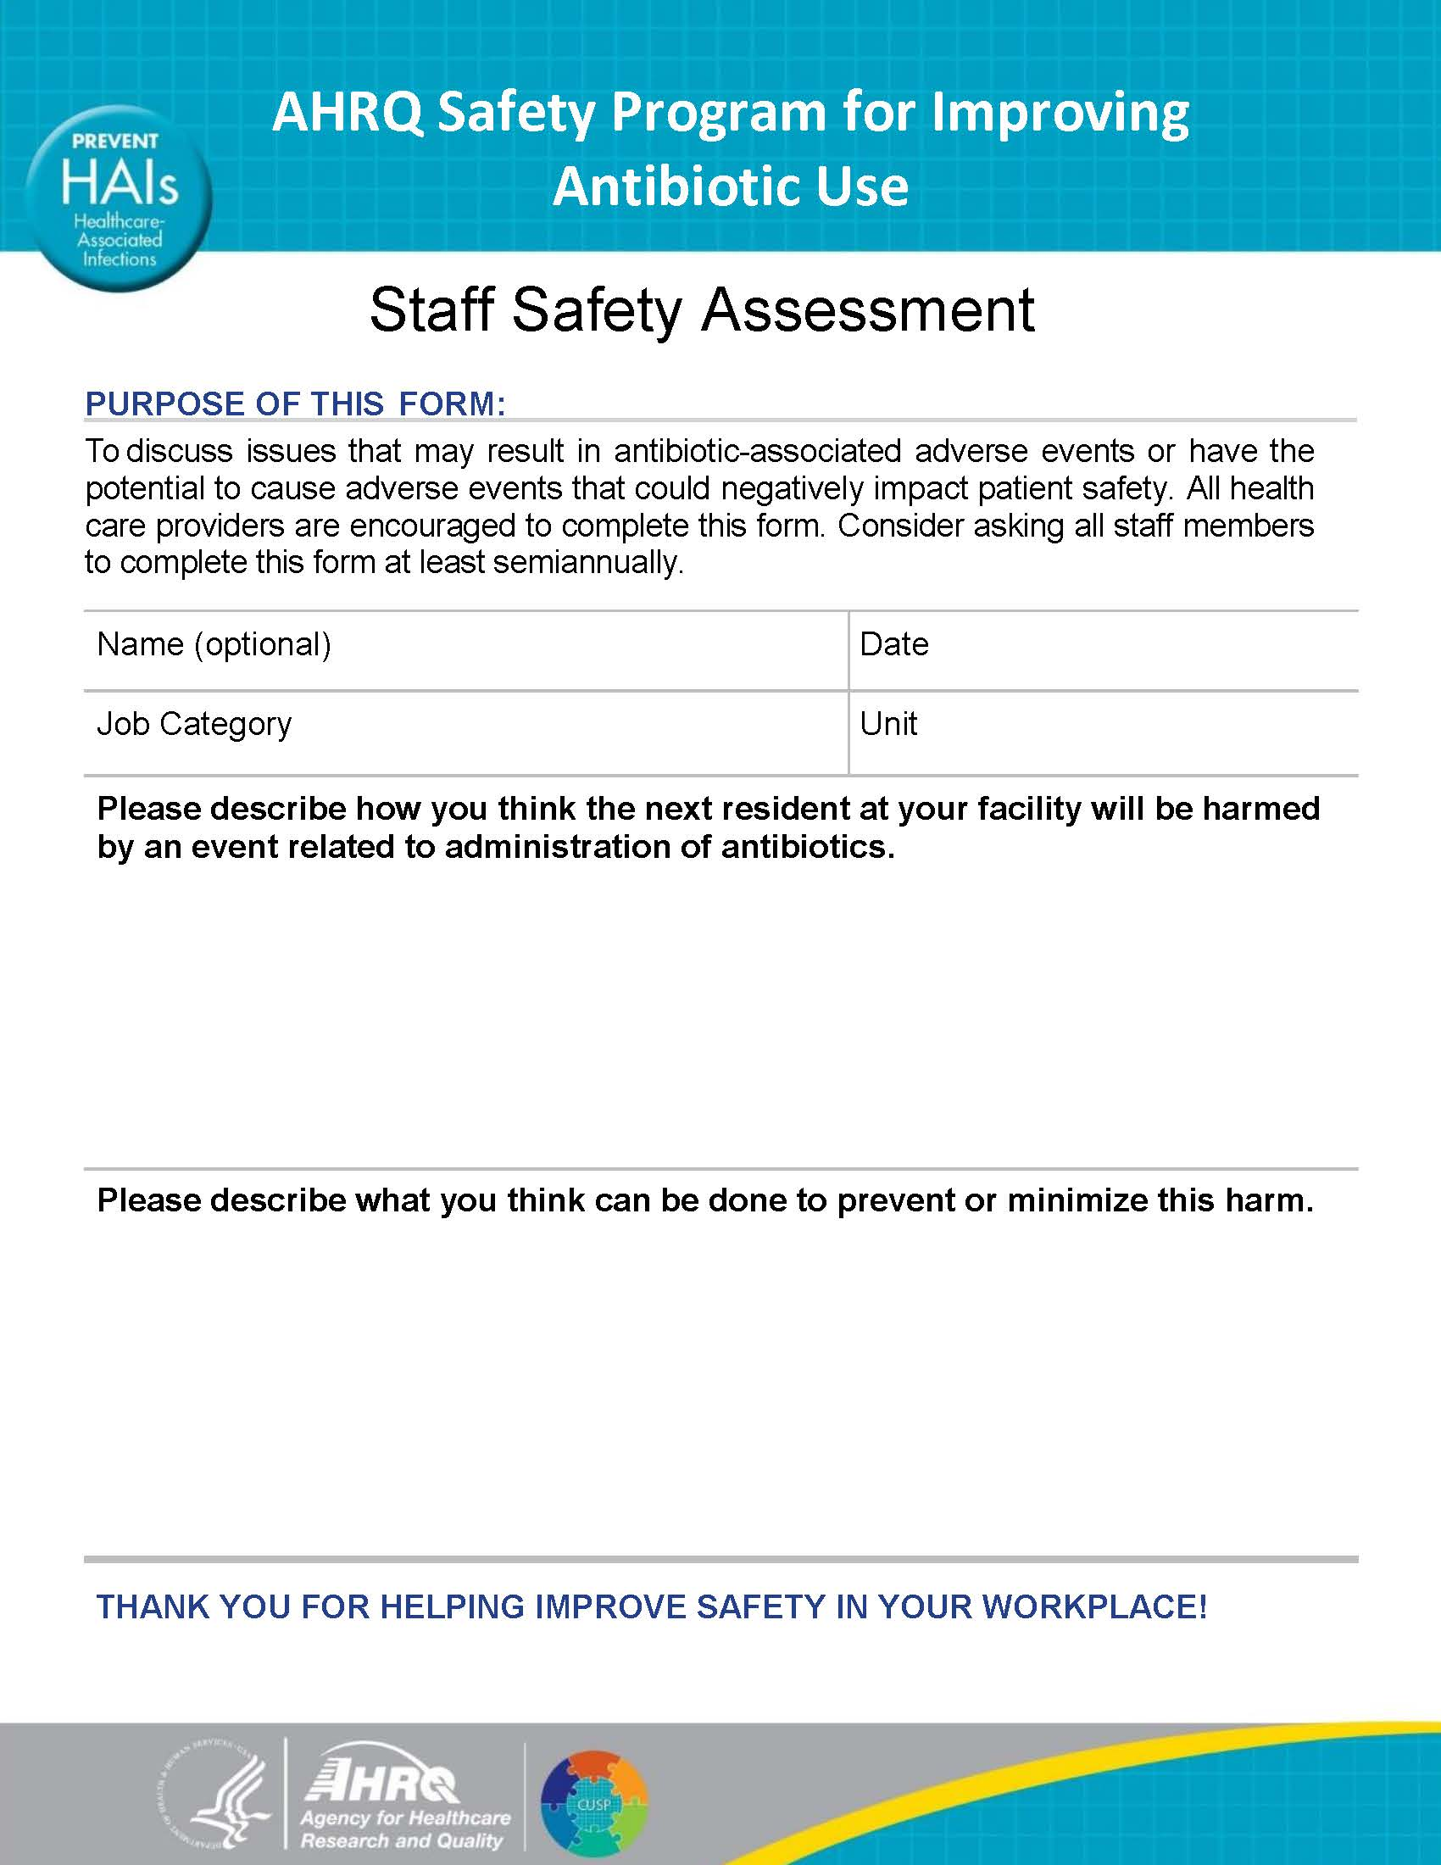
Identifying Problems
Describe the next resident scenario for which antibiotics may not be prescribed appropriately.
Describe what you think can be done to prevent this from happening.

Slide 24
Reality Check
Prescribers and frontline staff must reassess whether antibiotics are still needed or if therapy can be adjusted.
Foster a culture of safety for all team members.
Do not worry about offending clinicians.
All should feel comfortable talking about stopping/adjusting antibiotic therapy.

Slide 25
Summary
Improve the culture of safety.
Provide frontline staff with tools/support to identify and tackle hazards that threaten their patients.
Strive to eliminate preventable harm!
3 methods to eliminate unnecessary harm
Standardize practices
Create independent checks
Learn from problems

Slide 26
Activities To Pair With This Presentation
Activity, Stewardship Team | Activity, Frontline Providers
Use the Staff Safety Assessment to identify problems. Discuss the problem and identify an intervention. Designate an individual to collect baseline data for the intervention. Use the Checkpoint Tool to keep track of your progress. Collect and analyze data using the Monthly Data Collection Form. | Ask frontline staff to complete the Staff Safety Assessment.
Supporting Materials
Staff Safety Assessment Intervention Worksheet Checkpoint Tool Monthly Data Collection Form

Slide 27
Disclaimer
The findings and recommendations in this presentation are those of the authors, who are responsible for its content, and do not necessarily represent the views of AHRQ. No statement in this presentation should be construed as an official position of AHRQ or of the U.S. Department of Health and Human Services.
Any practice described in this presentation must be applied by health care practitioners in accordance with professional judgment and standards of care in regard to the unique circumstances that may apply in each situation they encounter. These practices are offered as helpful options for consideration by health care practitioners, not as guidelines.

Slide 28
References
Spellberg B, Guidos R, Gilbert D, et al. The Epidemic of Antibiotic-Resistant Infections: A Call to Action for the Medical Community from the Infectious Diseases Society of America. Clinical Infectious Diseases. 2008 Jan;46(2):155–64.
Antibiotic resistance treats in the United States, 2013. Apr 2013. www.cdc.gov/drugresistance/threat-report-2013/pdf/ar-threats-2013-508.pdf. Accessed August 9, 2018.
Antibiotic Prescribing and Use in Hospitals and Long-Term care. Apr 2017. www.cdc.gov/antibiotic-use/healthcare/. Accessed August 9, 2018.
Jernberg C, Lofmark S, Edlund C, et al. Long-term impacts of antibiotic exposure on the human intestinal microbiota. Microbiology. 2010 Nov;156(Pt 11):3216-23. PMID: 20705661.
Rea MC, O’Sullivan O, Shanahan F, et al. Clostridium difficile carriage in elderly subjects and associated changes in the intestinal microbiota. J Clin Microbiol. 2012 Mar;50(3):867-75. PMID:22162545.

Slide 29
References
Brown KA, Khanafer N, Daneman N, et al. Meta-analysis of antibiotics and the risk of community-associated Clostridium difficile infection. Antimicrob Agents Chemother. 2013 May;57(5):2326-32. PMID: 23478961.
Murphy SL, Xu J, Kochanek KD. Deaths: final data for 2010. Natl Vital Stat Rep. 2013 May;61(4):1-117. PMID: 24979972.
Lessa FC, Mu Y, Bamberg WM, et al. Burden of Clostridium difficile infection in the United States. N Engl J Med. 2015 Feb;372(9):825-34. PMID: 25714160.
Kahvecioglu D, Ramiah K, McMaughan D, et al. Multidrug-resistant organism infections in US nursing homes: a national study of prevalence, onset, and transmission across care settings, October 1, 2010-December 31, 2011. Infect Control Hosp Epidemiol. 2014 Oct;35 Suppl 3:S48-55. PMID: 25222898.
van der Geest S, Whyte SR, Hardon A. The anthropology of pharmaceuticals: a biographical approach. Ann Rev Anthropology. 1996 Oct;25(1):153-78.
Reason J. Human Error. Cambridge: University Press, Cambridge: 1990.

