Slide 1
Identifying Targets To Improve Antibiotic Use
AHRQ Safety Program for Improving Antibiotic Use
Long-Term Care
AHRQ Pub. No. 17(21)-0029
June 2021

Slide 2
Objectives
Identify opportunities to improve antibiotic prescribing
Recognize how to leverage frontline staff to guide safety improvement efforts around antibiotic prescribing
Recognize opportunities to use the Four Moments of Antibiotic Decision Making framework to improve antibiotic use

Slide 3
5 Steps for Improving the Culture of Patient Safety
Engage leadership for support and collaboration
Understanding the science of safety
Improve teamwork and communication
Recognize current practices that may lead to patient harm
Develop system-based solutions to improve patient safety
3

Slide 4
Recognizing Potential Harm
Opportunities for Improvement
Mistakes
Near Misses
Defects
Errors
Problems

Slide 5
Examples of Potential Harm
Prescribing antibiotics without evidence of a bacterial infection
Forgetting to write an end date or clear indication for antibiotics
Forgetting to order needed cultures or diagnostic studies
Prescribing antibiotics for too long
Forgetting to stop antibiotics when they are not needed
Accidentally miscounting days of therapy during transitions of care

Slide 6
How Can You Identify Potential Harm?
Seek input from a diverse group of health care workers
Staff Safety Assessment
Describe the next patient scenario for which antibiotics may not be prescribed appropriately
Describe what you think can be done to prevent this from happening

Slide 7
Case #1
Resident develops pain with urination. She feels tired but otherwise indicates she feels OK.
Her vital signs do not indicate a fever.
On assessment by the nurse, she has mild suprapubic tenderness.
Provider decides to send a urinalysis and urine culture.
She starts resident on a 7-day course of ciprofloxacin.

Slide 8
Case #1, continued
The laboratory faxes the urine culture results 2 days later.
Results arrive around 8 p.m. and are placed into the chart with no notification to the provider or other daytime staff.
The culture results show >100,000 colony forming units per milliliter of Klebsiella pneumoniae, sensitive to trimethoprim-sulfamethoxazole (TMP-SMX) and nitrofurantoin, but resistant to ciprofloxacin.
The resident remains on ciprofloxacin.

Slide 9
Case #1, continued
5 days later, the resident develops back pain and a fever, and appears drowsy.
She is transferred to the emergency department.
She is placed on intravenous antibiotics for pyelonephritis and admitted to the hospital.

Slide 10
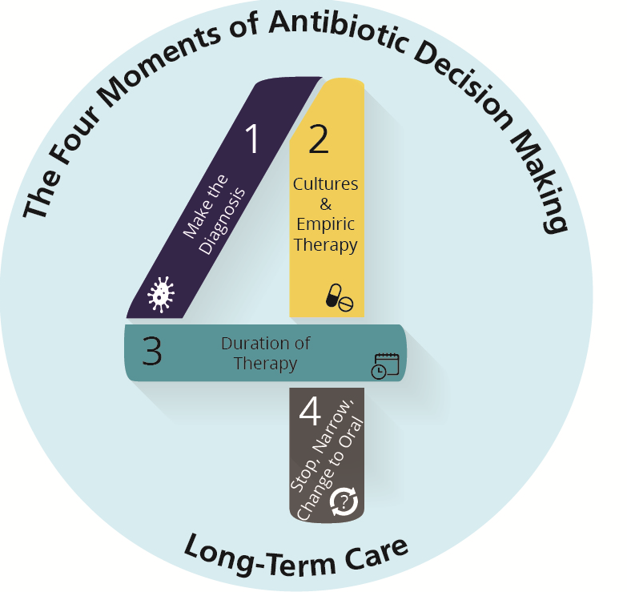
Four Moments of Antibiotic Decision Making

Slide 11
Staff Safety Assessment
Describe the next patient scenario for which antibiotics may not be prescribed optimally.
Describe what you think can be done to prevent this from happening again.
If urine culture results are not reviewed, there’s a missed opportunity to change antibiotics. Residents can become increasingly ill while receiving the wrong therapy.
Create an alert that requires prescribers to review and sign off on cultures when they return from the lab. Encourage nursing to review and discuss indications for antibiotic therapy with prescribers on a daily basis.

Slide 12
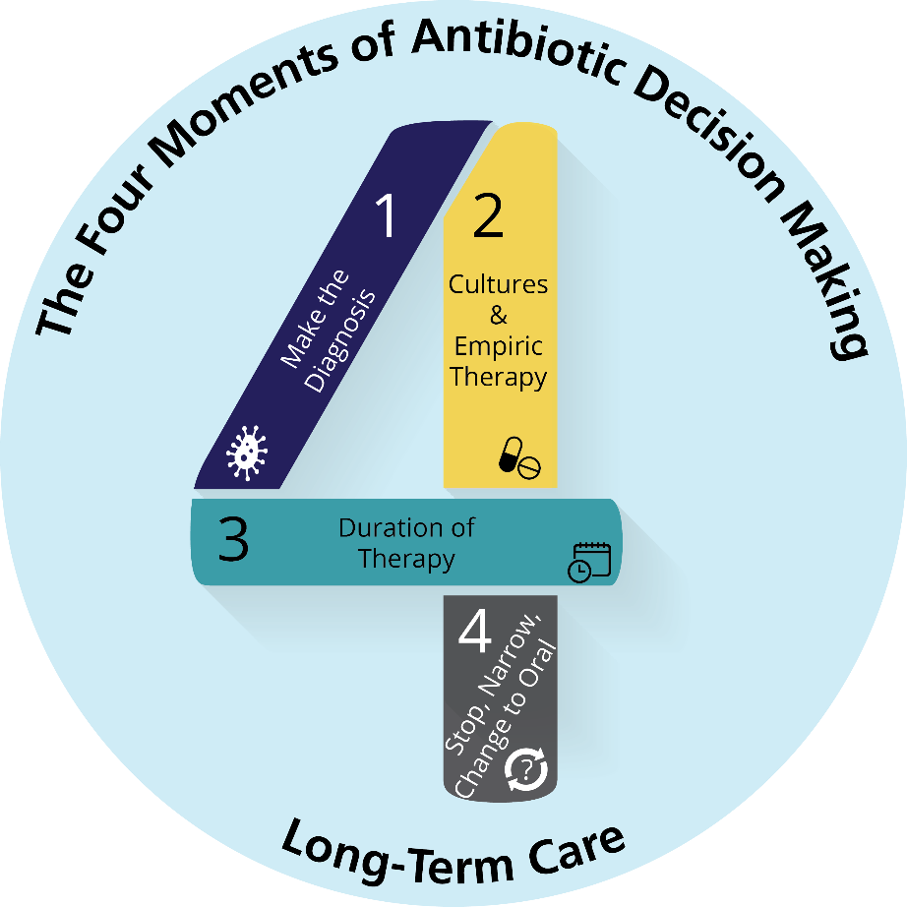
Use the Four Moments To Identify Problems¹
Reason J. Human Error. Cambridge: Cambridge University Press; 1990. Image courtesy of Cambridge University Press

Slide 13
How Can You Identify Problems?
The antibiotic stewardship team
Physician lead
Pharmacist lead
Nurse lead
Prioritize top problems
Identify all the factors that could lead to this problem
Technical factors
Adaptive factors

Slide 14
Problem Solving
1
First-order problem solving
Solves one problem in one particular instance
Generally does not help prevent future harm from occurring
Second-order problem solving
Uses adaptive interventions to change culture and beliefs
Identifies system opportunities to prevent them from occurring again
2

Slide 15
Technical Problems
Technical solutions often require a checklist or protocol.
Problem | Potential Solution(s)
The daytime nurse and prescriber never received notification of urine culture results. | The provider is notified of culture results via an electronic system or by fax. The clinician must acknowledge receipt of the culture results.
Clinicians are not using appropriate criteria to order urine cultures. | Pocket guides with criteria for when to order urine cultures.
 | Residents must meet specific criteria detailed on a checklist before anyone can request a urine culture.

Slide 16
Adaptive Problems
Adaptive solutions require a change in attitudes, beliefs, and behaviors.
Problem | Potential Solution(s)
Clinicians and nurses fear not prescribing antibiotics if a resident has a positive urine culture—even if the resident does not have symptoms. | Encourage a culture of safety. Use posters and commitment letters to help make everyone—clinicians, nurses, and family members—aware that antibiotics are powerful medicines. They should only be used when necessary, not “just in case.”
Case 1: Nurses may not want “to bother” some of the prescribers. | Help train nurses to communicate the information needed to help the clinician make an informed decision: urine culture results and an updated assessment of the resident. Tell clinicians to expect (and ask for) this information as well.

Slide 17
Summary
The Safety Staff Assessment should be completed by all staff in your building.
Using the Four Moments of Antibiotic Decision Making Form may help identify problems.
Start with a problem or potential harm that is easy to fix.
Use second-order problem solving to determine technical and adaptive solutions.

Slide 18
Activities To Complete
Activity, Stewardship Team | Activity, Frontline Providers
Use the Staff Safety Assessment to identify problems Review data collected on the Four Moments of Antibiotic Stewardship Decision Making Form Collect and analyze data using the Monthly Data Collection Form | Distribute the Antibiotic Side Effects One-Pager to prescribing clinicians and other frontline staff
Supporting Materials
Staff Safety Assessment Antibiotic Side Effects One-Pager Four Moments of Antibiotic Decision Making Form Monthly Data Collection Form

Slide 19
Disclaimer
The findings and recommendations in this presentation are those of the authors, who are responsible for its content, and do not necessarily represent the views of AHRQ. No statement in this presentation should be construed as an official position of AHRQ or of the U.S. Department of Health and Human Services.
Any practice described in this presentation must be applied by health care practitioners in accordance with professional judgment and standards of care in regard to the unique circumstances that may apply in each situation they encounter. These practices are offered as helpful options for consideration by health care practitioners, not as guidelines.

Slide 20
Reference
Reason J. Human error: models and management. BMJ. 2000 Mar 18;320(7237):768–70. PMID: 10720363.

