Slide 1
Assessment of the Resident With a Suspected Respiratory Tract Infection
AHRQ Safety Program for Improving Antibiotic Use
Long-Term Care
AHRQ Pub. No. 17(21)-0029
June 2021

Slide 2
Objectives
Recognize the signs and symptoms of a suspected respiratory tract infection
Identify indications for antibiotics and supportive care measures for residents with a cough
Recognize syndromes that may be confused with acute bacterial pneumonia

Slide 3
Terminology
Respiratory tract infections are common. They range from the common cold to pneumonia.
Common Cold
  An upper respiratory tract infection that can be caused by many different viruses. Treatment is supportive care (rest, fluids, analgesics) and time.
Acute Bronchitis
  Inflammation of the large airways. The vast majority (90%) of these infections are caused by viruses. Distinguishing this infection from pneumonia can be challenging.
Influenza¹
  A viral infection most common in the winter months (October through March). The best way to avoid this infection is by getting a yearly influenza vaccination or “flu shot.”
Pneumonia
  Inflammation of the lung. In adults, about one-fourth of these are caused by viruses with the remainder caused by bacteria. The diagnosis is made, in part, using a chest x ray.

Slide 4
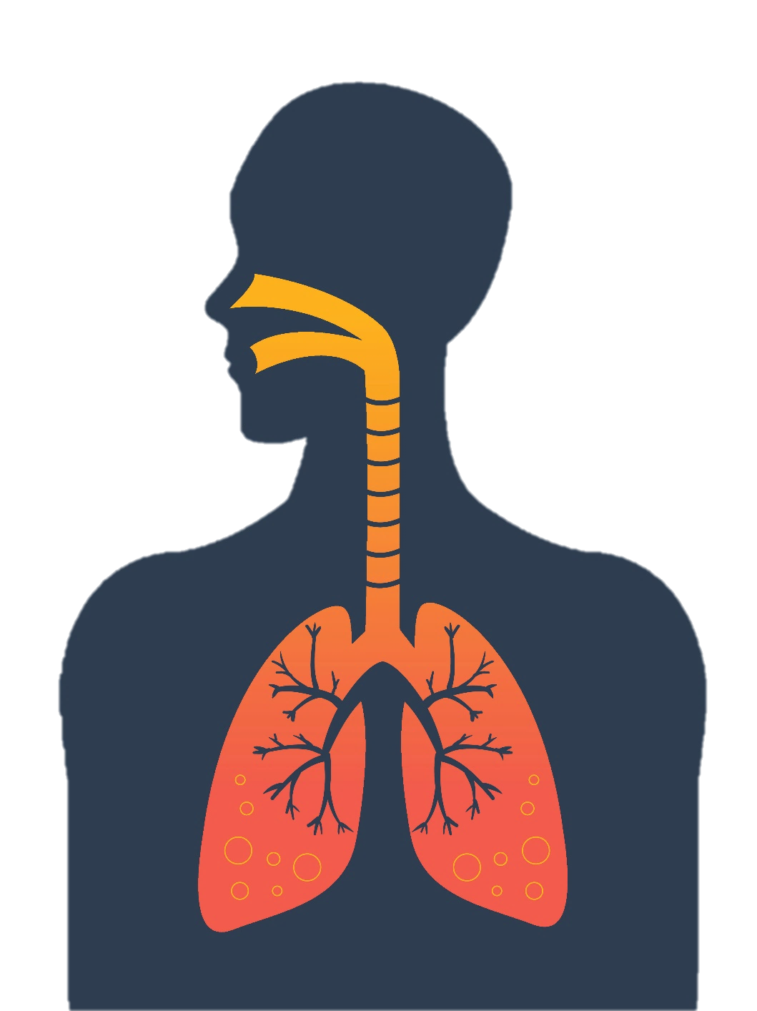
Upper or Lower Respiratory Tract Infection Descriptions
Common Cold
Infection caused by many different viruses. Affects sinuses and throat and may also cause headache, fatigue, low-grade fever.
Sinusitis
Inflammation and infection of the sinuses; 98% caused by viruses and usually part of a common cold.
Strep Throat
Infection of the tonsils and posterior oropharynx. Caused by group A Streptococcus. Requires a diagnostic test.
Laryngitis
Hoarse voice; inflammation and infection of the vocal cords; nearly always a viral infection and usually part of a common cold.
Bronchitis
Inflammation and infection of the large airways; 90% caused by viruses.
Pneumonia
Inflammation and infection of lung tissue; ~75% caused by bacteria.

Slide 5

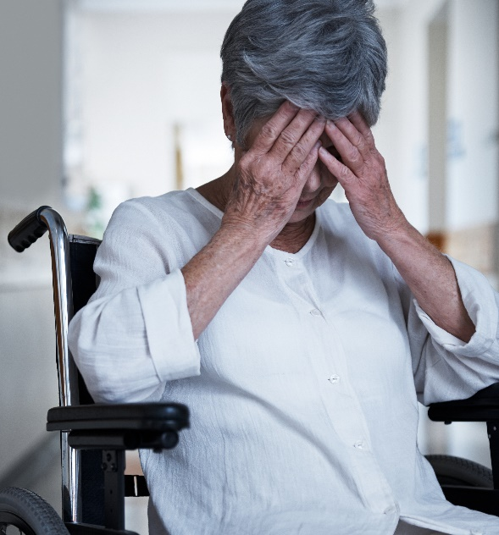
Case 1: Sandy
75-year-old resident
Has moderate dementia and congestive heart failure
Is wheelchair bound
For the past 2 days, she reports:
  Feeling stuffy
  Headache
  Muscle pain
  Coughing up yellow phlegm
  Fatigue
Other information:
  Last week her family came to visit for Christmas
    Her granddaughter was coughing
Vitals
Temperature 99.8F
HR 98
BP 124/86
RR 16
Pulse ox 96%

Slide 6

Case 1: Sandy, continued
  You observe that she appears congested with a runny nose and red eyes. Her lungs are clear on exam and she is breathing comfortably.
  What is your next step in management?
  1. Test for influenza.
  2. Start antibiotics.
  3. Send a urinalysis and a urine culture, and obtain a chest x ray.
  4. Bring her a bowl of ice cream and something to help her sleep.

Slide 7
Case 1: Sandy, Next Steps^{1,2}
You send a nasopharyngeal swab for flu. It comes back positive for Influenza A.
Suggested next steps:
Start oseltamivir, 75 mg twice daily for 5 days.
Place the resident on standard and droplet precautions—this means she will need her own room.
Test the resident’s roommate, anyone else with close exposure to the resident, and any of the residents in the facility with respiratory symptoms.
Confirm that all residents in the facility are vaccinated yearly to prevent future outbreaks.

Slide 8

Case 2: Jonas
73-year-old resident
Has a 50-pack-year smoking history and diabetes
He is at your facility for physical therapy as he recovers from a recent stroke
Has done relatively well and recently went home for a weekend
Two days later he reports—
  Feeling “lousy”
  Coughing up green sputum
  Scratchy pain in his upper chest when he coughs or takes a deep breath
Other information
  He hasn’t gone outside to smoke all day, which is definitely a change for him
Vitals
Temperature 99.4F
HR 96
BP 102/66
RR 22
Pulse oximetry 95%

Slide 9

Case 2: Jonas, continued
You perform a physical exam.
  He is coughing up dark green sputum while you examine him.
  He has a few wheezes on exam in both lungs.

Slide 10

Case 2: Jonas, Next Step
You decide to test for influenza. It comes back negative.
What should you do next?
  Start levofloxacin for 10 days for treatment of pneumonia.
  Provide a cough suppressant, encourage fluid intake, recommend he avoid smoking, and continue to monitor him.
  Call the nearest emergency department for admission.

Slide 11
Case 2: Jonas, 5 Days Later
Five days later Jonas says he feels better…
but he still has a cough that just won’t go away.
What should you do next?
  Ask for a set of vitals and assess Jonas
  Obtain a CBC and chest x ray to evaluate for pneumonia
  Start antibiotics

Slide 12

Bronchitis Versus Pneumonia
Acute Bronchitis
Definition: Self-limited inflammation of bronchi, the large airways of the lung
Cause: Viral (with rare exception)*
Symptoms:
  Cough for 5 days to 3 weeks
  Fever unusual (unless influenza)
  50% have sputum production
Diagnostic studies:
  Normal to slightly elevated WBC
  No specific chest film findings
Pneumonia
Definition: Inflammation or infection of the lung tissue
Cause: ~75% bacteria, ~25% viral
Symptoms:
  Cough, fever, sputum production common, chest wall pain
Diagnostic studies:
  Elevated WBC
  Chest films show infiltrates, possible effusions
*Bacterial causes include Mycoplasma pneumoniae, Chlamydia pneumoniae, and Bordetella pertussis, which causes whooping cough. Bordetella is the only one of these that requires antibiotic treatment.³

Slide 13
Case 2: Jonas, X Ray
You obtain the chest x ray and CBC:
  Normal WBC
  The chest x ray does not show any acute changes to suggest pneumonia
What do you think is going on with this resident?
  Acute bronchitis
  Pneumonia
  Influenza
  Common cold

Slide 14
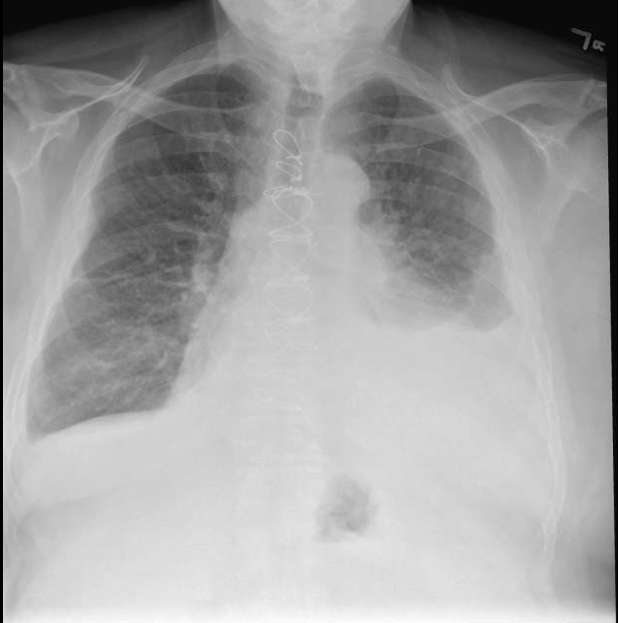
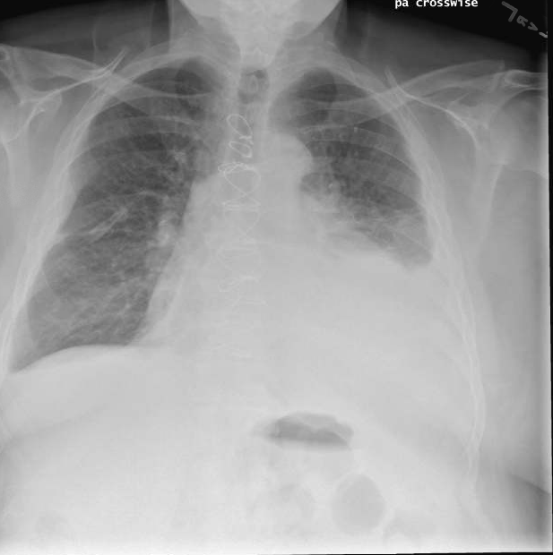
Chest X Rays in Older Adults
Diagnostic Testing⁴
Case: Pneumonia Versus Not Pneumonia
2 Weeks Ago Current

Slide 15
Case 2: Jonas, Antibiotics?
His daughter asks you for some antibiotics to make her dad’s cough go away.
What is your response?
Antibiotics are great at making coughs go away.
He most likely has bronchitis, which is due to a virus over 90 percent of the time.
Let me see about getting him some cough suppressants and we can try some breathing treatments.

Slide 16

Case 3: Peter
83-year-old resident
History of congestive heart failure
Complains of being short of breath with a wet cough
Has not felt well for the past 10 days
Cough is productive with clear sputum
Other information
  His roommate reports that last night they ordered delivery pizza and wings
Vitals
Temperature 97.9F
HR 84
BP 173/67
O2 sat 96% RA

Slide 17

Case 3: Peter, continued
Physical Exam and
Chest X Ray Results:
Crackles in the bases of lungs bilaterally
Abdomen soft
2+ pitting edema in bilateral lower extremities
Bilateral lower lobe infiltrates
Vitals
Temperature 97.9F
HR 84
BP 173/67
O2 sat 96% RA

Slide 18
Case 3: Peter, Diagnosis?
Based on the information provided so far, what do you think is going on with Peter?
  He has a viral pneumonia because he has not been feeling well for 10 days.
  He has bronchitis based on his lung exam.
  He is having a heart failure exacerbation.
  He has bacterial pneumonia and needs antibiotics.

Slide 19

Take-Home Points
The majority of upper respiratory infections are caused by viruses and do not require antibiotics.
During the winter months, all residents with fever and cough should be tested for influenza.
Clear communication regarding decision making with residents and family is key, and supportive measures should be provided for resident comfort.

Slide 20
Activities To Complete
Activity, Stewardship Team | Activity, Frontline Providers
Hold monthly Antibiotic Stewardship Team meetings Use the Staff Safety Assessment and Learning From Antibiotic-Associated Adverse Events forms to identify problems Discuss problems and identify another area to improve with an intervention Designate an individual to collect baseline data for the intervention Notify the Senior Executive of your plans. Use the Checkpoint Tool to keep track of your progress Collect and analyze data using the Monthly Data Collection Form | Ask frontline staff to complete the Staff Safety Assessment Distribute the Respiratory Virus Infections, Bacterial Pneumonia, and COPD Exacerbation one-pagers to prescribing clinicians and other frontline staff Apply the Four Moments of Antibiotic Decision Making Form to 5–10 residents each month
Supporting Materials
Respiratory Virus Infections, Bacterial Pneumonia, and COPD Exacerbation one-pagers Four Moments of Antibiotic Decision Making Form Monthly Data Collection Form Staff Safety Assessment Checkpoint Tool

Slide 21
Disclaimer
The findings and recommendations in this presentation are those of the authors, who are responsible for its content, and do not necessarily represent the views of AHRQ. No statement in this presentation should be construed as an official position of AHRQ or of the U.S. Department of Health and Human Services.
Any practice described in this presentation must be applied by health care practitioners in accordance with professional judgment and standards of care in regard to the unique circumstances that may apply in each situation they encounter. These practices are offered as helpful options for consideration by health care practitioners, not as guidelines.

Slide 22
References
Interim Guidance for Influenza Outbreak Management in Long-Term Care Facilities. Centers for Disease Control and Prevention. National Center for Immunization and Respiratory Diseases. Oct 2018. https://www.cdc.gov/flu/professionals/infectioncontrol/ltc-facility-guidance.htm. Accessed Jan 7, 2019.
Fry AM, Goswani D, Nahar K, et al. Efficacy of oseltamivir treatment started within 5 days of symptom onset to reduce influenza illness duration and virus shedding in an urban setting in Bangladesh: a randomized placebo-controlled trial. Lancet Infect Dis. 2014 Feb;14(2):109-18. PMID: 24268590.
McGuiness CB, Hill J, Fonseca E, et al. The disease burden of pertussis in adults 50 years and older in the United States: a retrospective study. BMC Infect Dis. 2013 Jan;13:32. PMID: 23343438.
Kaye KS, Stalam M, Shershen WE, et al. Utility of pulse oximetry in diagnosing pneumonia in nursing home residents. Am J Med Sci. 2002 Nov;324(5):237-42. PMID: 12449443.

