Slide 1
Assessment of the Resident With a Suspected Urinary Tract Infection
AHRQ Safety Program for Improving Antibiotic Use
Long-Term Care
AHRQ Pub. No. 17(21)-0029
June 2021

Slide 2
Objectives
Explain the terms urinary tract infection (UTI) and asymptomatic bacteriuria.
Recognize the signs and symptoms of a suspected UTI that should be reported to and discussed by the health care team.
Describe reasons to send urine for testing for a UTI.

Slide 3

Case 1: Mary Ann
Test Name | Results | Units | Ref. Range
URINE PH | 7.5 |  | 4.6-8.0
URINE COLOR | Yellow
URINE CLARITY | Turbid |  | Ref: Clear
URINE GRAVITY | 1.009 | L | 1.016-1.022
URINE PROTEIN | 100 | Mg/dL | Ref: Neg.
URINE GLUCOSE | Negative | Mg/dL | Ref: Neg
URINE KETONES | Negative | Mg/dL | Ref: Neg
URINE BLOOD | Moderate |  | Ref: Neg
ESTERASE (WBC) | Large |  | Ref: Neg
NITRITE, URINE | Positive |  | Ref: Neg
RBC/HPF | 46H | /hpf | 1-5
WBC/HPF | 26H | /hpf | 1-5
URINE BACTERIA | 1+
CULTURE RESULTS: >100,000 CFU/ML PROVIDENCIA RETTGERI ANTIBIOTIC SUSCEPTIBILITY TEST RESULTS: PROVIDENCIA RETTGERI
 | SUSC | INTP
AMPICILLIN | R | R | MCG/ML
CEFAZOLIN | >=32 | R | MCG/ML
CIPROFLOXACIN | I | I | MCG/ML
TRIMETH/SULFA | >=320 | R | MCG/ML
CEFTRIAXONE | <=1 | S
NITROFURANTOIN | 256 | R
AMPICILLIN/SULR |  | R | MCG/ML

Slide 4

Case 1: Question 1
Your colleague thinks the resident has a UTI.
Do you think she has a UTI?
  Yes
  No
  Don’t Know

Slide 5
Diagnosing a UTI
Systemic Signs
(fever or chills)
+
One or more symptoms that localize to the genitourinary tract
(frequency, urgency, bladder or pelvic pain, hematuria, new or worsening urinary incontinence)
Dysuria OR

Slide 6
Asymptomatic Bacteriuria^{1,2}
Positive urine culture
OR
positive urinalysis
+
NO SYMPTOMS of infection
The resident has asymptomatic bacteriuria.
This is
NOT
a UTI!

Slide 7


Asymptomatic Bacteriuria, continued¹⁻³
Common among older adults
Does not lead to increased risk of infection or death
Should not be treated
Notes:
Added references in bottom (see FG)

Slide 8


Case 1: Mary Ann, continued
Temperature 99.2ºF
Heart rate 85 beats per minute
Blood pressure 110/72
Respiratory rate 16 breaths per minute

Slide 9
Case 1: Question 2
Based on this information, what would you do next?
Vitals
Temperature 99.2ºF
Heart rate 85 beats per minute
Blood pressure 110/72
Respiratory rate 16 breaths per minute
Ask about urinary urgency, frequency, dysuria, chills,
and pelvic or bladder pain.
Good choice. These are signs and symptoms of a UTI.
Determine if she has an indwelling urinary catheter.
Good choice. If she does, try to find out why she has one and, if it’s chronic, when was it last changed.
Ask her about signs and symptoms of infection.
Good choice. A temperature of 99.2º F may be a normal variation, an early sign of systemic illness, or an error.
Contact the practitioner
with vitals, symptoms, and your assessment.
Good choice. Be sure to mention that you asked about signs and symptoms that could suggest a UTI.

Slide 10

Case 1: Assessment
Temperature 99.2ºF
Heart rate 85 beats per minute
Blood pressure 110/72
Respiratory rate 16 breaths per minute

Slide 11

Case 1: Take-Home Message
The following evening Mary Ann is feeling well
  Temperature is 98.1ºF
  She is happy she was not exposed to any unnecessary antibiotics, which could have led to harmful side effects
Lesson learned:
Treat the patient, not the lab values!

Slide 12


Case 2: Walter
Walter has a chronic indwelling urinary catheter
Daughter says his urine is cloudy and may have an odor
Daughter asks you to check urine for infection
Resident not available

Slide 13
Case 2: Question 1
What would you tell the resident’s daughter?
  Options:
    “He probably has a UTI because his urine is cloudy.”
    “He probably has a UTI because his urine smells bad.”
    “He seems to be feeling well. Let’s ask him about symptoms when he’s finished singing.”

Slide 14

Case 2: Take-Home Messages
Lessons Learned
Cloudy or smelly urine is NOT an indication to send a urine culture.
Urine in the collection bag can grow bacteria, leading to cloudy urine.
Cultures from the drainage bag or from the proximal port of the catheter do not necessarily reflect what is going on in the bladder.
For residents with cloudy or dark urine, consider an increase in oral fluids. Offer 4–8 oz. every 1–2 hrs.

Slide 15
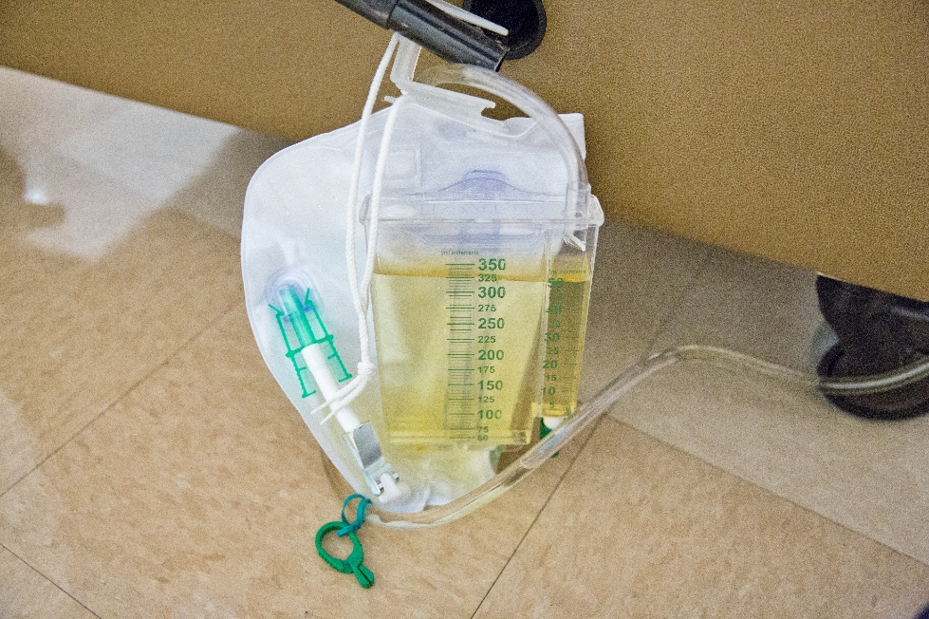
Urinary Catheters⁴
Blocked/occluded urinary catheters should be removed
Signs and symptoms of a catheter-associated UTI:
  Nonspecific signs:
    Fever, rigors or shakes, change in mental status, malaise or lethargy without another identified cause
  Specific signs:
    Flank pain, costovertebral
    angle tenderness, acute
    hematuria, and pelvic
    discomfort
Insufficient data
to suggest changing
catheter every 2 to 4
weeks will reduce the risk
of a catheter-associated UTI

Slide 16

Case 3: Sally
Burning with urination
Started on nitrofurantoin
Two days later, urine growing E. coli susceptible to nitrofurantoin
Symptoms have not improved despite appropriate antibiotic therapy

Slide 17

Case 3: Question 1
What would you do next?
  Send another urine culture.
  Start a different antibiotic.
  Send her to a urologist.
  Examine the resident.

Slide 18

Case 3: Take-Home Message
In addition to the burning with urination, she feels itchy and her external genitalia hurt
Examination reveals a yeast infection
Nitrofurantoin is stopped
Single dose of fluconazole
3 days later, resident feels better
Lessons learned:
UTIs are not the only reason for dysuria, in women or in men
If an antibiotic does not work, rather than try “better” antibiotics, consider other reasons for the resident’s signs and symptoms

Slide 19
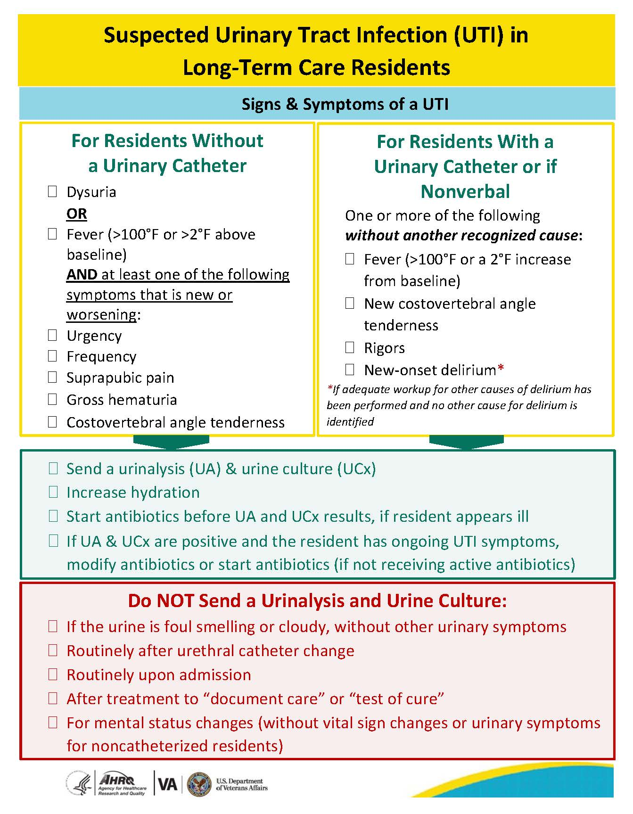
Do’s and Do Not’s: Pocket Cards

Slide 20

Overall: Take-Home Messages
If you are worried about a urinalysis or urine culture result, visit the resident and determine if he/she has symptoms.
If the resident is asymptomatic, a positive urine culture indicates asymptomatic bacteriuria rather than infection.
Treating a resident for asymptomatic bacteriuria can lead to harmful side effects.
Urinalysis and urine culture should only be sent if the resident is symptomatic, NOT if urine appears cloudy, dark, or smelly.
We treat people, not laboratory results!

Slide 21
Activities To Complete
Activity, Stewardship Team | Activity, Frontline Providers
Hold monthly Antibiotic Stewardship Team meetings Gather data from interventions | Review the signs and symptoms of urinary tract infections. As a team, discuss when it is appropriate to send a urinalysis and urine culture.
Supporting Materials
Suspected Urinary Tract Infection in Long-Term Care Residents – Signs and Symptoms of a UTI, pocket card and poster

Slide 22
Disclaimer
The findings and recommendations in this presentation are those of the authors, who are responsible for its content, and do not necessarily represent the views of AHRQ. No statement in this presentation should be construed as an official position of AHRQ or of the U.S. Department of Health and Human Services.
Any practice described in this presentation must be applied by health care practitioners in accordance with professional judgment and standards of care in regard to the unique circumstances that may apply in each situation they encounter. These practices are offered as helpful options for consideration by health care practitioners, not as guidelines.

Slide 23
References
Nicolle LE, Gupta K, Bradley S, et al. Clinical Practice Guideline for the Management of Asymptomatic Bacteriuria: 2019 Update by the Infectious Diseases Society of America. Clin Infect Dis. 2019 May 2;68(10):1611-5. PMID: 31506700.
Cai T, Nesi G, Mazzoli S, et al. Asymptomatic bacteriuria treatment is associated with a higher prevalence of antibiotic resistant strains in women with urinary tract infections. Clin Infect Dis. 2015 Dec 1;61(11):1655–61. PMID: 26270684.
Nicolle LE. 2015. Asymptomatic bacteriuria and bacterial interference. Microbiol Spectrum. 2015 Oct;3(5). PMID: 26542046.
Gould CV, Umscheid CA, Agarwal RK, et al. Guideline for Prevention of Catheter-Associated Urinary Tract Infections 2009. HICPAC Healthcare Infection Control Practices Advisory Committee. June 2019. https://www.cdc.gov/infectioncontrol/pdf/guidelines/cauti-guidelines-H.pdf. Accessed January 20, 2020.

