Slide 1
Changing the System To Improve Patient Safety
AHRQ Safety Program for Improving Antibiotic Use
Long-Term Care
AHRQ Pub. No. 17(21)-0029
June 2021

Slide 2
Objectives
Use barriers as opportunities to improve systems and prevent problems from recurring.
List factors that may compromise patient safety.
Develop an intervention to reduce barriers and evaluate if the intervention is effective.

Slide 3
View Potential Harms as Opportunities¹
Reframe a problem or error as an opportunity to prevent the same problem from occurring again
System design
Can result in “latent” failures
Human behavior
Can result in “active” failures

Slide 4
System Failures
System failures are latent problems that arise from managerial and organizational decisions (or lack of decisions)
Examples of antibiotic prescribing system failures
No notification system for when culture results are available
No pharmacy alerts for allergies to antibiotics

Slide 5
Active Failures
Errors that occur because of individual actions
Generally readily apparent
Examples of active failures
Giving a resident the wrong medication because someone misread the label
Not including a duration for an antibiotic when writing out an antibiotic prescription

Slide 6
Swiss Cheese Model²
Poor outcome
Unsafe acts – Active failures
Organizational Influences – Latent failures
Preconditions for unsafe acts –
Latent failures
Unsafe supervision – Latent failure
Image credit: Reason J. Human Error. Cambridge: Cambridge University Press; 1990.

Slide 7
Case 1
An 85-year-old nursing home resident develops—
Lethargy
Leg swelling
Increased oxygen requirements
A nonproductive cough
He is transferred to the emergency department for evaluation
EKG changes indicate a recent heart attack
Both of his lower legs are painful, red, and swollen with some serous weeping.

Slide 8
Case 1: continued
He is admitted to the hospital for treatment of his recent heart attack.
He is started on IV vancomycin for lower extremity cellulitis.
After 3 days in the hospital, he is transferred back to the long-term care facility.
His heart medications were adjusted.
He was prescribed a 14-day course of oral amoxicillin/clavulanic acid for cellulitis.

Slide 9
Case 1: continued
At the time of transfer, he is written for another 14-day course of oral antibiotics. He already received 3 days of antibiotics in the hospital.
His legs are improved but not better.
They are no longer weeping.
They are still somewhat swollen.
They are both still discolored.
10 days later, he complains of itching.

Slide 10
Case 1: continued
Rash over his chest, trunk, back, upper arms, and thighs.
Afebrile with no lymphadenopathy.
Pertinent labs are as follows:
White blood cell count 7,200 cells/mL
Absolute eosinophil count of 600 cells/mL
Creatinine 1.9 mg/dL (baseline 1.0 mg/dL)

Slide 11
Four Moments of Antibiotic Decision Making

Slide 12
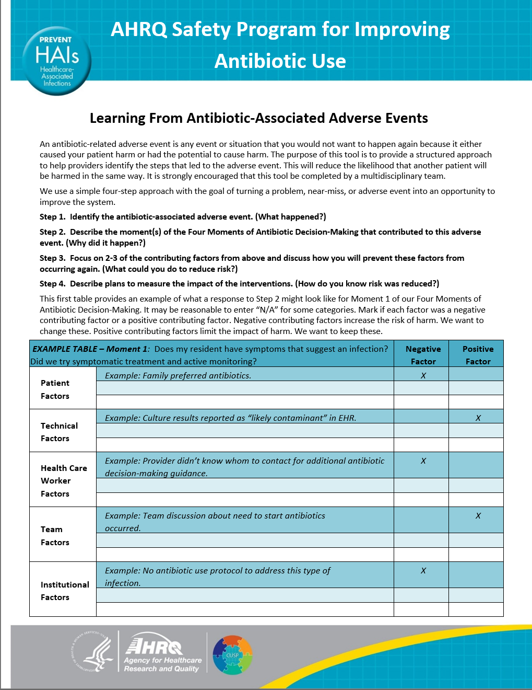
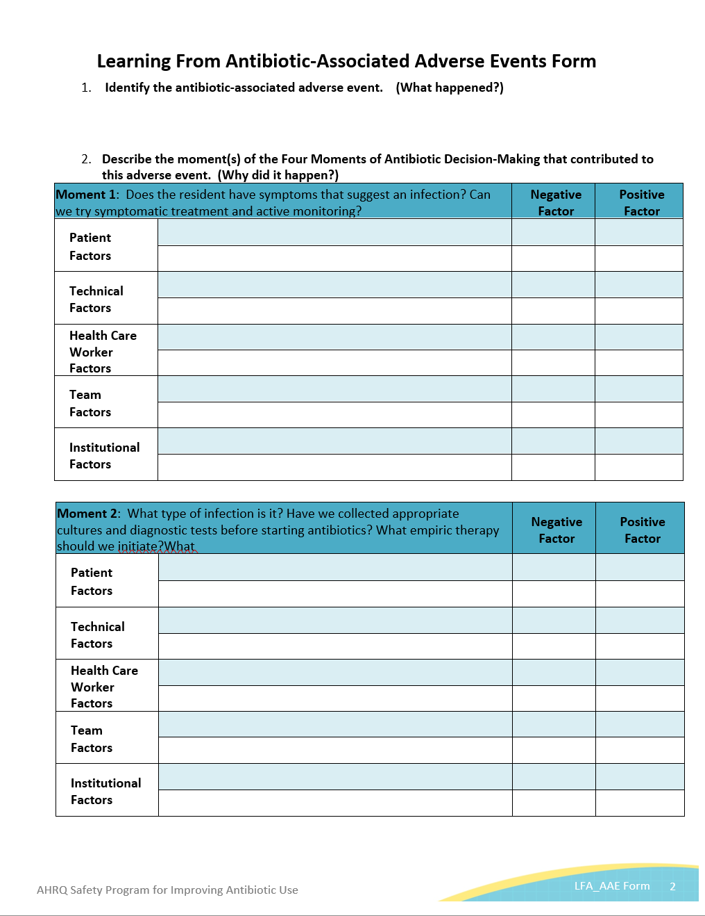
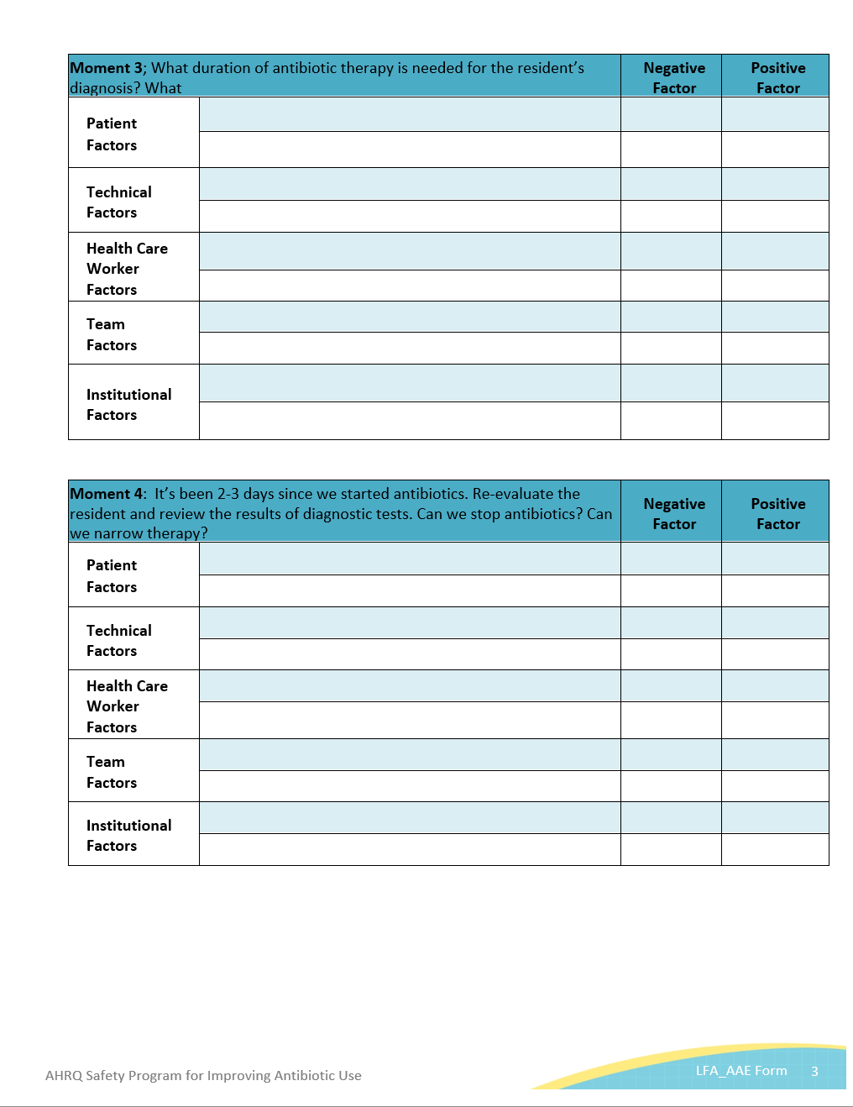
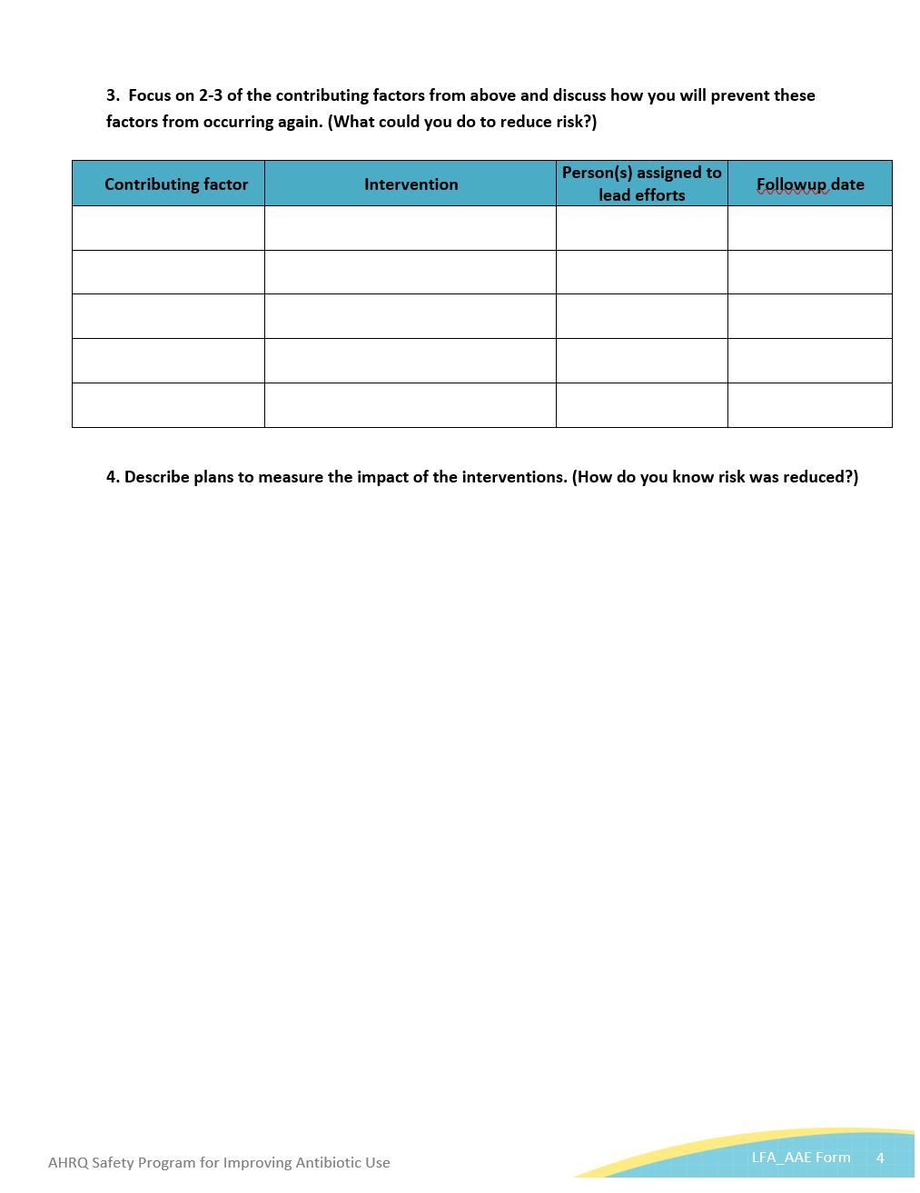
Problems Are Opportunities To Improve
What happened?
Why did it happen?
What could you do to reduce the risk?
How do you know that risk was reduced?
Learning From Antibiotic-Associated Adverse Events Form

Slide 13
What Happened?
Reconstruct the timeline.
Explain what happened.
Put yourself in the place of those involved.
Try to understand.
Imagine the world as they did when the event occurred.

Slide 14
Why Did It Happen?
Review list of factors that contributed to the incident.
Check off factors that negatively contributed and positively contributed to the incident.
Negative contributing factors are those that harmed or increased risk of harm
Positive contributing factors limited the impact of harm

Slide 15
What Could You Do To Reduce the Risk?
Set up safe design principles
Standardize what you do
Create independent checks
Make it visible

Slide 16
Strength of Interventions
Weaker Actions | Intermediate Actions | Stronger Actions
Order verification | Checklists/cognitive aid | Architectural/physical design changes
Warnings and labels | Increased staffing/reduce workload | Tangible involvement and action by leadership in support of patient safety
New policy, procedures, or memorandum | Redundancy | Simplify the process and remove unnecessary steps
Training and/or education | Enhance communication (e.g., read-back, SBAR) | Standardize equipment and/or process of care maps
Additional study/analysis | Software enhancement or modifications | New device usability testing before purchasing

Slide 17
How Do You Know the Risk Was Reduced?
Example – you create a new policy or procedure
Do staff know about policy or procedure?
Are staff using the procedure as intended?
Do staff believe risks were reduced?

Slide 18
Review
Identify a problem
Apply 4 moments
Learn from the problem to improve the system
Consider system/active failures which may have led to the problem or potential for harm.
Form an intervention to address an identified failure.
Test your intervention and disseminate your findings!

Slide 19
Activities To Complete
Activity, Stewardship Team | Activity, Frontline Providers
The Antibiotic Stewardship Team should complete a Staff Safety Assessment. Review the Staff Safety Assessments to identify common problems, themes, or ideas. Use the Learning From Antibiotic-Associated Adverse Events form to develop a plan. Keep the above materials to inform the next intervention. | Introduce the Four Moments of Antibiotic Decision Making Form. Apply this to 5-10 residents each month.
Supporting Materials
Staff Safety Assessment Four Moments of Antibiotic Decision Making Form Completion Guide for the Four Moments of Antibiotic Decision Making Form Learning From Antibiotic-Associated Adverse Events

Slide 20
Disclaimer
The findings and recommendations in this presentation are those of the authors, who are responsible for its content, and do not necessarily represent the views of AHRQ. No statement in this presentation should be construed as an official position of AHRQ or of the U.S. Department of Health and Human Services.
Any practice described in this presentation must be applied by health care practitioners in accordance with professional judgment and standards of care in regard to the unique circumstances that may apply in each situation they encounter. These practices are offered as helpful options for consideration by health care practitioners, not as guidelines.

Slide 21
References
Stranks, J. Human factors and behavioral safety. Butterworth-Heinemann. 2007; 130–1.
Kamoun G, Nicho M. Human and organizational factors of healthcare data breaches: the Swiss cheese model of data breach causation and prevention. Int J Healthc Inf Sys Inform. 2014;9(1):42–60.

