Slide 1
Improving Teamwork and Communication
AHRQ Safety Program for Improving Antibiotic Use
Long-Term Care
AHRQ Pub. No. 17(21)-0029
June 2021

Slide 2
Objectives
Recognize the importance of seeking input from all team members when making antibiotic prescribing decisions
Summarize how to use available AHRQ safety tools, such as SBAR, to improve communication related to antibiotic prescribing
Describe how to effectively communicate the potential harms of antibiotics to other health care providers, residents, and caregivers.

Slide 3
5 Steps for Improving the Culture of Patient Safety
Engage leadership for support and collaboration
Understand the science of safety
Improve teamwork and communication
Recognize current practices that may lead to patient harm
Develop system-based solutions to improve patient safety
3
3

Slide 4
Improve Teamwork and Communication
Improve teamwork
Develop tools and strategies to help teams work together effectively to improve resident safety
Team example: Staff performing weekly wound care rounds
Develop communication techniques for—
Stewardship and frontline team members
Residents and families

Slide 5
Four Key Characteristics of Effective Communication¹
Complete
Clear
Brief
Timely

Slide 6
Process of Communication²
Message to send
Encode
(My mom has a cough and I'm worried that she has pneumonia.)
Message Medium
Decode
(Daughter is worried and wants me to prescribe an antibiotic.)
Message received (but distorted)
“My mom has pneumonia; therefore, she needs an antibiotic.”

Slide 7
Process of Communication, Continued²
Message Received
Message to send
Decode
Message Medium
Encode
“I understand that you are worried about your mother. She has not had a fever, and all of her vital signs are stable. We will give her some cough medicine and some respiratory treatments to help her feel better and will continue to keep a close eye on her.
Most of the time, upper respiratory infections, or common colds, are caused by viral infections. I would like to hold off on starting antibiotics for now, because I don’t think she has a bacterial infection. Therefore, antibiotics will not be helpful, and antibiotics can cause side effects.”

Slide 8
DESC for Conflict With Patients and Families³
Describe the specific situation
Express your concerns about the action
Suggest other alternatives
Consequences should be stated and consensus should be reached

Slide 9
Case 1: Mr. W
Nurse: “I think Mr. W has a UTI. He didn’t eat dinner and he is not acting like himself. We need to start antibiotics.”

Slide 10
Case 1: Mr. W, Continued
Nurse: “I think Mr. W has a UTI. He didn’t eat dinner and he doesn’t seem like himself. We need to start antibiotics.”
Nurse should have mentioned:
“The resident has a fever.”
Simply saying the resident missed a meal and is acting funny is not enough.
“The resident’s symptoms are lower abdominal pain and fatigue.”

Slide 11
Case 1 — SBAR⁴
Improving Communication in a Brief and Timely Manner
Situation | State who you are calling about and why.
Background | State briefly what you know about the history and the current status. Include objective data: recent vital signs, pertinent exam findings, and notable labs.
Assessment | State what you think the problem is and how severe it is. A diagnosis is not necessary, but a specific concern should be stated.
Recommendations | State what you think needs to happen for the patient and also suggest a time frame.

Slide 12
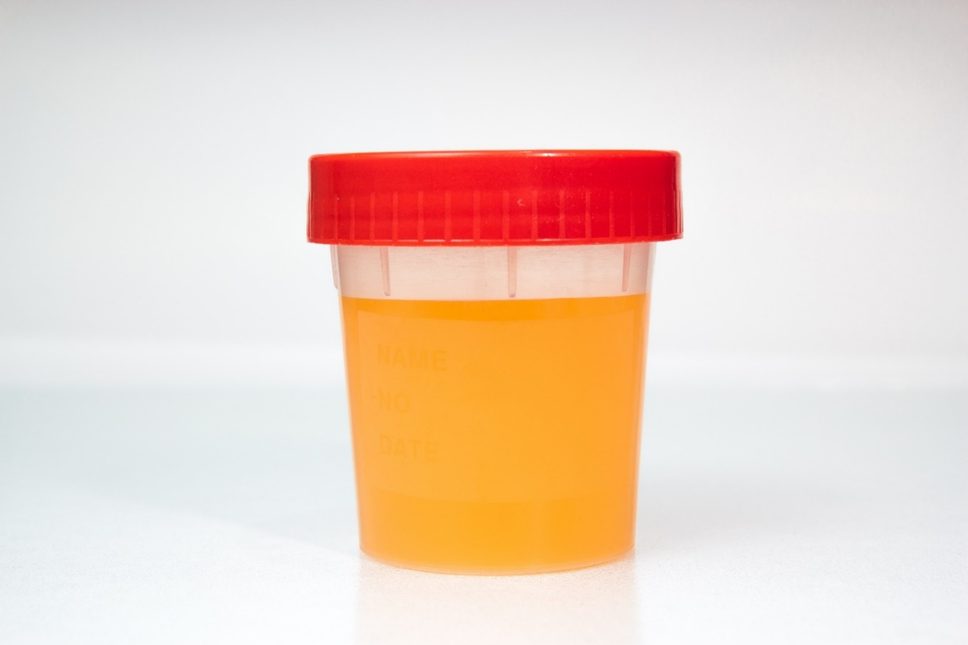
Case 2: Mrs. N
Two days later, Mrs. N’s urine culture results return with >100,000 CFU/mL gram-negative rods.

Slide 13
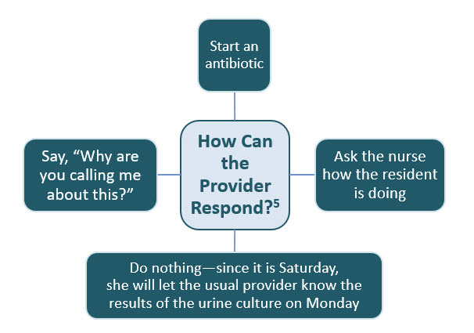
Case 2: Mrs. N, Continued

Slide 14
Case 3: Communication⁴
Situation | Hi Dr. K, I am calling about one of the residents.
Background | He was transferred here 3 weeks ago for rehab following a broken hip. He’s doing well.
Assessment | It looks like Mr. T was mistakenly continued on ciprofloxacin after his hospital discharge.
Recommendations | I think we need to stop the antibiotic now.
Why are you calling me about this on a Saturday? We will get to the bottom of it on Monday. I’m sure the hospital put him on it for a reason.
Covering
Physician
Nurse

Slide 15
Use Assertiveness (Not Aggressiveness)
Assertive | Aggressive
Standing up for your own or a patient’s interests Remaining calm and positive Respectfully defending your position Not accepting what is not right | Attacking (active) others’ opinions in favor of your own Ignoring (passive) others’ opinions in favor of your own
Approach for effective communication | Approach that impairs communication

Slide 16
Elements of Appropriate Assertion

Slide 17
Case 3: DESC Script^{3,5}
Describe the situation. | Dr. K, it looks like there was a mistake in the discharge paperwork and he has been continued on ciprofloxacin. He should not be on this antibiotic—it was started in the hospital for a UTI, but he has been on it for 3 weeks, and seems long to treat a urinary tract infection.
Express your concerns about the action. | I am concerned because he is also on several other drugs, which can lead to harmful drug interactions. There is also a black box warning on fluoroquinolones, and there are many side effects associated with this ciprofloxacin.
Suggest other alternatives. | I think we need to stop the ciprofloxacin today.
Consequences should be stated. | If we don’t stop the antibiotic today, he could suffer harmful side effects.

Slide 18
Summary
Efficient teamwork and effective communication play an integral role in the delivery of high-quality, resident-centered care that leads to improved outcomes for residents and the facility as a whole
Research shows a connection between communication errors and problems with patient care delivery
There are a variety of tools and strategies that health care teams can implement to improve the effectiveness of teamwork and communication in their clinical area

Slide 19
Activities To Complete
Activity, Stewardship Team | Activity, Frontline Providers
Collect data for your intervention As a team, apply the Four Moments of Antibiotic Decision Making Form to the care of one resident for whom there is concern for infection | Collect Staff Safety Assessment from frontline providers Introduce the DESC technique
Supporting Materials
Four Moments of Antibiotic Decision Making Form Completion Guide for the Four Moments of Antibiotic Decision Making Form DESC Technique Poster

Slide 20
Disclaimer
The findings and recommendations in this presentation are those of the authors, who are responsible for its content, and do not necessarily represent the views of AHRQ. No statement in this presentation should be construed as an official position of AHRQ or of the U.S. Department of Health and Human Services.
Any practice described in this presentation must be applied by health care practitioners in accordance with professional judgment and standards of care in regard to the unique circumstances that may apply in each situation they encounter. These practices are offered as helpful options for consideration by health care practitioners, not as guidelines.

Slide 21
References
TeamSTEPPS for Office-Based Care: Communication. September 2015. Agency for Healthcare Research and Quality, Rockville, MD. http://www.ahrq.gov/teamstepps/officebasedcare/module3/office_comm.html. Accessed June 28, 2017.
Dayton E, Henriksen K. Communication failure: basic components, contributing factors, and the call for structure. Jt Comm J Qual Patient Saf. 2007 Jan;33(1):34-47. PMID: 17283940.
DESC Script. Johns Hopkins Medicine, Armstrong Institute. Kentucky Hospital Improvement Innovation Network. KY. July 2012. http://www.k-hen.com/Portals/16/Documents/PSCTCommunicationsLab.pdf Accessed Jun 19, 2017.
SBAR Toolkit. Institute for Healthcare Improvement. Cambridge, MA. 2017. http://www.ihi.org/resources/Pages/Tools/sbartoolkit.aspx . Accessed June 23, 2017.
Toolkit 3. Minimum Criteria for Common Infections Toolkit. September 2017. Agency for Healthcare Research and Quality, Rockville, MD. https://www.ahrq.gov/nhguide/toolkits/determine-whether-to-treat/toolkit3-minimum-criteria.html. Accessed Aug 29, 2018.

