Slide 1
Discussing Infectious Concerns About Residents With Family Members and Caregivers
AHRQ Safety Program for Improving Antibiotic Use
Long-Term Care
AHRQ Pub. No. 17(21)-0029
June 2021

Slide 2
Objectives
Review strategies to discuss potential harm associated with antibiotic use to family members of residents
Address end-of-life care as it relates to antibiotic use
Recognize supportive and comfort care measures for residents who are uncomfortable

Slide 3
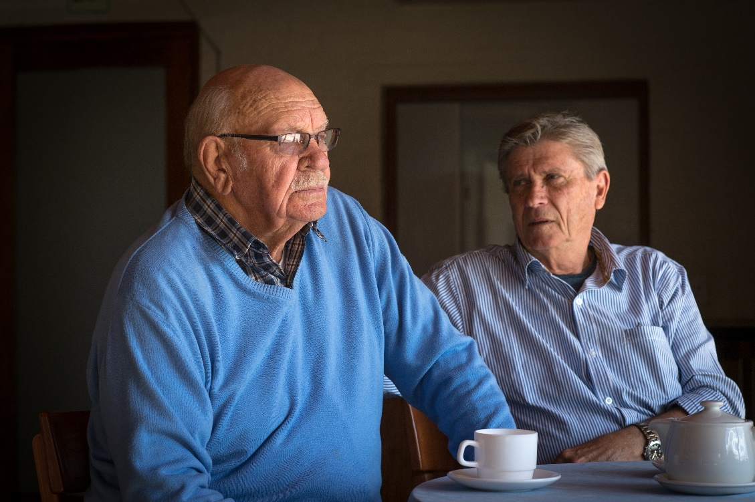
Social Pressure Can Drive Antibiotic Prescribing^{1,2}
Family pressure to prescribe antibiotics may drive unnecessary prescriptions
Social pressure can be reduced with proper education and involvement of family members in the care plan

Slide 4


Pressure To Prescribe²
“… if the family really insists, then
I am quite willing to prescribe [antibiotics].”
“…in retrospect I just shouldn’t have done it [prescribed antibiotics]. But sometimes you do it for the family…”

Slide 5

Case 1: Ms. Alvarez
Ms. Alvarez is a long-term care resident with a history of Parkinson’s disease and dementia
Refused breakfast and seems less “vibrant” than usual
Keeps talking about her
husband, who passed
away several years ago
Ms. Alvarez’s daughter
says that last time this
happened her mother was diagnosed with a UTI, and she requests a urine culture

Slide 6
Case 1: Ms. Alvarez, Continued
Ms. Alvarez is sitting in a chair looking out the window
Her vital signs are within the normal range
She does not have a Foley catheter and denies any pain, and her examination is normal
She does not verbalize any symptoms
She tells you she did not eat breakfast because she is waiting for her husband to join her
You determine that Ms. Alvarez is clinically stable and she is a bit more confused than baseline

Slide 7


Effective Communication
Listen to concerns
  Restate the concerns or main problem
  “I agree that she seems a bit more confused.”
Address concerns
  Express empathy/understanding
  Explain your reasoning
  Offer solutions and reassurance

Slide 8

Empathy & Understanding
“It must be hard to see your mom like this. She must be very different from the person you knew even just a year ago.”

Slide 9
Explain Your Reasoning
“Physically, your mom looks OK. She does not have a fever and her assessment is normal.”
“I understand you are concerned, but she does not have signs or symptoms of infection right now. There are lots of reasons why she might be more confused today.”
“Research from the last few years tells us that UTIs are not really a common reason for confusion.”
“Sometimes a bad night’s sleep or a change in medication can make someone confused. Sometimes even just a little dehydration can affect an older adult.”

Slide 10
Explain Your Reasoning, Continued
“It’s really hard to get a clean urine sample so the culture often comes back looking positive, but it’s because of contamination. To get a really good sample, we may have to do an in-and-out catheterization—which is pretty uncomfortable, and I don’t think the pain she will feel is worth it when the suspicion for a UTI is very low.”
“Getting a urine culture, which is likely to be contaminated, could lead to treating her for an infection she does not have, which may cause harm.”

Slide 11
Explain Your Reasoning, Continued
“Antibiotics can have significant side effects, including allergic reactions, diarrhea, or other gastrointestinal upset. Exposure to antibiotics also puts your mom at risk for developing a future infection with resistant bacteria, which could make antibiotics less effective for her.”

Slide 12
Offer Solutions
“We will watch her closely over the next 24 hours and get vital signs on a regular basis.”
“It is possible that she is dehydrated or did not get enough sleep last night. I think we should try and make sure she drinks enough fluid and continue to reorient her.”
“If you’re going to be here for a while, maybe you can encourage her to keep drinking some water or juice.”
“If she does not get better in the next day or two, or looks worse before that, we’ll talk again and see what else we can try.”

Slide 13
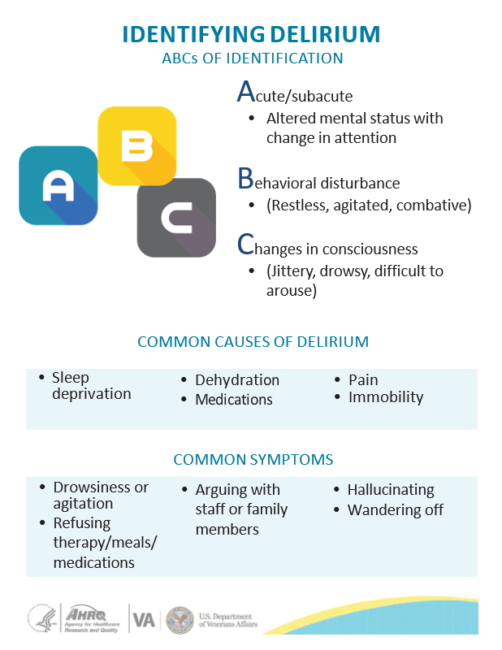
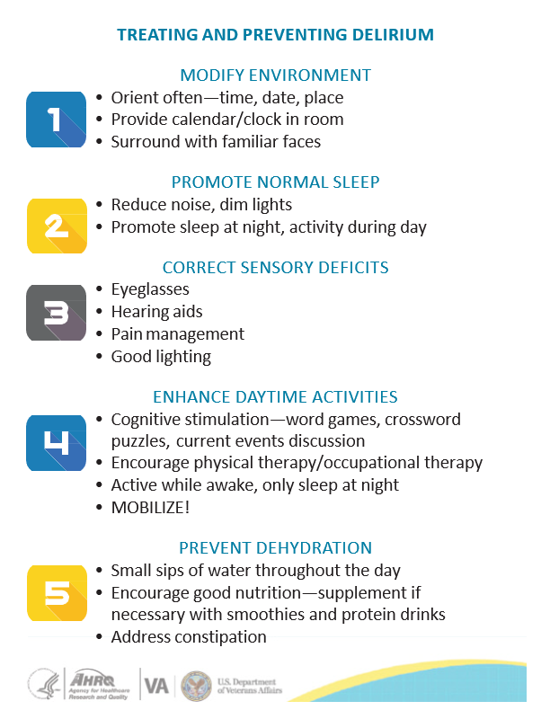
Offer Solutions

Slide 14
Success!
Ms. Alvarez’s daughter
agrees to the plan for
active monitoring.
The next morning,
Ms. Alvarez seems back
to her baseline.
Her daughter seems
happy with her care.
She understands why you made the decision you made.
She decides that in the future, she will not immediately ask for antibiotics every time her mom has a change in mental status.

Slide 15
End-of-Life Care³
Antibiotics are often prescribed to people who are dying, even when they don’t have symptoms of a bacterial infection
42% of nursing home residents with advanced dementia are prescribed antibiotics during their last 2 weeks of life
25% of hospice patients receive antibiotics during their final weeks of life

Slide 16
End-of-Life Care^{4,5}
Antibiotic therapy may cause harm, particularly for frail, elderly patients
Potential rehospitalization
Invasive diagnostic testing (catheters, blood draws)
IV therapy requires uncomfortable lines
Antibiotics cause side effects (rashes, diarrhea)
Antibiotics cause drug-resistant bacteria to develop

Slide 17

Case 2: Ms. Jones
72-year-old woman
Recently transferred to your facility for hospice care for stage 4 metastatic lung cancer
Has limited capacity to make
medical decisions
Made it clear that her goal
was to die comfortably
Her family was in agreement
with these wishes
A few days after she is transferred, she develops a productive cough

Slide 18
Case 2: Ms. Jones, Continued
“I think she has pneumonia; she’s been coughing like crazy.
We better start her on antibiotics.”
Assessment:
She has a productive cough and crackles at the base of her left lung
She is lying in bed breathing comfortably on 2L/min nasal cannula
She has no fever and no increase in her oxygen requirements

Slide 19

Case 2: Support and Comfort
Humidified oxygen
Giving her the option of getting oxygen through a mask because it’s hard to inhale through her nose when coughing
Tissues and a cup at
her bedside to spit into
Additional pillows
  Including one to hug
  while she’s coughing
  because she complained
  of being sore from
  coughing so much
Refilling her water pitcher
Lozenges, cough suppressants

Slide 20
Case 2: Ms. Jones, Continued
You review her advance directive
  She is DNR/DNI and has requested no life prolonging interventions
  Her goal is comfort care
Discuss her care with the patient and her husband
Let’s review our approach and think about some ways to talk with Ms. Jones and her husband

Slide 21

Effective Communication
Listen to concerns
  Restate the concerns or main problem
  “I understand why you are concerned about this cough. I hear it, and it sounds pretty rough.”
Address concerns
  Express empathy/understanding
  Explain your reasoning
  Offer solutions and reassurance

Slide 22

Empathy & Understanding
“This must be so hard for you, to see her suffer with such a terrible disease.”
“We expect her to have a cough as the lung cancer progresses.”
“It is possible that your wife may develop pneumonia; this is a common infection at the end of life.”

Slide 23
Reasoning⁵
“People in hospice care often die from infections. What we understand is that attempting to treat infections does not change the overall situation and sometimes actually decreases their level of comfort.”
“Even if we treat her for pneumonia, it won’t make her any better than she was a day or two ago.”
“People with pneumonia often need to go to the hospital. Sometimes we start treatment here, but even oral medications have risks and side effects.”

Slide 24
Solutions and Reassurance
“We can try to make her more comfortable by making it easier to cough phlegm out of her lungs. We can give her humidified oxygen and nebulizer treatments. There are also over-the-counter medications that may help.”
“Some medications, like codeine or morphine, will help suppress the cough reflex, which means she can get some rest. They also cause sedation and will make it easier for her to be comfortable.”

Slide 25

Family Meetings Regarding End-of-Life Care
Establish resident/family goals of care
Inform the family that infections are expected at the end of life, and may often be the terminal event
Reassure them that your team will continue to provide symptomatic relief and comfort measures

Slide 26

Key Points
Effective communication is a key component
Educating residents and family members about the risks of antibiotic treatment is recommended prior to prescribing antibiotics
Goals of care should be established early on in the treatment plan

Slide 27


AHRQ Safety Program for Improving Antibiotic Use
Long-Term Care
Narrated Presentation
Discussing Infectious Concerns About Residents With Family Members and Caregivers
Content supported in part by the VA
Link to Discussing Infectious Concerns narrated presentation

Slide 28
Activities To Complete
Activity, Stewardship Team | Activity, Frontline Providers
Hold your Antibiotic Stewardship Team meeting Collect and analyze data using the Monthly Data Collection Form | Review the Talking With Residents and Family Members About Antibiotics poster and display in common areas, such as break rooms and work stations Apply the Four Moments of Antibiotic Decision Making Form to 5–10 residents each month
Supporting Materials
Talking With Residents and Family Members About Antibiotics poster Identifying Delirium Pocket Cards (4x6 and 8x11) Four Moments of Antibiotic Decision Making Form Monthly Data Collection Form

Slide 29
Disclaimer
The findings and recommendations in this presentation are those of the authors, who are responsible for its content, and do not necessarily represent the views of AHRQ. No statement in this presentation should be construed as an official position of AHRQ or of the U.S. Department of Health and Human Services.
Any practice described in this presentation must be applied by health care practitioners in accordance with professional judgment and standards of care in regard to the unique circumstances that may apply in each situation they encounter. These practices are offered as helpful options for consideration by health care practitioners, not as guidelines.

Slide 30
References
Fleming A, Bradley C, Cullinan S, et al. Antibiotic prescribing in long-term care facilities: a qualitative, multidisciplinary investigation. BMJ Open. 2014 Nov 5;4(11):e006442. PMID: 25377014.
Van Buul LW, van der Steen JT, Doncker SM, et al. Factors influencing antibiotic prescribing in long-term care facilities: a qualitative in-depth study. BMC Geriatr. 2014 Dec 16;14:136. PMID: 25514874.
D’Agata E, Mitchell SL. Patterns of antimicrobial use among nursing home residents with advanced dementia. Arch Intern Med. 2008 Feb 25;168(4):357-62. PMID: 18299489.
Levin PD, Simor AE, Moses AE, et al. End-of-life treatment and bacterial antibiotic resistance: a potential association. Chest. 2010 Sep;138(3):588-94. PMID: 20472860.
Givens JL, Jones RN, Shaffer ML, et al. Survival and comfort after treatment of pneumonia in advanced dementia. Arch Intern Med. 2010 Jul 12;170(13):1102-7. PMID: 20625013.

