Slide 1
Management of a Resident With a Suspected Respiratory Tract Infection
AHRQ Safety Program for Improving Antibiotic Use
Long-Term Care
AHRQ Pub. No. 17(21)-0029
June 2021

Slide 2
Objectives
Review testing and empiric treatment options for pneumonia
Discuss opportunities for de-escalation of antibiotic therapy for pneumonia using results of diagnostic tests
Discuss reasonable durations of antibiotic therapy for pneumonia for residents of long-term care settings

Slide 3
Risk Stratification
Residents in generally good health with suspected bacterial pneumonia are likely to be infected with common community pathogens (e.g., Streptococcus pneumoniae, Haemophilus influenzae).
Residents who meet any of the following criteria are at risk of pneumonia with more resistant infections such as Pseudomonas aeruginosa:
Recent hospitalization or exposure to broad-spectrum antibiotics
Previous growth of Pseudomonas
Bronchiectasis or tracheostomy dependency
Immunocompromised

Slide 4
Case 1: Mary
90-year-old resident with mild dementia
Treated 2 weeks ago for a suspected UTI with nitrofurantoin
Typically active and works well with physical therapy Has no problems swallowing and is at low risk for aspiration
Now:
Nurse notices she has been coughing all night
Temperature of 99.2° Fahrenheit

Slide 5
Case 1: Diagnostic Evaluation
First Steps: Physical exam with vital signs, lung exam, CBC with differential, chest x ray
Temp 99.2° Fahrenheit
Heart rate 98 beats per minute
Blood pressure 110/87
Oxygen saturation 95%
Respiratory rate 22 breaths per minute
WBC count 11,200 cells/mL, 74% neutrophils
Elderly woman, appears fatigued
Coughing intermittently
Few crackles at base of left lung
Chest x ray: hazy infiltrate left lower lobe

Slide 6
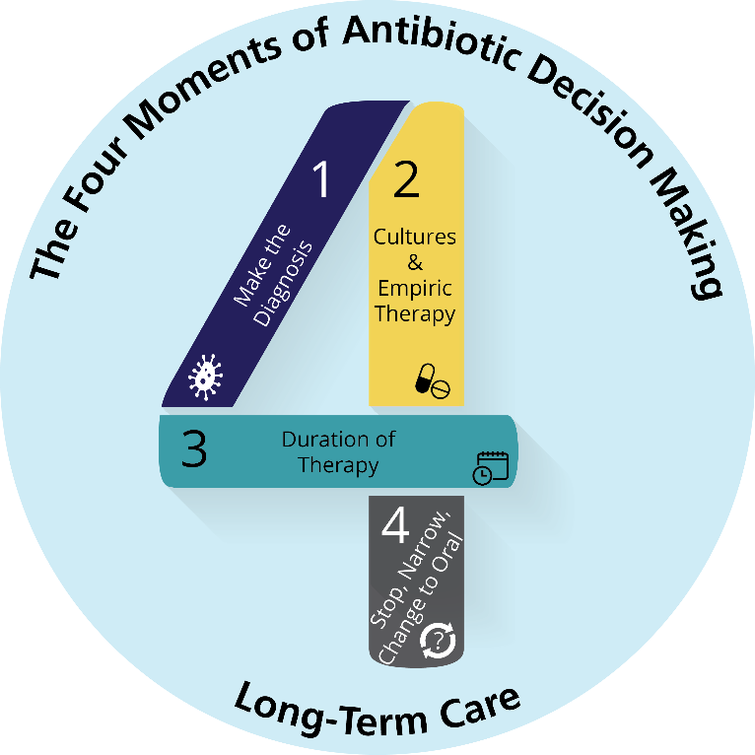
The Four Moments of Antibiotic Decision Making
Does the resident have symptoms that suggest an infection? Can we try symptomatic treatment and active monitoring?
What type of infection is it? Have we collected appropriate cultures and diagnostic tests before starting antibiotics? What empiric therapy should we initiate?
What duration of antibiotic therapy is needed for the resident’s diagnosis?
It’s been 2–3 days since we started antibiotics. Re-evaluate the resident and review results of diagnostic tests. Can we stop antibiotics? Can we narrow therapy?

Slide 7
Bronchitis Versus Pneumonia
Acute Bronchitis
Definition:
Self-limited inflammation of bronchi, the large airways of the lung
Cause:
Viral (with rare exceptions)
Symptoms:
Cough for 5 days to 3 weeks
Fever less common (unless influenza)
50% have increased sputum production
Diagnostic Studies:
Normal to slightly elevated WBCs
Infiltrate on chest x ray unlikely
Pneumonia
Definition:
Infection of the lung tissue
Cause:
~75% bacteria, ~25% viral
Symptoms:
Cough, fever is common, increased sputum production common, chest wall pain, tachypnea
Diagnostic Studies:
Elevated WBCs
Chest x rays show infiltrates
7

Slide 8
The Four Moments of Antibiotic Decision Making
Does the resident have symptoms that suggest an infection? Can we try symptomatic treatment and active monitoring?
What type of infection is it? Have we collected appropriate cultures and diagnostic tests before starting antibiotics? What empiric therapy should we initiate?
What duration of antibiotic therapy is needed for the resident’s diagnosis?
It’s been 2–3 days since we started antibiotics. Re-evaluate the resident and review results of diagnostic tests. Can we stop antibiotics? Can we narrow therapy?

Slide 9
Diagnostic Tests^{1,2}
Gram stain and sputum culture
Respiratory viral panel
Coronavirus infection or COVID-19 PCR
Streptococcus pneumoniae urinary antigen (Ag)
Legionella urinary Ag

Slide 10
Urinary Antigen Tests
Urine pneumococcal and Legionella Ags
Often not available in nursing homes
Consider obtaining access to these diagnostic tests

Slide 11
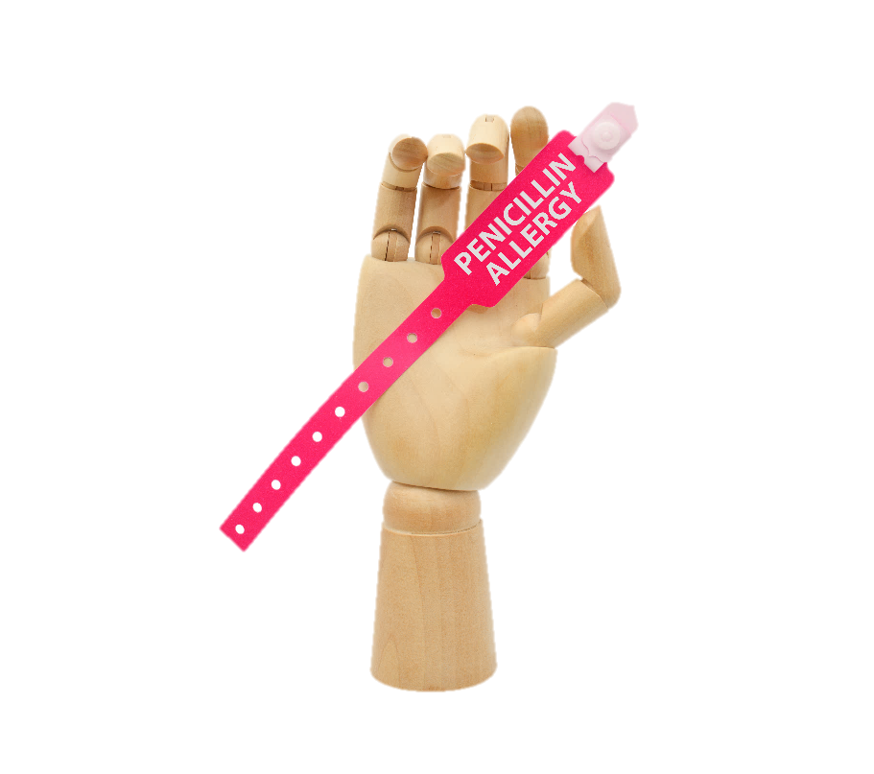
Treatment: Low Risk for a Resistant Organism³
Beta-lactam therapy (amoxicillin-clavulanate, oral second or third-generation cephalosporins, ampicillin-sulbactam, or ceftriaxone)³
PLUS
azithromycin or doxycycline
Penicillin allergic:
moxifloxacin or levofloxacin

Slide 12
Narrated Presentation
Link to Penicillin Allergy narrated presentation

Slide 13
Treatment: At Risk for a Resistant Organism¹
Consider cefepime or piperacillin-tazobactam (with or without anti-MRSA therapy)
PLUS
azithromycin or doxycycline
Penicillin allergic:
levofloxacin +/- anti MRSA therapy

Slide 14
Case 1: Mary
The on-call health care practitioner starts Mary on a 10-day course of levofloxacin.
Fortunately, her daytime provider remembered to send a flu swab and urine pneumococcal testing.

Slide 15
The Four Moments of Antibiotic Decision Making
Does the resident have symptoms that suggest an infection? Can we try symptomatic treatment and active monitoring?
What type of infection is it? Have we collected appropriate cultures and diagnostic tests before starting antibiotics? What empiric therapy should we initiate?
What duration of antibiotic therapy is needed for the resident’s diagnosis?
It’s been 2–3 days since we started antibiotics. Re-evaluate the resident and review results of diagnostic tests. Can we stop antibiotics? Can we narrow therapy?

Slide 16
Duration
5 to 7 days of antibiotics is sufficient!⁴⁻⁷
Mary needs 5 days total

Slide 17
Case 1: Mary
Mary’s urine pneumococcal Ag is positive What is the next best step in management?
Continue the previous levofloxacin course.
Stop levofloxacin and switch to amoxicillin.
Stop all antibiotics.
Transfer to the hospital.

Slide 18
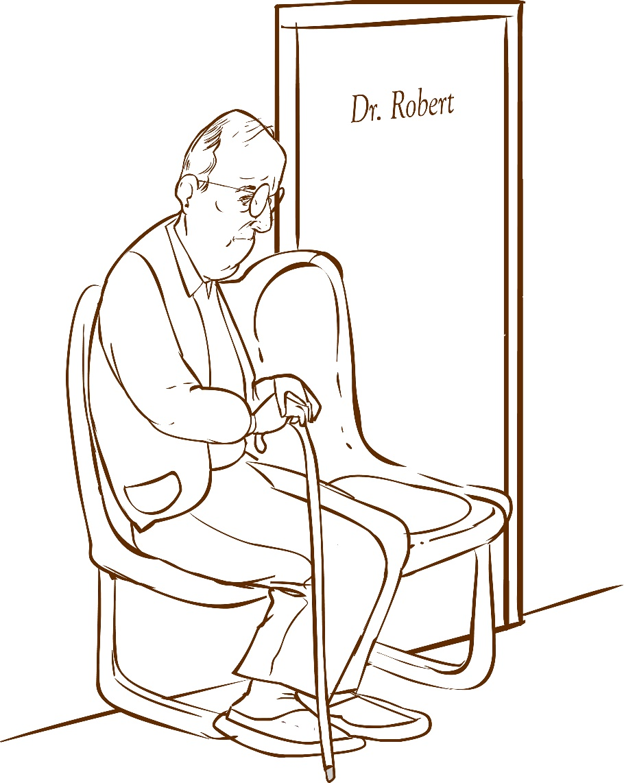
When To Consider Transfer
Resident has not shown clinical improvement within 24 hours of starting antibiotic therapy
Clinical instability
Unable to maintain oxygen saturation
Hypotension (systolic blood pressure <100)
Tachycardia (heart rate >100 beats per minute)

Slide 19
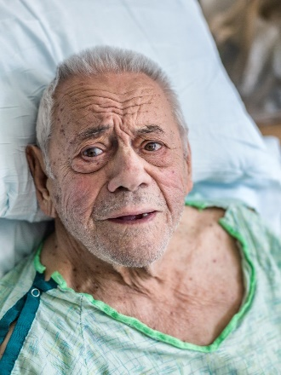
Case 2: Francisco
Evening nurse notes:
92-year-old bed-bound resident at your facility
Daytime nurse notes:
When she was feeding him applesauce earlier that day he choked
Was coughing afterwards
He is coughing a lot
His oxygen saturations are dropping

Slide 20
Francisco’s Chest X Ray⁸
Chest x ray shows new consolidation in right lower lobe
WBC count 12,000 cells/µL
Image courtesy of Massachusetts Medical Society, August 13, 2018

Slide 21
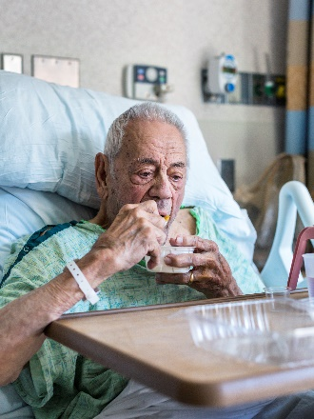
Aspiration Pneumonia Versus Pneumonitis⁸
 | Aspiration Pneumonitis | Aspiration Pneumonia
Pathophysiology | Acute lung injury from acidic material | Progression to bacterial infection
Clinical features | No symptoms or productive cough, respiratory distress 2–5 hours after aspiration with improvement within 24 hours | Tachypnea, cough, and fever
Treatment | Active monitoring Prevention—speech and swallow evaluation | Antibiotics Respiratory support

Slide 22
Case 2: Management
What is the next best step in management?
Start levofloxacin.
Obtain a sputum culture, urine Legionella antigen, and urine pneumococcal antigen.
Transfer to the emergency department.
Place on speech/swallow precautions and start active monitoring for at least 48 hours.

Slide 23
Treatment Choices
Similar treatment approach to bacterial pneumonia—make sure to assess risk of infection with a resistant organism!

Slide 24
Key Points
Appropriate diagnostic testing can determine if an infection is present and help target antibiotic therapy.
5 to 7 days of antibiotics is sufficient for most cases of pneumonia.
Antibiotics are not always necessary for people who have aspirated.
Active monitoring is recommended for at least 48 hours and starting antibiotics if the resident gets worse or does not improve.

Slide 25
Activities To Complete
Activity, Stewardship Team | Activity, Frontline Providers
Hold monthly stewardship meetings Collect and analyze data using the Monthly Data Collection Form | Review the Talking With Residents and Family Members About Lower Respiratory Tract Infections poster and display it in common areas, such as break rooms and work stations Distribute the Bacterial Pneumonia in Long-Term Care, Respiratory Virus Infections and Aspiration Pneumonitis and Aspiration Pneumonia one-pagers to prescribing clinicians and other frontline staff Apply the Four Moments of Antibiotic Decision Making Form to 5–10 residents each month
Supporting Materials
Talking With Residents and Family Members About Lower Respiratory Tract Infections poster Bacterial Pneumonia in Long-Term Care one-pager Approach to Patients With Reported Penicillin Allergy one-pager Four Moments of Antibiotic Decision Making Form Monthly Data Collection Form

Slide 26
Disclaimer
The findings and recommendations in this presentation are those of the authors, who are responsible for its content, and do not necessarily represent the views of AHRQ. No statement in this presentation should be construed as an official position of AHRQ or of the U.S. Department of Health and Human Services.
Any practice described in this presentation must be applied by health care practitioners in accordance with professional judgment and standards of care in regard to the unique circumstances that may apply in each situation they encounter. These practices are offered as helpful options for consideration by health care practitioners, not as guidelines.

Slide 27
References
Metlay JP, Waterer GW, Long AC, et al. Diagnosis and treatment of adults with community-acquired pneumonia. An Official Clinical Practice Guideline of the American Thoracic Society and Infectious Diseases Society of America. Am J Respir Crit Care Med. 2019; 200:e45–e67. PMID: 31573350.
Jain S, Self WH, Wunderink RG, et al. Community-acquired pneumonia requiring hospitalization among U.S. adults. N Engl J Med. 2015 Jul 30;373(5):415-27. PMID: 26172429.
Bartlett JG, Breiman RF, Mandell LA, et al. Community-acquired pneumonia in adults: guidelines for management. The Infectious Diseases Society of America. Clin Infect Dis. 1998 Apr;26(4):811-38. PMID: 9564457.
Shorr AF, Zadeikis N, Xiang JX, et al. A multicenter, randomized, double-blind, retrospective comparison of 5- and 10-day regimens of levofloxacin in a subgroup of patients aged > or =65 years with community-acquired pneumonia. Clin Ther. 2005 Aug;27(8):1251-9. PMID: 16199249.
Chastre J, Wolff M, Fagon JY, et al. Comparison of 8 vs 15 days of antibiotic therapy for ventilator-associated pneumonia in adults: a randomized trial. JAMA. 2003 Nov 19;290(19):2588-98. PMID: 14625336.
Kalil AC, Metersky ML, Klompas M, et al. Management of adults with hospital-acquired and ventilator-associated pneumonia: 2016 clinical practice guidelines by the Infectious Diseases Society of America and the American Thoracic Society. Clin Infect Dis. 2016 Sep 1;63(5):e61-e111. PMID: 27418577.

Slide 28
References
Larimore WL, Hartman JR. Diary from a week in practice. Am Fam Physician. 1992 Jan;45(1):110, 112. PMID: 1728083.
Marik PE. Aspiration pneumonitis and aspiration pneumonia. N Engl J Med. 2001 Mar 1;344(9):665-71. PMID: 11228282.

