Slide 1
Appropriate Collection of Microbiologic Specimens
AHRQ Safety Program for Improving Antibiotic Use
Long-Term Care
AHRQ Pub. No. 17(21)-0029
June 2021

Slide 2
Objectives
Recognize that collecting a good specimen is important to making treatment decisions.
Detail procedures for collecting urine and respiratory samples from nursing home residents.
Describe strategies that reduce the risk of collecting contaminated microbiologic samples.
Goal—to collect high-quality samples, which will lead to better decisions about antibiotic prescriptions for residents

Slide 3
Case 1: Clara
Indications for Urine Collection
Residents without urinary catheters who develop new pain with urination, or dysuria
Commonly Mistaken Symptoms
Incontinence or urgency alone
Foul-smelling or cloudy urine

Slide 4
Case 1: Continued
“I do not think I can stand long enough to get a midstream, ‘clean catch’ urine sample on my own.”

Slide 5
Case 1: Options for Female Residents
Offer to catch urine while she urinates.
Provide a toilet hat to collect urine.
Obtain an in-and-out catheterization.

Slide 6
Case 1: Options for Male Residents
Catch midstream specimen.
Clean skin around genitals to reduce bacterial contamination.
Help clean the periurethral region and maintain midstream specimen.
Provide condom catheter.

Slide 7
Case 2: Bernard
Resident has chronic indwelling urinary catheter due to urinary retention and inability to void independently
Develops a fever with flank pain

Slide 8
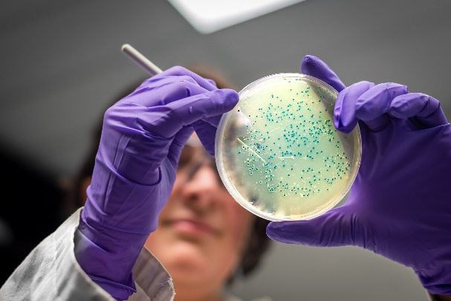
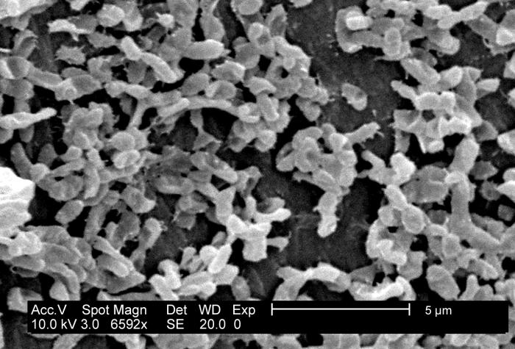
Why We Collect Urine From a Clean Catheter¹
Rapid Colonization
Biofilm Formation
False Positive Culture
Biofilm image source: Chelsea Samaniego Meltzer, EID Fellow, Centers for Disease Control and Prevention Biofilm Laboratory, Division of Healthcare Quality Promotion. https://phil.cdc.gov/Details.aspx?pid=5041. Accessed March 31, 2020.

Slide 9
Case 2: True/False
Why place a new urinary catheter before collecting the sample?²
If the urinary catheter has been in too long, the urine specimen is not helpful.
Placing a new catheter can help hasten the resolution of symptoms.
The catheter does not need to be changed before collecting the sample.

Slide 10
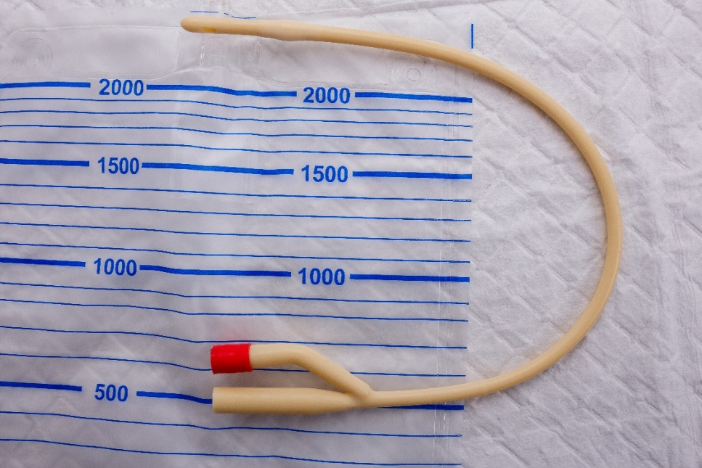
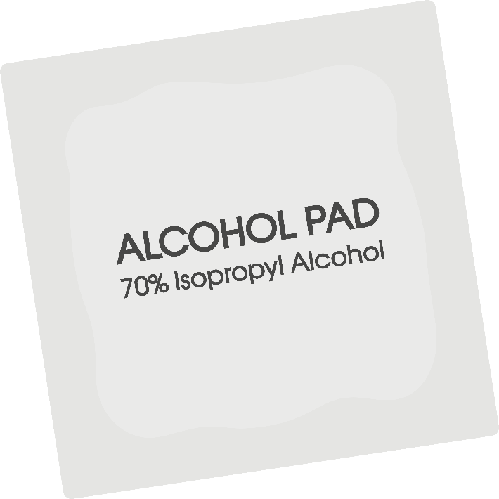
Steps To Collect Urine From a Clean Catheter
If no urine is in the tube, clamp the tube for 15–30 minutes prior to procedure.
Alcohol wipe the port prior to access.
Insert a 10 cc syringe at an angle into the port. Draw back 3–5 mL.
Insert specimen into sterile container.
Label the specimen with time, date, and type/source. Transfer to lab or refrigerator within 15 minutes.

Slide 11
Knowledge Check
1
Why do you need to change gloves before a new catheter is placed?
You just removed a contaminated catheter. If you don’t change gloves, you will immediately transfer bacteria to the new catheter and contaminate the urine specimen.

Slide 12
Knowledge Check, continued
2
Why is it important to refrigerate the specimen if it can’t be transported to the lab within 2 hours?
Specimens that aren’t handled properly are at risk for bacterial overgrowth and should not be accepted for analysis in the laboratory. All that hard work obtaining the urine sample will be useless if the specimen isn’t stored and transported appropriately.

Slide 13
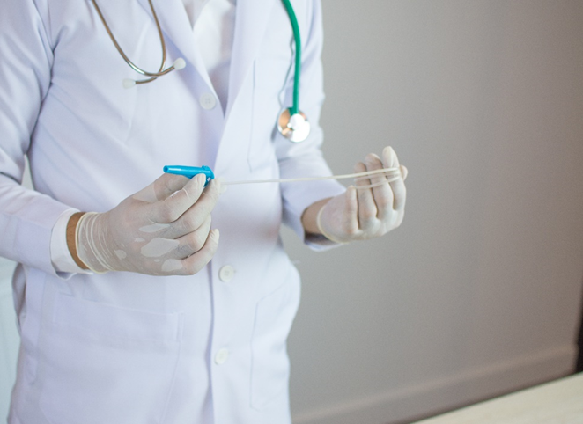
Take-Home Messages: Urine Collection
Help residents clean the periurethral region prior to collecting a urine sample.
If midstream clean-catch specimens are not possible, perform an in-and-out catheterization.
For residents with a catheter, urine culture specimens should be obtained from freshly placed catheters, when feasible.
Always wash your hands and obtain the specimen in a sterile container.
Transport urine samples promptly (within 15 minutes) to lab; refrigerate if samples cannot be transported immediately.

Slide 14
Case 3: Carol
What else should be sent in the evaluation?
CBC with differential
Urine Legionella and urine Strep
pneumoniae antigen (if available)
Rapid influenza – during influenza
season (and other respiratory
viruses depending on local
epidemiology)
Urine culture – not indicated
here, with other localizing
symptoms (respiratory) and no
complaints of urinary symptoms

Slide 15
Case 3: Continued
How could you have—
Prevented the resident from being started on broad- spectrum antibiotics?
Improved the likelihood of obtaining a good sputum sample the first time?
Avoided the mistakes that were made in the respiratory collection process?

Slide 16
Collecting a Good Respiratory Sample
Wash hands and use new gloves for specimen collection.
Ask the resident to rinse her mouth with water prior to collection.
Transfer to the lab or refrigerator promptly.
Obtain an early-morning specimen, ideally before starting antibiotics.
Explain to the resident that you need phlegm from her lungs, not just spit from her mouth.
Collect the specimen in a sterile, labeled container.

Slide 17
Remember That Clinical Context Is Important!
Sputum cultures should only be sent on residents whom you are concerned have a lower respiratory tract infection (pneumonia).
A positive sputum culture does not necessarily mean that organism is responsible for infection.
Sputum cultures should NOT be sent on residents with bronchitis or a COPD exacerbation as these are typically caused by viral infections.

Slide 18
Summary
Bacterial cultures should only be collected from residents with abnormal and concerning clinical symptoms.
Bacterial colonization does not necessarily represent infection.
A good microbiologic specimen can help to make the correct diagnosis and direct treatment—and protect your residents from unnecessary antibiotic use.

Slide 19
Activities To Complete
Activity, Stewardship Team | Activity, Frontline Providers
Continue to meet monthly as a team and review interventions. Continue to collect and analyze data using the Monthly Data Collection Form. | Share feedback about the intervention with the Antibiotic Stewardship Team. Review the Collecting Bacterial Cultures and Urine Culture Collection posters and display them in common areas, such as break rooms and work stations. Review sample collection processes for urine at your facility. Apply the Four Moments of Antibiotic Decision Making Form to 5–10 residents each month.
Supporting Materials
Collection of Microbiological Cultures Collecting Bacterial Cultures Poster Urine Culture Collection Poster Four Moments of Antibiotic Decision Making Form Monthly Data Collection Form

Slide 20
Disclaimer
The findings and recommendations in this presentation are those of the authors, who are responsible for its content, and do not necessarily represent the views of AHRQ. No statement in this presentation should be construed as an official position of AHRQ or of the U.S. Department of Health and Human Services.
Any practice described in this presentation must be applied by health care practitioners in accordance with professional judgment and standards of care in regard to the unique circumstances that may apply in each situation they encounter. These practices are offered as helpful options for consideration by health care practitioners, not as guidelines.

Slide 21
References
Centers for Disease Control and Prevention. Public Health Image Library (PHIL). Office of the Associate Director for Communications, Division of Public Affairs. https://phil.cdc.gov/phil/details.asp. Accessed July 25, 2017.
Hooton TM, Bradley SF, Cardenas DD, et al. Diagnosis, Prevention, and Treatment of Catheter-Associated Urinary Tract Infection in Adults: 2009 International Clinical Practice Guidelines from the Infectious Diseases Society of America. Clin Infect Dis. 2010 Mar1;50(5):625-63. PMID: 21075247. https://www.idsociety.org/uploadedFiles/IDSA/Guidelines-Patient_Care/PDF_Library/Comp%20UTI.pdf

