Slide 1
Partnering With a Senior Executive
AHRQ Safety Program for Improving Antibiotic Use
Long-Term Care
AHRQ Pub. No. 17(21)-0029
June 2021

Slide 2
Objectives
Identify the qualities a senior executive brings to a team and recognize how they can help improve patient safety.
Describe the responsibilities of the senior executive.
Identify strategies for engaging executive leaders in your safety and quality projects.

Slide 3
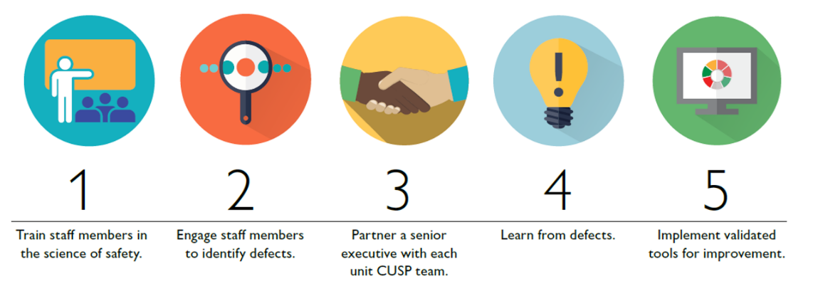

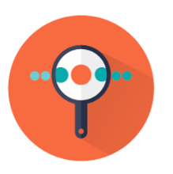
5 Steps for Improving the Culture of Patient Safety
Engage leadership for support and collaboration
Understand the science of safety
Improve teamwork and communication
Recognize current practices that may lead to patient harm
Develop system-based solutions to improve patient safety
3

Slide 4

Why Focus on Leader Engagement?
“Leadership support” is the most commonly reported barrier to patient safety improvement projects.^{1,2}

Slide 5

What Does an Executive Offer?
Ability to impact structure for your antibiotic stewardship program.
Ability to push consistency across the system.
Ability to provide material resources and finances.

Slide 6


Scenario
Delays in getting lab results back in a timely fashion make it hard to know how to adjust warfarin doses.
Delays in lab results are making our residents unsafe!

Slide 7
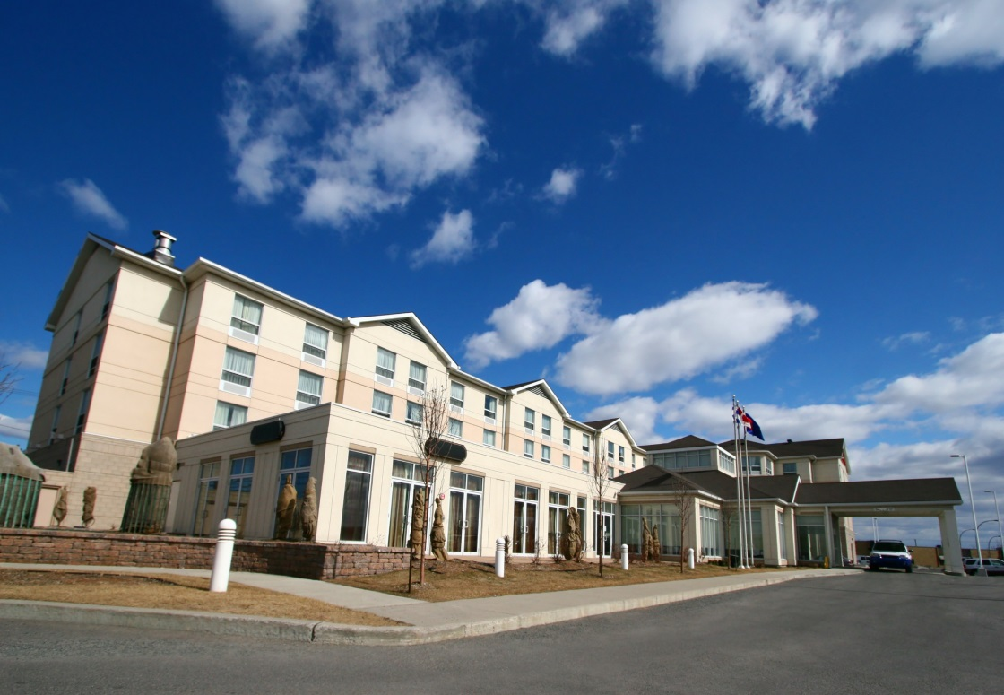
Identifying Your Executive
Senior executives in a nursing home may include:
  Administrator or executive director
  Medical director
  CEO of the company or facility

Slide 8

Scenario
Company’s CEO, Dawn Silver
  Engaged in the community
  Has served on a board to address reducing catheter-associated UTIs in long-term care

Slide 9

Engaging Your Executive
Make sure you clarify requests.
  What exactly is your team asking for?
Be specific.
Be prepared.
Have evidence to support your requests.
Anticipate obstacles and solutions.
Give a reasonable time frame to address your concerns.

Slide 10

Executive Partnership: Win-Win
Executives can—
Develop strategies for the entire organization
Realize fiscal benefits for the facility
Collaborate with instead of demanding from
Quantify and report impressive outcomes
… and more!

Slide 11

Success/Challenges
Busy schedules
Not available to meet on a regular basis
Often do not have a clinical background
Create a reasonable schedule for all of you
  Quarterly meetings
Explain any clinical information

Slide 12

How To Engage Your Senior Executive
Set a reasonable time schedule
Prepare before the meeting

Slide 13

Dialogue for Senior Executive Rounds
Thanks for joining us.
We have identified a patient safety issue that our antibiotic stewardship team would like to address first…
Here are some potential solutions…
We would love your help and ideas.

Slide 14

Second Example
Problem
  Concerned family members who insist on antibiotics
Solution
  A communication tool for nurses to use to discuss antibiotics
Result
  Situation is getting worse after 2 months

Slide 15
Framing the Discussion
Need to improve our communication techniques
We developed a communication tool and did an in-service training
2 months later, during check-in, most of the nurses have not been using the tool

Slide 16
How Can the Senior Executive Help?
Need time to train staff
Need to educate families directly using pamphlets and posters
Need to have material printed
Can we start training staff this July and have material by August?

Slide 17

Benefits of Senior Executive Support
Emphasizes effective communication within the organization
Attends meetings with ASP team
Supports technical and adaptive changes
Collaborates to develop and implement plans
Ensures necessary resources
Holds staff accountable for reducing harm

Slide 18


Summary
Your senior executive—
  Does not need a clinical
  background
  Should be an active team
  member
  Is responsible for—
    Supporting effective communication
    Meeting with the antibiotic stewardship team
    Understanding technical and adaptive work
    Collaborating with the team to address safety issues
    Holding staff accountable

Slide 19
Activities To Complete
Activity, Stewardship Team | Activity, Frontline Providers
Schedule a meeting with a senior executive To prepare for the meeting Identify a specific issue or concern (based on the brainstorming from the first meeting) Put together current data, goals for the project, and reasons you need funding | Invite interested parties to join the stewardship team
Supporting Materials
Four Moments of Antibiotic Decision Making Form 4 Moments Poster

Slide 20
Disclaimer
The findings and recommendations in this presentation are those of the authors, who are responsible for its content, and do not necessarily represent the views of AHRQ. No statement in this presentation should be construed as an official position of AHRQ or of the U.S. Department of Health and Human Services.
Any practice described in this presentation must be applied by health care practitioners in accordance with professional judgment and standards of care in regard to the unique circumstances that may apply in each situation they encounter. These practices are offered as helpful options for consideration by healthcare practitioners, not as guidelines.

Slide 21
References
Woo, K. Milworm G, and Dowding G. Characteristics of Quality Improvement Champions in Nursing Homes: A Systematic Review With Implications for Evidence-Based Practice. Worldviews Evid Based Nurs. 2017 Dec;14(6):440-446.
Vogus TJ, Weick KE, Sutcliffe KM. Doing no harm: enabling, enacting, and elaborating a culture of safety in health care. Acad Manag Perspect. 2010;24:60–77.

