Slide 1
Communicating Infectious Concerns With Antibiotic Prescribers
AHRQ Safety Program for Improving Antibiotic Use
Long-Term Care
AHRQ Pub. No. 17(21)-0029
June 2021

Slide 2
Objectives
Describe the components of, and when to use SBAR:
Situation
Background
Assessment
Recommendation
Implement SBAR to improve communication between nursing staff and providers
Recognize that SBAR can support the role of nurses as advocates for antibiotic stewardship

Slide 3
Communication Errors Can Have Disastrous Effects¹⁻³
Communication failures were the root cause of the majority of sentinel events
Intimidation can lead to medication error
Health care professionals reported feeling pressure to give a medication
They could not effectively communicate their concerns

Slide 4
Barriers to Communication in Long-Term Care^{4,5}
Lack of physician openness to communication
Lack of on-site availability of physicians
Logistic challenges (noise, lack of privacy)
Inconsistencies in nurse preparedness

Slide 5
Effective Communication Is…⁶
Complete
Communicate all relevant information while avoiding unnecessary details
Clear
Use standard terminology and make sure the whole team understands
Brief
Be concise
Timely
Regular updates to family members/providers regarding status changes
Avoid delays that could compromise a resident’s condition

Slide 6
SBAR: Improving Communication in a Brief and Timely Manner⁷
Situation
State who you are calling about and why
Background
State briefly what you know about the history and the current status
Assessment
State what you think the problem is and how severe it is
Recommendation
State what you think needs to happen for the patient and also suggest a time frame

Slide 7
SBAR To Improve Communication
Nearly 90% of nurses found SBAR useful for organizing information and communicating with medical providers.⁴
SBAR helps to:
Organize thinking
Increase confidence in communication skills

Slide 8
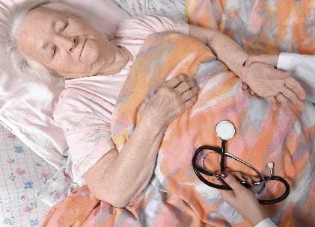
Case 1: Elma R.
92-year-old resident with a history of a pulmonary embolism (on anticoagulation)
Overnight, she tripped on the railing of her bed and fell on her hip
When the nurse found her, she was confused
She did not think she’d hit her head
She asked to “just go back to bed”

Slide 9
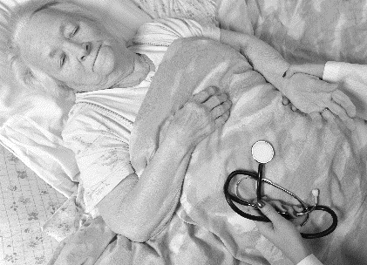
Case 1: Elma R., continued
The nurse helps Elma get back into bed
She pages on-call provider to notify him of the event
He calls back 3 hours later
Take 1

Slide 10
Case 1: Elma R. – Take 1
Nurse: Hello Dr. K, I am calling about Ms. R., a 92-year-old long-term care resident. She fell out of bed tonight. She seemed confused, but she’s sleeping now.
Dr.: She’s confused? Maybe she has an infection. Let’s get a UA and urine culture. You can also get some imaging of her head in the morning if she still seems out of it.
Nurse: OK, thank you, I will do that.
Take 1

Slide 11
Was This Communication Effective?
Evaluation | Answer | Reason
Complete? | No | The nurse did not share: Resident’s anticoagulation status No update on vitals
Clear? | No | Physician did not ask questions No idea about urinary symptoms that would merit workup for UTI No questions about the resident’s background or anticoagulation status
Brief? | Yes
Timely? | No | Prescriber did not call back in prompt time interval
Take 1

Slide 12
Case 1: Elma R. – Take 2
Situation: “Hello Dr. K., I am calling about Ms. R., the 92-year-old in room 332. She tripped and fell and landed on her hip; she seems ok but disoriented.”
Background: “She has a history of pulmonary embolism, is on warfarin, and has dementia. She does not seem to have mental status changes. Her vitals are normal and she has no symptoms other than pain in her hip.”
Assessment: “I am concerned because of her anticoagulation status; she is already developing a hematoma on her hip.”
Recommendation: “I think she needs to be transferred to the hospital for imaging.”
Take 1
Take 2

Slide 13
Getting a Response Using SBAR
You should get a response from the practitioner
You may (and should!) suggest the kind of response you would like from the practitioner
I think that Ms. R. needs to be seen sooner rather than later, and I wouldn’t feel comfortable waiting until the morning.

Slide 14
Case 2: Fred B.
Microbiology lab must notify the facility if patient has a culture growing a multidrug-resistant organism
One of the residents is growing a multidrug-resistant organism in his urine
Resident is not on antibiotics and is feeling fine
His urine was sent over a week ago, but no one on the floor can recall why

Slide 15
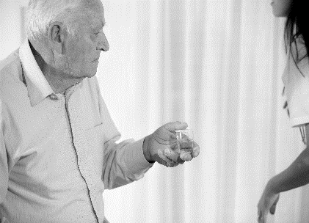
Case 2: Fred B. – Take 1
It is Saturday at 8 p.m.
You call the physician to relay the information from the microbiology lab
This is the nurse for Mr. B. in room 214. The lab just called me, and he has a resistant organism growing in his urine culture.
Take 1

Slide 16
Case 2: Fred B. – Take 1
How would you expect the physician to respond to that communication?
A. Come in on the weekend and evaluate the resident.
B. Start an antibiotic based on the urine culture results.
C. Tell the nurse to wait until Monday and notify the regular practitioner. “I’m too busy right now.”
D. Ask for more information regarding symptoms.
Take 1

Slide 17
Provider Perceptions Vary
Without context, a call about a positive urine culture will likely lead to an antibiotic prescription.
I’m calling because our policy states I must inform a health care practitioner about all positive cultures.
Take 1

Slide 18
Case 2: Fred B. – Take 2
Situation: Hello, I am calling about Mr. B. in room 214. The lab just called – he has a resistant organism in his urine. Our policy states I must inform the on-call physician about all positive cultures.
Background: He is an 83-year-old with Parkinson’s disease. He does not have a catheter. He is not on antibiotics, and no one can recall why the urine culture was sent.
Assessment: He has no signs or symptoms of a urinary tract infection; his vital signs are stable and he is clinically at his baseline.
Recommendation: I think we should continue to observe him. I placed him on isolation precautions. I don’t see a need to start him on antibiotics at this time.
Take 1
Take 2

Slide 19
Take 2: The Response
SBAR changes the provider’s next steps
A. Come in on the weekend and evaluate the resident.
B. Start an antibiotic based on the urine culture results.
C. Tells the nurse to wait until Monday and notify the regular practitioner. “I’m too busy right now.”
D. Ask for more information regarding symptoms.
Take 1
Take 2

Slide 20
Case 3: Mark P.
75-year-old man with dementia and progressive multiple sclerosis
Has a chronic indwelling urinary catheter for neurogenic bladder
Saturday: T 99⁰F for > 8 hours
Subdued, vague pain
Sunday: start antibiotics; obtain lab studies and chest x ray
Monday: chest x ray unchanged
Wednesday: back to normal and afebrile

Slide 21
Case 3: Mark P. – Take 1
On Wednesday, Mark’s urine culture results comes back as negative or no growth.
His nurse faxes the urine culture results to provider’s office.
Mark receives all 10 days of his antibiotics.
He develops diarrhea and is in isolation for 4 days until the C. difficile test results come back negative.
Take 1

Slide 22
Case 3: Mark P. – Take 2
Situation: Mark P., 75-year-old with multiple sclerosis
Background: Had a fever to 99⁰F over weekend. Started amox/clav Sunday.
Assessment: Urinalysis with 67 WBC/hpf; he has a chronic indwelling urinary catheter. His urine culture came back negative. His white blood cell count was normal and his chest x ray unchanged. No fever since Sunday evening. Back to baseline on Monday.
Recommendation: He seems to be better. His labs are normal, except for the WBC in his urine, which he usually has. Should we consider stopping the antibiotics? Today is day 4 of a 10-day course.
Take 1
Take 2

Slide 23
Key Points
Effective communication is a key component to ensure resident safety.
SBAR provides the framework for clear, concise communication about a resident’s status.
Your assessment and impression of the resident is a critical part of the communication, and directly affects health care practitioner responses and resident outcomes.

Slide 24
AHRQ Safety Program for Improving Antibiotic Use Long-Term Care
Narrated Presentation
Link to Communicating With
Prescribers narrated presentation
Communicating Infectious Concerns With Antibiotic Prescribers
Content supported in part by the VA

Slide 25
Activities To Complete
Activity, Stewardship Team | Activity, Frontline Providers
Hold Antibiotic Stewardship Team meetings Gather data from the intervention Collect and analyze data using the Monthly Data Collection Form | Distribute and review the Delirium cards (4x6 and 8½x11) Display the Four Questions To Ask Your Doctor or Nurse About Antibiotics poster in common areas, such as the dining room or recreation area Apply the Four Moments of Antibiotic Decision Making Form to 5-10 residents each month
Supporting Materials
Four Questions To Ask Your Doctor or Nurse About Antibiotics poster Four Moments of Antibiotic Decision Making Form Monthly Data Collection Form

Slide 26
Disclaimer
The findings and recommendations in this presentation are those of the authors, who are responsible for its content, and do not necessarily represent the views of AHRQ. No statement in this presentation should be construed as an official position of AHRQ or of the U.S. Department of Health and Human Services.
Any practice described in this presentation must be applied by health care practitioners in accordance with professional judgment and standards of care in regard to the unique circumstances that may apply in each situation they encounter. These practices are offered as helpful options for consideration by health care practitioners, not as guidelines.

Slide 27
References
Sentinel Event Statistics Data. Oakbrook Terrace, IL: The Joint Commission. August 2016. https://www.jointcommission.org/se_data_event_type_by_year_/. Accessed March 27, 2020.
10 Most Identified Sentinel Event Root Causes. ASC COMMUNICATIONS 2020. 2013. https://www.beckershospitalreview.com/quality/10-most-identified-sentinel-event-root-causes.html. Accessed Oct 2, 2020.
Intimidation: Practitioners speak up about this unresolved problem (Part I). Horsham, PA: Institute for Safe Medication Practices. March 2004. https://www.ismp.org/resources/intimidation-practitioners-speak-about-unresolved-problem-part-i. Accessed March 30, 2020.
Renz SM, Boltz MP, Wagner LM, et al. Examining the feasibility and utility of an SBAR protocol in long-term care. Geriatr Nurs. 2013 Jul-Aug;34(4):295-301. PMID: 23721751.
Tjia J, Mazor KM, Field T, et al. Nurse-physician communication in the long-term care setting: perceived barriers and impact on patient safety. J Patient Saf. 2009 Sep;5(3):145-52. PMID: 19927047.
TeamSTEPPS 2.0 for Long-Term Care, Module 3 - Communication, Instructor Guide. Rockville, MD: Agency for Healthcare Research and Quality. November 2017. http://www.ahrq.gov/teamstepps/longtermcare/index.html. Accessed March 30, 2020.
SBAR Toolkit. Institute for Healthcare Improvement. 2017. http://www.ihi.org/resources/Pages/Tools/sbartoolkit.aspx. Accessed March 30, 2020.

