Slide 1
Sustaining Your Antibiotic Stewardship Program
AHRQ Safety Program for Improving Antibiotic Use
Long-Term Care
AHRQ Pub. No. 17(21)-0029
June 2021

Slide 2
Objectives
Recognize that stewardship interventions must be sustained to have a continued effect
Discuss approaches for identifying new stewardship targets
Discuss personnel and resources necessary to successfully sustain a stewardship program

Slide 3
Evidence Review¹⁻³
Reviewed 20 recent published antibiotic stewardship interventions with quantitative outcomes in long-term care
Interventions with sustained changes:
Compared local policy with published guidelines
Individualized feedback to providers
Focused on a specific infection

Slide 4
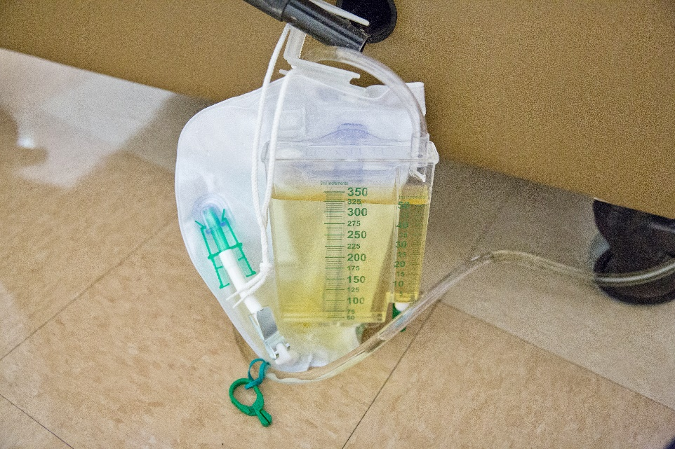
Intervention for Catheter-Associated Asymptomatic Bacteriuria⁴
Intervention sites:
5 acute care units
5 nursing home units at a VA medical center
Providers given individualized case-based audit and feedback of treatment for presumed CAUTIs
Control sites:
3 acute care units
2 nursing home units
Providers given didactic slides and emailed guidelines about CAUTI treatment

Slide 5
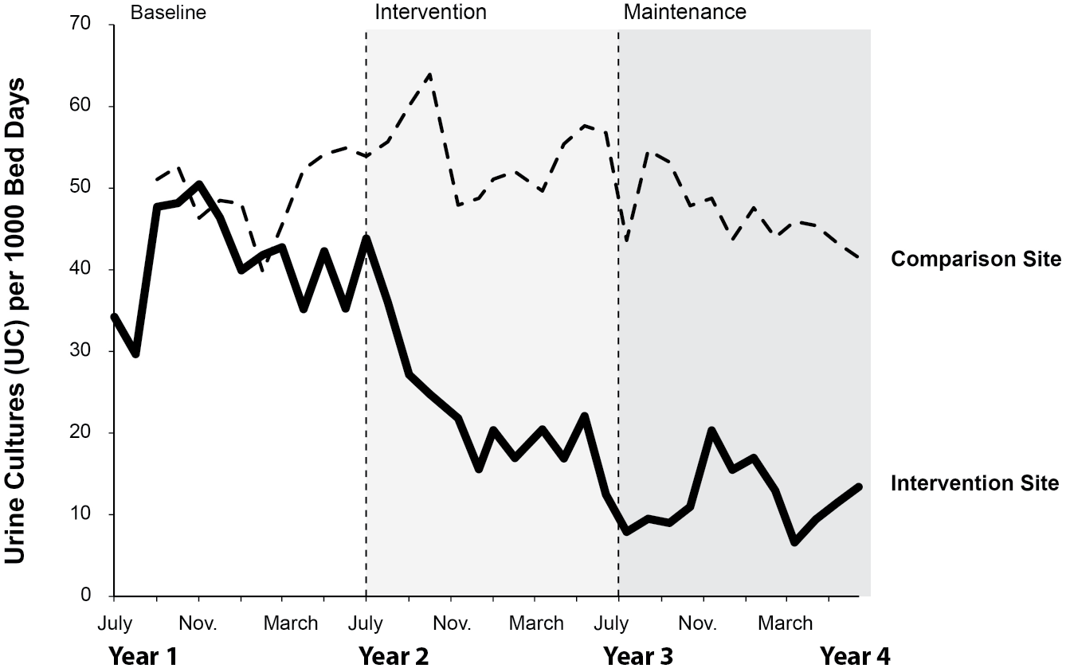
Monthly Rates of Urine Cultures per 1,000 Bed-Days⁴
Shown are the interventions vs comparison sites across 3 study periods (P < .001)
Used with permission from Barbara W. Trautner, Baylor College of Medicine.

Slide 6
Case 1: Identifying the Problem
Facility had especially high rates of fluoroquinolone prescriptions
ASP decided to collect baseline antibiotic prescribing data on fluoroquinolone use to determine what was driving this practice
Do specific providers favor fluoroquinolones?
Is there a specific syndrome for which we are using a lot of fluoroquinolones?

Slide 7
Case 1: Formulating the Intervention
Baseline data = 60% of fluoroquinolone prescriptions were from one prescriber
Created individualized prescriber portfolios
Showed each prescriber their antibiotic prescribing patterns
Distributed antibiotic use protocols for UTIs and respiratory tract infections

Slide 8
Example of Individualized Feedback
Prescriptions for UTI | Facility | Dr. A
w Amoxicillin-clavulanate | 10% | 9%
w Cefdinir | 21% | 17%
w Ciprofloxacin | 21% | 40%
w Nitrofurantoin | 29% | 21%
w Bactrim | 19% | 13%
Reviewed and discussed:
Antibiotic use protocols
Antibiotic stewardship policy
Antibiotic use
Dr. A,​
Sign and Date: __________________​
Medical Director, ​
Sign and Date: __________________​

Slide 9
Another Example
Metric | Facility | Dr. A
Antibiotic prescription with dose, duration, and indication documented | 27 of 42 (64%) | 8 of 8 (100%)
Urine culture ordered for residents’ indication of UTI | 16 of 20 (80%) | 2 of 4 (50%)
Median duration of therapy | 7 days | 11 days
Reviewed and discussed:
Antibiotic use protocols
Antibiotic stewardship policy
Antibiotic use
Dr. A,​ Sign and Date: __________________​
Medical Director, ​
Sign and Date: __________________​

Slide 10
Antibiotic Use Protocols^{1-3,5-7}
Available as One-Pagers from the AHRQ Web site
Make sure these are in concordance with local policies
Consider asking for provider feedback
Focus on common infections (UTI, respiratory infections)
Diagnostic criteria for treating infection
Appropriate antibiotic choices
Recommended length of therapy
Use standardized assessment criteria

Slide 11
Adapt Materials

Slide 12
Case 1: Lisa (Director of Nursing – LTC Facility)
Data for the next month show significant reduction in fluoroquinolone prescriptions and duration of antibiotic therapy
Now:
Share results with stakeholders, staff, and administration
Improves buy-in, shows the hard work is making a difference, and increases sustainability

Slide 13
Share Your Successes!

Slide 14
Monitor Antibiotic Use and Resistance⁵
Review antibiotic prescriptions
Upon admission
Upon return from hospital or ED
Started by covering provider
During monthly medication review
Review surveillance data of resistant bacteria

Slide 15
Measure Antibiotic Use
Metric | Pros | Cons
Days of therapy (DOT): Any dose of antibiotic given on a single day per 100 (or 1,000) resident days | Estimates total burden of antibiotic use. Tracks changes in overall use. | Does not measure length of treatment. Labor intensive.
Antibiotic starts: Number of new antibiotic prescriptions per month or per 100 (or 1,000) resident days | Measures frequency of prescribing. Tracks changes in starts. | Does not measure total antibiotic burden or length of treatment.
Number of antibiotic prescriptions for duration >7 days per month | Tracks efforts to reduce excessive length of prescriptions. | Does not measure the frequency of overall antibiotic prescriptions.
Content adapted with permission from Dr. David Nace, University of Pittsburgh.

Slide 16
Feedback: How and What To Distribute⁵
Written reports to all levels of clinical staff:
Overall antibiotic use
Compliance with protocols
Surveillance data for drug-resistant bacteria and for Clostridioides difficile
Written reports to individual prescribers:
Prescriber’s antibiotic use
Prescriber’s compliance with antibiotic use protocols
Written acknowledgement of feedback
Remember to share successes!

Slide 17
Pair Feedback With Appropriate Education⁵
Antibiotic stewardship education
To all staff, at least annually
Antibiotic use protocols
Distribute to all prescribers and nursing staff
At least biannually, update when new policies or guidelines are released
Residents and caregivers should be educated and involved in the care process with any new prescription

Slide 18
Leverage the Data…
Collect and Analyze Compliance With Antibiotic Use Protocols
Share feedback to individuals and with the whole facility.
Share education.
Measure Antibiotic Use
Share feedback to individuals and with the whole facility.
Share education.
Monitor Antibiotic Use and Resistance
Share feedback with individuals and with the whole facility.
Share education.
18

Slide 19
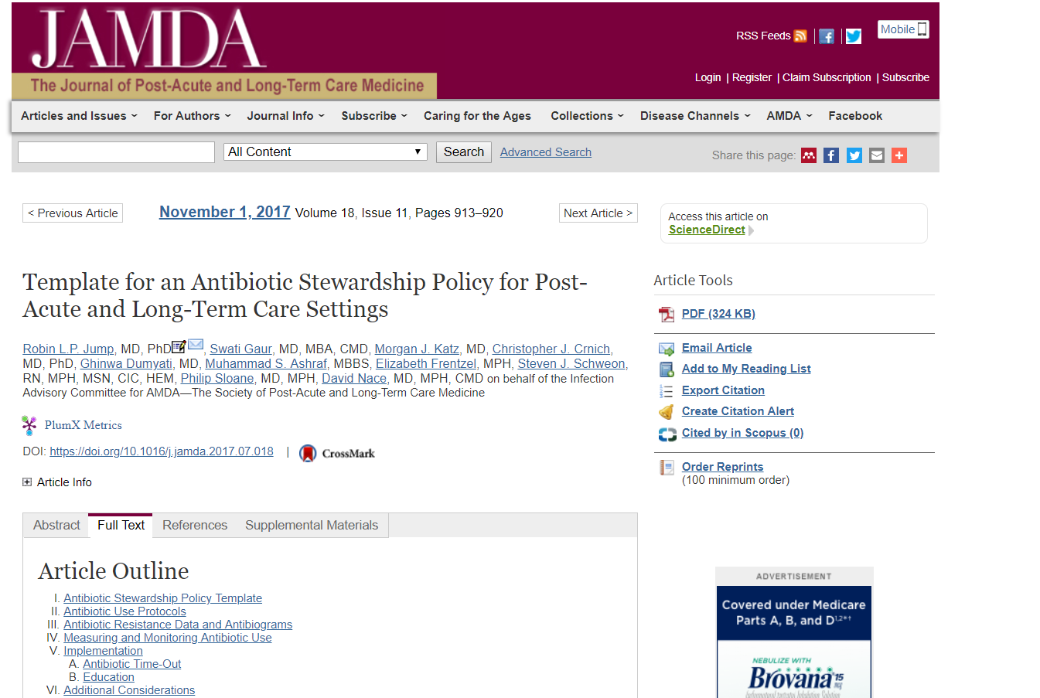
There’s Help....
Template of an Antibiotic Stewardship Policy⁵
https://pubmed.ncbi.nlm.nih.gov/28935515/
Resources to help support your efforts

Slide 20
Key Points
Feedback paired with education for prescribers and staff is key to sustainability of your program
Choose a method to monitor and measure your antibiotic usage—make this a regular activity
(i.e., at least quarterly)
Share your successes and distribute the data for buy-in and continued support

Slide 21
Activities To Complete
Activity, Stewardship Team | Activity, Frontline Providers
Hold monthly Antibiotic Stewardship Team meeting Analyze data from the Monthly Data Collection Form Use the Staff Safety Assessment and Learning From Antibiotic Adverse Events forms to identify problems Discuss problems and identify interventions Designate an individual to collect baseline data for the intervention Notify the Senior Executive of your plans. Use the Checkpoint Tool to keep track of your progress Collect and analyze data using the Monthly Data Collection Form | Ask frontline staff to complete the Staff Safety Assessment Apply the Four Moments of Antibiotic Decision Making Form to 5–10 residents each month
Supporting Materials
Guide to Sustainability Planning Other Resources for Long-Term Care Syndrome-specific one-pagers, accessible through the Learn Best Practices section of the toolkit Four Moments of Antibiotic Decision Making Form Monthly Data Collection Form

Slide 22
Disclaimer
The findings and recommendations in this presentation are those of the authors, who are responsible for its content, and do not necessarily represent the views of AHRQ. No statement in this presentation should be construed as an official position of AHRQ or of the U.S. Department of Health and Human Services.
Any practice described in this presentation must be applied by health care practitioners in accordance with professional judgment and standards of care in regard to the unique circumstances that may apply in each situation they encounter. These practices are offered as helpful options for consideration by health care practitioners, not as guidelines.

Slide 23
References
Katz MJ, Gurses AP, Tamma PD, et al. Implementing antimicrobial stewardship in long-term care settings: an integrative review using a human factors approach. Clin Infect Dis. 2017 Nov;65(11):1943-51. PMID: 29020290.
Stone ND, Ashraf MS, Calder J, et al. Surveillance definitions of infections in long-term care facilities: revisiting the McGeer criteria. Infect Control Hosp Epidemiol. 2012 Oct;33(10):965-77. PMID: 22961014.
McGeer A, Cambell B, Emori TG, et al. Definitions of infection for surveillance in long-term care facilities. Am J Infect Control. 1991 Feb;19(1):1-7. PMID: 1902352.
Trautner BW, Grigoryan L, Petersen NJ, et al. Effectiveness of an antimicrobial stewardship approach for urinary catheter-related asymptomatic bacteriuria. JAMA Intern Med. 2015 Jul;175(7):1120-7. PMID: 26010222.
Jump RLP, Gaur S, Katz M, et al. Template for an antibiotic stewardship policy for post-acute and long-term settings. J Am Med Dir Assoc. 2017 Nov 1;18(11):913-20. PMID: 28935515.
Loeb M, Bentley DW, Bradley S, et al. Development of minimum criteria for the initiation of antibiotics in residents of long-term-care facilities: results of a consensus conference. Infect Control Hosp Epidemiol. 2001 Feb;22(2):120-4. PMID: 11232875.
Determine whether it is necessary to treat a potential infection with antibiotics. October 2016. Rockville, Md. Agency for Healthcare Research and Quality. https://www.ahrq.gov/nhguide/toolkits/determine-whether-to-treat/index.html. Accessed Feb 20, 2018.

