Slide 1
AHRQ Safety Program for Improving Antibiotic Use Making Effective Changes in Antibiotic Decision Making
Acute Care
AHRQ Pub. No. 17(20)-0028-EF
November 2019

Slide 2
Objectives
Identify relevant factors that could improve antibiotic use
Identify interventions to reduce future harm associated with unnecessary antibiotic use
Apply interventions to effectively address concerns related to antibiotic decision making

Slide 3
Let’s Begin With a Case
65-year-old man presenting with right upper quadrant pain
Ascending cholangitis associated with biliary duct obstruction from a gallstone
Temperature of 101° F, pulse of 100, and blood pressure of 121/75
Admitted to the hospital and initiated on vancomycin and piperacillin/tazobactam
On day 2, he undergoes ERCP and the stone is removed
Blood cultures from admission grow lactose-fermenting Gram-negative rods
Continues vancomycin and piperacillin/tazobactam after the Gram-stain results

Slide 4
Case, Continued
On day three, a vancomycin trough returns at 35 mcg/mL and his creatinine has increased from 1.0 mg/dL to 2.5 mg/dL
The antibiotic stewardship team suggests stopping vancomycin since his blood cultures have grown E. coli
The stewardship team also recommends changing piperacillin/tazobactam to ceftriaxone
The team waits until the following day to check with the consulting gastroenterologist to obtain his approval to make these changes

Slide 5
Case, Continued
The following day vancomycin is stopped
The creatinine is now 2.7 mg/dL
The patient is started on ceftriaxone but the provider forgets to discontinue the piperacillin/tazobactam order
The patient has a renal ultrasound to evaluate his acute renal failure and undergoes several needle sticks to obtain vancomycin troughs
On day 5, his creatinine is improving and discharge planning is initiated

Slide 6
Case, Continued
14. The bedside nurse asks a questions about discharge medications, which makes the team realize that the piperacillin/tazobactam was never discontinued
15. A PICC was placed for the patient to receive intravenous (IV) ceftriaxone for five more days

Slide 7
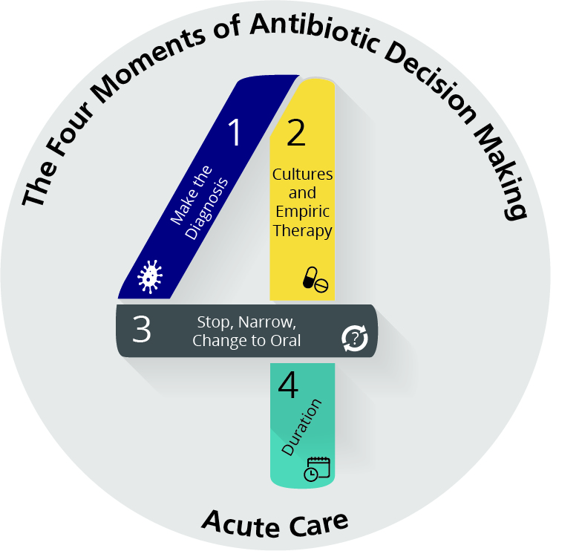
The Four Moments of Antibiotic Decision Making
Does my patient have an infection that requires antibiotics?
Have I ordered appropriate cultures before starting antibiotics? What empiric therapy should I initiate?
A day or more has passed. Can I stop antibiotics? Can I narrow therapy or change from IV to oral therapy?
What duration of antibiotic therapy is needed for my patient's diagnosis?

Slide 8
Moments of Antibiotic Decision Making
Defect | Issue | Moment
Vancomycin started empirically | MRSA unlikely to be a pathogen in uncomplicated biliary infections | 2
Piperacillin/tazobactam started empirically | Patient does not have risk factors for Pseudomonas aeruginosa and is not severely ill | 2
Continues on vancomycin after blood cultures grow a Gram-negative rod | Vancomycin should have been stopped. Acute kidney injury and unnecessary lab tests and imaging could have been avoided | 3
Piperacillin/tazobactam continued after ceftriaxone started | Piperacillin/tazobactam should have been stopped when ceftriaxone was started | 3
Team waits to discuss modifying antibiotic regimen with GI consultant | Antibiotics with synergistic nephrotoxicity were continued because of concern for prescribing etiquette | 3
Vancomycin trough obtained after vancomycin discontinued | This leads to unnecessary patient inconvenience, costs, and personnel time. | 3

Slide 9
Moments of Antibiotic Decision Making
Defect | Issue | Moment
Patient remained on IV antibiotics for duration of hospitalization | Antibiotics could have been changed from IV to PO once clinical improvement and ability to tolerate PO demonstrated | 3
PICC placed | No need for PICC if patient could have received an oral regimen | 3
Received 10 days of antibiotics | Reasonable to consider shorter course of therapy given clinical improvement and appropriate source control measures | 4

Slide 10
Learning From Antibiotic-Associated Adverse Events
Adverse event: Patient develops acute kidney injury
Learning from antibiotic-associated adverse events:
What happened?
Why did it happen?
How will you reduce the risk of the adverse event from happening again?
How will you know the risk is reduced?
Antibiotic-related adverse events are events that either caused harm or had the potential to cause harm.

Slide 11
Learning from Antibiotic-Associated Adverse Events
Negative contributing factors – Factors that increased the risk of harm for the patient (want to change these)
Positive contributing factors – Factors that limited the impact of harm for the patient (want to keep these)

Slide 12
Factors Associated With Adverse Events
Five categories of factors that contribute to adverse events
Patient factors are related to the clinical or emotional condition of the patient/family
Negative: Unclear clinical diagnosis; family strongly prefers a certain antibiotic regimen
Positive: Clear clinical syndrome; patient informed about stewardship issues
Technical factors are related to stewardship resources including information technology resources
Negative: No guidelines; knowledge gaps in education; too many dose options in EHR; difficult to order the desired cultures; no order sets; day of antibiotic therapy not documented in progress notes
Positive: Guidelines exist; mechanism to work with IT to develop reports, order sets, etc.

Slide 13
Factors Associated With Adverse Events
Types of factors
Health care worker factors are related to individual members of the patient care team
Negative: provider has too many responsibilities; provider doesn’t know who to contact for additional antibiotic decision-making guidance, etc.
Positive: interest in stewardship; dedicated time to perform interventions
Team factors are related to communication and teamwork
Negative: no mechanism for daily review of antibiotics; poor written or verbal communication during handoffs; treatment plan not discussed as a group
Positive: daily briefing about antibiotic regimen with team
Institutional factors are related to institution culture and resources
Negative: stewardship is not prioritized; lack of resources for stewardship;
Positive: institution endorses stewardship; acknowledgement of good stewardship

Slide 14
Negative and Positive Contributing Factors
Negative Contributing Factors | Positive Contributing Factors
Vancomycin unnecessarily started empirically | Antibiotic stewardship team reviewed case and recommended stopping vancomycin
Vancomycin not discontinued when cultures revealed E. coli | Serum creatinine was monitored
Team waited to discuss stopping vancomycin with the GI service until clinical rounds the next day | Vancomycin trough was monitored
No mechanism in place for laboratory to notify prescribers and/or bedside nurse when vancomycin troughs are supratherapeutic

Slide 15
Reducing the Risk of Negative Contributing Factors
Negative Contributing Factors Vancomycin unnecessarily started empirically
Develop local guidelines for intra-abdominal infections that discuss the limited situations in which empiric vancomycin may be necessary Ensure guidelines are available at the point of care Develop indications for appropriate vancomycin use Implement a pre-prescription authorization system or order sets for vancomycin

Slide 16
Reducing the Risk of Negative Contributing Factors
Negative Contributing Factors Vancomycin not discontinued when cultures revealed E. coli
Develop guidelines for intra-abdominal infections that discuss culture-directed therapy recommendations Implement an antibiotic time out tool to be reviewed on clinical rounds Perform post-prescription review and feedback for patients on vancomycin Develop vancomycin auto-stops Educate nurses about reviewing culture results and how they should be comfortable discussing with prescribers whether changes in antibiotic regimens are needed

Slide 17
Reducing the Future Risk of Negative Contributing Factors
Negative Contributing Factors Team waited to discuss stopping vancomycin with the GI service until the next morning during rounds
Educate all staff about the potential for AKI with vancomycin and that vancomycin should be discontinued as soon as it is no longer needed Team should be educated about not worrying about prescriber etiquette if a delay in stopping therapy could cause patient harm

Slide 18
Reducing the Risk of Negative Contributing Factors
Negative Contributing Factors No mechanism in place for laboratory to notify prescribers and/or bedside nurse when vancomycin troughs are supratherapeutic
Establish parameters for supratherapeutic vancomycin troughs for the laboratory to call prescribers or bedside nurse If prescriber is called, should notify bedside nurse immediately to hold off on administering further vancomycin doses If bedside nurse is called, he/she should refrain from hanging further vancomycin bags until discussing the situation with the prescriber

Slide 19
Responding to an Antibiotic-Associated Adverse Event
Form a multidisciplinary team to develop potential solutions
Seek input from a senior executive, as needed
When potential solutions are identified, make it clear who is charged with implementing them
Develop “deadlines” for when people are responsible for reporting back to the group
Determine if something can be measured to demonstrate that incidence of the adverse event has been reduced

Slide 20
Make Sure Risks Are Being Reduced
Follow up
Do staff know about the adverse event and proposed changes to reduce the likelihood of the adverse event happening again?
Do staff believe risks were reduced?
Can something be measured to evaluate compliance with the new practices?
Do staff have ongoing concerns?

Slide 21
Summary
Adverse events related to antibiotics should be evaluated to determine areas for improvement.
When performing these evaluations, identify negative and positive contributing factors as well as the category of factor.
Work with all relevant team members to determine solutions to prevent future harm.
Follow up to ensure that solutions are implemented and harm is reduced.

Slide 22
Disclaimer
The findings and recommendations in this presentation are those of the authors, who are responsible for its content, and do not necessarily represent the views of AHRQ. No statement in this presentation should be construed as an official position of AHRQ or of the U.S. Department of Health and Human Services.
Any practice described in this presentation must be applied by health care practitioners in accordance with professional judgment and standards of care in regard to the unique circumstances that may apply in each situation they encounter. These practices are offered as helpful options for consideration by health care practitioners, not as guidelines.

