Slide 1
Improving Communication and Teamwork Around Antibiotic Decision Making
AHRQ Safety Program for Improving
Antibiotic Use
Acute Care
AHRQ Pub. No. 17(20)-0028-EF
November 2019

Slide 2
Objectives
Explain how to improve communication with other health care workers.
Explain how to improve communication with patients and families.
Explain how to work as a team to improve antibiotic prescribing using The Four Moments of Antibiotic Decision Making framework.

Slide 3
Improve Communication and Teamwork
Effective communication strategies
Understand and implement communication techniques among the stewardship and frontline team members, patients, and families
Improved teamwork
Develop strategies to enhance teamwork so that teams have ownership of approaches and actions to improve antibiotic use and prevent harm associated with antibiotics

Slide 4
“
“
The single biggest problem in communication is the illusion that it has taken place.
- George Bernard Shaw

Slide 5
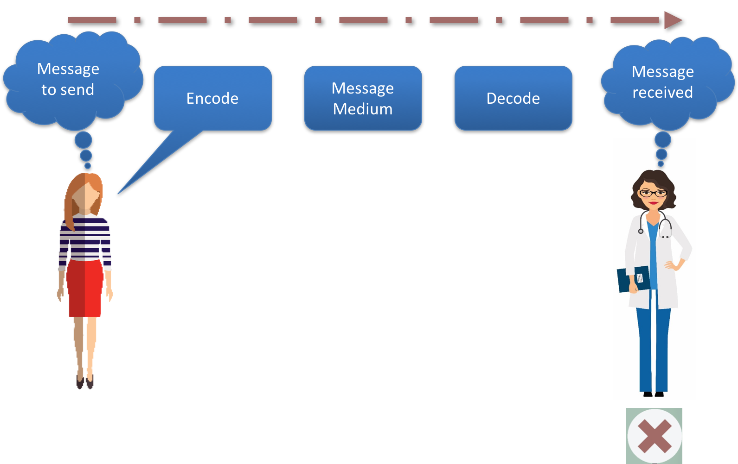
Process of Communication¹
“We recommend that you use ceftriaxone for the E. coli bacteremia.”

Slide 6
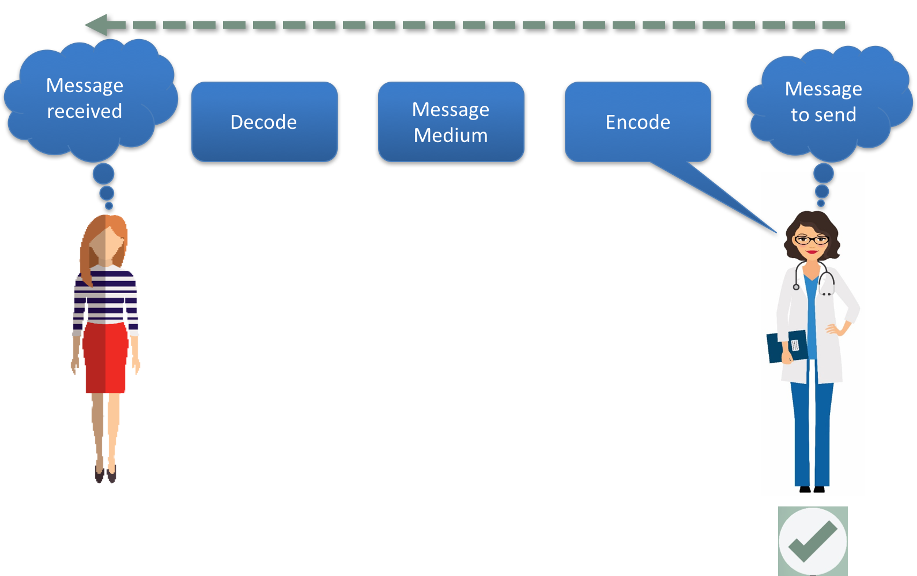
Process of Communication Continued¹
“I understand that you recommend stopping piperacillin / tazobactam and starting ceftriaxone. Is this correct?”
“I understand that you recommend stopping piperacillin/tazobactam and starting ceftriaxone. Is this correct?”

Slide 7
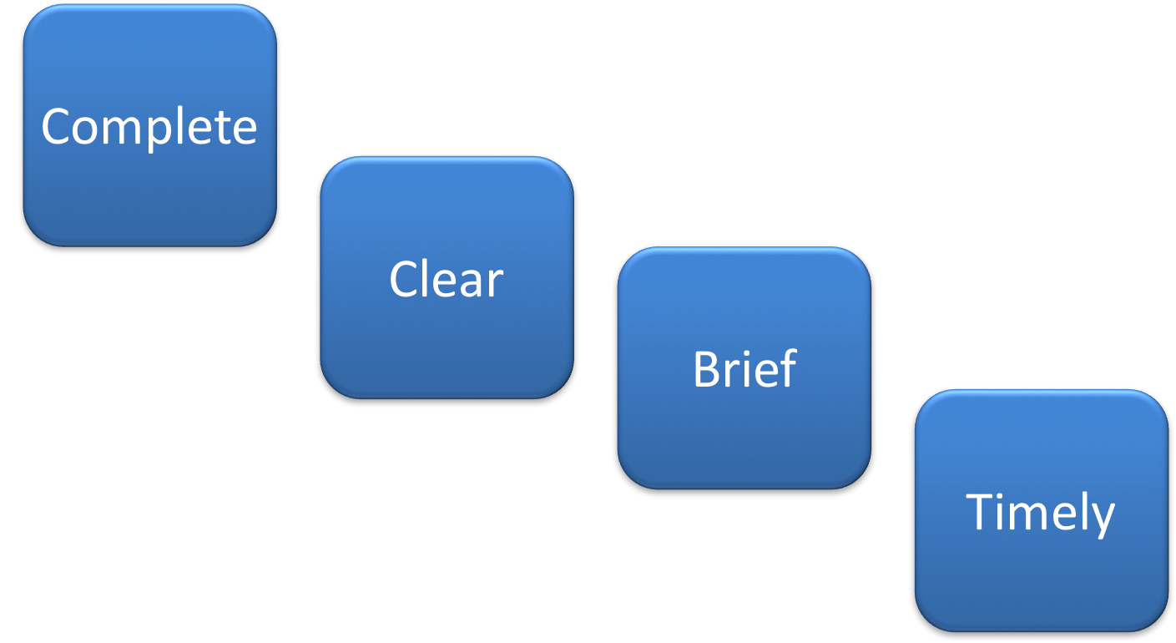
Four Key Components of Effective Communication²

Slide 8
Use Assertive (Not Aggressive) Statements
Assertive | Aggressive
Standing up for your own or a patient’s interests Remaining calm and positive Not being actively or passively aggressive Not accepting what is not right | Attacking (active) others’ opinions in favor of your own Ignoring (passive) others’ opinions in favor of your own
Approach for effective communication | Approach that impairs communication

Slide 9
Elements of Appropriate Assertion
Provide evidence or data to support your concerns.
Focus on the common goals of quality care and the welfare of the patient.
Avoid the issue of who’s right and who’s wrong.
Actively avoid being perceived as judgmental.
Be hard on the problem, not the people.
Gather your thoughts before speaking.

Slide 10
Advocacy and Assertion
An assertive statement should:³
Open the discussion
State the concern
State the problem (real or perceived)
Offer a solution
Obtain an agreement

Slide 11
ALEEN⁴
 | Conflicts With Patients and Families
Anticipate | Gather all the information about what is happening including patient and family expectations.
Listen | “Can you help me understand why you feel this way or are upset?”
Empathize | “That is understandable.” “You have every right to be upset” or “You feel ill and want to feel better.”
Explain | “Would it be all right if I explained why things are happening as they are?” or “why I’m making this recommendation?”
Negotiate | “Let’s try to agree on our path forward” or “Let’s come up with a plan.”

Slide 12
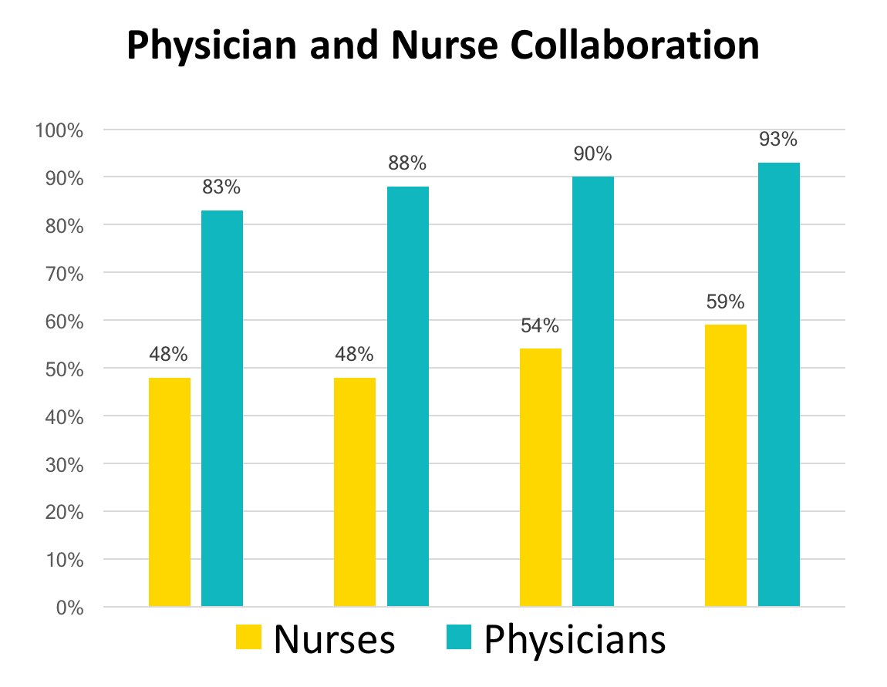
Ineffective Communication⁵
Good teamwork means the nurse does what I say.
Good teamwork means I am asked for my input.

Slide 13
Teamwork Climate Across Michigan ICUs⁶
No CLABSI = 6 months or more with zero

Slide 14
Approaches To Improve Teamwork
Begin daily discussions (antibiotic time outs) regarding antibiotic use on all patients being started or on antibiotics during patient rounds or at a specific, prespecified time
How to operationalize an antibiotic time out
Select a “prompter” (consider the bedside nurse or clinical pharmacist)
Use an antibiotic time out tool (available on AHRQ Safety Program Web site)
Add antibiotic cessation, narrowing, IV to PO, duration questions to existing daily goals sheet
Create a different method that works for you!
Have local guidelines available at the point of care when antibiotic-related decisions are being made

Slide 15
Approaches To Improve Teamwork
Unscheduled conversations as needed for complex or controversial prescribing issues
May involve the antibiotic stewardship team, infectious diseases consultant, pharmacists, nurses, respiratory therapists, etc.
Allow for updates on patient status and review of the plan with identification of any needed changes.

Slide 16
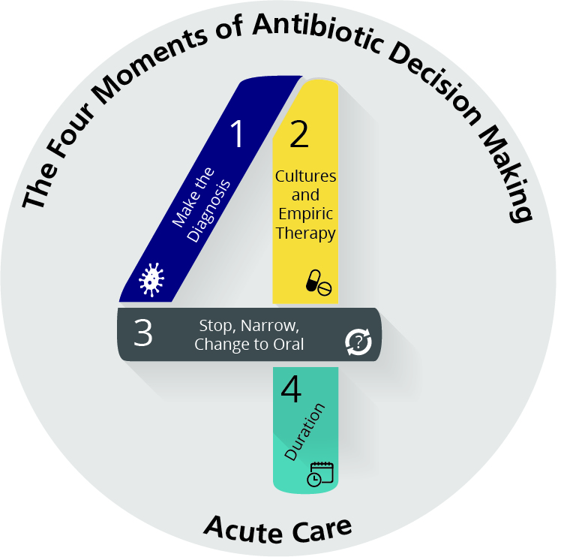
Four Moments of Antibiotic Decision Making
Does my patient have an infection that requires antibiotics?
Have I ordered appropriate cultures before starting antibiotics? What empiric therapy should I initiate?
A day or more has passed. Can I stop antibiotics? Can I narrow therapy or change from IV to oral therapy?
What duration of antibiotic therapy is needed for my patient's diagnosis?

Slide 17
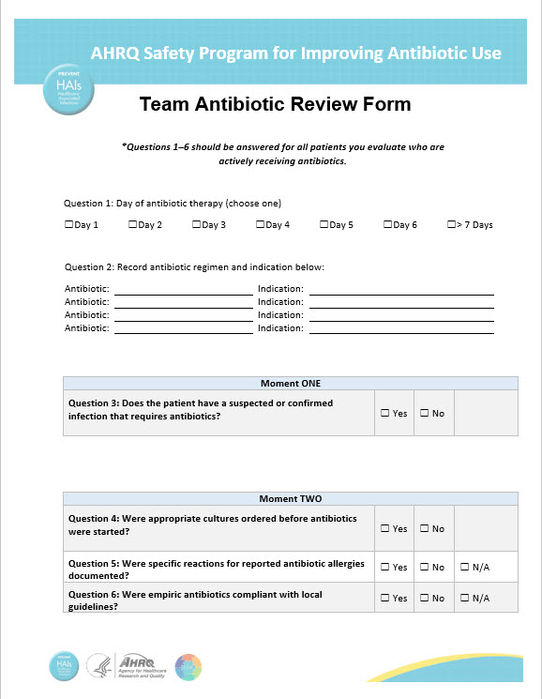
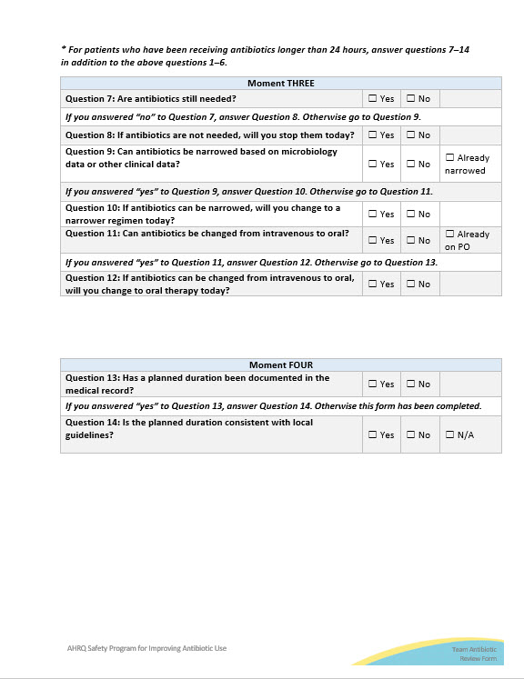
Team Antibiotic Review Form

Slide 18
Summary
Effective communication plays an integral role in the delivery of high-quality, patient-centered care and is critical in ensuring that antibiotics are prescribed in the safest way possible.
Frontline providers should identify opportunities to improve communication and teamwork by reviewing barriers that they identify around antibiotic prescribing.
The stewardship team and frontline providers should discuss how and where they want to improve communication surrounding antibiotic decisions.

Slide 19
Disclaimer
The findings and recommendations in this presentation are those of the authors, who are responsible for its content, and do not necessarily represent the views of AHRQ. No statement in this presentation should be construed as an official position of AHRQ or of the U.S. Department of Health and Human Services.
Any practice described in this presentation must be applied by health care practitioners in accordance with professional judgment and standards of care in regard to the unique circumstances that may apply in each situation they encounter. These practices are offered as helpful options for consideration by health care practitioners, not as guidelines.
19

Slide 20
References
Dayton, E, Henriksen, K. Communication failure: basic components, contributing factors, and the call for structure. Jt Comm Qual Patient Saf. 2007 Jan;33(1):34-47. PMID: 17283940.
TeamSTEPPS for Office-Based Care: Communication. Agency for Healthcare Research and Quality, Rockville, MD. September 2015. http://www.ahrq.gov/teamstepps/officebasedcare/module3/office_comm.html. Accessed April 17, 2019.
Conflict Resolution (Slide Presentation). Agency for Healthcare Research and Quality, Rockville, MD. October 2014. http://www.ahrq.gov/professionals/education/curriculum-tools/cusptoolkit/toolkit/contentcalls/conflict_resolution-slides/conflictresslides.html. Accessed April 17, 2019.

Slide 21
References
ALEEN Script. Johns Hopkins Medicine, Armstrong Institute. Kentucky Hospital Improvement Innovation Network. KY. July 2012. URL: http://www.k-hen.com/Portals/16/Documents/PSCTCommunicationsLab.pdf. Accessed April 17, 2019.
Huang DT, Clermont G, Sexton JB, et al. Perceptions of safety culture vary across the intensive care units of a single institution. Crit Care Med. 2007 Jan;1(35):165-76. PMID: 17110876.
Pronovost PJ, Berenholtz SM, Goeschel C, et al. Improving patient safety in intensive care units in Michigan. J Crit Care. 2008 Jun;23(2):207.21. PMID: 18538214.

