Slide 1
Identifying Targets for Improvement in Antibiotic Decision Making
AHRQ Safety Program for Improving Antibiotic Use
Acute Care
AHRQ Pub. No. 17(20)-0028-EF
November 2019

Slide 2
Objectives
Recognize how to differentiate technical and adaptive issues related to antibiotic prescribing.
Explain how to be proactive in asking staff about how the next patient may be harmed by antibiotic prescribing decisions.
Explain how to leverage frontline wisdom to guide safety improvement efforts.
Explain how to recognize antibiotic-related concerns using the Four Moments of Antibiotic Decision Making framework.

Slide 3
What Are Antibiotic Improvement Targets?
Unnecessarily broad-spectrum empiric antibiotic therapy
Delayed antibiotic initiation for patients with sepsis
Forgetting to obtain needed cultures
Forgetting to narrow antibiotic therapy based on clinical data
Forgetting to discontinue antibiotics when they are not needed
Forgetting to discontinue surgical prophylaxis
Forgetting to convert from intravenous to enteral therapy
Accidentally miscounting days of therapy during transitions of care
Prescribing excess durations of antibiotic therapy
Development of a Clostridioides difficile infection

Slide 4
Technical Problems
Related to a gap in knowledge or lack of needed equipment
Solution is straightforward, usually requiring resources but not culture change
Problem | Potential Solution(s)
Prescribers are unaware that the recommended duration of therapy for community-acquired pneumonia is generally 5 days | Develop pocket guides Automatic popups in the EHR
Delay in getting antibiotics from the pharmacy to the patient | Invest in machines that can house certain antibiotics on the unit

Slide 5
Adaptive Problems
Require a change in attitudes, beliefs, and behaviors
Solutions can be hard to implement because they require consensus, teamwork, communication, change in habits
Problem | Potential Solution(s)
Physicians feel uncomfortable discontinuing vancomycin when a colleague decided to start it the previous day | Acknowledge there is a problem Discuss drivers of the problem (e.g., fear of offending colleagues, difficulty explaining change in regimen to a patient) and solutions at group meetings Revisit the issue regularly

Slide 6
Problem Solving
1
First-order problem solving
Solves one problem in one particular instance
Generally does not help prevent future harm from occurring
Second-order problem solving
Uses adaptive interventions to change culture and beliefs
Identifies system opportunities to prevent harm from occurring again
2

Slide 7
Identifying Antibiotic-Associated Adverse Events
Multidisciplinary meetings
Opportunity to elaborate on issues that have resulted in antibiotic-associated adverse events or had the potential to cause adverse events that could jeopardize patient safety
Decide as a group if they are technical and/or adaptive issues
As a group, discuss first-order and second-order solutions

Slide 8
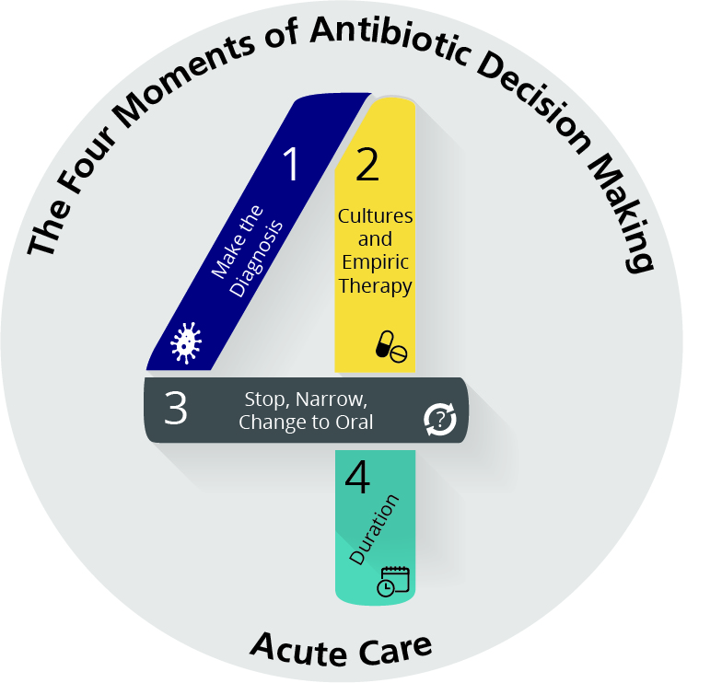
Four Moments of Antibiotic Decision Making
Does my patient have an infection that requires antibiotics?
Have I ordered appropriate cultures before starting antibiotics? What empiric therapy should I initiate?
A day or more has passed. Can I stop antibiotics? Can I narrow therapy or change from IV to oral therapy?
What duration of antibiotic therapy is needed for my patient's diagnosis?

Slide 9
Moment 3: Narrow or Stop Therapy
De-escalation: Modifying antibiotic therapy to agents considered to have a narrower spectrum of activity or stopping antibiotic therapy completely
Guided by—
Microbiology data
Clinical status of the patient
Goals
Optimize therapy
Select agents that minimize side effects

Slide 10
Is Antibiotic De-escalation Safe?¹
De-escalation of antibiotics led to a 28% reduced risk of death compared with no de-escalation.
Study | Relative risk of mortality (95% confidence interval)
Alvarez-Lerma, 2006 | 0.58 (0.24–1.42)
Giantsou, 2007 | 0.16 (0.05–0.51)
Eachempati, 2009 | 1.08 (0.69–1.71)
De Waele, 2010 | 0.35 (0.08–1.52)
Morel, 2010 | 0.74 (0.38–1.45)
Joung, 2011 | 0.16 (0.02–1.2)
Heenan, 2012 | 0.72 (0.36–1.41)
Gonzalez, 2013 | 0.91 (0.52–1.59)
Knack, 2013 | 0.39 (0.2–0.75)
Mokart, 2014 | 0.52 (0.22–1.23)
Garnacho-Montero, 2014 | 0.68 (0.5–0.93)
Leone, 2014 | 1.34 (0.72–2.47)
Paskovaty, 2015 | 0.79 (.037–1.7)
Overall relative risk of mortality | 0.68 (0.52–0.88)

Slide 11
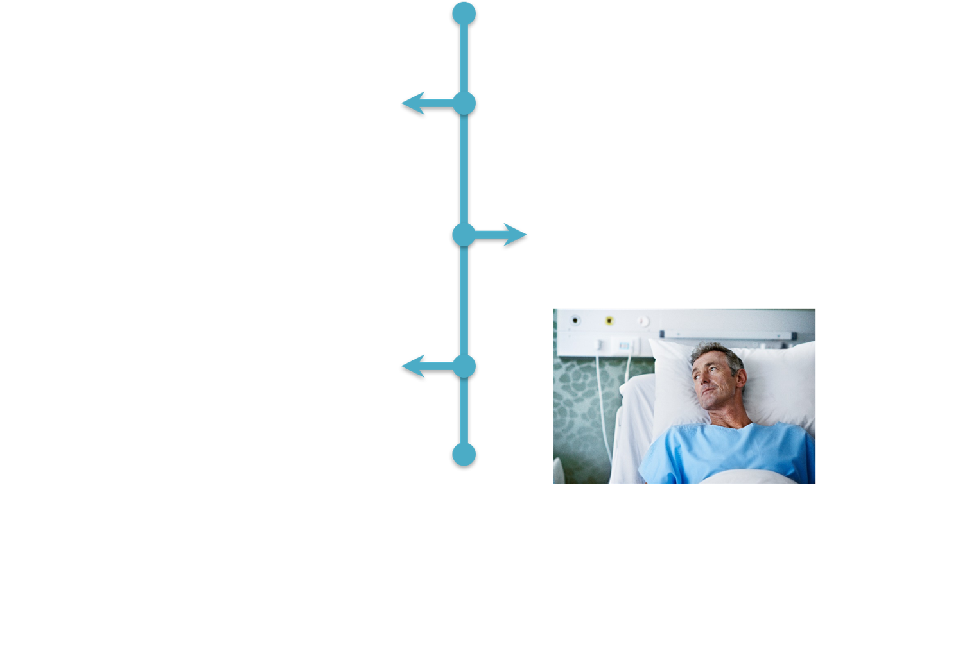
Case #1: Example of De-escalation
A patient with a past history of mitral valve endocarditis is admitted with high fevers, hypotension, and diffuse myalgias.
He is diagnosed with presumptive endocarditis and started on vancomycin and ceftriaxone.
By day 3 of therapy, blood cultures are growing a viridans group streptococcus susceptible to penicillin (with a low MIC).
In this case, while vancomycin and ceftriaxone both have activity against the organism, penicillin is the preferred choice given its narrow spectrum, excellent activity against the organism, and low side-effect profile.

Slide 12
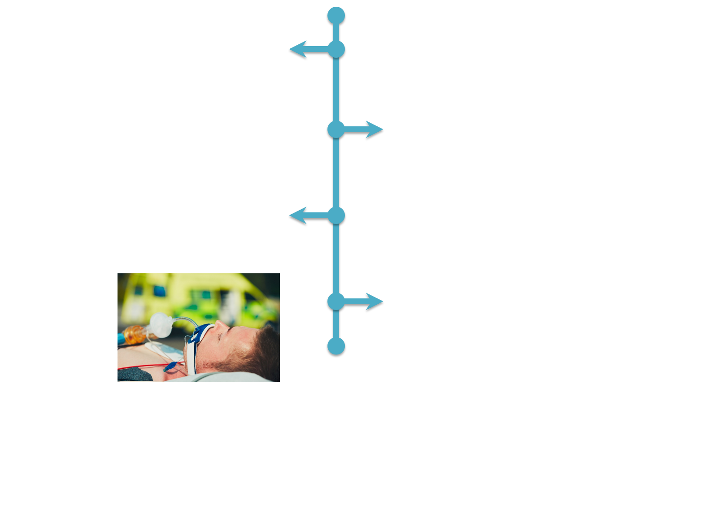
Case #2: Example of De-escalation
A patient hospitalized after undergoing a spinal fusion is diagnosed with pneumonia.
He requires intubation and is admitted to the ICU and started empirically on vancomycin and cefepime.
He improves over the next few days and is extubated on day 3.
Sputum cultures grow a pan-susceptible E. coli.
Not necessary to continue broad-spectrum therapy. Cefazolin is preferable over cefepime because there is less association with C. difficile infection.

Slide 13
Case #3: Example of Discontinuing Therapy
A patient presents to the ED.
Chest x ray shows bilateral infiltrates vs. edema greater on the right than the left.
Initiated on ceftriaxone, azithromycin, and furosemide.
The next day, he reports that his shortness of breath has resolved.
A sputum culture is pending.
In this case, the diagnosis is highly likely to be heart failure. The patient had a favorable response to diuresis so it is reasonable to stop his antibiotics. There is no need to wait for the results of a sputum culture when clinical judgment suggests he does not have an infection.

Slide 14
Your Turn!
Think about antibiotic usage in your unit…
What is a concern you have had related to antibiotic prescribing?
During formal meetings, decide on the best approach to periodically review and prioritize antibiotic-related prescribing concerns

Slide 15
Summary
There is room for improvement when it comes to antibiotic decision making at most institutions.
It is important for clinical staff to feel comfortable participating in optimizing antibiotic use on a unit or service.
Use of the Four Moments of Antibiotic Decision Making framework can help to identify opportunities for improvement at the individual patient level.
Teams also should review and prioritize their concerns regarding antibiotic use as a group.

Slide 16
Disclaimer
The findings and recommendations in this presentation are those of the authors, who are responsible for its content, and do not necessarily represent the views of AHRQ. No statement in this presentation should be construed as an official position of AHRQ or of the U.S. Department of Health and Human Services.
Any practice described in this presentation must be applied by health care practitioners in accordance with professional judgment and standards of care in regard to the unique circumstances that may apply in each situation they encounter. These practices are offered as helpful options for consideration by health care practitioners, not as guidelines.

Slide 17
Reference
Tabah A, Cotta MO, Garnacho-Montero J, et al. A systematic review of the definitions, determinants, and clinical outcomes of antimicrobial de-escalation in the intensive care unit. Clin Infect Dis. 2016 Apr 15;62(8):1009-17. PMID: 26703860.

