Slide 1
Making the Case That Improving Antibiotic Use Is a Patient Safety Issue
AHRQ Safety Program for Improving
Antibiotic Use
Acute Care
AHRQ Pub. No. 17(20)-0028-EF
November 2019

Slide 2
Objectives
Explain the potential harm associated with antibiotic use
Recognize that patient harm is often preventable
Recognize that change efforts often require a focus on systems, not individuals
Recognize the importance of diverse input to prevent harm

Slide 3
The Importance of Antibiotics
Revolutionized modern medicine
Have saved countless lives
Prompt administration of the correct antibiotics at the right dose can be critical for patients who need them
However, the use of antibiotics is not entirely benign!
Notes:
5

Slide 4
Antibiotic Overuse
Approximately 50% of hospitalized patients receive at least one antibiotic during their hospital stay.¹
Approximately 30-50% of antibiotics hospitalized patients receive are unnecessary.²

Slide 5
Antibiotic-Associated Adverse Events
Notes:
5

Slide 6
Antibiotic-Associated Adverse Events
In a cohort of ~1,500 hospitalized patients receiving antibiotic therapy, 20% developed antibiotic-associated adverse events³
~25% of these patients developed antibiotic-associated adverse events after hospital discharge
Most adverse events had some clinical ramifications
Additional hospitalizations (3%)
Prolonged hospital stay (24%)
Additional clinical or emergency department visits (9%)
Additional laboratory tests, electrocardiograms, or imaging studies (61%)

Slide 7
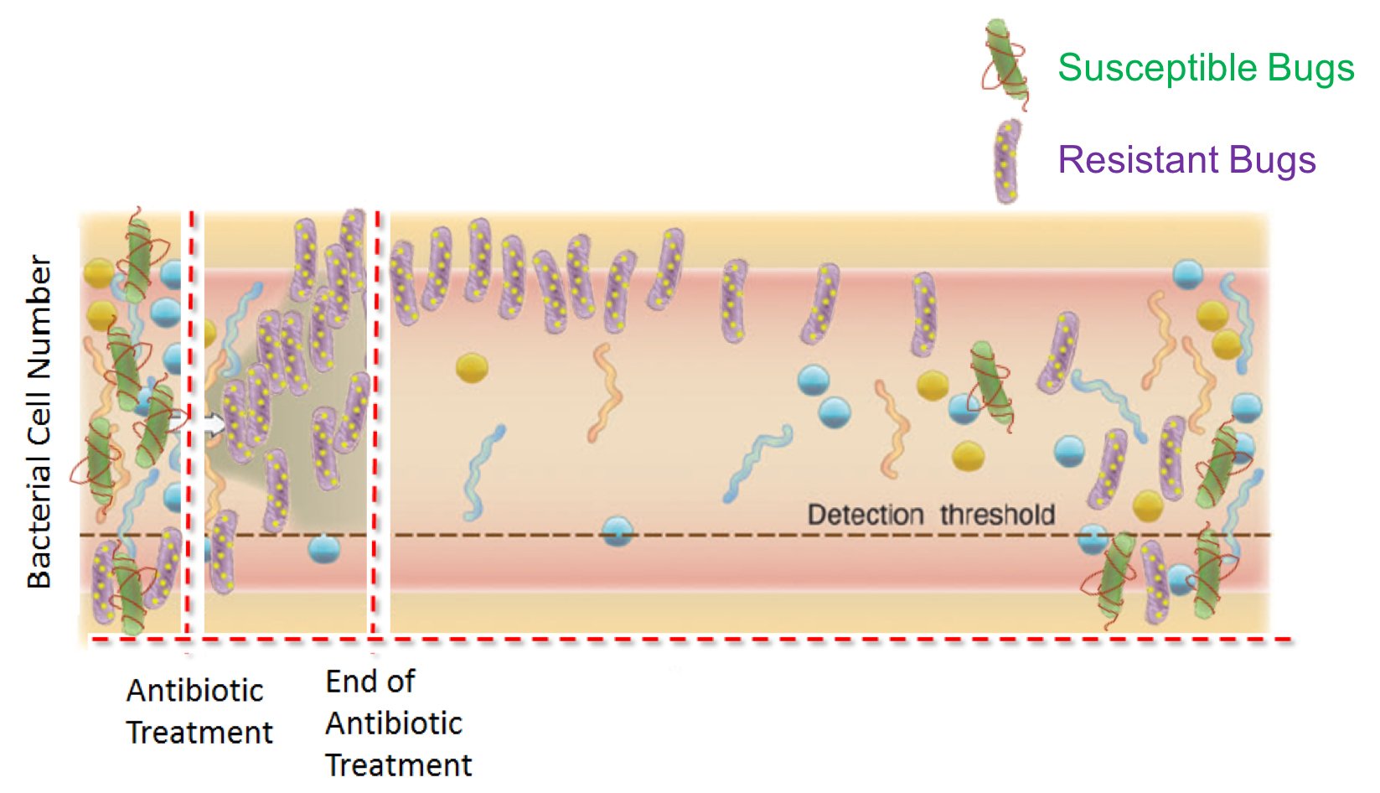
Antibiotics Alter the Bacteria in the Gut⁴
Jernberg C, Löfmark S, Edlund C, et al. Long-term impacts of antibiotic exposure on the human intestinal microbiota. Microbiology. 2010 Nov;156(Pt 11):3216-23. PMID: 20705661. doi:10.1099/mic.0.040618-0. Used with permission.

Slide 8
Antibiotics & Clostridiodes difficile
Antibiotics can increase the risk of Clostridiodes difficile infection (CDI)
Greatest risk⁵
Clindamycin (odds ratio 16.8)
Third-generation cephalosporins (odds ratio 5.7)
Fluoroquinolones (odds ratio 4.3)
Patients are at risk while receiving antibiotics and up to at least 12 weeks later

Slide 9
Antibiotic Development⁶

Slide 10
Clinical Case
50-year-old man with cerebral palsy⁷
Known seizure history
Presented to emergency department with a seizure
Chest imaging: bilateral airspace opacities at the base of his lungs
Not producing sputum, so sputum cultures were not sent
Initiated on piperacillin/tazobactam for presumed aspiration pneumonia
Admitted to the intensive care unit
Clinical improvement within 24 hours
Upon discharge from ICU, completed 7-day course of piperacillin/tazobactam and discharged home

Slide 11
Clinical Case, Continued
One week later: Re-presented to the hospital with a fulminant Clostridioides difficile infection
Day 18 of hospitalization: Died

Slide 12
Where Are the Areas for Improvement?
Image credit: Reason J. Human Error. Cambridge: Cambridge University Press; 1990.

Slide 13
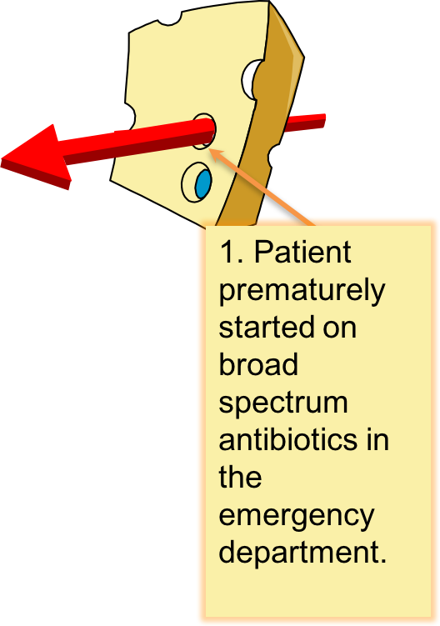
Where Are the Areas for Improvement? Step 1
Image credit: Reason J. Human Error. Cambridge: Cambridge University Press; 1990.

Slide 14
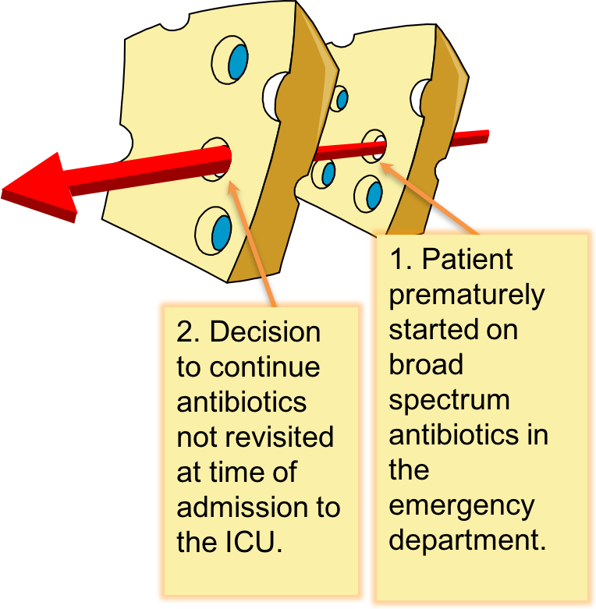
Where Are the Areas for Improvement? Step 2
Image credit: Reason J. Human Error. Cambridge: Cambridge University Press; 1990.

Slide 15
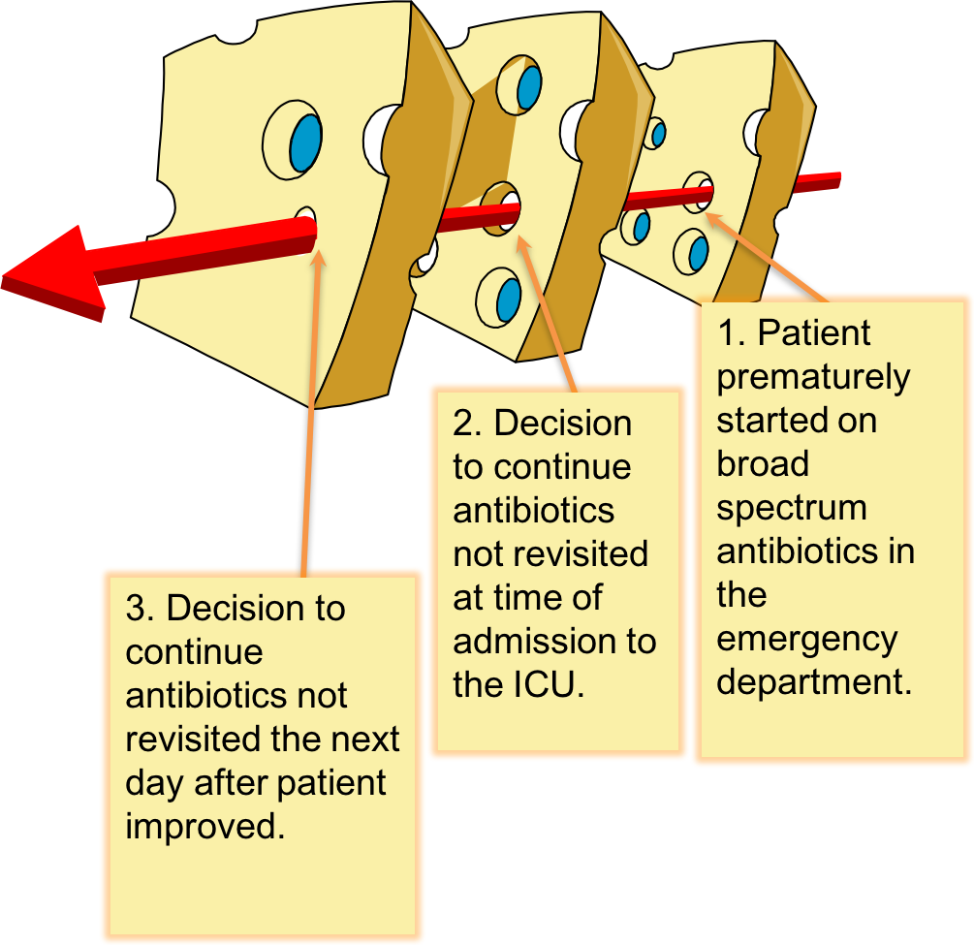
Where Are the Areas for Improvement? Step 3
Image credit: Reason J. Human Error. Cambridge: Cambridge University Press; 1990.

Slide 16
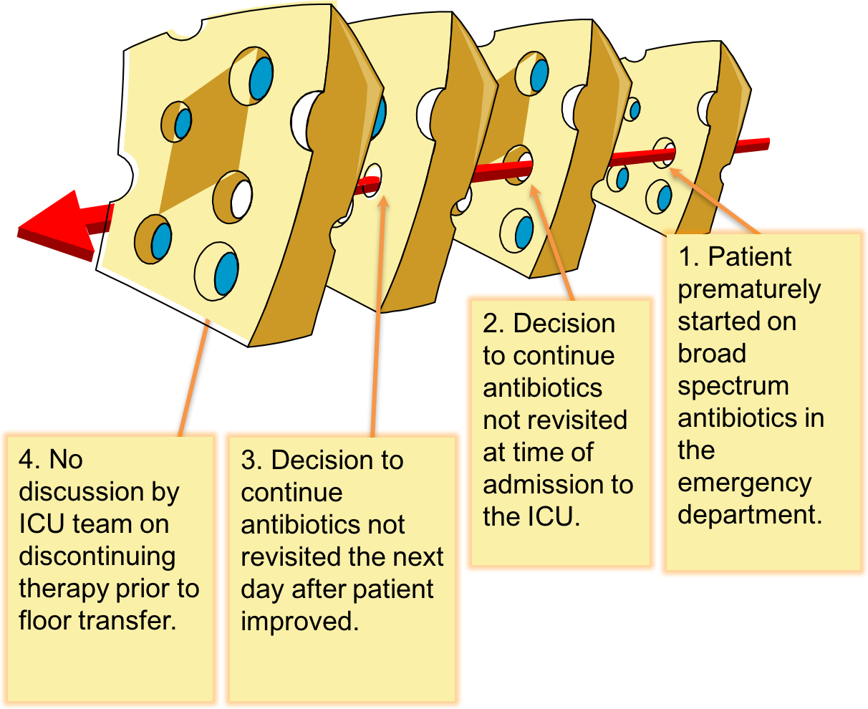
Where Are the Areas for Improvement? Step 4
Image credit: Reason J. Human Error. Cambridge: Cambridge University Press; 1990.

Slide 17
Where Are the Areas for Improvement? Step 5
Image credit: Reason J. Human Error. Cambridge: Cambridge University Press; 1990.

Slide 18
Clinical Case 2
76-year-old woman presents to her doctor for her annual visit
Complains of difficulty falling asleep; otherwise feels well
Her doctor sends a urinalysis and urine culture in case her symptoms are related to a urinary tract infection (UTI)
Has ≥100,000 CFU/mL of a pan-susceptible E. coli in urine culture
Another clinician sees urine culture results and prescribes a 7-day course of ciprofloxacin

Slide 19
Clinical Case 2, Continued
Two months later she has fevers, dysuria, and flank pain
Presents to her local ED and is hypotensive
Admitted and initiated on cefepime
Urine culture grows ≥100,000 CFU/mL E. coli resistant to ciprofloxacin but susceptible to a number of β-lactams
Completed a 7-day course of cefepime

Slide 20
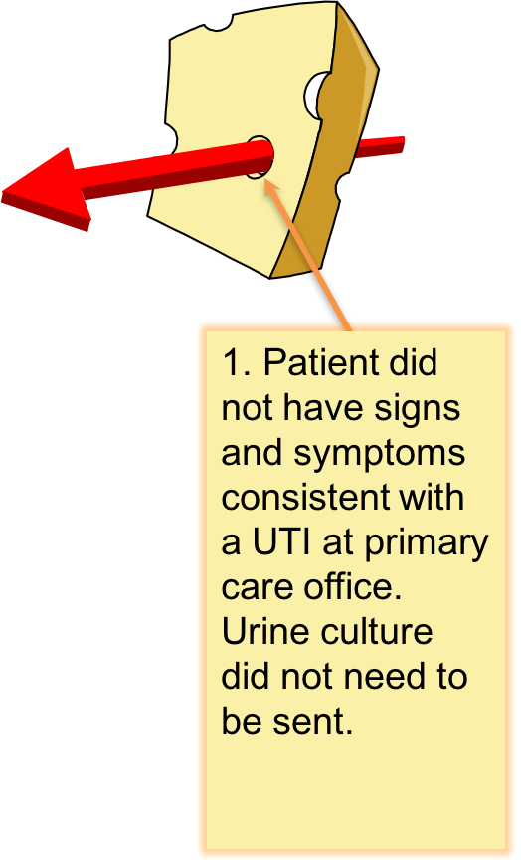
Where Are the Areas for Improvement? Step 1
Image credit: Reason J. Human Error. Cambridge: Cambridge University Press; 1990.

Slide 21
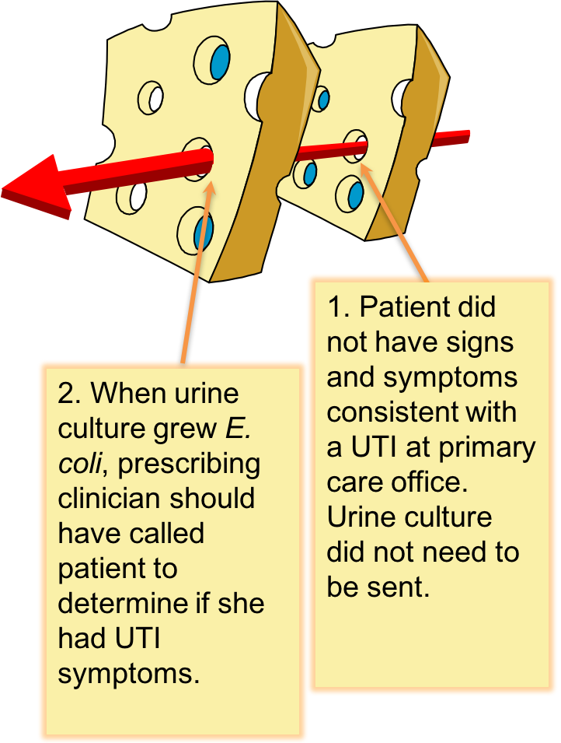
Where Are the Areas for Improvement? Step 2
Image credit: Reason J. Human Error. Cambridge: Cambridge University Press; 1990.

Slide 22
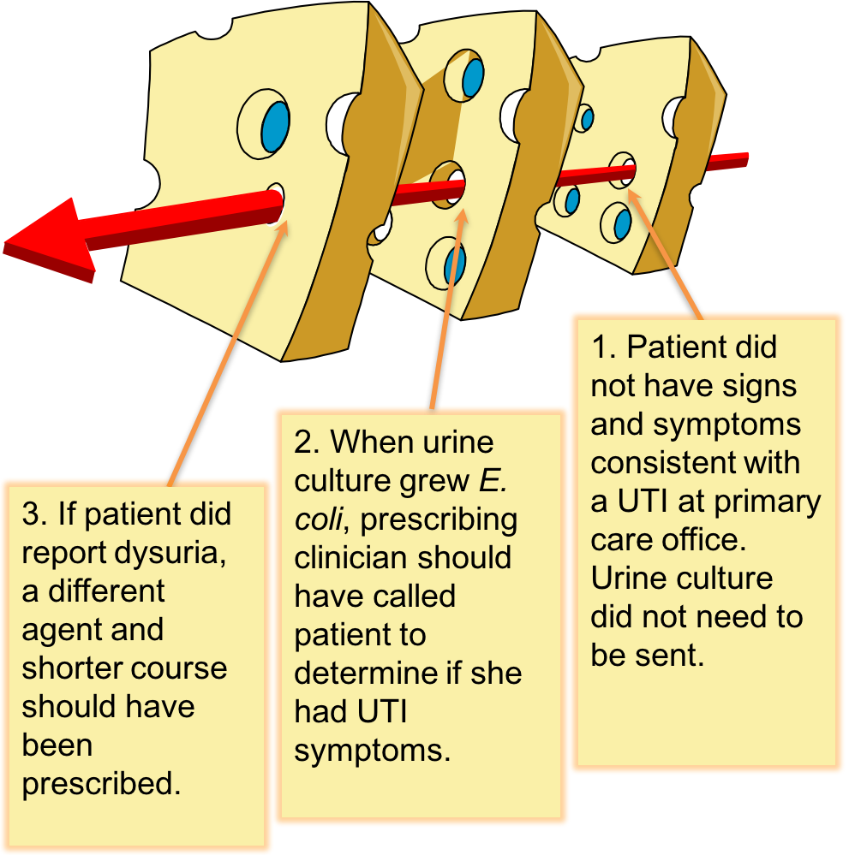
Where Are the Areas for Improvement? Step 3
Image credit: Reason J. Human Error. Cambridge: Cambridge University Press; 1990.

Slide 23
Where Are the Areas for Improvement? Step 4
Image credit: Reason J. Human Error. Cambridge: Cambridge University Press; 1990.

Slide 24
Where Are the Areas for Improvement? Step 5
Image credit: Reason J. Human Error. Cambridge: Cambridge University Press; 1990.

Slide 25
Social Determinants of Antibiotic Prescribing
Medicine is often an art, not an exact science
Social influences include—
Relationships between clinicians
Relationships between clinicians and patients
Risk, fear, anxiety, and emotion

Slide 26
Safe Prescribing Is a Team Sport
Understand that antibiotic use is a patient safety issue
Improve communication and teamwork around antibiotic prescribing
Identify areas for improvement in antibiotic decision making
Make effective changes related to antibiotic decision making

Slide 27
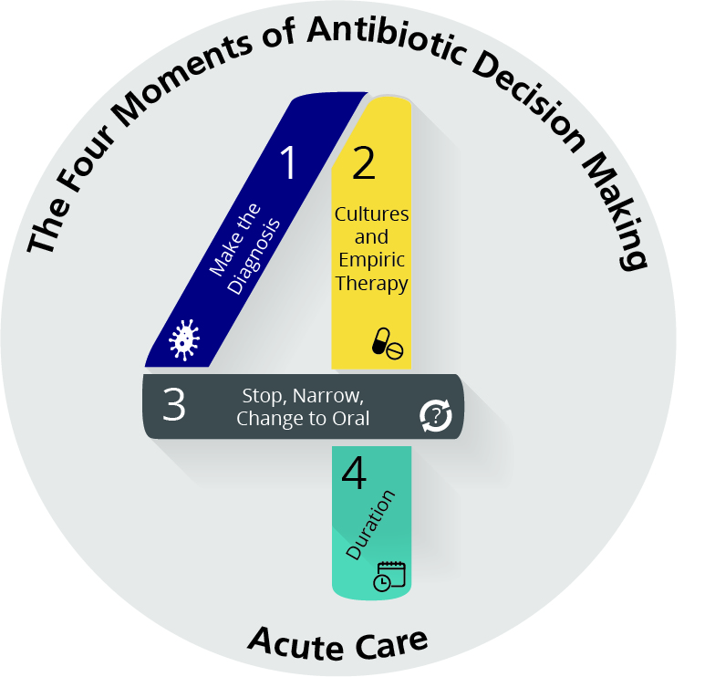
The Four Moments of Antibiotic Decision Making
Does my patient have an infection that requires antibiotics?
Have I ordered appropriate cultures before starting antibiotics? What empiric therapy should I initiate?
A day or more has passed. Can I stop antibiotics? Can I narrow therapy or change from IV to oral therapy?
What duration of antibiotic therapy is needed for my patient's diagnosis?

Slide 28
Take Home Points
Almost half of hospitalized patients receive at least one antibiotic during their hospital stay, and they are often not necessary.
Approximately 20% of hospitalized patients develop antibiotic-associated adverse events.
Standardizing practices by routinely using the Four Moments of Antibiotic Decision Making framework and developing local guidelines can help optimize antibiotic use.

Slide 29
Disclaimer
The findings and recommendations in this presentation are those of the authors, who are responsible for its content, and do not necessarily represent the views of AHRQ. No statement in this presentation should be construed as an official position of AHRQ or of the U.S. Department of Health and Human Services.
Any practice described in this presentation must be applied by health care practitioners in accordance with professional judgment and standards of care in regard to the unique circumstances that may apply in each situation they encounter. These practices are offered as helpful options for consideration by health care practitioners, not as guidelines.

Slide 30
References
Magill SS, Edwards JR, Beldavs ZG, et al. Prevalence of antimicrobial use in US acute care hospitals, May-September 2011. JAMA. 2014 Oct 8;312(14):1438-46. PMID: 25291579.
Hecker MT, Aron DC, Patel NP, et al. Unnecessary use of antimicrobials in hospitalized patients: current patterns of misuse with an emphasis on the anti-anaerobic spectrum of activity. Arch Intern Med. 2003 Apr 28;163(8):972-8. PMID: 12719208.
Tamma PD, Avdic E, Li DX, et al. Association of Adverse Events with Antibiotic Use in Hospitalized Patients. JAMA Internal Medicine. 2017 Sep; 177(9):1308-1315. PMID: 28604925.
Jernberg C, Löfmark S, Edlund C, et al. Long-term impacts of antibiotic exposure on the human intestinal microbiota. Microbiology. 2010 Nov;156(Pt 11):3216-23. PMID: 20705661.
Brown KA, Khanafer N, Daneman N, et al. Meta-analysis of antibiotics and the risk of community-associated Clostridium difficile infection. Antimicrob Agents Chemother. 2013 May;57(5):2326-32. PMID: 23478961.

Slide 31
References
Talbot GH, Jezek A, Murray BE, et al. The Infectious Diseases Society of America’s 10 x ’20 Initiative (Ten new systemic antibacterial agents FDA-approved by 2020): is 20 x ‘20 a possibility? Clin Infect Dis. 2019 Jun 18;69(1):1-11. PMID: 30715222.
Joundi RA, Wong BM, Leis JA. Antibiotics "just-in-case" in a patient with aspiration pneumonitis. JAMA Intern Med. 2015 Apr;175(4):489-90. PMID: 25665174.

