Slide 1
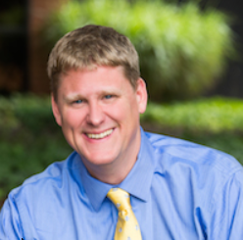
Getting to Blood Pressure Goal
Alex Krist MD MPH
Family Physician
Virginia Commonwealth University
Member, US Preventive Services Task Force
ahkrist@vcu.edu

Slide 2
Disclaimer
Although I am a member of the U.S. Preventive Services Task Force (USPSTF), materials provided in this presentation reflect my individual views and do not represent the views or recommendations of the USPSTF. The overall presentation should not be attributed to the USPSTF.

Slide 3
Study Measures – Blood Pressure
Percentage of patients age 18 to 85 years with a diagnosis of hypertension whose blood pressure was adequately controlled (<140/90) during the measurement year
Similar measures
NCGQ #0018
NQF #0018
PQRS #236
CMS #165v4

Slide 4
What is the right BP goal?
JNC VIII – goal of <150/90 for patients age 60 and older
JNC VIII – goal of <140/90 for all patients under age 60
ACCORD trial – no benefit of aiming for SBP 120 in diabetics
Sprint trial – reduced mortality for high risk non-diabetics aiming for SBP of 120

Slide 5
SPRINT Caveats!!!!
Patients had a high risk of cardiovascular disease
On average patients were on 2.8 medications
The average SBP in the treatment group was 121 (not <120)
BP was based on mean of three readings taking after sitting 5 minutes quietly
The study was terminated early

Slide 6
Getting to Goal
Decide with you patients what the best blood pressure goal
Some patients don’t mind more medications
But more medicine means closer monitoring
Recheck all high blood pressure readings
If the home readings are good, and you believe them, enter a home reading as your last measure

Slide 7
Thank you for your interest

