Slide 1
New Resources to Help Providers Help Smokers Quit
STEPHEN BABB
Office on Smoking and Health
July 26th, 2016

Slide 2
Table of Contents
The Opportunity
The Problem
The Solution
Advantages of a Protocol
The Package
Tobacco Treatment Protocol
Tobacco Treatment Action Guide
Implementation Guidance
Additional Resources on MH Website
Intended Audiences
How These Tools Can Be Used
Contact

Slide 3
The Opportunity
Effective treatments and clinical interventions exist to help smokers quit.
70-80% of smokers visit a primary care clinician annually.
Even brief advice from a clinician increases quit rates..
Smokers expect their doctors to ask about their smoking.
The five A’s – Ask, Advise, Assess, Assist, Arrange – offer clinicians a simple, proven approach.

Slide 4
The Problem
Many clinicians feel that they lack the time & training to help patients quit smoking.
While clinicians have been improving on the Ask & Advise steps, clinicians struggle with the “Assist” & “Arrange” steps.
Clinicians can become discouraged because most smokers try to quit multiple times before succeeding.
Inadequate or confusing cessation insurance coverage may further frustrate clinicians.
In the absence of well-designed systems, clinicians may be inconsistent in delivering cessation interventions.

Slide 5
The Solution
These protocols can help clinicians intervene more effectively & consistently by:
Prompting clinicians to identify tobacco users and intervene with them
Making it easier for clinicians to take these steps
Documenting these steps and providing clinicians with feedback on their performance
Documenting the outcomes of consistent intervention
Well-designed, evidence-based cessation protocols exist

Slide 6
Advantages of a Protocol
Operationalizes evidence-based approaches
Standardizes the content and delivery of interventions
Standardizes the content and delivery of interventions
Expands the care team
Makes it easier to measure performance and recognize/reward success

Slide 7
The Package
The tools
are based on the 2008 Public Health Service cessation clinical practice guideline
incorporate more recent research & developments
are customizable
are intended to be used together
Protocol for Identifying & Treating Tobacco Users
Outlines a series of simple steps that clinicians can follow to help smokers quit
Action Steps for Clinicians
Describes actions that health systems can take to set up clinicians to be successful
Provides additional information for clinicians
Implementation Guide
Identifies strategies for successful implementation of a protocol

Slide 8
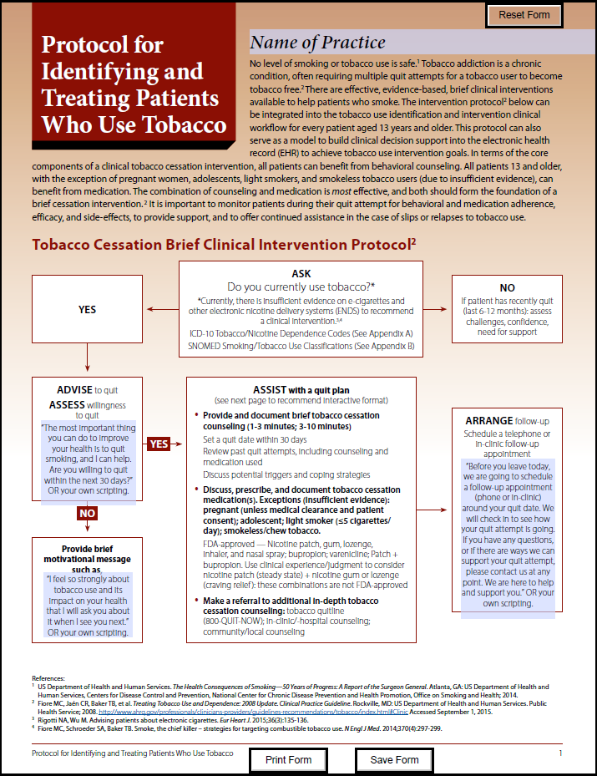
Tobacco Treatment Protocol
Flow chart for brief intervention
Steps to assist patients with a quit plan
Considerations
ICD-10 codes for tobacco & nicotine dependence
SNOMED codes for smoking/tobacco use
http://millionhearts.hhs.gov/tools protocols/protocols.html

Slide 9
Tobacco Treatment Action Guide
Actions to improve delivery system design
Overview of 5 A’s model
Overview of FDA-approved tobacco cessation medications
Resources
References
http://millionhearts.hhs.gov/files/Tobacco-Cessation-Action-Guide.pdf

Slide 10
Implementation Guidance
Insights from key medical/clinical stakeholders on successful strategies for
Preparing to implement the protocol
Implementing the protocol
Providing performance feedback
Evaluating implementation
http://millionhearts.hhs.gov/files/MH_Tobacco_ Cessation_Protocol_Implementation_Guidance.pdf

Slide 11
Additional Resources on MH Website
Sample protocols
Atrius Health and Harvard Vanguard Medical Associates
Louisiana State University Health System
Veterans Health Administration
Other tools and resources
http://millionhearts.hhs.gov/tools-protocols/protocols.html

Slide 12
Intended Audiences
Intended audiences for these tools include
Health care providers
Provider organizations (e.g., medical associations)
Health care systems
Organizations that work with health care systems
Million Hearts partners
The tools were vetted with multiple stakeholders, including
The HHS Cessation Workgroup
The 5 As
The American Lung Association/American Academy of Pediatrics Clinical Practice Workgroup

Slide 13
How These Tools Can Be Used
Help health systems:
Redesign workflows to support consistent cessation intervention
Distribute cessation tasks among the health care team
Implement referral systems, e.g., referrals to quitlines
Integrate cessation interventions into electronic health records
Provide clinicians with:
An understanding of their role in cessation
A clear roadmap that removes guesswork
A practical place to start
Handy references
The tools to be successful

Slide 14
Contact
For more information, contact CDC 1-800-CDC-INFO (232-4636) TTY: 1-888-232-6348 www.cdc.gov The findings and conclusions in this report are those of the authors and do not necessarily represent the official position of the Centers for Disease Control and Prevention.

