Slide 1
Strategies to Better Manage Lipids – Statin Pearls
Alex Krist MD MPH
Family Physician
Virginia Commonwealth University
Member, US Preventive Services Task Force
ahkrist@vcu.edu

Slide 2
Disclaimer
Although I am a member of the U.S. Preventive Services Task Force (USPSTF), materials provided in this presentation reflect my individual views and do not represent the views or recommendations of the USPSTF. The overall presentation should not be attributed to the USPSTF.

Slide 3
Study Measures – Cholesterol
Percentage of “high-risk” adult patients who were prescribed or are taking a statin. High risk is defined as:
Having a diagnosis of atherosclerotic cardiovascular disease
Ever having an LDL above 190
Or being age 40-75 with diabetes and an LDL between 70-189
Similar measures
GPRO Prev-13

Slide 4
USPSTF Recommendation November 2016
Legend
B: Recommended.
C: The recommendation depends on the patient’s situation.
D: Not recommended.
I: The balance of benefits and harms cannot be determined.
Population | Recommendation | Grade
Adults ages 40-75 years with no symptoms or history of CVD and a calculated 10-year CVD event risk of ≥10% | The USPSTF recommends that adults without a history of cardiovascular disease (CVD) (i.e., symptomatic coronary artery disease or thrombotic stroke) use a low- to moderate-dose statin for the prevention of CVD events when all of the following criteria are met: They are ages 40 to 75 years They have one or more CVD risk factors (i.e. , dyslipidemia, diabetes, hypertension, or smoking) They have a calculated 10-year risk of a cardiovascular event of 10% or greater Identification of dyslipidemia and calculation of 10-year CVD event risk requires universal lipid screening in adults ages 40 to 75 years. See the Clinical Considerations section for information on screening. | B

Slide 5
USPSTF Recommendation November 2016 (2)
Population | Recommendation | Grade
Adults ages 40-75 years with no symptoms or history of CVD and a 10-year CVD event risk of 7.5%-10% | Although statin use may be beneficial for the primary prevention of CVD events in some adults with a 10-year CVD event risk of less than 10%, the likelihood of benefit is smaller due to a lower probability of disease and uncertainty in individual risk prediction. Clinicians may choose to offer a low- to moderate dose statin to certain adults without a history of CVD when all of the following criteria are met: • They are ages 40 to 75 years • They have one or more CVD risk factors (i.e., dyslipidemia, diabetes, hypertension, or smoking) • They have a calculated 10-year risk of a cardiovascular event of 7.5% to 10% | C
Adults age 76 years and older without a history of heart attack or stroke | The USPSTF concludes that the current evidence is insufficient to assess the balance of benefits and harms of statin use for the prevention of CVD events in adults age 76 years and older without a history of heart attack or stroke. | I
Children and adolescents younger than age 20 years | The USPSTF concludes that the current evidence is insufficient to assess the balance of benefits and harms of screening for lipid disorders in children and adolescents younger than age 20 years. | I

Slide 6
Dealing with Cost – Good Rx
Simvastatin 20mg = $6.30 - $20.29 per month
Simvastatin 40mg = $7.20 - $21.20 per month
Atorvostatin 20mg = $9.95 - $58.00 per month
Atorvostatin 40mg = $10.55 - $59.61 per month
Atorvostatin 80mg = $11.15 - $58.83 per month

Slide 7
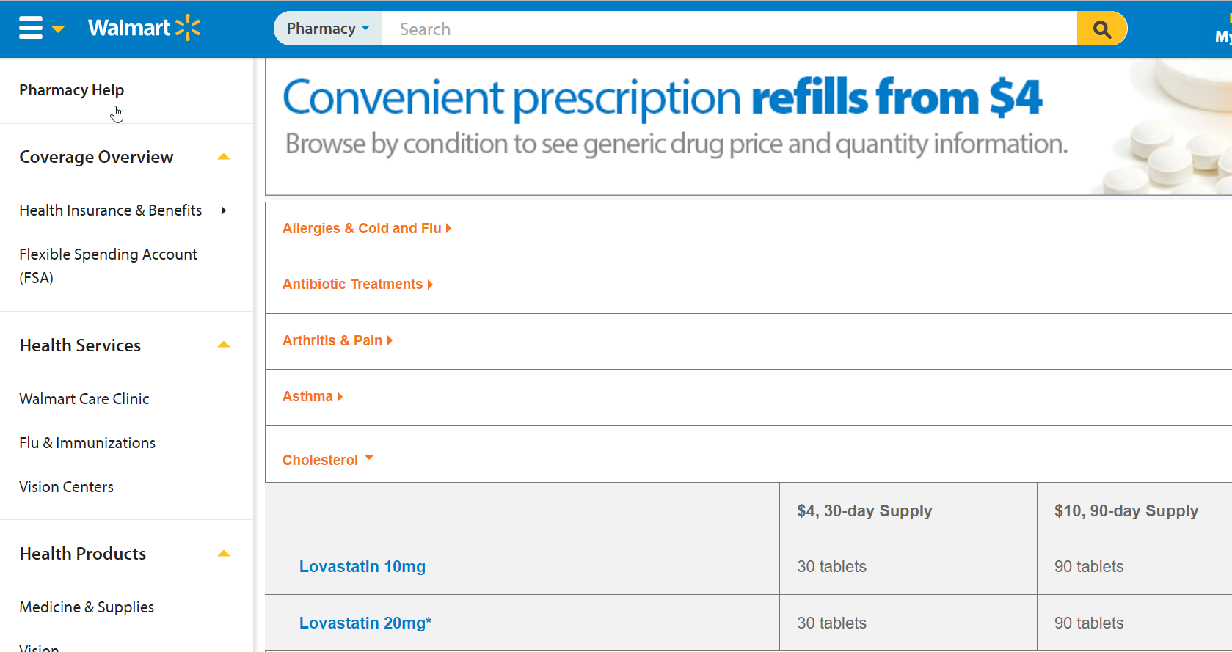
Dealing with Cost

Slide 8
Key Side Effects of Statins
Increased risk of diabetes
Muscle aches – rhabdomyolysis
Hepatotoxicity
Strategies for addressing symptoms
For rhabdoyolysis or severe hepatotoxicity – stop statin
Other side effects – try a 6 week break and then restarting
Add Co-enzyme Q10
Stop statin and focus on reducing other risks

Slide 9
Thank you for your interest

