Slide 1
Building Better Primary Care:
New Tools for
Getting Evidence into Practice
An AHRQ EvidenceNOW Webinar
August 22, 2018
*The Webinar will begin shortly.*

Slide 2
Welcome
Building Better Primary Care:
New Tools for Getting Evidence into Practice
HOUSEKEEPING:
Participant lines muted
Chat technical questions to Host
Use Q&A to submit questions for the Panelists

Slide 3
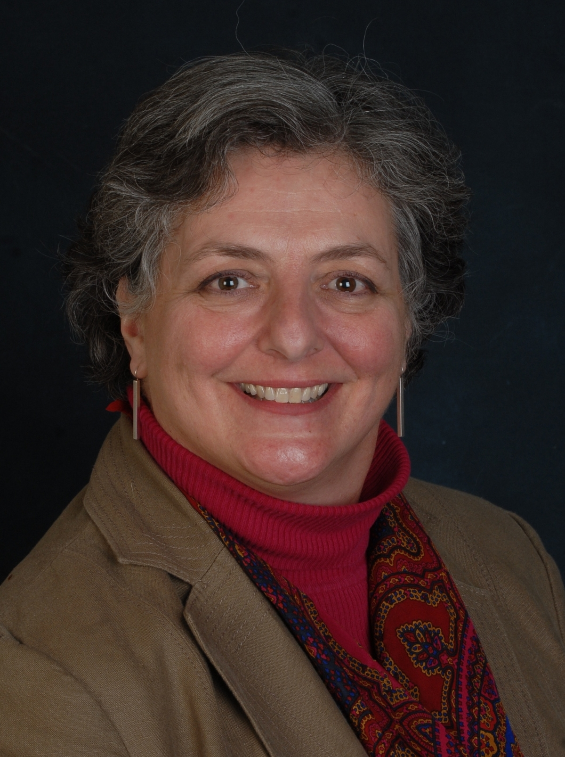
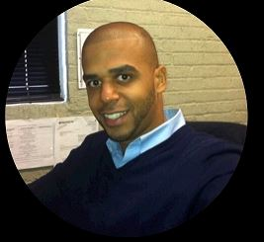
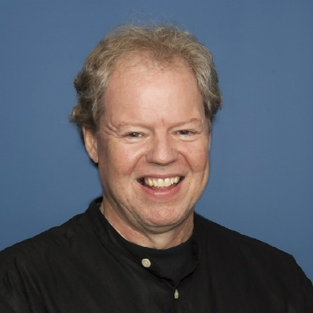
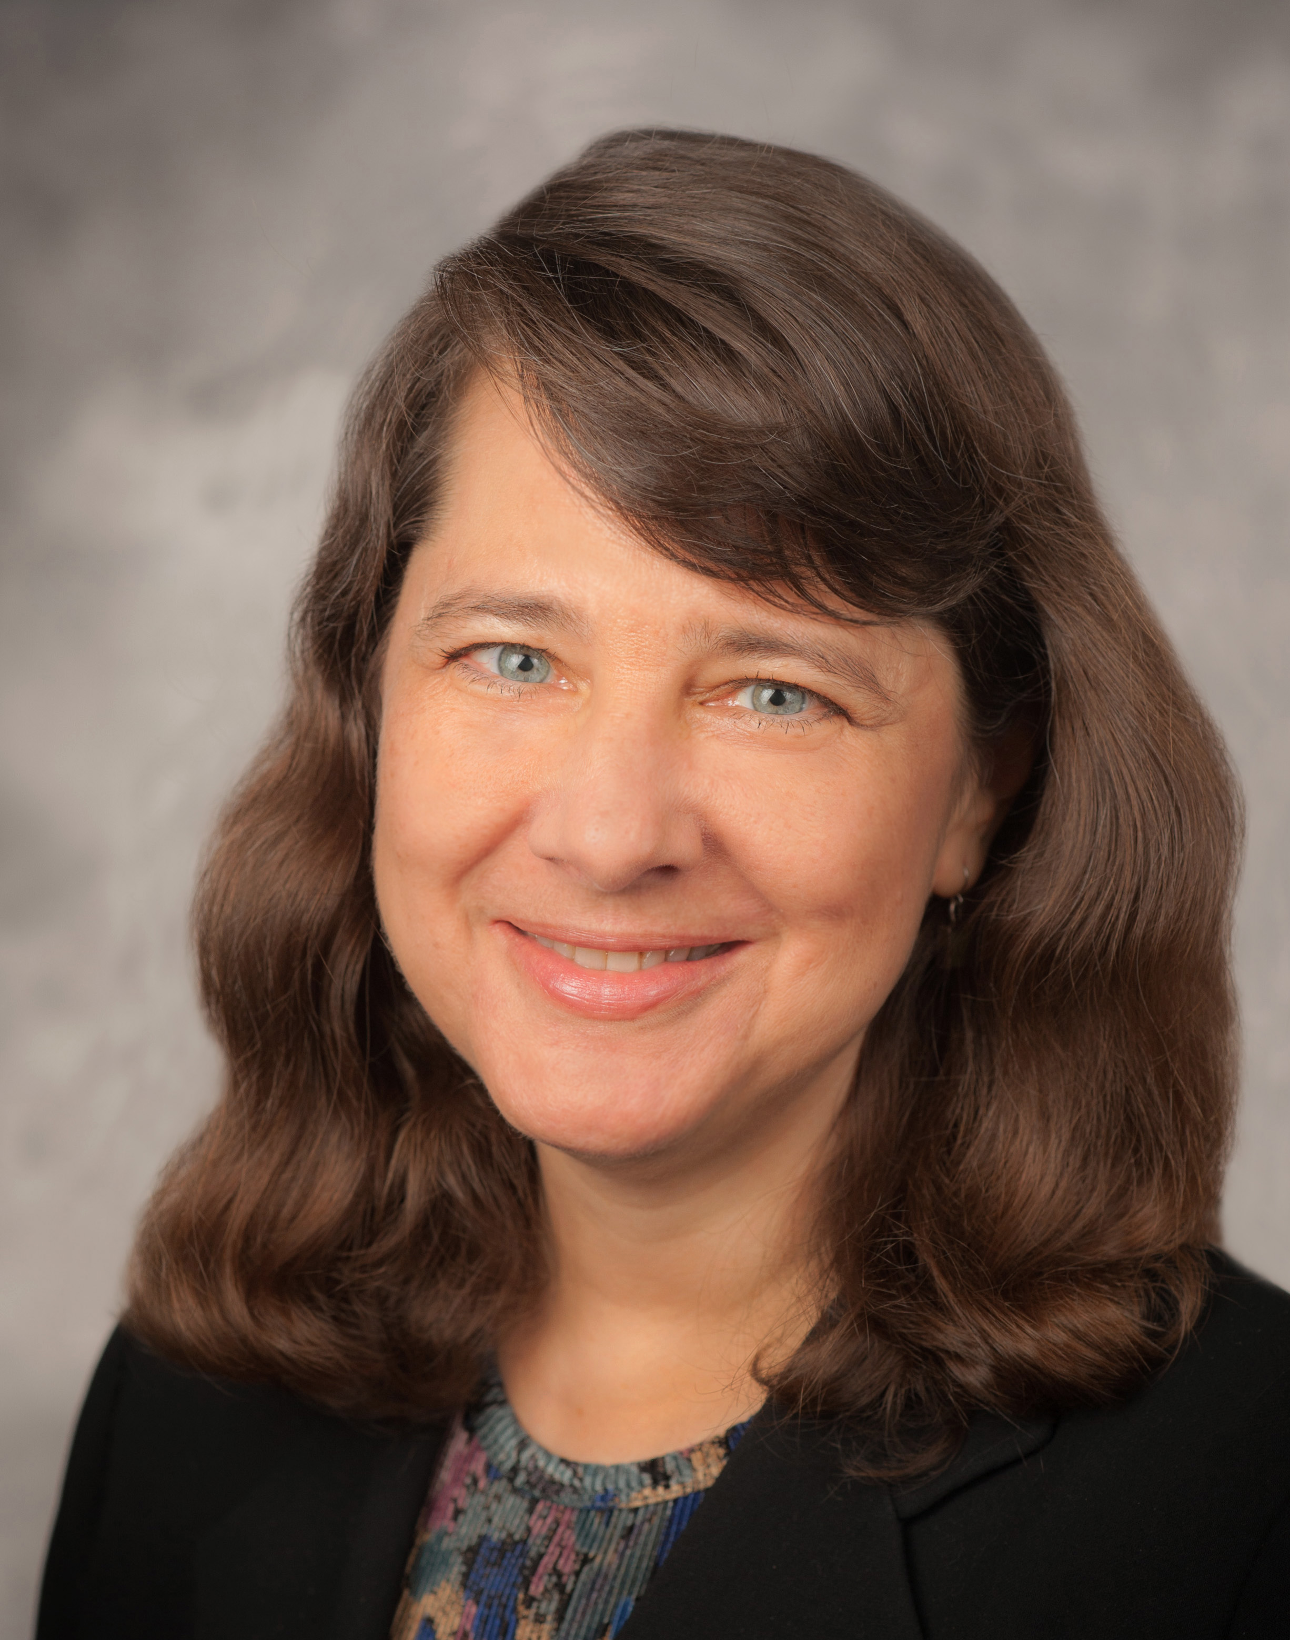
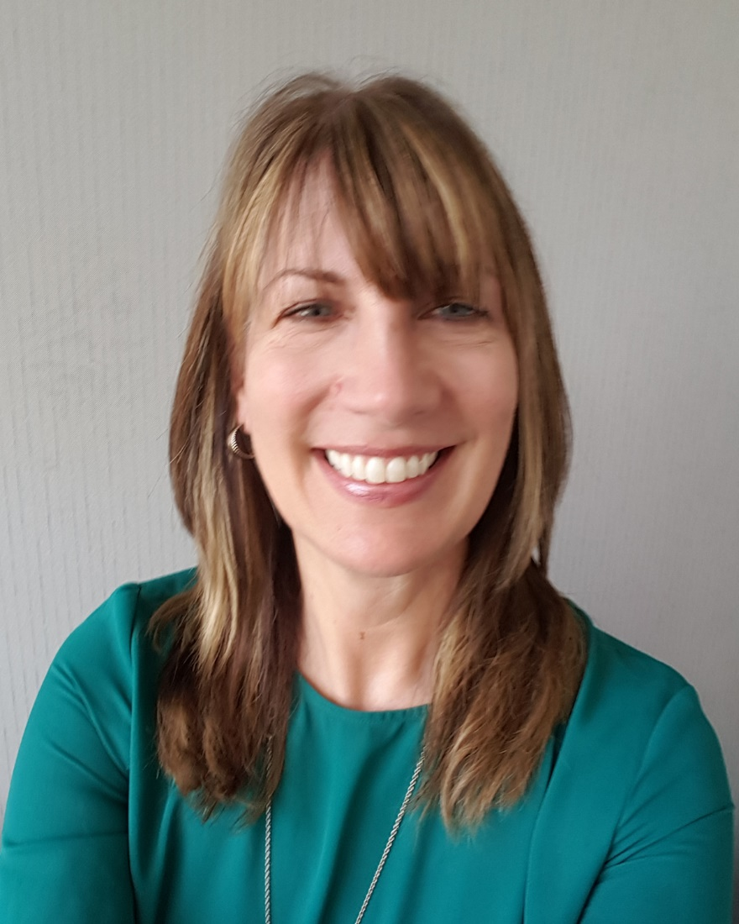
Speakers
Agency for Healthcare Research & Quality
Primary Care Information Project and HealthyHearts NYC
Janice Genevro
Ernesto Fana
Bob McNellis
MetaStar and Healthy Hearts in the Heartland
Cindy Brach
Julie Schmelzer

Slide 4
Agenda for the Webinar
Welcome and Introductions (Jan Genevro)
EvidenceNOW 101 (Bob McNellis)
Tools and Resources for Practices and Practice Facilitators (Cindy Brach)
Practice Facilitators’ Experiences with Key Resources (Bob with Julie Schmelzer and Ernesto Fana)
Questions and Answers (All)

Slide 5
AHRQ’s PCPF Bulletin
Two ways to subscribe:
  Go to www.ahrq.gov
    Click on the link for “Email Updates”
    Enter your email address
    On the list of subscription topics, scroll down to “Practice Facilitation in Primary Care” under Quality and Patient Safety and click the box.
  Send an email to robert.mcnellis@ahrq.hhs.gov with a request to subscribe

Slide 6
EvidenceNOW 101

Slide 7
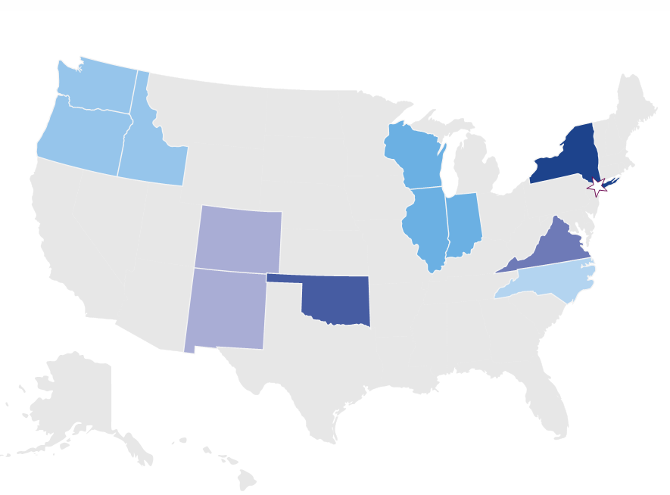
EvidenceNOW 101
EvidenceNOW is an AHRQ grant initiative designed to help small and medium-sized primary care practices across the U.S. use the latest evidence to improve the heart health of millions of Americans.

Slide 8
The Goals of EvidenceNOW
Help practices implement evidence to improve health care with a focus on the ABCS
Help practices identify ways to build their capacity to receive and incorporate evidence in the future
Learn how external QI support helps primary care practices improve the way they work and improve the health of their patients
Build and disseminate a blueprint of what works to transform primary care

Slide 9

Cooperatives Provided External Support

Slide 10
Findings

Slide 11
Findings

Slide 12
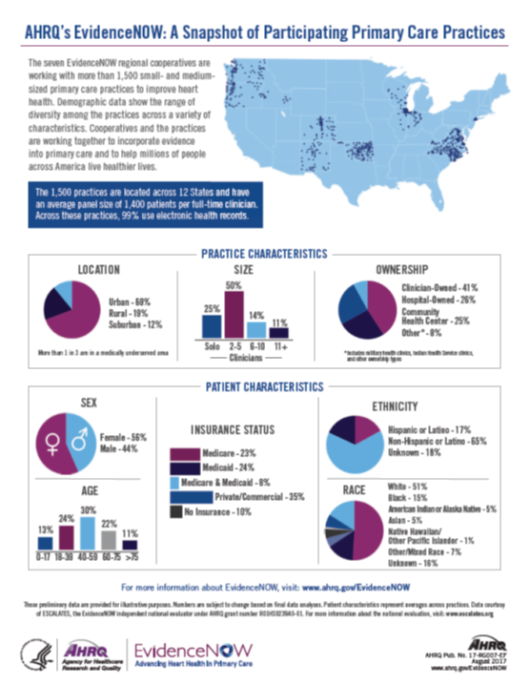
Findings

Slide 13
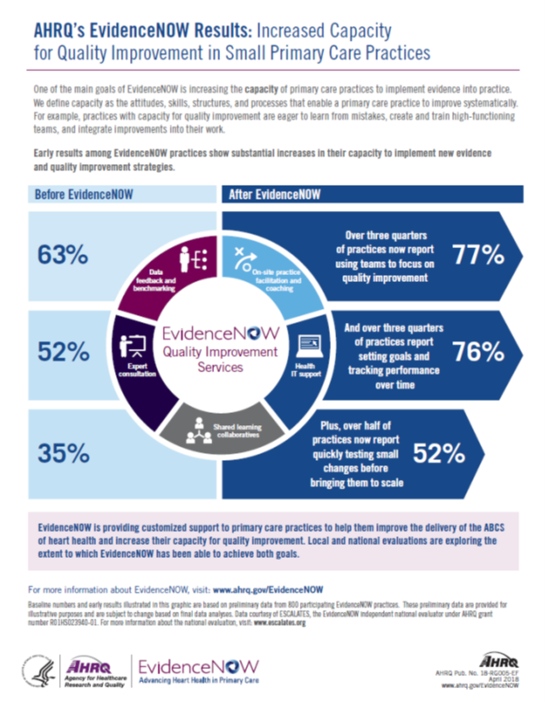
Findings

Slide 14
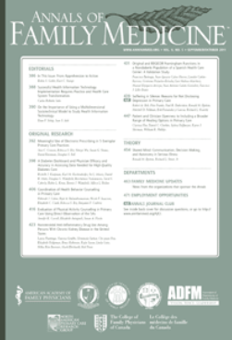
Findings

Slide 15
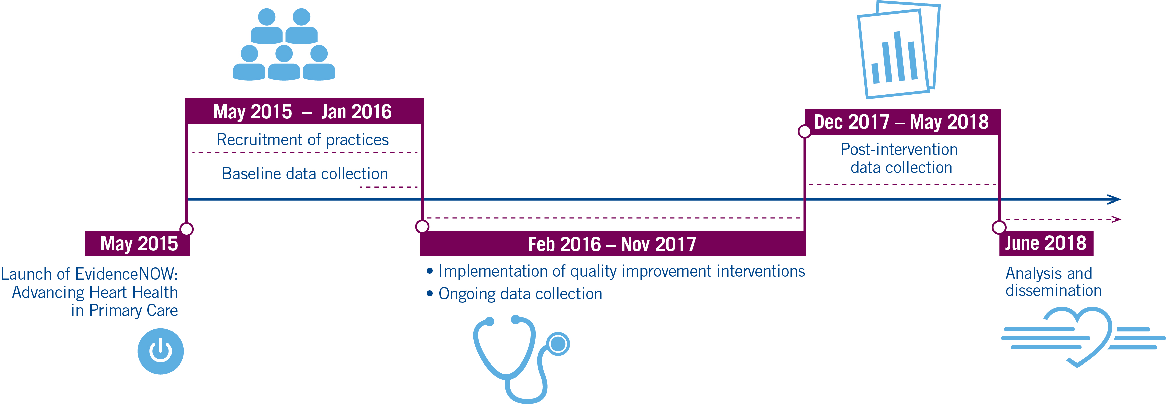
Timeline

Slide 16
Tools and Resources for
Practices and Practice Facilitators:
Putting the EvidenceNOW Model to Work

Slide 17
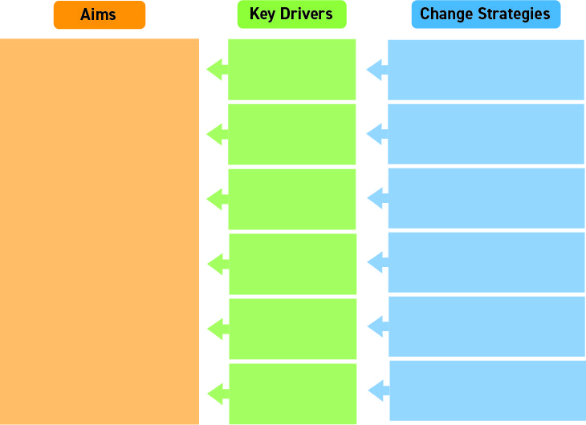
What is a key driver diagram?

Slide 18
The EvidenceNOW
Key Driver Diagram

Slide 19

Key Driver 1:
Seek, select, and customize the best evidence for use by the practice
Change Strategies
  • Develop a Process
  • Select Evidence
  • Embed in Info Systems
  • Inform Patients

Slide 20

Key Driver 2:
Implement a data-driven quality improvement process to integrate evidence into practice procedures
Change Strategies
  • Develop QI Team
  • Adopt QI Approach
  • Select QI Measures
  • Engage Care Teams

Slide 21

Key Driver 3:
Optimize information systems to extract data and support use of evidence in practice
Change Strategies
  • Identify Data Coordinator
  • Maximize EHRs
  • Use Registries & More
  • Involve Care Teams
  • Focus on Data Quality
  • Link Patients & Teams in Info System
  • Create a QI Dashboard

Slide 22

Key Driver 4:
Create and support high functioning teams to deliver high-quality evidence-based care
Change Strategies
  • Establish Care Teams
  • Assign Patients to Care Teams
  • Empower Team Members
  • Optimize Communication
  • Engage with Evidence
  • Participate in QI

Slide 23

Key Driver 5:
Engage patients and families in evidence-based care and quality improvement
Change Strategies
  • Target Appropriate Patients
  • Support Patient Engagement in Care
  • Link to Community Resources
  • Involve Patients in Integrating
  Evidence

Slide 24

Key Driver 6:
Nurture leadership and create a culture of continuous learning and evidence-based practice
Change Strategies
  • Forge a Vision
  • Support Evidence-based Practice
  • Encourage Learning
  • Review Measures
  • Identify Champions
  • Create a QI Culture

Slide 28

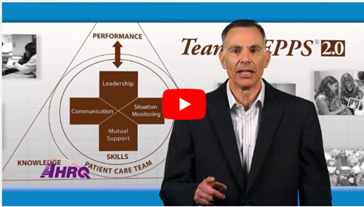
Complete online and classroom training curriculum

Slide 29
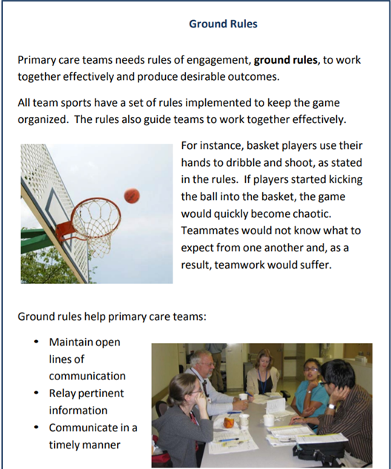
Short practice tools

Slide 30
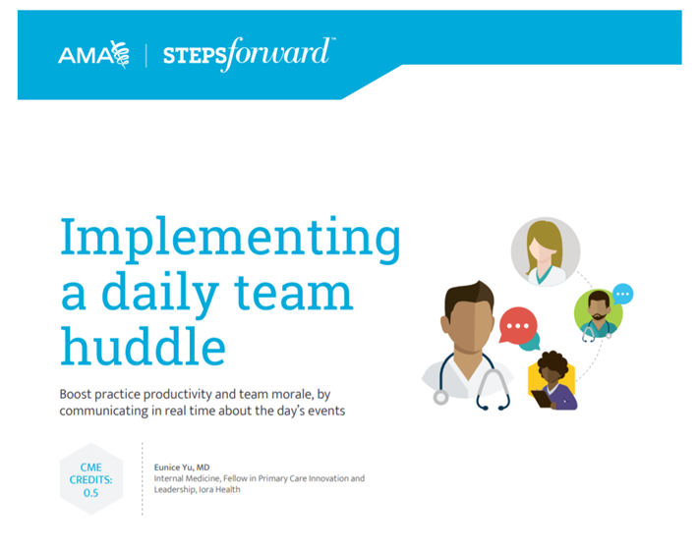
Full implementation guides

Slide 31
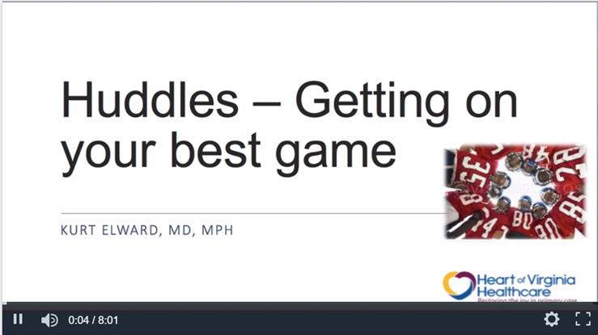
Recorded webinars

Slide 32
Available October 1, 2018
Tools & Resources for
Practices & Practice Facilitators:
Putting the EvidenceNOW Model to Work
www.ahrq.gov/evidencenow

Slide 33
Practice Facilitators’ Experiences
with Key Resources

Slide 34
Practice Facilitators’ Experience with Key Resources
Ernesto Fana
Primary Care Information Project and HealthyHearts NYC
Bob McNellis
AHRQ
Julie Schmelzer
MetaStar and Healthy Hearts in the Heartland

Slide 35
Notes:
Page 144 from NYC ABCS Toolkit

Slide 37
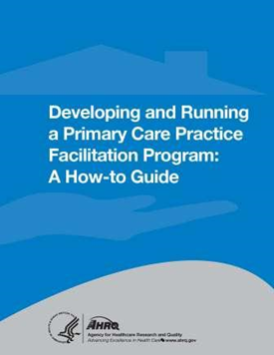


Slide 41
Q & A

Slide 42
AHRQ’s PCPF Bulletin
Two ways to subscribe:
  Go to www.ahrq.gov
    Click on the link for “Email Updates”
    Enter your email address
    On the list of subscription topics, scroll down to “Practice Facilitation in Primary Care” under Quality and Patient Safety and click the box.
  Send an email to robert.mcnellis@ahrq.hhs.gov with a request to subscribe

Slide 43
Thank you for attending
Building Better Primary Care:
New Tools for Getting Evidence into Practice
An AHRQ EvidenceNOW Webinar
Questions? Contact Bob McNellis: robert.mcnellis@ahrq.hhs.gov

