Slide 1
Central Venous Catheter Maintenance
AHRQ Safety Program for Intensive Care Units: Preventing CLABSI and CAUTI
Maintaining Awareness and Proper Care of Catheters in Place
AHRQ Pub. No. 17(22)-0019
April 2022

Slide 2
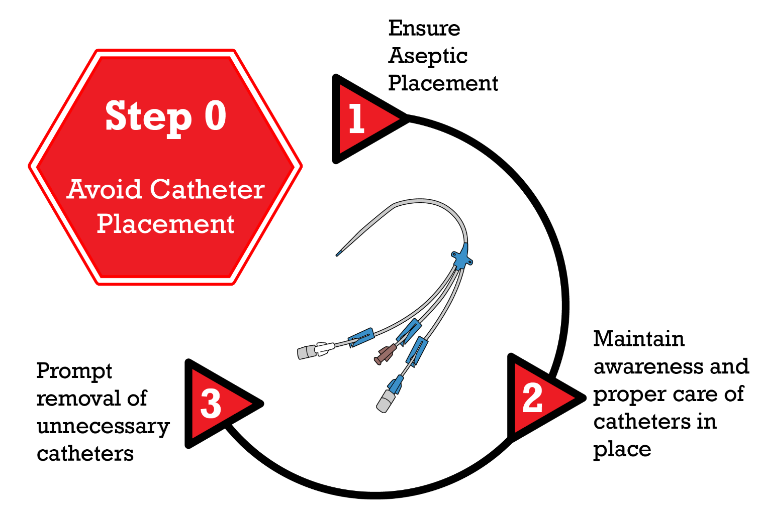
Step 2. Maintenance Disrupting the Life Cycle of a Catheter Device^{1,2}
Patel PK, Gupta A, Vaughn VM, et al. Review of strategies to reduce central line-associated bloodstream infection (CLABSI) and catheter-associated urinary tract infection (CAUTI) in adult ICUs. J Hosp Med. 2018 Feb;13(2):105-16. Epub 8 Nov 2017. PMID: 29154382. Used with permission of Journal of Hospital Medicine.
AHRQ Safety Program for ICUs: Preventing CLABSI and CAUTI
CVC Maintenance ׀ 2

Slide 3
Case Scenario
Mrs. Dunn is admitted to the ICU with urosepsis
A central venous catheter (CVC) is placed for vasopressors
Her condition improves
A CVC continues to be used after it is no longer indicated
Day 7—CLABSI diagnosed
What is your assessment of this case?
Disclaimer: All case studies are hypothetical and not based on any actual patient or hospital information. Any similarity between a case study and actual patient or hospital experience is purely coincidental.
AHRQ Safety Program for ICUs: Preventing CLABSI and CAUTI
CVC Maintenance ׀ 3

Slide 4
CLABSI During COVID³
NHSN analysis reports increases in CLABSIs between 2019 and 2020
Reasons for increase
Increased device utilization and length of use
Reduced contact between staff and isolated patients
Increased use of prone positioning
Changes in acuity
Need for refocus on infection prevention and CLABSI reduction
Importance of basic practices is crucial
AHRQ Safety Program for ICUs: Preventing CLABSI and CAUTI
CVC Maintenance ׀ 4

Slide 5
Basics of Maintenance: Hardwiring Practice⁴
Discussion of daily need
Dressing integrity/site securement/CHG dressing
CHG baths
Accessing the site
Administration and tubing set changes
AHRQ Safety Program for ICUs: Preventing CLABSI and CAUTI
CVC Maintenance ׀ 5

Slide 6
Daily Assessment for CVC Necessity⁴
Assess necessity of CVC daily with the multidisciplinary ICU team during daily rounds
Use daily rounds forms to prompt discussion among staff
Post or share checklists for CVC indications as a guide during assessments
Share results with leadership, identify gaps, and garner support for recommended improvements in compliance or processes
Develop electronic medical record (EMR) prompts that highlight assessment criteria
Discuss line during handoffs – consider including ED and anesthesia personnel
Assess compliance to maintenance bundle
If central line is indicated, bathe daily with CHG and follow essential CVC maintenance procedures
AHRQ Safety Program for ICUs: Preventing CLABSI and CAUTI
CVC Maintenance ׀ 6

Slide 7
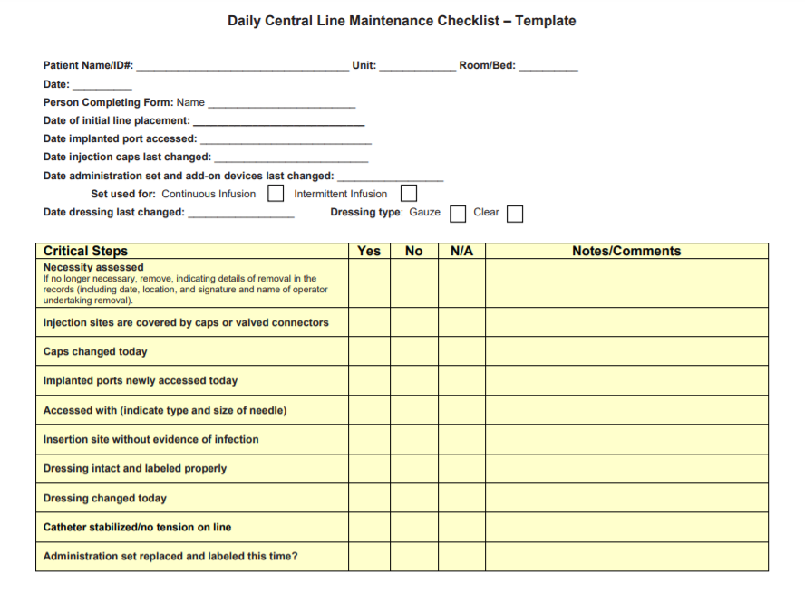
Central Venous Catheter Maintenance Bundle⁴
© The Joint Commission. Reprinted with permission.
AHRQ Safety Program for ICUs: Preventing CLABSI and CAUTI
CVC Maintenance ׀ 7

Slide 8
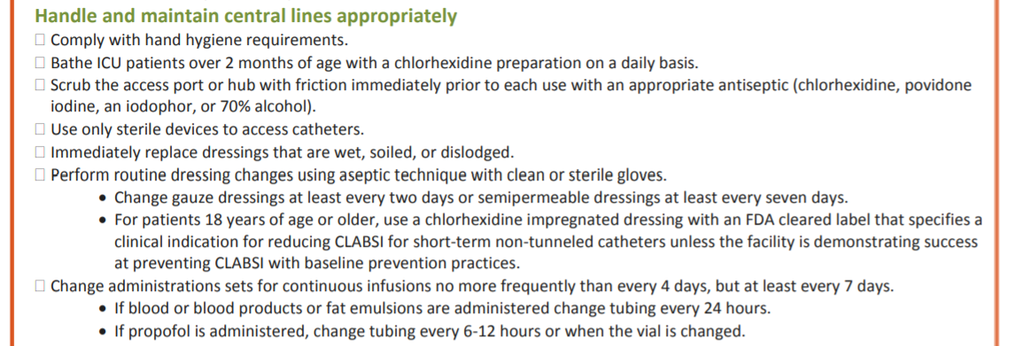
CLABSI Prevention Guidelines⁵
2011 CDC Guideline for CLABSI Prevention highlights:
Hand hygiene
Maximum barrier precautions
Proper skin antisepsis
Cover with sterile dressing
Access port or hub with appropriate antiseptic and use only sterile devices to access
Daily bathing with CHG
Use aseptic technique for dressing changes
Maintain dressing integrity and change if soiled, wet, or dislodged
Promptly remove unnecessary lines
AHRQ Safety Program for ICUs: Preventing CLABSI and CAUTI
CVC Maintenance ׀ 8

Slide 9
Standardize CVC Dressing Care^{6,7}
Assess dressing status daily
Replace the dressing only when it becomes damp, loosened, or soiled
Replace dressing on short-term CVC sites—
Every 2 days for gauze dressings
Every 7 days for transparent dressings
Use aseptic technique
Document date and time on dressing
Do not disturb or change a clean, dry, intact dressing until recommended date
Use standard dressing kits
AHRQ Safety Program for ICUs: Preventing CLABSI and CAUTI
CVC Maintenance ׀ 9

Slide 10
CHG Bathing⁸⁻¹²
Consider incorporating CHG bathing to reduce CLABSIs
Application and training sessions for ICU team members
Apply as per product directions
Be aware of the commonly missed areas – such as the neck, back of the knees, and between fingers and toes
Do not rinse off
Avoid application with cotton materials
Check compatibility with skin lotions
Clean wounds and devices
Clean the perineum
Clean the face but not near the eyes or ears
AHRQ Safety Program for ICUs: Preventing CLABSI and CAUTI
CVC Maintenance ׀ 10

Slide 11
Standardize CVC Line Access Process ^{4,6,13,14}
Reduce central line entries as much as possible
Schedule medications to reduce the number of entries into the line
“Scrub the hub” for no less than 5 seconds with an appropriate antiseptic prior to every access
Change hub, connectors, or ports at least as frequently as the administration set, no more frequently than every 72 hours
Continuous passive disinfection of catheter hubs have been shown to prevent contamination and bloodstream infection in some studies
Perform hand hygiene before and after central line entry
Monitor staff compliance with hub, connector, or port disinfection and care
AHRQ Safety Program for ICUs: Preventing CLABSI and CAUTI
CVC Maintenance ׀ 11

Slide 12
Standardize CVC Tubing Care^{4-7,12}
Perform hand hygiene
Reduce the number of times the CVC line is opened
Change all tubing and any add-ons at the same time when possible
Replace administration sets not used for blood, blood products, or lipids no more frequently than every 96 hours
Consider impact of different fluids, like blood and lipids, on tubing change frequency
AHRQ Safety Program for ICUs: Preventing CLABSI and CAUTI
CVC Maintenance ׀ 12

Slide 13
Barriers to CVC Maintenance
Lack of knowledge—both initially and ongoing
Lack of buy-in and understanding of the “why”
Time constraints, staffing issues
Lack of available supplies
Absence of auditing of compliance
Absence of feedback about process measures and outcomes
AHRQ Safety Program for ICUs: Preventing CLABSI and CAUTI
CVC Maintenance ׀ 13

Slide 14
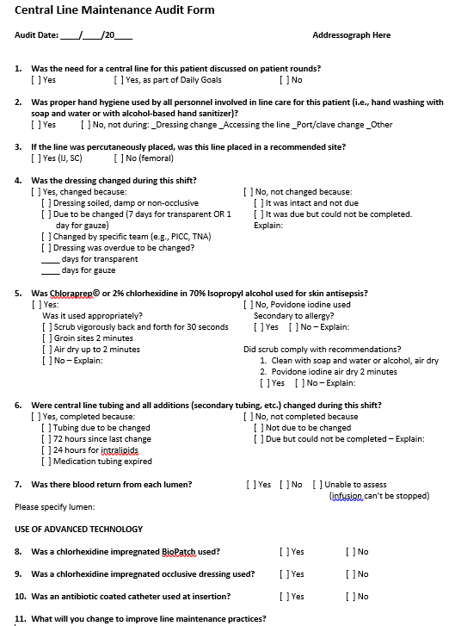
Overcoming Barriers to CVC Maintenance¹⁵
Utilize advanced tools and strategies
Incorporate prompts into existing EMR charting
Create customized checklists, standardized processes
Use prepackaged dressing change kits
Conduct audit bundle compliance with “just-in-time” coaching and feedback
AHRQ Safety Program for ICUs: Preventing CLABSI and CAUTI
CVC Maintenance ׀ 14

Slide 15
Supportive Evidence for the Bundles^{16,17}
Summary of findings from two meta-analyses
Demonstrated effectiveness of insertion and maintenance bundles to prevent central-line-associated bloodstream infections in critically ill patients of all ages
Implementation of checklists and care bundles appear to yield the strongest risk reductions
AHRQ Safety Program for ICUs: Preventing CLABSI and CAUTI
CVC Maintenance ׀ 15

Slide 16
Take-Home Points^{5, 16,17,18}
Use a central line maintenance bundle checklist
Conduct a daily assessment of CVC necessity
Standardize processes for accessing the CVC, dressing changes, CHG bathing and tubing changes
Perform hand hygiene
“Scrub the hub” every time you access a central line
If rates are elevated, assess care and maintenance issues
Use PDSA to overcome barriers to CVC maintenance care
AHRQ Safety Program for ICUs: Preventing CLABSI and CAUTI
CVC Maintenance ׀ 16

Slide 17
References
Meddings J, Saint S. Disrupting the life cycle of the urinary catheter. Clin Infect Dis. 2011 Jun;52(11):1291-3. PMID: 21596672.
Patel PK, Gupta A, Vaughn VM, et al. Review of strategies to reduce central line-associated bloodstream infection (CLABSI) and catheter-associated urinary tract infection (CAUTI) in adult ICUs. J Hosp Med. 2018 Feb;13(2):105-16. PMID: 29154382.
Patel PR, Weiner-Lastinger LM, Dudeck MA, et al. Impact of COVID-19 pandemic on central line-associated bloodstream infections during the early months of 2020, National Healthcare Safety Network. Infect Control Hosp Epidemiol. 2021 Mar 15;1-4. [Epub ahead of print.] doi:10.1017/ice.2021.108. PMID: 33719981.
The Joint Commission. Preventing Central Line–Associated Bloodstream Infections: Useful Tools, An International Perspective. http://www.jointcommission.org/CLABSIToolkit. Accessed October 2, 2021.
Centers for Disease Control and Prevention. Checklist for Prevention of Central Line-Associated Bloodstream Infections. https://www.cdc.gov/hai/pdfs/bsi/checklist-for-clabsi.pdf. Accessed October 11, 2021.
O'Grady NP, Alexander M, Burns LA, et al. Guidelines for the prevention of intravascular catheter-related infections. Clin Infect Dis. 2011 May 1;52(9):e162-e193. PMCID: PMC3106269.
Gorski L, Hadaway L, Hagel M, et al. Infusion Therapy Standards of Practice, 2016 update. J Infus Nurs. 2016;39(1S):51-5. PMID: 33394637.
Huang SS. Chlorhexidine-based decolonization to reduce healthcare-associated infections and multidrug-resistant organisms (MDROs): who, what, where, when, and why? .J Hosp Infect. 2019;103(3):235-43. PMID: 31494130.
Climo MW, Yokoe DS, Warren DK, et al. Effect of daily chlorhexidine bathing on hospital-acquired infection. N Engl J Med. 2013;368(6):533-54. PMID: 23388005.
Huang SS, Septimus E, Kleinman K, et al. Targeted versus universal decolonization to prevent ICU infection. New Engl J Med. 2013;368(24):2255-65. PMID: 23718152.
Agency for Healthcare Research and Quality. Appendix E. Training and Educational Materials (continued). https://www.ahrq.gov/hai/universal-icu-decolonization/universal-icu-ape3.html. Accessed October 11, 2021.
Rickard CM, Marsh NM, Larsen EN, et al. Effect of infusion set replacement intervals on catheter-related bloodstream infections (RSVP): a randomised, controlled, equivalence (central venous access device)-non-inferiority (peripheral arterial catheter) trial. Lancet. 2021;397(10283):1447-58. PMID: 33865494.
Wright MO, Tropp J, Schora DM, et al. Continuous passive disinfection of catheter hubs prevents contamination and bloodstream infection. Am J Infect Control. 2013 Jan;41(1):33-8. doi: 10.1016/j.ajic.2012.05.030. PMID: 23084024.
AHRQ Safety Program for ICUs: Preventing CLABSI and CAUTI
CVC Maintenance ׀ 17

Slide 18
References
Marschall J, Mermel LA, Fakih M, et al. Strategies to prevent central line-associated bloodstream infections in acute care hospitals: 2014 update. Infect Control Hosp Epidemiol. 2014 Jul;35(7):753-71. PMID: 24915204.
Agency for Healthcare Research and Quality. Appendix 6: Central Line Maintenance Audit Form. Content last reviewed March 2018. http://www.ahrq.gov/professionals/education/curriculum-tools/clabsitools/clabsitoolsap6.html. Accessed on October 11, 2021.
Ista E, Hoven B, Kornelisse RF, et. al Effectiveness of insertion and maintenance bundles to prevent central-line-associated bloodstream infections in critically ill patients of all ages: a systematic review and meta-analysis. Lancet Infect Dis. 2016 Jun;16(6):724-34. doi: 10.1016/S1473-3099(15)00409-0. PMID: 26907734.
Blot K, Bergs J, Vogelaers D, et al. Prevention of central line–associated bloodstream infections through quality improvement interventions: a systematic review and meta-analysis. Clin Infect Dis. 2014;59(1):96-105. PMID: 24723276.
Institute for Healthcare Improvement. Science of Improvement: Testing Changes. http://www.ihi.org/resources/Pages/HowtoImprove/ScienceofImprovementTestingChanges.aspx. Accessed October 11, 2021.
AHRQ Safety Program for ICUs: Preventing CLABSI and CAUTI
CVC Maintenance ׀ 18

