Slide 1
Engaging the Team and Applying CUSP in the ICU Setting
AHRQ Safety Program for Intensive Care Units:
Preventing CLABSI and CAUTI
AHRQ Pub. No. 17(22)-0019
April 2022

Slide 2
Objectives
Define key aspects of safety culture and why it is important
Recall two strategies to obtain staff feedback to improve patient safety culture and engage the team
Identify the three principles of safe design for systems​
Describe how to identify defects from process monitoring

Slide 3
Four Primary Concepts of The Science of Safety¹⁻³
Standardize
Care
Create
Independent
Checks
Learn From Defects
Safety is the property of the system—every system is perfectly designed to achieve its end results
Standardization, independent checks, and learning from defects are the principles of safe design
Principles of safe design apply to both technical and adaptive work
Teams with diverse and independent input make wise decisions

Slide 4
What Is Safety Culture?⁴
CULTURE
Perceived priority of safety relative to other goals
Culture is the compass team members use to guide their behaviors, attitudes, and perceptions on the job
What will I get praised for?
What will I get reprimanded for?
What is the “right” thing to do?
BEHAVIOR
ON THE JOB
OUTCOMES
Patient and Family Safety
Care Provider Safety

Slide 5
Safety Culture Is Related to Outcomes^{5,6}
Patient Outcomes
Clinician Outcomes
Patient care experience
Infection rates, sepsis
CAUTIs
CLABSIs
Treatment errors
Incident reporting
Burnout and turnover
Safety culture can change through intervention
Best evidence so far for culture interventions that use multiple components

Slide 6
Stages of Engagement⁵
Engagement: “To involve oneself or become occupied; to participate fully and deeply”
Active support of the program
Engaged
Apathy
Aversion
Uninvolved

Slide 7
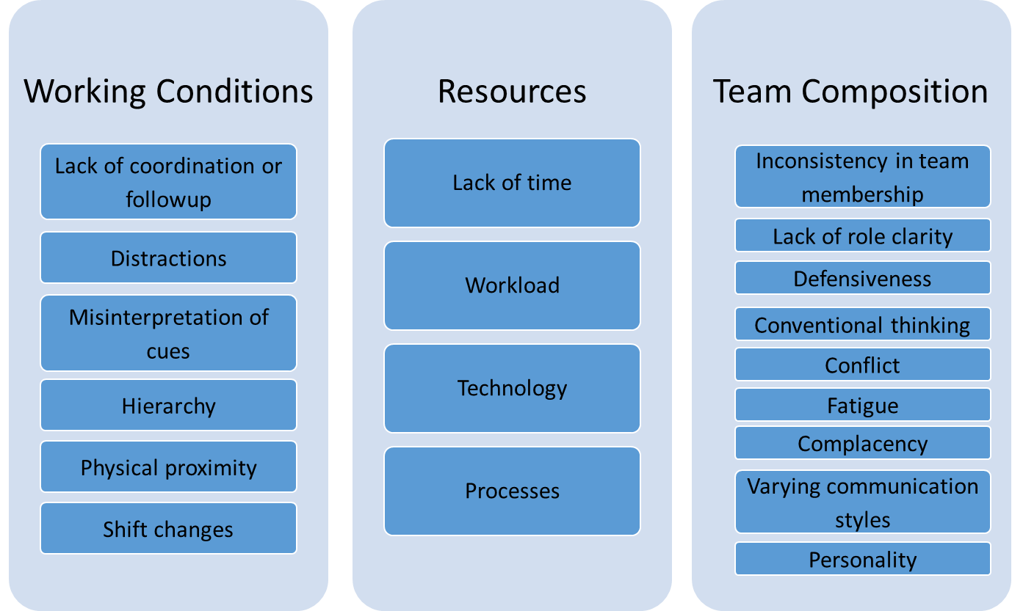
Barriers to Team Effectiveness⁵

Slide 8
Working and Learning as a Team
Create a safe space and time for discussions
Use patient-centered dialogue
Review and analyze data
Promote knowledge sharing and educational opportunities
Consider and discuss how to use tools and resources
Make it fun and celebrate successes!
Share information regularly with peers and mentors
Issues and concerns
Lessons learned
Best practices

Slide 9
Why I Care Template
I care about patient safety because…

Slide 10
TeamSTEPPS Tools⁷
Brief
Huddle
Debrief
Situation-Background- Assessment-Recommendation (SBAR)
“I am Concerned. I am Uncomfortable. This is a Safety issue.” (CUS)
2-Challenge Rule
Check Back
Call Out
Hand Off
Describe, Express, Suggest, Consequences (DESC) Script
AHRQ TeamSTEPPS Pocket Guide

Slide 11
Where To Find Defects^{8,9}
Adverse event reporting systems
Sentinel events
Claims data
Infection rates
Process audits
Staff safety assessments
Where else might you find information to identify defects?

Slide 12
Gathering Group Wisdom⁹⁻¹²
Defect Analysis
To identify root causes of an infection, opportunities for improvement
Tools/techniques
CLABSI Event Report template
CAUTI Event Report template
5 Whys
Staff Safety Assessment
Brainstorming
To generate new ideas, set priorities
Tools/techniques
Brainstorming
Fishbone diagram
Affinity diagram
Multivoting
1-2-4-All

Slide 13
Learning From Defects¹³
What happened?
From the view of the person involved
Why did it happen?
How will you reduce the risk of it happening again?
How will you know the risk was reduced?
1
2
3
4

Slide 14
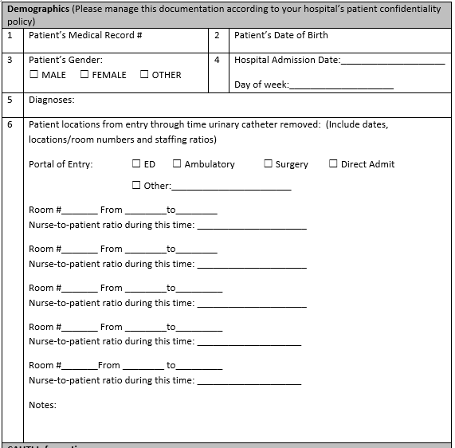
Event Report Tools
The event report tools have the following domains:
Demographics
CLABSI/CAUTI information
Catheter information
Catheter bundle practices
Other potential contributing factors for CLABSI/CAUTI

Slide 15
Understand Why Defect Happened
Refer back to tools used and/or drawings/diagrams developed
Look for weaknesses in the process
Are there redundant steps?
Are there variables that make care inconsistent among providers?
Are there breaches in compliance to best practices?
Evaluate the way your workspaces are designed
Is the workflow reasonable?
Is the workflow efficient?
Look for contributing system factors

Slide 16
Examples of Defects of Failures That Affect Patient Safety¹⁴⁻¹⁷
Defect | Intervention
Missing supplies on kit/cart | Checklist developed for stocking cart; staff appointed to stock carts
Urinary catheter alternatives are limited and/or are of poor quality, so are not used | Evidence-based practices and equipment review done; ICU staff and Materials Management engaged to coordinate trials for select alternatives.
Short-term central venous catheter dressing changed daily, despite site being clean, dry, and intact | Daily central line maintenance bundle checklist to assess dressing and documentation of date changed or change due date for gauze and transparent dressings

Slide 17
Build Resiliency Into Interventions¹⁸
Forcing functions and constraints
Automation and computerization
Standardization and protocols
Checklist and independent check systems
Rules and policies
Education and information
Vague warning (e.g., “Be more careful”)
Strongest
STRENGTH OF INTERVENTION
Weakest

Slide 18
Discussion Questions
What is the most common barrier to your CUSP team’s engagement?
Where are the opportunities in your ICU to get new ideas and increase engagement?
How have you engaged your team in learn from defects process?

Slide 19
Tools and Resources¹⁹⁻²³
AHRQ CUSP Tools
CUSP Culture Checkup Tool
Videos
Understand the Science of Safety module
The 4 E’s
Psychological Safety
Learn From Defects
AHRQ ICU Safety Program Toolkit
Video – Having Difficult Conversations About Preventing Infections in the ICU
Video – Creating Team Buy-In To Work Toward Zero Preventable Infections in ICUs
CLABSI and CAUTI Event Report Tools
Why I Care Template

Slide 20
References
Vincent C, Taylor-Adams S, Stanhope N. Framework for analyzing risk and safety in clinical medicine. BMJ. 1998 Apr 11;316(7138):1154-7. PMID: 9552960.
Pronovost PJ, Holzmueller CG, Martinez E, et al. A practical tool to learn from defects in patient care. Jt Comm J Qual Patient Saf. 2006 Feb;32(2):102-8. PMID: 16568924.
Agency for Healthcare Research and Quality. Learn From Defects in Care of Mechanically Ventilated Patients: Slide Presentation. http://www.ahrq.gov/professionals/quality-patient-safety/hais/tools/mvp/modules/cusp/learn-from-defects-slides.html Accessed on July 18, 2021.
Agency for Healthcare Research and Quality. Assess Patient Safety Culture Using the Hospital Survey on Patient Safety: Slide Presentation. http://www.ahrq.gov/professionals/quality-patient-safety/hais/tools/mvp/modules/cusp/assess-psc-hsop-slides.html. Accessed on July 18, 2021.
Agency for Healthcare Research and Quality. Assemble the Team. http://www.ahrq.gov/professionals/education/curriculum-tools/cusptoolkit/modules/assemble/index.html. Accessed on July 18, 2021.
Vifladt A, Simonsen BO, Lydersen S. The association between patient safety culture and burnout and sense of coherence: A cross-sectional study in restructured and not restructured intensive care units. Intensive Crit Care Nurs. 2016 Oct;36:26-34. PMID: 27212614.
Agency for Healthcare Research and Quality. Pocket Guide: TeamSTEPPS. http://www.ahrq.gov/teamstepps/instructor/essentials/pocketguide.html. Accessed on July 18, 2021.
Vincent C, Taylor-Adams S, Stanhope N. Framework for analyzing risk and safety in clinical medicine. BMJ. 1998 Apr 11;316(7138):1154-7. PMID: 9552960.
Agency for Healthcare Research and Quality. Staff Safety Assessment. http://www.ahrq.gov/professionals/education/curriculum-tools/cusptoolkit/toolkit/staffsafetyassess.html. Accessed on July 18, 2021.
Lipmanowicz H, McCandless K. The Surprising Power of Liberating Structures: Simple Rules to Unleash A Culture of Innovation. Liberating Structures Press, Seattle, WA; 2014.
Cherry RA, West CE, Hamilton MC, et al. Reduction of central venous catheter associated blood stream infections following implementation of a resident oversight and credentialing policy. Patient Saf Surg. 2011 Jun 3;5(1):15. PMID: 21639916.
Quality Topics A to Z. American Society for Quality, Milwaukee, WI. http://asq.org/learn-about-quality/. Accessed on July 18, 2021.
Agency for Healthcare Research and Quality. Learn from Defects Tool. http://www.ahrq.gov/professionals/education/curriculum-tools/cusptoolkit/toolkit/learndefects.html. Accessed on July 18, 2021.

Slide 21
References
O'Grady NP, Alexander M, Burns LA. Guidelines for the prevention of intravascular catheter-related infections. Am J Infect Control. 2011 May;39(4 Suppl 1):S1-34. PMID: 21511081.
Gorski L, Hadaway L, Hagel M, et al. Infusion Therapy, Standards of Practice, 2016 update. J Infus Nurs. 2016;39(15):51-5.
Preventing Central Line-Associated Bloodstream Infections: Useful Tools, An International Perspective. The Joint Commission. http://www.jointcommission.org/CLABSIToolkit.
Marschall J, Mermel LA, Fakih M, et al; Society for Healthcare Epidemiology of America. Strategies to prevent central line-associated bloodstream infections in acute care hospitals: 2014 update. Infect Control Hosp Epidemiol. 2014 Jul;35(7):753-71. doi: 10.1086/676533. PMID: 24915204.
Agency for Healthcare Research and Quality. Learning From Defects Through Sensemaking: Slide Presentation. http://www.ahrq.gov/professionals/quality-patient-safety/hais/tools/surgery/modules/implementation/imp_learn_from_defects-slides.html. Accessed on July 18, 2021.
Agency for Healthcare Research and Quality. Understand the Science of Safety. http://www.ahrq.gov/professionals/education/curriculum-tools/cusptoolkit/modules/understand/index.html. Accessed on July 18, 2021.
Agency for Healthcare Research and Quality. Culture Check-Up Tool. http://www.ahrq.gov/professionals/education/curriculum-tools/cusptoolkit/toolkit/culturecheckup.html. Accessed on July 18, 2021.
Agency for Healthcare Research and Quality. The 4 E's. http://www.ahrq.gov/professionals/education/curriculum-tools/cusptoolkit/videos/02b_the4es/index.html. Accessed on July 18, 2021.
Agency for Healthcare Research and Quality. Psychological Safety. http://www.ahrq.gov/professionals/education/curriculum-tools/cusptoolkit/videos/02d_psych_safety/index.html. Accessed on July 18, 2021.
Agency for Healthcare Research and Quality. Assess Patient Safety Culture Using the Hospital Survey on Patient Safety: Slide Presentation. http://www.ahrq.gov/professionals/quality-patient-safety/hais/tools/mvp/modules/cusp/assess-psc-hsop-slides.html. Accessed on July 18, 2021.

