Slide 1
Building an Engaged Comprehensive Unit-based Safety Program Team
AHRQ Safety Program for Intensive Care Units:
Preventing CLABSI and CAUTI
AHRQ Pub. No. 17(22)-0019
April 2022

Slide 2
Objectives
Identify tools and resources available to support your CLABSI and/or CAUTI improvement journey, including AHRQ’s Comprehensive Unit-based Safety Program (CUSP)
Develop strategies to build a successful CUSP team
Facilitate discussions with team members on how to build an engaged CUSP team

Slide 3
What is “CUSP”?¹
CUSP stands for Comprehensive Unit-based Safety Program
The CUSP model combines improvements in teamwork, communication, and safety culture together with evidence-based best practices to help teams make care safer

Slide 4
The CUSP Model^{1,2}
Created through a collaborative effort of AHRQ and State- and national-level innovators in patient safety
Dovetails with and supports a range of quality and safety improvement models
Encompasses a wide range of safety tools and approaches
Based on the understanding that all culture is local, and that work to improve culture must be owned at the unit level
Rooted in the premise that harm is not an acceptable “cost of doing business”
Is appropriate for use across many and various healthcare domains
Has been used effectively to reduce a variety of clinical harms
Stories of Success: Using CUSP To Improve Safety

Slide 5
How Does CUSP Help Your Team Achieve Healthcare-Acquired Infection Reduction Goals?³⁻⁵
Provides a framework that is strengthened by leveraging diverse viewpoints and expertise
Helps the team understand what needs to be done and how to do it in the ICU
Creates a shared mental model across disciplines that translates evidence-based practices to care
Provides a more efficient, productive, and safe environment+

Slide 6
Build an ICU CUSP Team That–
Understands that patient safety culture is unit based
Comprises engaged frontline providers who take ownership of patient safety
Includes staff members who have different levels of experience
Incorporates members based on clinical intervention
Meets regularly (at least monthly)
Provides adequate resources

Slide 7
CUSP Team Members³
Nurses: bedside, nurse management, clinical nurse specialist, educator
Nurse’s aides
Physicians
Executive partners
Infection preventionists
Medical directors
Pharmacists
Clinical team (therapists and care technicians)
Patient safety officers
Quality department
Ancillary staff (e.g., environmental services)
Subject matter experts (e.g., staff who insert PICC lines, dialysis team member)
Senior leaders
Team leaders
Staff

Slide 8
The CUSP Team Leader’s Role³
Engages with senior executive
Establishes a multidisciplinary team
Encourages ICU staff involvement
Obtains staff feedback
Manages documentation of CUSP activities
Educates staff about CUSP
Role may be filled by a nurse manager, clinical nurse specialist, nurse educator, physician, or other ICU staff member; include a co-lead

Slide 9
The Senior Executive’s Role^{6,7}
Assists the team in prioritizing improvement efforts
Helps the team navigate organizational bureaucracy
Ensures the CUSP team has resources to fix problems
Participates in activities that support teamwork and communication to prevent patient harm
Role may be filled by a chief nursing officer, chief medical officer, chief executive officer, etc.

Slide 10
Engaging the Senior Executive in CUSP Team^{7,8}
Identify ways to involve the senior executive in activities already occurring on the unit
Daily briefings, rounding, shared governance meetings, etc.
Celebrations of success
Implement Senior Leader Patient Safety Rounding
Provide bulleted information in advance about the CUSP implementation such as aim statement, actions to be taken, and results to date
Encourage interactions between senior executive and all unit staff

Slide 11
The Physician Champion’s Role³
Serves as role model for CUSP activities
Communicates with physician groups as needed
Listens to, communicates, and addresses physician care concerns, practices, and goals
Meets with CUSP team and participates in monthly meetings
Assists with implementation of interventions

Slide 12
Recruiting and Engaging Physicians in CUSP Team⁵
Consider the format of your unit (open vs. closed) to determine your approach to engaging physicians
Consider having a CUSP physician champion for each infection (CLABSI, CAUTI) versus one CUSP physician champion for both
Assess physician availability and time allotted to participate
Invite physician to team meetings, co-present at medical staff meetings
Prepare reports to share information relevant to physician perspective
Include physician in multidisciplinary rounding
Work with physician's collaborating partners to enhance communication
Schedule a call to discuss role in interventions, and listen to and address their concerns
Explore opportunities for rewarding physicians (e.g., stipend, gift card, performance goals)

Slide 13
The Nurse Manager’s Role⁹
Ensures that care delivery aligns with the highest quality of care
Assures safety assessment results and outcome data are shared with staff
Facilitates knowledge building and staff training to meet clinical competencies
Follows up with entire clinical team on possible barriers, progression, and success of CUSP
Manages local resources
Ensures ICU’s daily activities are aligned with organizational goals
Partners with senior executives to obtain buy-in and support
Serves as the decision maker to carry out plans
Inspires staff to participate in other quality improvement programs and initiatives
Assures role coverage for all CUSP interventions

Slide 14
The Nurse Champion’s Role
Fully engages in patient care
Understands HAI morbidity and mortality
Connects CUSP to patient and family engagement
Knows how care is provided at the bedside
Supports bedside nurses and management
Discusses barriers, new ideas, progress, and successes
Understands importance of defect analysis
Role may be filled by a staff nurse, assistant nurse manager, clinical nurse specialist, or nurse practitioner

Slide 15
Additional Suggested Roles
Infection Preventionist
Meets with CUSP team and participates in monthly meetings
Keeps senior executives and committees up to date on barriers, progress, and successes on the unit
Ensures real-time, unit-level data is available to ICU team
Facilitates knowledge building and skills training for staff to meet infection prevention competencies
Understands importance of defect analysis and real-time feedback to unit staff
Quality/Performance Improvement Specialist
Meets with CUSP team and participates in monthly meetings
Understands the science of safety and importance of defect analysis
Integrates improvement opportunities into daily workflow
Provides guidance in development of tests of change
Incorporates auditing into performance measures
Others
Medical residents and fellows, environmental services, therapists, and members of the transport team

Slide 16
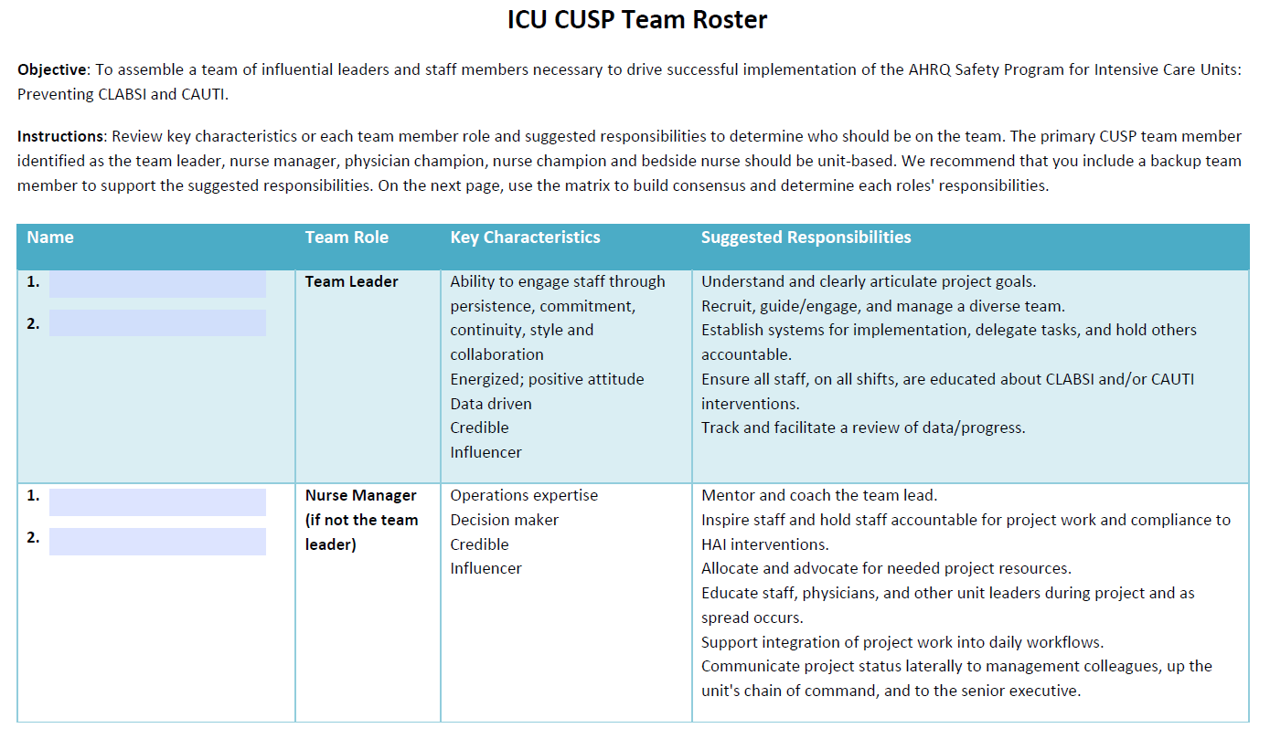
Use Team Roster To Assign Roles and Responsibilities

Slide 17
Discussion Questions
In your current ICU team, do you have all the roles listed in the Team Roster?
What roles would you like to add?
What challenges do you foresee as you put the team together?
What staff (by role) do you believe it will be easiest to recruit to your CUSP team?
What staff (by role) do you believe it will be most difficult to recruit to your CUSP team?

Slide 18
Recommended CUSP Tools and Resources^{7,10-14}
Safety Issues Worksheet for Senior Executive Partnership
AHRQ CUSP Toolkit videos
Building Your CUSP Team
The Role of the Nurse Manager
Physician Engagement
Engage the Senior Executive
Making It Work Tip Sheet
Assembling the CUSP Team
Engaging Senior Leaders in Preventing HAIs
Engaging Physicians in Preventing CLABSI and CAUTI
Engaging Physician Champions in Preventing CLABSI and CAUTI

Slide 19
References
Agency for Healthcare Research and Quality. What Is CUSP? http://www.ahrq.gov/professionals/quality-patient-safety/cusp/cusp-success/whatiscusp.html. Accessed on July 18, 2021.
Agency for Healthcare Research and Quality. Implement Teamwork and Communication. http://www.ahrq.gov/professionals/education/curriculum-tools/cusptoolkit/modules/implement/index.html. Accessed on July 18, 2021.
Agency for Healthcare Research and Quality. Assemble the Team. http://www.ahrq.gov/professionals/education/curriculum-tools/cusptoolkit/modules/assemble/index.html. Accessed on July 18, 2021.
Reader TW, Flin R, Mearns K, et al. Developing a team performance framework for the intensive care unit. Crit Care Med. 2009;37(5):1787-93. PMID: 19325474.
Baggs JG, Schmitt MH, Mushlin AI, et al. Association between nurse-physician collaboration and patient outcomes in three intensive care units. Crit Care Med. 1999 Sep;27(9):1991-8. PMID: 10507630.
Agency for Healthcare Research and Quality. Engage the Senior Executive. http://www.ahrq.gov/professionals/education/curriculum-tools/cusptoolkit/modules/engage/index.html. Accessed on July 18, 2021.
Agency for Healthcare Research and Quality. Safety Issues Worksheet for Senior Executive Partnership. http://www.ahrq.gov/professionals/education/curriculum-tools/cusptoolkit/toolkit/safetysnrchklst.html. Accessed on July 18, 2021.
Knobloch MJ, Chewning B, Musuuza J, et al. Leadership rounds to reduce health care-associated infections. Am J Infect Control. 2018 Mar;46(3):303-10. PMID: 29102425.
Agency for Healthcare Research and Quality. The Role of the Nurse Manager. http://www.ahrq.gov/professionals/education/curriculum-tools/cusptoolkit/modules/nursing/index.html. Accessed on July 18, 2021.

Slide 20
References
10. Agency for Healthcare Research and Quality. Building Your CUSP Team. http://www.ahrq.gov/professionals/education/curriculum-tools/cusptoolkit/videos/02c_build_cusp_team/index.html. Accessed on July 18, 2021.
Agency for Healthcare Research and Quality. The Role of the Nurse Manager. http://www.ahrq.gov/professionals/education/curriculum-tools/cusptoolkit/modules/nursing/index.html. Accessed on July 18, 2021.
Agency for Healthcare Research and Quality. Physician Engagement. http://www.ahrq.gov/professionals/education/curriculum-tools/cusptoolkit/videos/02e_phys_engagement/index.html. Accessed on July 18, 2021.
Agency for Healthcare Research and Quality. Engage the Senior Executive. http://www.ahrq.gov/professionals/education/curriculum-tools/cusptoolkit/videos/03a_engage_senior_exec/index.html. Accessed on July 18, 2021.
Agency for Healthcare Research and Quality. AHRQ Safety Program for Intensive Care Units: Preventing CLABSI and CAUTI. http://www.ahrq.gov/professionals/quality-patient-safety/hais/tools/preventing/index.html. Accessed on July 18, 2021.

