Slide 1

Using Data To Drive Change and Improve Patient Safety
AHRQ Safety Program for Intensive Care Units:
Preventing CLABSI and CAUTI
AHRQ Pub. No. 17(22)-0019
April 2022

Slide 2
Objectives
Describe why data are critical to driving
improvement in your intensive care unit (ICU)
List data elements required for program participation and why these are collected
Identify two best practices for sharing data with the ICU Comprehensive Unit-based Safety Program (CUSP) team and frontline staff

Slide 3

Data for Performance Improvement
Essential in order to set and monitor progress toward goals
Provides rapid-cycle feedback
Generates awareness
Engages leadership and staff
Tied to reimbursement

Slide 4



Key Sources of Data
  Practices
  Policies
  Procedures
ICU Assessment
  HAI rate and standardized infection ratio (SIR)
  Device utilization rate and standardized utilization ratio (SUR)
National Healthcare Safety Network (NHSN) Data
  Identify healthcare-associated infection (HAI) gap
  Step-by-step plan
ICU Action Plan

Slide 5
Why the ICU Assessment?
Collects data on current HAI prevention practices, policies, and procedures to tailor the education program to meet your needs
Assessment covers the following:
  Team roles and responsibilities
  Resources available in unit
  Top three strengths and weaknesses identified by unit
  Team culture
  CLABSI/CAUTI (indwelling central line and urinary catheter life cycle)
    Appropriateness
    Alternatives
    Insertion
    Maintenance
    Removal
    Urine culturing stewardship

Slide 6
After Completing the ICU Assessment
Discuss your findings together as a team—find the story that the data tell you
  Did anything surprise you or your team?
  Where do you see opportunities for improvement?
  What are you currently doing well and how do you plan to sustain it?
Set an aim statement
  Connect to one area that needs to be improved in your unit in order to reduce CLABSI and/or CAUTI rates. Pick a priority that will tie to a concrete process, practice, policy or behavior.
  What are you trying to accomplish?
  Would the goal improve outcomes? Specifically, would it reduce rates?
  How will your team know that a change is an improvement?

Slide 7
Collecting Data – NHSN
CLABSI and CAUTI data; device utilization data
  Required reporting by Centers for Medicare & Medicaid Services (CMS), often required by State
  Collected and reported by your infection prevention team via NHSN
  Available data for your team to use

Slide 8
Understanding NHSN SIR and SUR Metrics^{1,2}
Risk-adjusted metrics to evaluate if your rates are increasing or unchanged over time and see how your ICU compares to other like units
Standardized infection ratio (SIR)
  If greater than 1, then higher number of infections than expected
  If less than 1, then less infections than expected
Standardized utilization ratio (SUR)
  If greater than 1, then higher device utilization than expected
  If less than 1, then lower device utilization than expected

Slide 9
Other Data Sources
Recommendations for other data to analyze and discuss together with team
  Unit patient safety culture survey results
  Staff safety assessments
  Outcome and device utilization data
  Process auditing data: insertion bundle data, maintenance bundle data, hand hygiene compliance data, etc.
  Targeted assessment for prevention (TAP) cumulative attributable difference (CAD)
  TAP assessment data
  Results of defects analyses or root cause analyses
  Patient stories

Slide 10
Assessment of Patient Safety Culture^{3,4}
Purpose is to examine details of safety culture in the ICU/hospital
All staff encouraged to complete the survey
Validated tools
  Hospital Survey on Patient Safety Culture (HSOPS)
  Safety Attitudes Questionnaire (SAQ)
  Safety, Communication, Organizational Reliability, Physician & Employee Burnout, and Engagement (SCORE)
If the last survey had less than a 60 percent response rate, consider completing a safety culture survey again

Slide 11
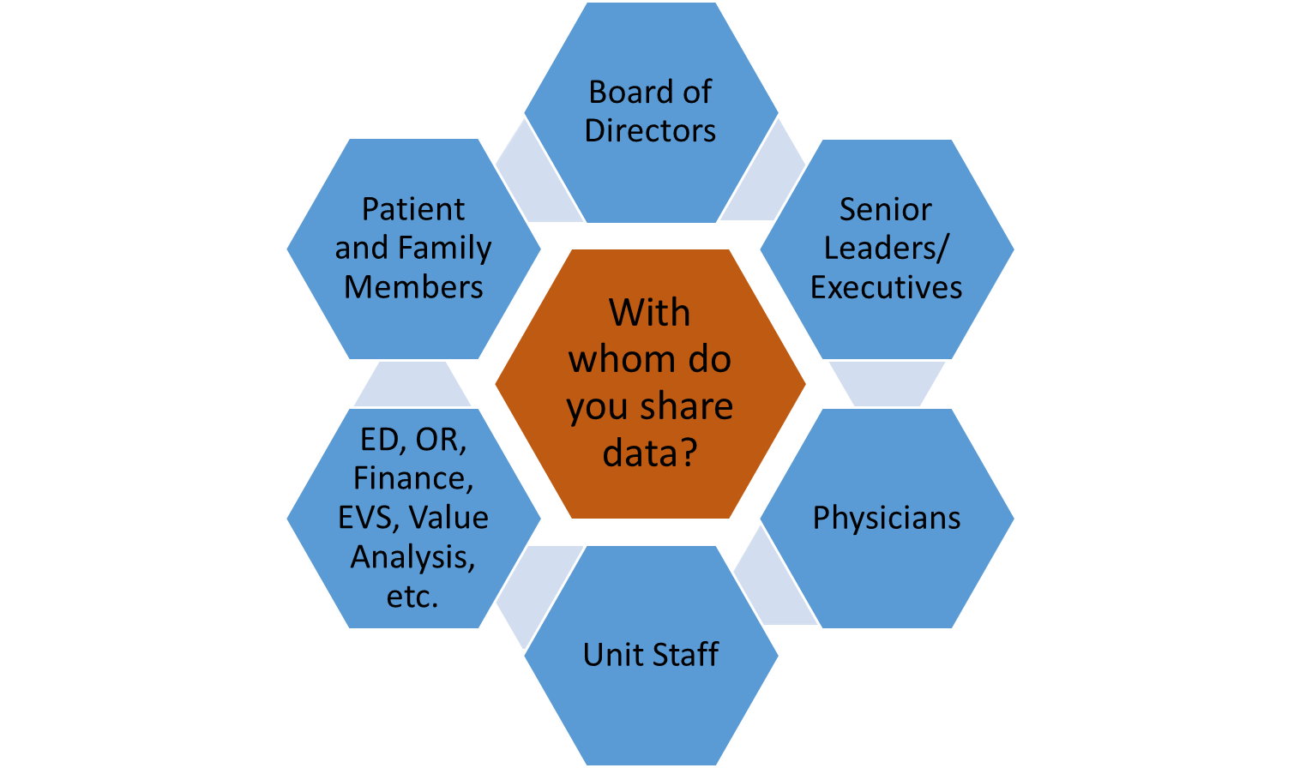
Use Data To Communicate a Plan for Change

Slide 12
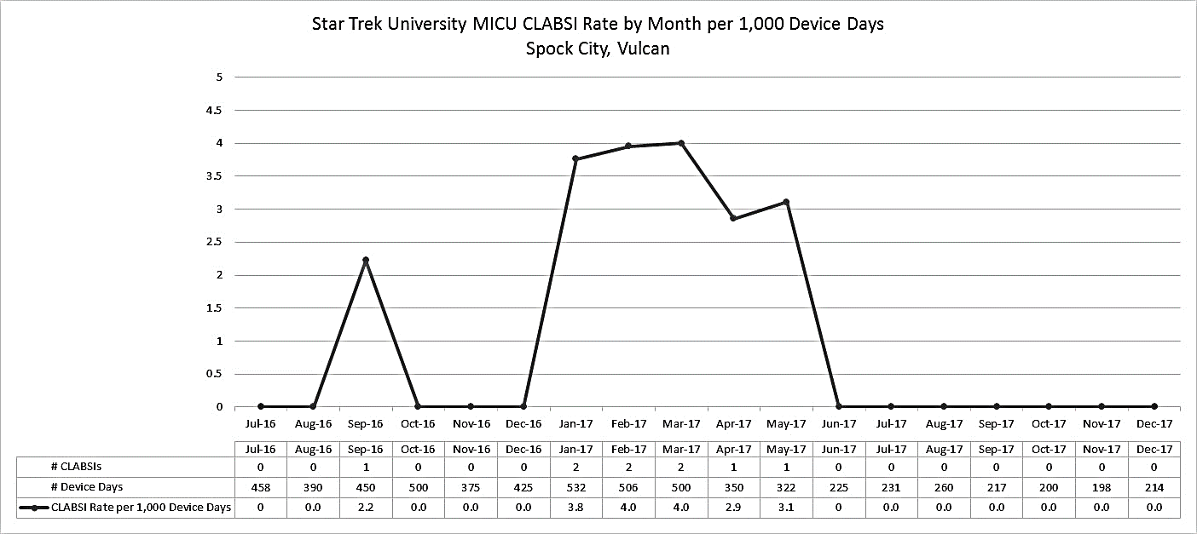
Tell the Story Using Data – A Run Chart
Neighborhood Community Hospital (NCH) MICU CLABSI Rate by Month per 1,000 Device Days
Abbreviation: MICU = medical ICU
Disclaimer: All case studies are hypothetical and not based on any actual patient or hospital information. Any similarity between a case study and actual patient or hospital experience is purely coincidental.

Slide 13
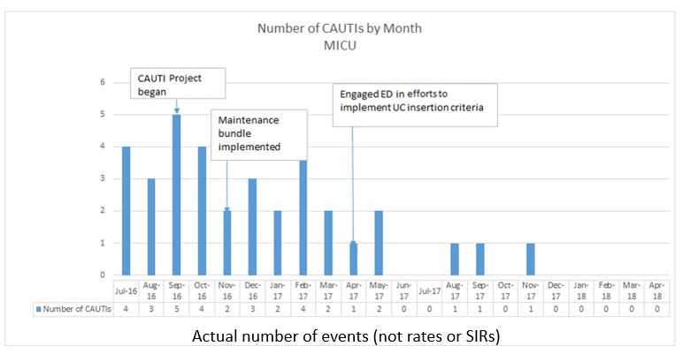
Tell the Story Using Data: Numerator Data
Abbreviation: MICU = medical ICU
Disclaimer: All case studies are hypothetical and not based on any actual patient or hospital information. Any similarity between a case study and actual patient or hospital experience is purely coincidental.

Slide 14
Patient Harm Index at NCH MICU
Number of HAI Events
Abbreviations: C. difficile = Clostridioides difficile, MRSA = methicillin-resistant Staphylococcus aureus, SSI = surgical site infection
Disclaimer: All case studies are hypothetical and not based on any actual patient or hospital information. Any similarity between a case study and actual patient or hospital experience is purely coincidental.

Slide 15
Tell the Story Using Data: Transparency
The MICU at NCH Is Preventing Infections!
How Are We Doing?
Date: | 4/29 – 5/5 (Information posted 5/7)
Days since last central line-associated bloodstream infection | 257
Days since last catheter-associated urinary tract infection | 86
Days since last ventilator-associated pneumonia | 73
Hand hygiene compliance rate this week | 72%
Disclaimer: All case studies are hypothetical and not based on any actual patient or hospital information. Any similarity between a case study and actual patient or hospital experience is purely coincidental.

Slide 16
Integrating Data Into Quality Work
Where learning occurs
  Synthesis of data and stakeholder tacit insights from it
  Assessment of current status
  Determination if progress is being made or not
  If progress is occurring, is it enough and at the right speed?
  If it is not progressing, why?
When decisions are needed
  Do interventions need to be revised/stopped/spread?
  Do failures need to be addressed?
  Do milestones need to be celebrated?
  What additional questions need to be asked and answered to move forward?

Slide 17

Discussion Questions
Has your ICU team set up regularly scheduled meetings to discuss learnings from this program?
How are data used to engage your CUSP team?
With whom do you share the data?

Slide 18
Tools and Resources^{5,6}
Staff Safety Assessment
Weeks Without CLABSI Banner
ICU Assessment
CUSP Training Videos
  Having Difficult Conversations About Preventing Infections in the ICU
  Increasing Ownership and Engagement at Multiple Levels To Prevent Infections in ICUs

Slide 19
References
The NHSN Standardized Infection Ratio (SIR): A Guide to the SIR. Atlanta, GA: Centers for Disease Control and Prevention. https://www.cdc.gov/nhsn/pdfs/ps-analysis-resources/nhsn-sir-guide.pdf. Accessed August 25, 2021.
The NHSN Standardized Utilization Ratio (SUR): A Guide to the SUR. Atlanta, GA: Centers for Disease Control and Prevention. https://www.cdc.gov/nhsn/pdfs/ps-analysis-resources/nhsn-sur-guide-508.pdf. Accessed August 25, 2021.
SCORE Survey. 2018. Safe & Reliable Health Care, LLC, and The Duke Patient Safety Center, Durham, NC. https://safeandreliablecare.com/score-survey Accessed August 25, 2021.
Agency for Healthcare Research and Quality. About SOPS. http://www.ahrq.gov/sops/quality-patient-safety/patientsafetyculture/index.html. Accessed August 25, 2021.
Agency for Healthcare Research and Quality. Staff Safety Assessment. http://www.ahrq.gov/professionals/education/curriculum-tools/cusptoolkit/toolkit/staffsafetyassess.html. Accessed August 25, 2021.
Agency for Healthcare Research and Quality. Appendix 1: Weeks Without CLABSI Banner. http://www.ahrq.gov/professionals/education/curriculum-tools/clabsitools/clabsitoolsap1.html. Accessed August 25, 2021.

