Slide 1
Quality Improvement in Action
AHRQ Safety Program for Intensive Care Units:
Preventing CLABSI and CAUTI
AHRQ Pub. No. 17(22)-0019
April 2022

Slide 2
Objectives
Describe methods to identify your intensive care unit’s (ICU) focus area of improvement using quality improvement strategies
Recall the components of a strong aim statement for developing an action plan
Summarize next steps to create your ICU’s first test of change using the Plan-Do-Study-Act (PDSA) cycle

Slide 3
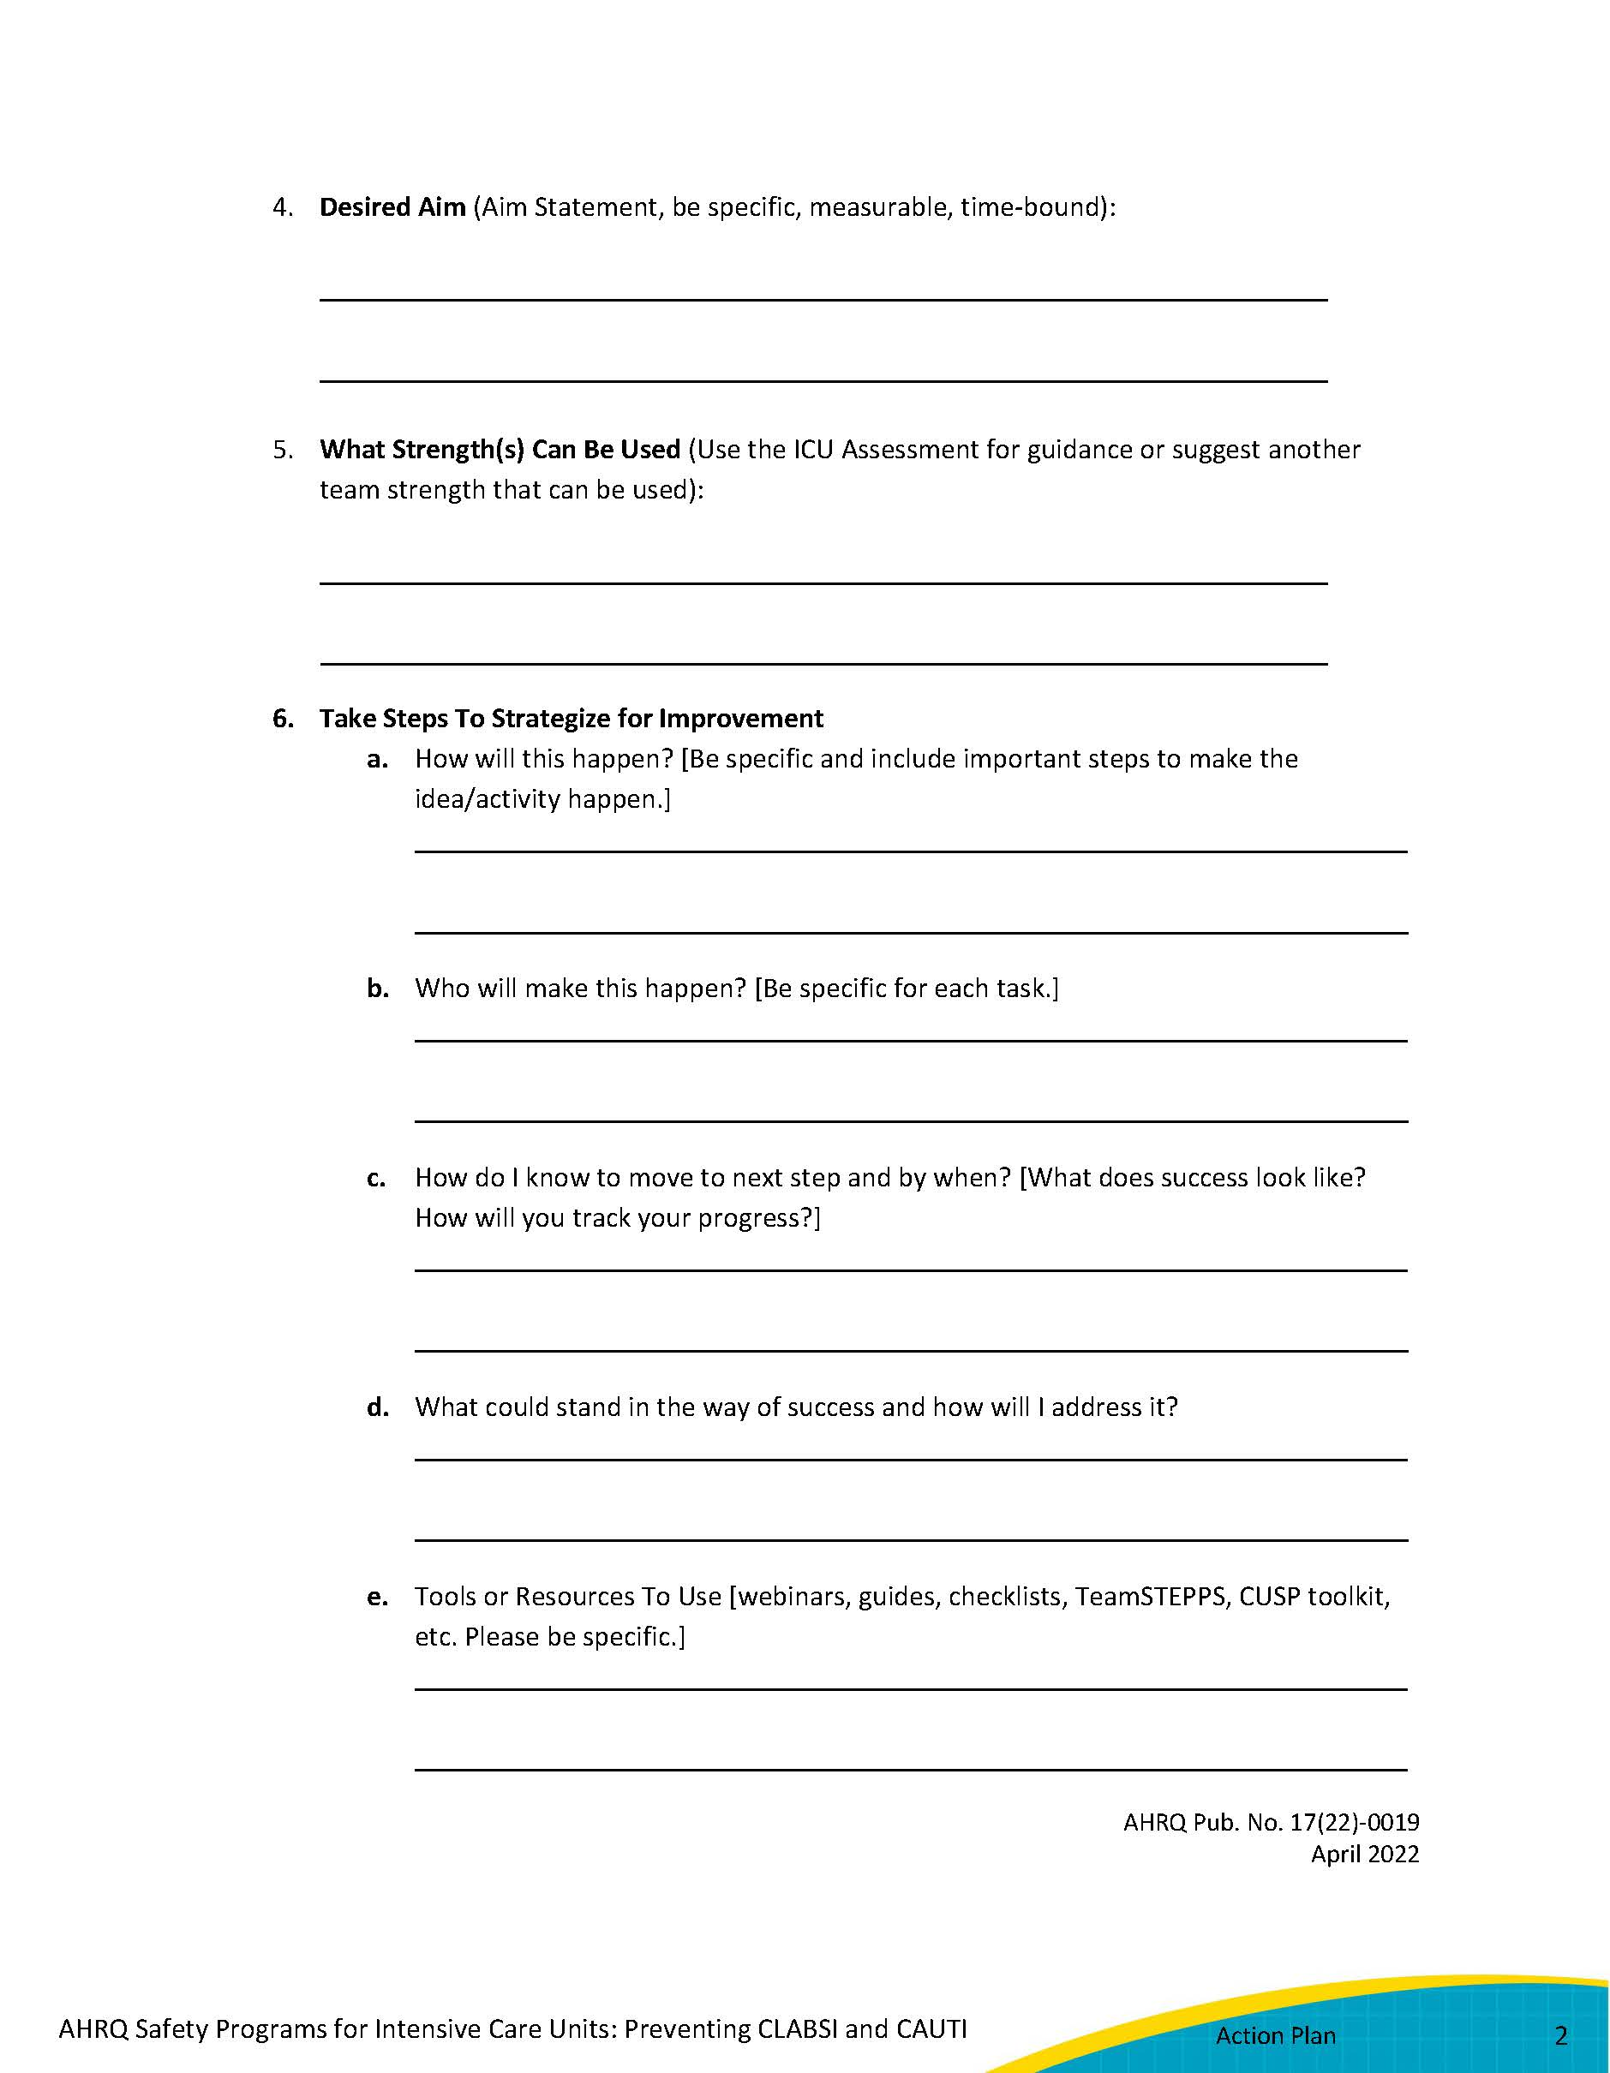
Action Planning

Slide 4
One ICU’s Story
Neighborhood Community Hospital (NCH) is a fictitious 400-bed community hospital with an 18-bed medical/surgical ICU
Central line-associated bloodstream infection (CLABSI) and catheter-associated urinary tract infection (CAUTI) CAD being >1.0:
CLABSI CAD = 12, CAUTI CAD = 6
ICU CUSP Team
Co-team leaders: clinical nurse specialist and ICU nurse manager
Physician champion: unit Medical Director Dr. James
Senior executive: vice president of clinical transformation

Slide 5
Identifying the Problem: Data Sources
National Healthcare Safety Network (NHSN) CLABSI and CAUTI data: standardized infection ratio (SIR) and standardized utilization ratio (SUR)
ICU Assessment
Additional data:
Unit patient safety culture survey results or staff safety assessment
Results of defects analyses or root cause analyses
Patient stories
Process audits
Insertion bundle data
Maintenance bundle data
Hand hygiene compliance data
Staff insights (through brainstorming, surveys, etc.)

Slide 6
NHSN Data Review
CLABSI Data
CLABSI SIR = 1.28 for the past 6 months
Central line SUR = 1.17
CAD = 12
CAUTI Data
CAUTI SIR = 0.95 for the past 6 months
Indwelling urinary catheter SUR = 1.1
CAD = 6

Slide 7
Review of Gaps as Identified in ICU Assessment
CLABSI
Insertion/maintenance products
Monthly adherence and skill audits
CAUTI
Monthly adherence to skill audits
Multidisciplinary catheter rounds
Adaptive
Unit culture
Senior leadership engagement
CAUTI and CLABSI champions

Slide 8
Additional Data From ICU Assessment
Strengths
Commitment to teamwork among all team members
Effective communication among team members
Number of nurses in the ICU
Barriers
Team to focus on the project
Competition with other patient safety initiatives
Ownership by senior leadership

Slide 9
Hospital Survey on Patient Safety: ICU Results
Dimensions of Concern
Staffing: 48.9%
Drivers of score: Use more agency/temporary staff than is best for patient care; staff in this unit work longer hours than is best for patient care
Communication openness: 53%
Driver of score: Staff did not feel comfortable questioning decisions/actions of those with more authority
Communication about error: 38.9%
Driver of score: We are informed about errors that happen in this unit

Slide 10
Data From Defects Analyses - CLABSI
CLABSI – 10 cases reviewed
8 central lines were placed in the emergency department (ED); 1 in the ICU by intensivist; 1 in operating room (OR) by anesthesia
4 lines placed by ED physicians were in internal jugular position, based on their comfort level per ED physician feedback; those asked were concerned about causing pneumothorax w/subclavian insertion because these four patients had chronic obstructive pulmonary disease
Average line dwell time is 12.4 days; staff relay most left in “just in case”
Median time from insertion to infection is 9 days; 8 of 10 had time from insertion to infection >7 days
Neither unit nor hospital has insertion criteria; criteria considered to be individual for patient
Daily review for necessity is often not documented, or done per staff; daily ICU goal sheet not used—it is old and needs revision to be actionable
All cases had blood cultures drawn from the line

Slide 11
Data From Defects Analyses – CAUTI
CAUTI – 6 cases reviewed
Average catheter dwell time is 6 days; all were left in for intake and output (I&O) and retained when transferred to floor
Median time from insertion to infection is 5 days
All 6 catheters were placed in the ED, prior to ICU admission; insertion criteria not documented
Daily review for necessity is documented; all were kept in for I&O but documentation did not support
All 6 cases had fever; 2 cases had symptoms of UTI other than fever; all cultures obtained as part of pan-culture order after patient spiked fever

Slide 12
Decision-Making Process: Where Do We Focus?
Consider impact of each type of infection
Relevance: the extent to which addressing this harm would impact patients’ mortality and morbidity and prevent suffering
Incidence (how many infections do we see?)
Cost
Public perception (public reporting)
Reimbursement (value-based purchasing)
List gaps in CLABSI and CAUTI prevention from all data sources

Slide 13
NCH’s Focus Area: CLABSI
Higher SIR and SUR
Several gaps also applicable to CAUTI prevention (daily reviews for necessity, tracking of device dwell times)
Adding emergency department representation to CUSP team to build relationships for future work on CAUTI

Slide 14
Aim Statements and SMART Terms¹
What are we trying to accomplish?
The aim should be SMART:
Specific
Measurable
Achievable
Relevant
Timebound (by when)

Slide 15
NCH Med/Surg ICU Action Plan
Identified Gap (describe) Example:
Elevated CLABSI SIR – 1.28; SUR 1.17
How did you identify the gap you have chosen to address? Select all that apply.
Unit Data
ICU Assessment
Hospital Survey on Patient Safety Culture (HSOPS)
Safety Attitudes Questionnaire (SAQ)
Manchester Patient Safety Assessment Framework (MaPSaF)
Other – Please specify source: Process audit data, defect analyses, patient stories, comparison of unit practices to best practice guidelines
Reason for Choosing this Gap (For example, is the gap the most obvious barrier? Is this gap something that is likely to overcome at this time? Is the gap something the unit has overcome before? Be specific):
CLABSI SIR higher than CAUTI SIR, CLABSI has a higher morbidity/mortality than CAUTI, several opportunities for tests of change exist to disrupt the life cycle of the central line device (I.e., indications, alternative position, maintenance, daily review for necessity), work with another unit.
Desired Aim (Aim Statement, be specific, measureable, time-bound):
Reduce CLABSI SIR to at least 0.75 in the NCH Medical/Surgical ICU by December 31.

Slide 16
Plan-Do-Study-Act (PDSA)²
Plan
Do
Study
Act
What are we trying to accomplish?
How will we know that a change is an improvement?
What change can we make that will result in improvement?

Slide 17
Brainstorming – Getting Started
Share great service experiences
Identify what’s stopping your unit from delivering safer care
Brainstorm list of questions to ask from gaps identified in your data
How might we . . . ensure that a daily line review for necessity is completed and documented by ICU staff?
How might we . . . ensure senior leadership buy-in to this program?
How might we . . . address central line maintenance issues?

Slide 18
Brainstorming Results: CLABSI Reduction Priorities³
Don’t insert central lines if not indicated.
Remove central lines as soon as no longer needed.
Ensure dressing changes and line maintenance are performed per evidence-based best practices.

Slide 19
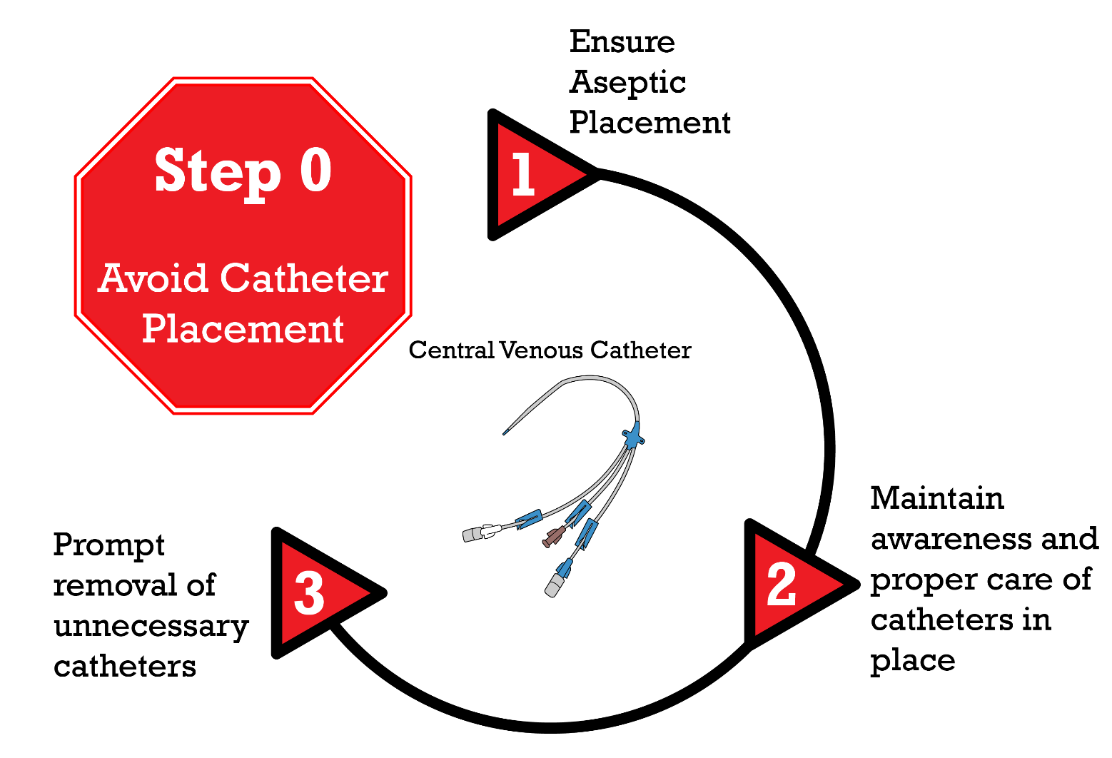
CLABSI Considerations: Prevention Strategies^{4,5}
Meddings J, Saint S. Disrupting the life cycle of the urinary catheter. Clinical Infectious Diseases. 2011;52(11):1291-3. doi:10.1093/cid/cir195. Adapted and reproduced by permission of Oxford University Press on behalf of the Infectious Diseases Society of America. © The Author 2011. All rights reserved. For permissions, please email journals.permissions@oup.com. This figure is not included under the U.S. Government open access license policy of this website.

Slide 20
Considerations
Relevance: What changes for best practice are in our locus of control that would have the biggest impact as quickly as possible that we can start with?
What changes do we have the resources to make?
Time management
Education
Monitoring/collecting and analyzing data
What do we have the will to do?
Staff buy-in
Physician buy-in

Slide 21
NCH Action Planning: The Gap
Identified Gap (describe)
Central line dwell times are prolonged related to no consistent process in place to conduct daily reviews for necessity.

Slide 22
NCH Action Planning: Identifying the Gap
How did you identify the gap you have chosen to address? Select all that apply.
Unit Data – Central line SUR = 1.17
ICU Assessment – No consistent daily review for necessity
Hospital Survey on Patient Safety Culture (HSOPS) – high numbers of travelers/temp staff
Other – Please specify source:
Defect analysis – dwell time, no documentation of daily review for necessity
Staff brainstorming
Literature review of CLABSI prevention science – i.e., Central Venous Catheter Removal module

Slide 23
NCH Action Planning: Choosing the Gap
3. Reason for choosing this gap
Staff feel closure of this gap is feasible in a rapid manner and will decrease the length of time patients are at risk for CLABSI
Staff suggested it and want to own designing, implementing, and monitoring it
Staff identified tier 1 interventions to optimize prompt removal of clinically unnecessary central lines as a high priority to help prepare them for conversations during interdisciplinary rounds
Staff articulate desire to learn how to implement rapid cycle changes as they design and implement a standardized process

Slide 24
NCH Action Planning: The Aim Statement
4. Desired aim:
Reduce CLABSI SUR to at least 0.9 in the
NCH medical-surgical ICU by December 31.
Staff identified this as the milestone they are reaching for, with the ultimate goal of reaching and maintaining a zero CLABSI rate.
The SMART goal for this particular gap is:
To achieve 80% compliance with daily review of necessity for all central lines in the medical-surgical ICU by December 31.

Slide 25
NCH Action Planning: Strengths
5. What strength(s) can be used:
Staff engagement and interest
Staff desire to make a rapid change with the potential to significantly contributes to patient safety
Staff eagerness to understand how to do PDSAs
NOTE: Use the ICU Assessment and patient safety culture survey results for guidance, or have the team suggest strengths that can be used

Slide 26
Resources⁶⁻⁹
ICU Action Plan Template
CUSP Learn From Defects Tool
CAUTI Event Report Tool
CLABSI Event Report Tool
Institute for Healthcare Improvement’s Plan-Do-Study-Act (PDSA) Worksheet
Video – Addressing Attitudes and Beliefs About Preventing Infections in ICUs

Slide 27
References
Doran GT. There's a S.M.A.R.T. way to write management's goals and objectives. Management Review, 2018Nov;(70)35-6.
Model for Improvement. Associates in Process Improvement, 2018. http://www.apiweb.org/. Accessed on July 23, 2021.
Marschall J, Mermel L, Mohamad F, et al. Strategies to prevent central line–associated bloodstream infections in acute care hospitals: 2014 update. Infect Control Hosp Epidemiol. 2014 Jul;35(7):753-71. PMID: 24915204.
Meddings J, Saint S. Disrupting the life cycle of the urinary catheter. Clin Infect Dis. 2011 Jun;52(11):1291-3. PMID: 21596672.
Patel PK, Gupta A, Vaughn VM, et al. Review of strategies to reduce central line-associated bloodstream infection (CLABSI) and catheter-associated urinary tract infection (CAUTI) in adult ICUs. J Hosp Med. 2018 Feb 1;13(2):105-16. PMID: 29154382.
Agency for Healthcare Research and Quality. Learn from Defects Tool. http://www.ahrq.gov/professionals/education/curriculum-tools/cusptoolkit/toolkit/learndefects.html. Accessed on July 23, 2021.
Agency for Healthcare Research and Quality. Appendix O. CAUTI Event Report Template. http://www.ahrq.gov/professionals/quality-patient-safety/hais/cauti-tools/impl-guide/implementation-guide-appendix-o.html. Accessed on July 23, 2021.
Agency for Healthcare Research and Quality. Appendix 7. Central Venous Catheter-Associated Laboratory-Confirmed Blood Stream Infection Event Report Template for Defect Analysis. http://www.ahrq.gov/professionals/education/curriculum-tools/clabsitools/clabsitoolsap7.html. Accessed on July 23, 2021.
Plan-Do-Study-Act (PDSA) Worksheet. Cambridge, MA: Institute for Healthcare Improvement. http://www.ihi.org/resources/Pages/Tools/PlanDoStudyActWorksheet.aspx. Accessed on July 23, 2021.

