Slide 1
Using a Tiered Approach With Comprehensive Unit-based Safety Program Principles
AHRQ Safety Program for Intensive Care Units:
Preventing CLABSI and CAUTI
AHRQ Pub. No. 17(22)-0019
April 2022

Slide 2
Objectives
Describe the tiered approach for central line-associated bloodstream infection (CLABSI) and catheter-associated urinary tract infection (CAUTI) prevention
Give an example of how to develop a test of change using the tiered approach to CLABSI and CAUTI prevention
Explain how Comprehensive Unit-based Safety Program (CUSP) methods provide a foundation for the tiered approaches

Slide 3
Model for Improving Care¹⁻⁴
LOCAL PROBLEMS
COMMON PROBLEMS
Comprehensive Unit-based Safety Program (CUSP)
Translating Evidence Into Practice (TRIP)
Improving Care of Patients With Urinary or Central Line Catheters
Prework: Measure clinician and staff perceptions of safety culture with Hospital Survey on Patient Safety Culture
Summarize the evidence in a checklist
Identify local barriers to implementation
Measure performance
Ensure all patients get the evidence
Engage
Educate
Execute
Evaluate
Avoid placing catheter unless medically necessary; consider alternatives
Use aseptic technique when inserting and maintaining catheter
Review daily for clinical necessity; remove as soon as no longer indicated
Culture appropriately
Engage leadership for support and collaboration
Understand the science of safety
Assemble the team to improve teamwork and communication
Identify defects
Learn from defects
ADAPTIVE WORK
TECHNICAL WORK

Slide 4
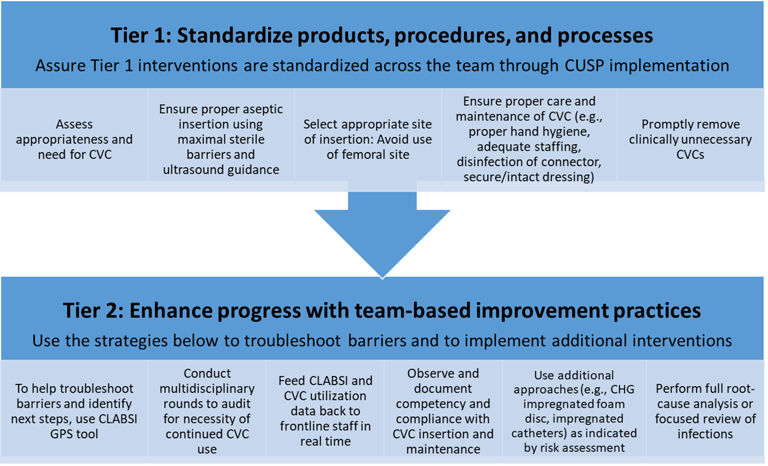
Tiered Approach to CLABSI Prevention⁵⁻⁸
Abbreviations: CHG = chlorhexidine gluconate; CLABSI = central line-associated blood stream infection; CVC = central venous catheter; GPS = Guide to Patient Safety
These materials were expanded, enhanced, and adapted from tiered interventions implemented in Cohorts 1 and 2 of the AHRQ Safety Program for ICUs: Preventing CLABSI and CAUTI from materials developed for CAUTI prevention by faculty and staff at the Department of Veterans Affairs and the University of Michigan.

Slide 5
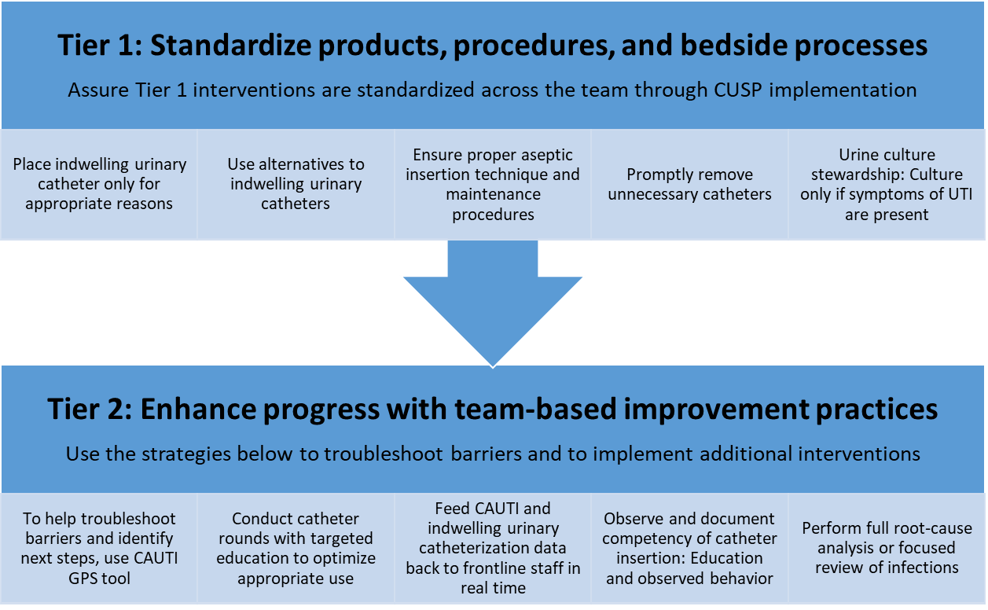
Tiered Approach to CAUTI Prevention^{5-6,9-10}
Abbreviations: CAUTI = catheter-associated urinary tract infection; GPS = Guide to Patient Safety; UTI = urinary tract infection
These materials were expanded, enhanced, and adapted from tiered interventions implemented in Cohorts 1 and 2 of the AHRQ Safety Program for ICUs: Preventing CLABSI and CAUTI from materials developed for CAUTI prevention by faculty and staff at the Department of Veterans Affairs and the University of Michigan.

Slide 6
Four Primary Concepts of the Science of Safety¹¹
Standardize
Care
Create
Independent
Checks
Learn From Defects
Safety is the property of the system—every system is perfectly designed to achieve its end results
Standardization, independent checks, and learning from defects are the principles of safe design
Principles of safe design apply to both technical and team work
Teams with diverse and independent input make wise decisions

Slide 7
Just Culture¹²⁻¹⁴
“Holds itself accountable”
“Holds staff members accountable”
“Has staff members who hold themselves accountable”
Understand Just Culture video

Slide 8
Systems and Behaviors: Work Together To Improve Outcomes¹²
System Design
Mission, Values, and Expectations
Improved Outcomes
Behavioral Choices
Foundational elements of Just Culture include promotion of learning systems, accountability, and justice.

Slide 9
Apply CUSP

Slide 10
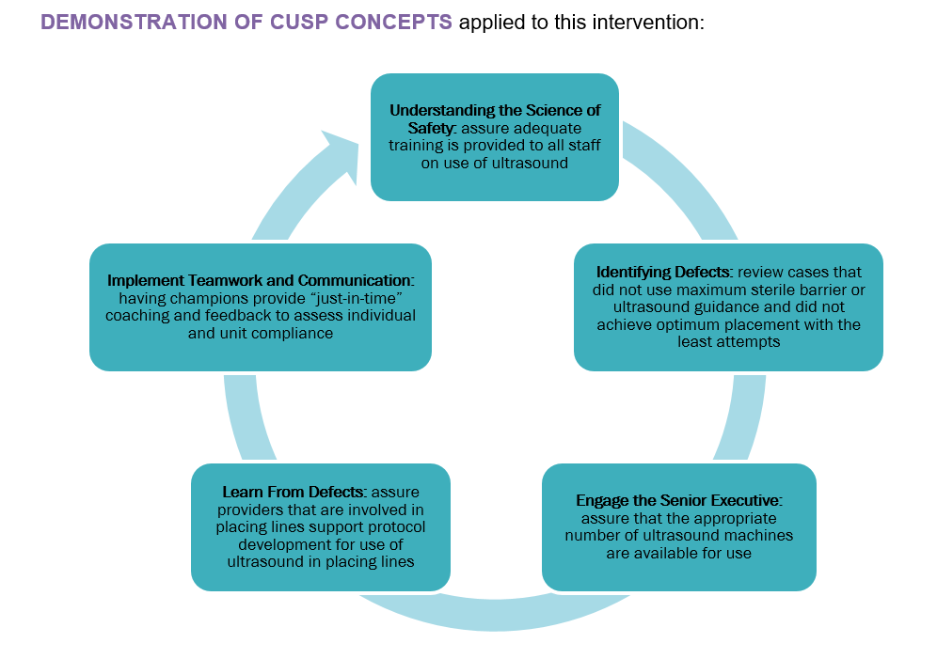
Let’s Take a Deeper Look – CLABSI
Ensure proper aseptic insertion techniques using maximal sterile barriers and ultrasound guidance

Slide 11
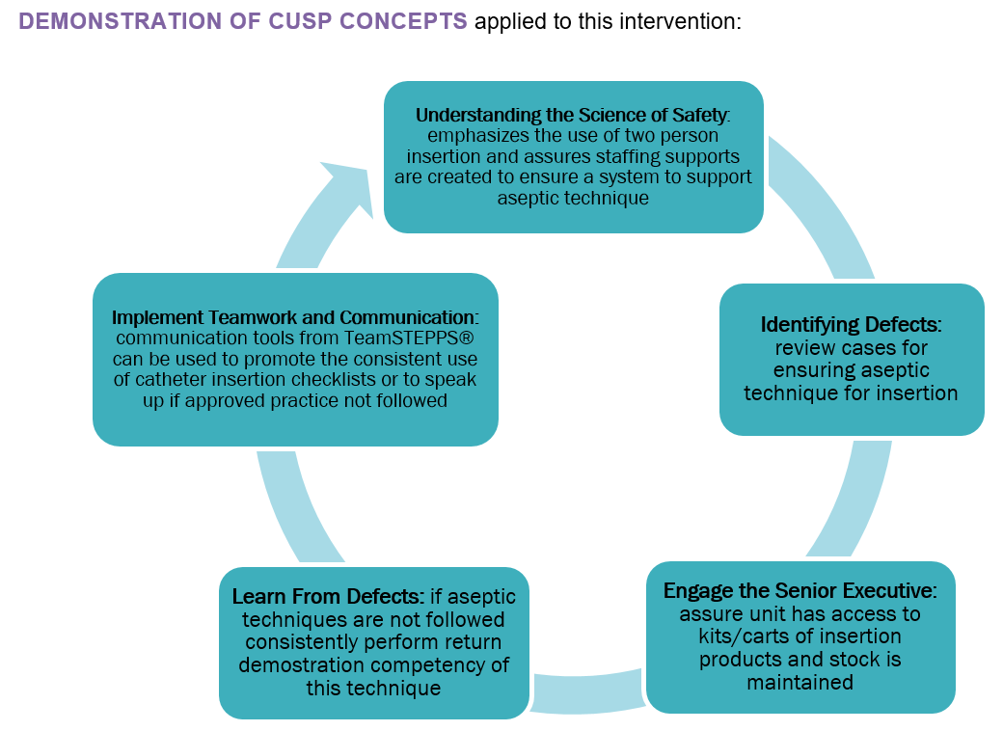
Let’s Take a Deeper Look – CAUTI
Ensure proper aseptic insertion techniques and maintenance procedures

Slide 12
Discussion Questions
What tier 1 intervention is most frequently used in your ICU?
What tier 1 intervention has been the most challenging to implement?
What tier 2 intervention is most frequently used in your ICU?
What tier 2 intervention has been the most challenging to implement?

Slide 13
Resources¹⁵⁻¹⁸
Understand the Science of Safety
Standardize When You Can
Create Independent Checks
Principles of Safe Design Apply to Technical and Teamwork
CAUTI Guide to Patient Safety
CLABSI Guide to Patient Safety
A Playbook for Preventing CAUTI and CLABSI in the ICU Setting
Module – Using a Tiered Approach With CUSP Principles
Making It Work Tip Sheets
Empowering Nurses To Implement Nurse-Driven Protocols for Reducing CAUTI in the ICU Setting
Overcoming the Just in Case Mindset

Slide 14
References
Agency for Healthcare Research and Quality. Action Plan for Translating Research Into Practice: Gap Analysis and Tests of Change: Slide Presentation. http://www.ahrq.gov/professionals/quality-patient-safety/hais/tools/mvp/modules/cusp/actionplan-trip-slides.html. Accessed on August 24, 2021.
Pronovost PJ, Berenholtz SM, Needham DM. Translating evidence into practice: a model for large scale knowledge translation. BMJ. 2008 Oct 6;337:a1714. PMID: 18838424.
Pronovost PJ, Berenholtz SM, Goeschel C, et al. Improving patient safety in intensive care units in Michigan. J Crit Care. 2008 Jun;23(2):207-21. PMID: 18538214.
Patel PK, Gupta A, Vaughn VM, et al. Review of strategies to reduce central line-associated bloodstream infection (CLABSI) and catheter-associated urinary tract infection (CAUTI) in adult ICUs. J Hosp Med. 2018 Feb 1;13(2):105-116. PMID: 29154382.
Saint S, Fowler KE, Sermak K, et al. Introducing the No Preventable Harms campaign: creating the safest health care system in the world, starting with catheter-associated urinary tract infection prevention. Am J Infect Control. 2015 Mar 1;43(3):254-9. PMID: 25728151.
Patel PK, Gupta A, Vaughn VM, et al. Review of strategies to reduce central line-associated bloodstream infection (CLABSI) and catheter-associated urinary tract infection (CAUTI) in adult ICUs. J Hosp Med. 2018 Feb 1;13(2):105-116. PMID: 29154382.
Chopra V, Flanders SA, Saint S, et al. The Michigan appropriateness guide for intravenous catheters (MAGIC): Results from a multispecialty panel using the RAND/UCLA appropriateness method. Ann Intern Med. 2015;163:S1-40. PMID: 26369828.
CLABSI Guide to Patient Safety Tool. ImprovePICC.com, Ann Arbor, MI. http://www.improvepicc.com/gpsclabsi.html. Accessed on August 24, 2021.
Meddings J, Saint S, Fowler KE, et al. The Ann Arbor Criteria for Appropriate Urinary Catheter Use in Hospitalized Medical Patients: Results Obtained by Using the RAND/UCLA Appropriateness Method. Ann Intern Med. 2015 May 5;162(9 Suppl):S1-34. PMID: 25938928.
CAUTI Guide to Patient Safety Tool. CatheterOut.org, Ann Arbor, MI. https://catheterout.org/?q=gps. Accessed on August 24, 2021.

Slide 15
References
Agency for Healthcare Research and Quality. Science of Safety and Identifying Defects in Care of Mechanically Ventilated Patients: Facilitator Guide. http://www.ahrq.gov/professionals/quality-patient-safety/hais/tools/mvp/modules/cusp/science-of-safety-facguide.html. Accessed on August 24, 2021.
Agency for Healthcare Research and Quality. Apply CUSP. http://www.ahrq.gov/professionals/education/curriculum-tools/cusptoolkit/modules/apply/index.html. Accessed on August 24, 2021.
Agency for Healthcare Research and Quality. Understand Just Culture. http://www.ahrq.gov/professionals/education/curriculum-tools/cusptoolkit/videos/07a_just_culture/index.html. Accessed on August 24, 2021.
Marx D. Patient Safety and the “Just Culture”: A Primer for Health Care Executives. New York: Trustees of Columbia University in the City of New York, Columbia University; 2001.
Agency for Healthcare Research and Quality. Understand the Science of Safety. http://www.ahrq.gov/professionals/education/curriculum-tools/cusptoolkit/modules/understand/index.html. Accessed on August 24, 2021.
Agency for Healthcare Research and Quality. Standardize When You Can. http://www.ahrq.gov/professionals/education/curriculum-tools/cusptoolkit/videos/04c_standardize/index.html. Accessed on August 24, 2021.
Agency for Healthcare Research and Quality. Create Independent Checks. http://www.ahrq.gov/professionals/education/curriculum-tools/cusptoolkit/videos/04d_indchecks/index.html. Accessed on August 24, 2021.
Agency for Healthcare Research and Quality. Principles of Safe Design Apply to Technical and Teamwork. http://www.ahrq.gov/professionals/education/curriculum-tools/cusptoolkit/videos/04f_techtmwork/index.html. Accessed on August 24, 2021.

