Slide 1
Indwelling Urinary Catheter Alternatives
AHRQ Safety Program for Intensive Care Units: Preventing CLABSI and CAUTI
Avoiding Placement and Determining Appropriateness
AHRQ Pub. No. 17(22)-0019
April 2022

Slide 2
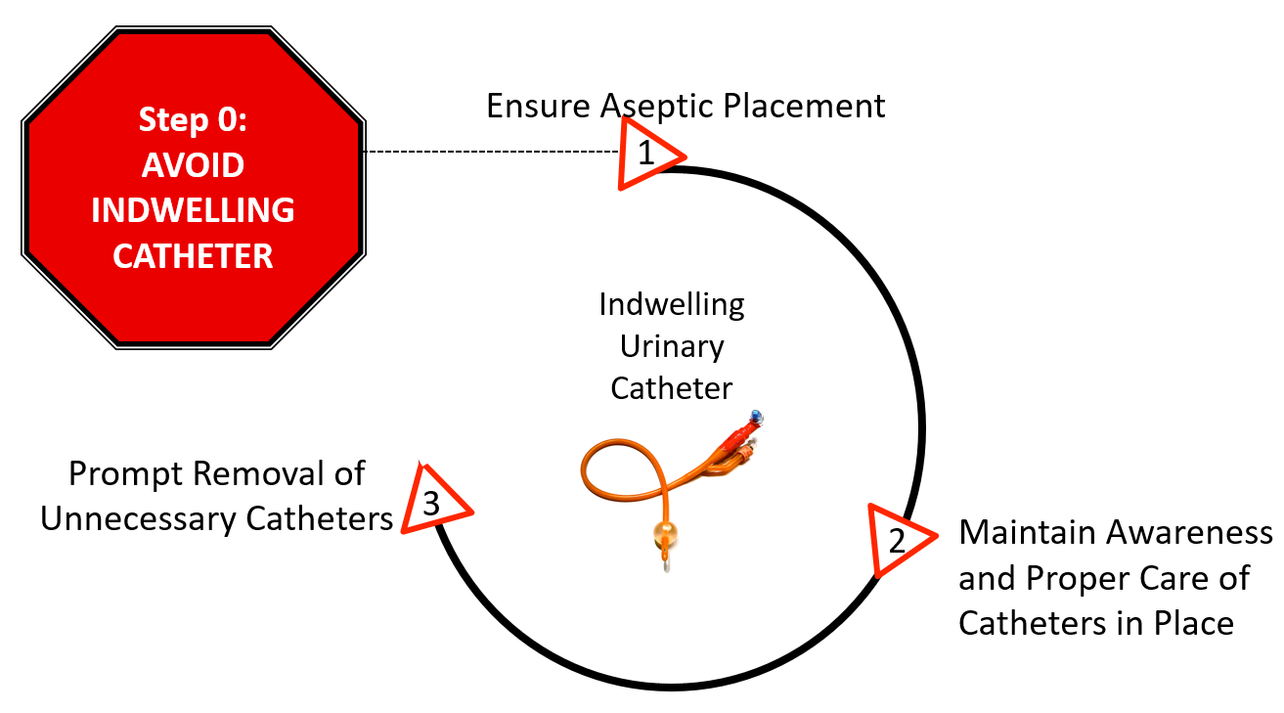
Avoid Unnecessary Urinary Catheter Placement^{1,2}
Patel PK, Gupta A, Vaughn VM, et al. Review of Strategies to Reduce Central Line-Associated Bloodstream Infection (CLABSI) and Catheter-Associated Urinary Tract Infection (CAUTI) in Adult ICUs. J Hosp Med. 8 November 2017 [online ahead of print]. Used with permission of Journal of Hospital Medicine.
AHRQ Safety Program for ICUs: Preventing CLABSI and CAUTI
IUC Alternatives ׀ 2

Slide 3
Assess the Patient’s Needs³
Does this patient really need a urinary catheter?
OR
Is there an alternative to the catheter that could be used?
AHRQ Safety Program for ICUs: Preventing CLABSI and CAUTI
IUC Alternatives ׀ 3

Slide 4
Alternatives³⁻⁵
Consider alternatives based on a patient’s individual care needs
Alternative devices and procedures provide a much lower risk of infectious complications
58% reduction in CAUTIs seen with introduction of a novel female external device
Can reduce or eliminate noninfectious complications
When considering alternatives—
Involve the Supply Chain/Materials Management Department
Have staff provide feedback on alternative products
AHRQ Safety Program for ICUs: Preventing CLABSI and CAUTI
IUC Alternatives ׀ 4

Slide 5
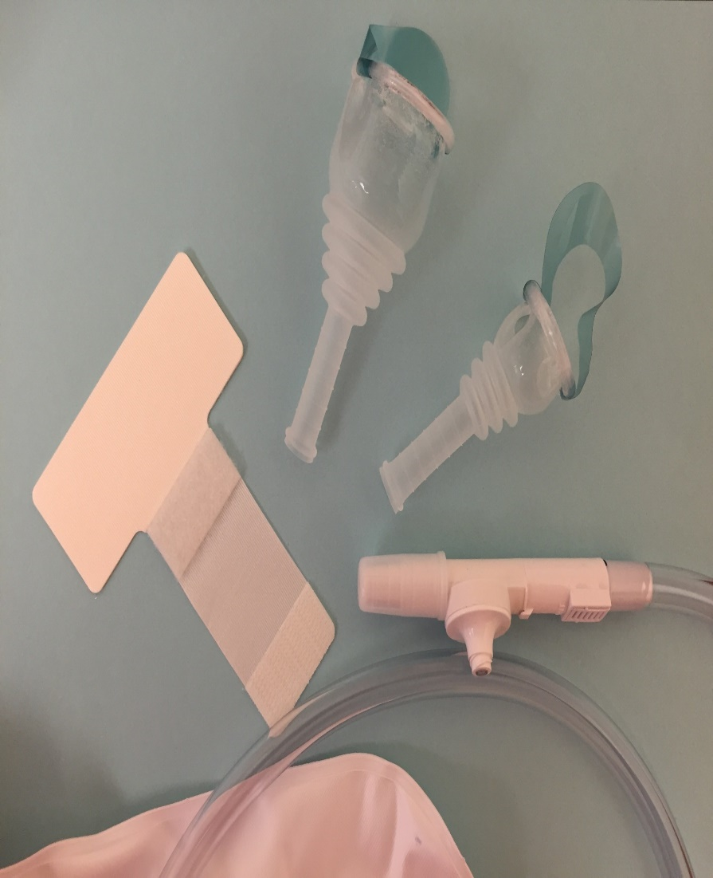
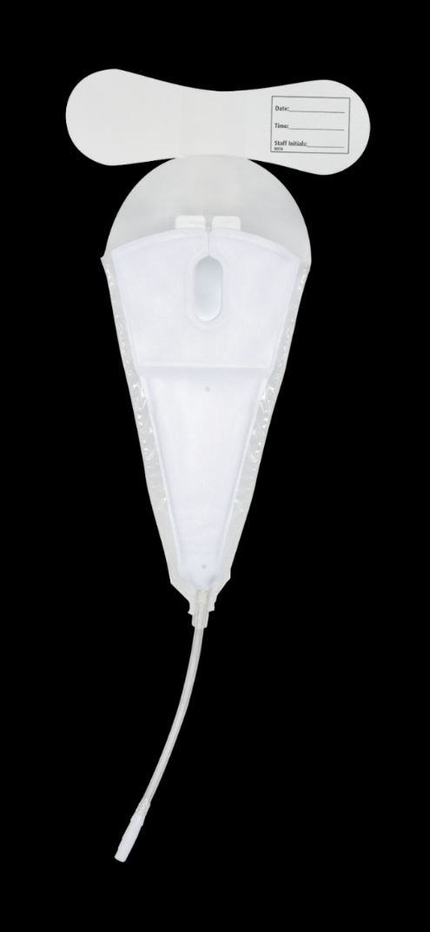
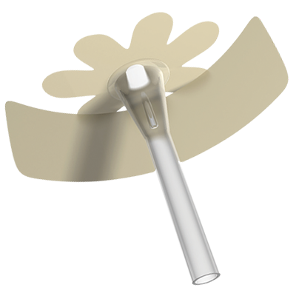
External or Condom Catheter Basics
AHRQ Safety Program for ICUs: Preventing CLABSI and CAUTI
IUC Alternatives ׀ 5

Slide 6
Indications for Use of External Catheters^{3,6}
Stage III or IV or unstageable pressure ulcers
Incontinence-associated dermatitis
Daily measurement of urine volume
Single 24-hour urine sample
Collection for a urinalysis
Presence of acute, severe pain with movement
Patient request for external catheter
Comfort in dying patient
AHRQ Safety Program for ICUs: Preventing CLABSI and CAUTI
IUC Alternatives ׀ 6

Slide 7
Inappropriate Use of External Catheters⁷
Uncooperative or combative patient
Any type of urinary retention
Hourly measurement of urine volume required
Urinary incontinence when nurses can turn/provide skin care
Routine use to manage incontinence
To reduce risk of falls
For convenience of urinary management during transport
Patient/family/staff request when there are no expected difficulties managing urine
To prevent urinary tract infection
AHRQ Safety Program for ICUs: Preventing CLABSI and CAUTI
IUC Alternatives ׀ 7

Slide 8
Male External Urine Collection Devices: Advantages and Disadvantages⁶
Condom Catheter
Advantages
Reduces risk of complications and is better tolerated compared with indwelling catheter
Disadvantages
One size does not fit all
Leakage, skin necrosis, edema, allergy
Newer Male Technology
One size does fit all based on different design
Prevents maceration of the shaft
Reduces leakage
AHRQ Safety Program for ICUs: Preventing CLABSI and CAUTI
IUC Alternatives ׀ 8

Slide 9
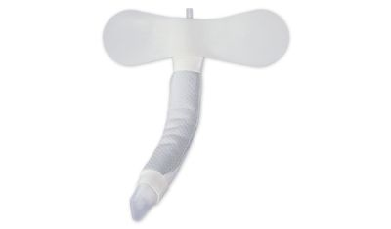
Female External Catheter^{6,8}
The female external catheter has now become an acceptable alternative
Correct positioning of the device is important
It is placed between the labia and the urethral opening
The device is attached to wall suction
When female voids, the urine flows thru the fabric into the collection chamber at the distal end, and the suction takes the urine to the collection container
Studies have reported that this is a feasible alternative to an indwelling urinary catheter for managing urine.
AHRQ Safety Program for ICUs: Preventing CLABSI and CAUTI
IUC Alternatives ׀ 9

Slide 10
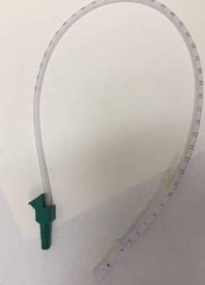
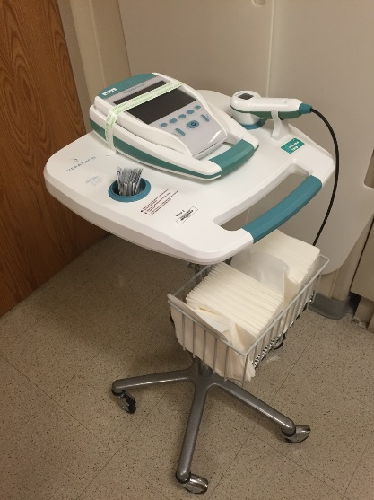
Urinary Retention^{9,10} Strategies and Alternatives To Overcome Barriers
Use Bladder Scanner
Perform Straight Catheterization
AHRQ Safety Program for ICUs: Preventing CLABSI and CAUTI
IUC Alternatives ׀ 10

Slide 11
Straight Catheters: Indications¹¹⁻¹³
Acute urinary retention
Chronic urinary retention
Stage III or IV or unstageable pressure ulcer
Urinary incontinence
Urine volume measurements
Random urine sample collection
Management of urination in patients with immobility
Postvoid residual urine assessment
AHRQ Safety Program for ICUs: Preventing CLABSI and CAUTI
IUC Alternatives ׀ 11

Slide 12
The Incontinent Patient¹⁴⁻¹⁶
Minimize the risk of skin breakdown (incontinence-associated dermatitis) by—
Cleaning and drying the area right away
Using moisturizing creams
Avoiding products that contain alcohol
Considering the use of a skin sealant or moisture barrier
Considering a male or female external catheter for select patients
If no other alternatives, use a pad and change frequently
AHRQ Safety Program for ICUs: Preventing CLABSI and CAUTI
IUC Alternatives ׀ 12

Slide 13
Measuring Urine Output in Adults: Weighing Pads¹⁷
Wet Pad – Dry Pad = Output
AHRQ Safety Program for ICUs: Preventing CLABSI and CAUTI
IUC Alternatives ׀ 13

Slide 14
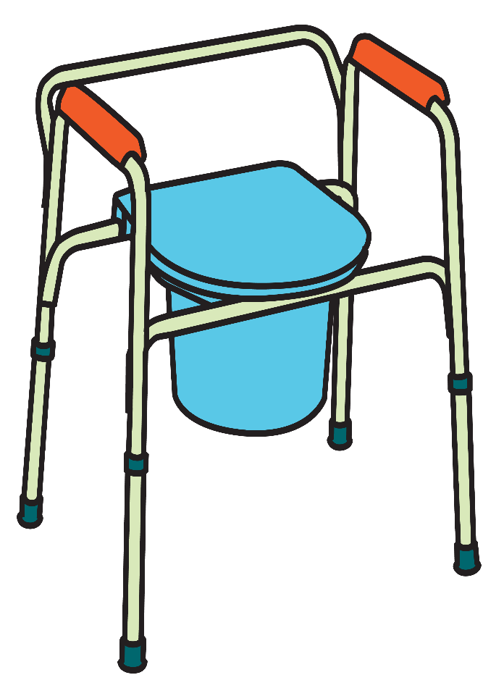
Other Essentials
Bedside commode
Bedpan
Hats – urine or specimen containers used inside toilets
Urinals
AHRQ Safety Program for ICUs: Preventing CLABSI and CAUTI
IUC Alternatives ׀ 14

Slide 15
Barriers to Alternatives
Time
Perception patient must have a urinary catheter for accurate intake and output
Unit culture issues
Nursing reluctance
Lack of physician support
Lack of available or appropriate supplies
AHRQ Safety Program for ICUs: Preventing CLABSI and CAUTI
IUC Alternatives ׀ 15

Slide 16
Tips for Implementation
Recognize that nurses and physicians may have different perceptions on use of alternatives
Include discussions on the use of alternatives during rounds
Use the Comprehensive Unit-based Safety Program (CUSP) team or equivalent to help communicate expectations
Consider the rapid cycle methodology—Plan, Do, Study, and Act (PDSA) cycles—to test alternatives on small groups of patients
AHRQ Safety Program for ICUs: Preventing CLABSI and CAUTI
IUC Alternatives ׀ 16

Slide 17
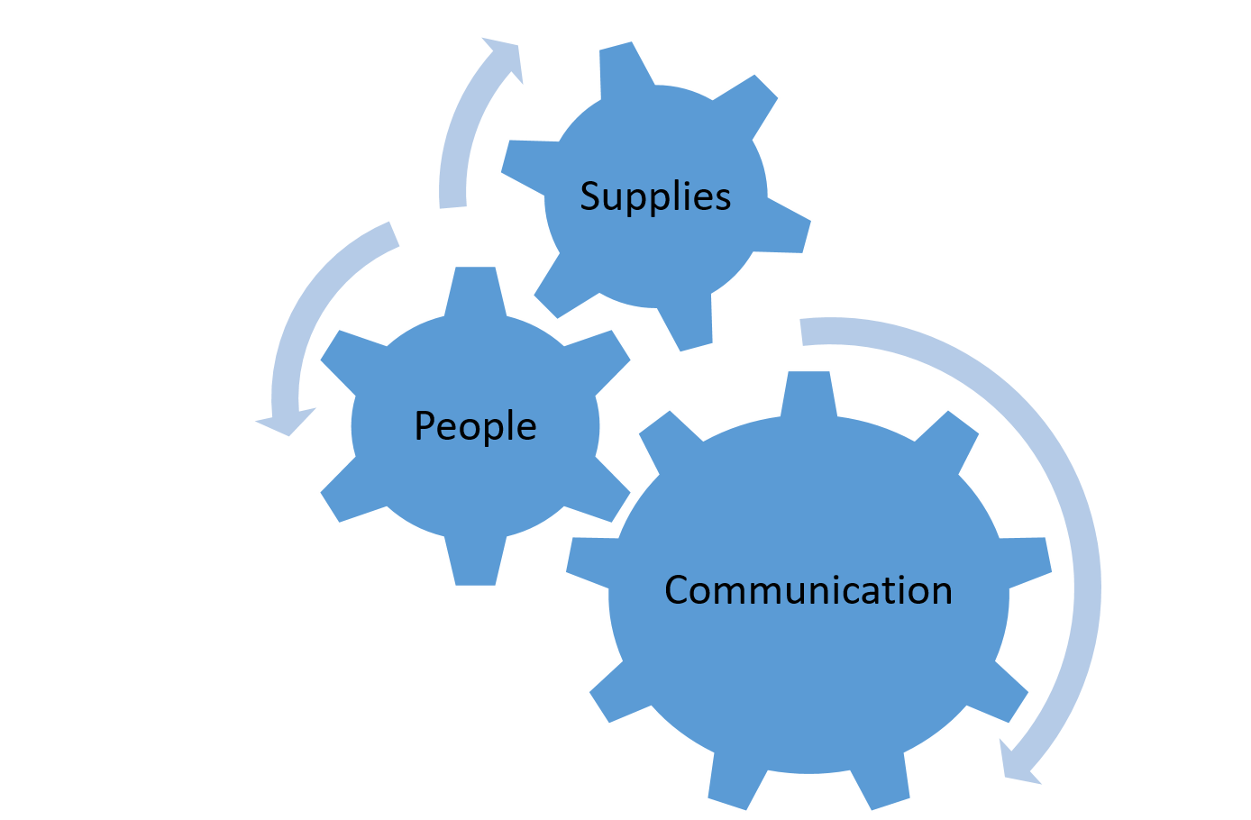
Multidisciplinary Rounds
Rounding provides an excellent opportunity to—
Verify the need for the catheter
Evaluate alternative strategies
Ensure post-residual voiding
Educate patient and family
AHRQ Safety Program for ICUs: Preventing CLABSI and CAUTI
IUC Alternatives ׀ 17

Slide 18
Take-Home Points
Stop and think critically about whether your patient needs a urinary catheter or if there are alternatives that may be appropriate
Accurate intake and output can be achieved without the use of a urinary catheter
Educate staff on the use of alternatives and include them in the trialing and selection process
Include discussion of alternatives in daily rounding
AHRQ Safety Program for ICUs: Preventing CLABSI and CAUTI
IUC Alternatives ׀ 18

Slide 19
References
Meddings J, Saint S. Disrupting the life cycle of the urinary catheter. Clin Infect Dis. 2011 Jun;52(11):1291-3. PMID: 21596672.
Patel PK, Gupta A, Vaughn VM, et al. Review of strategies to reduce central line-associated bloodstream infection (CLABSI) and catheter-associated urinary tract infection (CAUTI) in adult ICUs. J Hosp Med. 2018 Feb;13(2):105-16. PMID: 29154382.
Lo E, Nicolle L, Coffin S, et al. Strategies to prevent catheter-associated urinary tract infections in acute care hospitals: 2014 update. Infect Control Hosp Epidemiol. 2014 May;35(5):464-79. doi: 10.1086/675718. PMID: 24709715.
Saint S, Trautner BW, Fowler KE, et al. A multicenter study of patient-reported infectious and noninfectious complications associated with indwelling urethral catheters. JAMA Intern Med. 2018;178(8):1078‐85. doi:10.1001/jamainternmed.2018.2417. PMID: 29971436.
Zavodnick J, Harley C, Zabriskie K, et al. Effect of a female external urinary catheter on incidence of catheter-associated urinary tract infection. Cureus. 2020;12(10):e11113. PMID: 33240709.
Gray M, Skinner C, Kaler W. External collection devices as an alternative to the indwelling catheter. J Wound Ostomy Continence Nurs. 2016; 43(3): 301-7. PMID: 26974963.
Agency for Healthcare Research and Quality. Technical Interventions To Prevent CAUTI. https://www.ahrq.gov/hai/cauti-tools/guides/implguide-pt3.html. Accessed October 12, 2021.
Beeson T, Davis C. Urinary management with an external female collection device. J Wound Ostomy Continence Nurs. 2018 Mar; 45(2): 187–9. PMID: 29394218.
Agency for Healthcare Research and Quality. Appendix C. Sample Bladder Scan Policy. October 2020. http://www.ahrq.gov/professionals/quality-patient-safety/hais/cauti-tools/impl-guide/implementation-guide-appendix-c.html. Accessed October 12, 2021.
Meddings J, Rogers MA, Krein SL, et al. Reducing unnecessary urinary catheter use and other strategies to prevent catherter-associated urinary tract infection: an integrative review. BMJ Qual Saf. 2014 Apr;23(4):277-89. PMID: 24077850.
Association for Professionals in Infection Control and Epidemiology. Guide to Preventing Catheter-Associated Urinary Tract Infections. https://apic.org/Professional-Practice/Implementation-guides/#implementaion-guide-7454. Accessed October 11, 2021.
Gould CV, Umscheid CA, Agarwal RK, et al. Guideline for prevention of catheter-associated urinary tract infections 2009. Infect Control Hosp Epidemiol. 2010 Apr;31(4):319-26. PMID: 20156062.
Meddings J, Saint S, Fowler K, et al. The Ann Arbor criteria or appropriate urinary catheter use in hospitalized medical patients: results obtained by using the RAND/UCLA appropriateness method. Ann Intern Med. 2015 May 5;162(9 Suppl):S1-S34. PMID: 25938928.
Doughty D, Junkin J, Kurz P, et al. Incontinence-associated dermatitis: consensus statements, evidence-based guidelines for prevention and treatment, and current challenges. J. Wound Ostomy Continence Nurs. 2012; 39(3): 303-15. PMID: 22572899.
Gray M, Beeson T, Kent D, et al. Interventions Post Catheter Removal (iPCaRe) in the Acute Care Setting: An Evidence- and Consensus-Based Algorithm. J Wound Ostomy Continence Nurs. 2020;47(6):601-618. PMID: 33201147.
McNichol LL, Ayello EA, Phearman LA, et al. Incontinence-associated dermatitis: state of the science and knowledge translation. Adv Skin Wound Care. 2018;31(11):502-13. PMID: 30303813.
Beuscher T. Pad weighing for reduction of indwelling urinary use and catheter-associated urinary tract infection: a quality improvement project. J Wound Ostomy Continence Nurs. 2014;41(6):604-8. PMID: 25377111.
AHRQ Safety Program for ICUs: Preventing CLABSI and CAUTI
IUC Alternatives ׀ 19

