Slide 1
Indwelling Urinary Catheter Indications
AHRQ Safety Program for Intensive Care Units: Preventing CLABSI and CAUTI
Avoiding Placement and Determining Appropriateness
AHRQ Pub. No. 17(22)-0019
April 2022

Slide 2
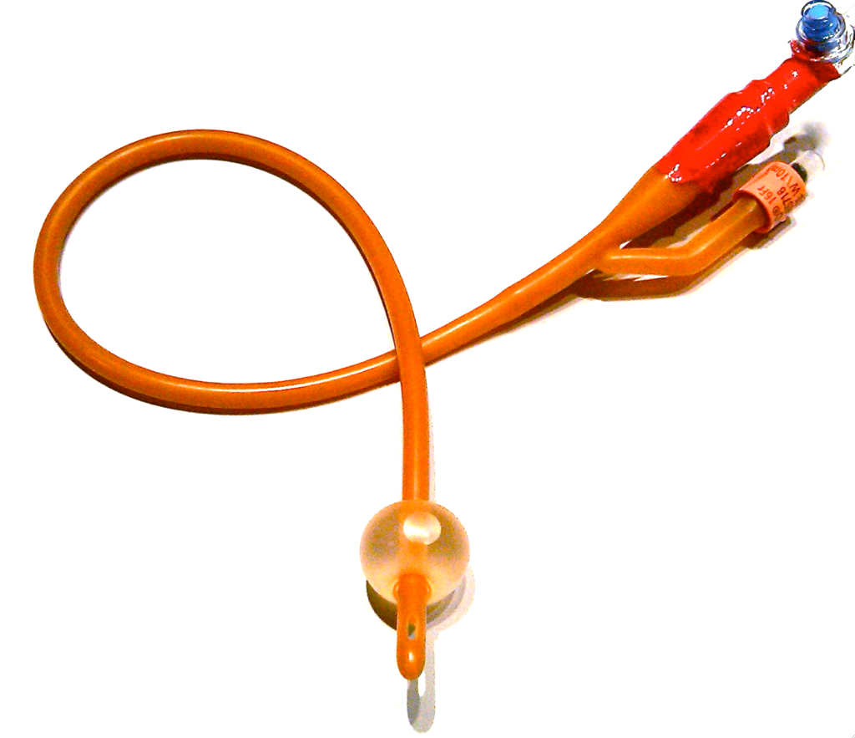
Lifecycle of a Urinary Catheter¹
Catheter Placement
1
Indwelling Urinary Catheter
Catheter Removal
3
2
Maintenance Care of Urinary Catheter
Meddings J, Saint S. Disrupting the life cycle of the urinary catheter. Clin Infect Dis. 2011;52(11):1291-3. PMID: 21596672. Adapted with permission.

Slide 3
Disrupting the Lifecycle of a Urinary Catheter^{1,2}
Step 0:
AVOID INDWELLING CATHETER
Ensure Aseptic Placement
1
Indwelling Urinary Catheter
Prompt Removal of Unnecessary Catheters
3
2
Maintain Awareness and Proper Care of Catheters in Place
Patel PK, Gupta A, Vaughn VM, et al. Review of strategies to reduce central line-associated bloodstream infection (CLABSI) and catheter-associated urinary tract infection (CAUTI) in adult ICUs. J Hosp Med. 2018 Feb 1;13(2):105-16. Epub 2017 Nov 8. Used with permission of Journal of Hospital Medicine.

Slide 4
Using Appropriateness Criteria To Reduce Catheter Use^{1,2}
Step 0:
AVOID INDWELLING CATHETER
Ensure Aseptic Placement
1
Place urinary catheter only when appropriate
Indwelling Urinary Catheter
Optimize use of alternatives
3
Maintain Awareness and Proper Care of Catheters in Place
Prompt Removal of Unnecessary Catheters
2
Reminders/stop orders use appropriateness criteria to prompt catheter removal
Daily review of continued need for urinary catheter

Slide 5
Team Strategies Are Needed To Reduce Inappropriate Urinary Catheter Use
Develop a “shared mental model” between nurses and physicians
Recruit (not assign) an ICU nurse and physician as bedside champions to lead the project
Consider your post removal protocol for use in preventing inappropriate catheters from being inserted
Develop programs and education for the emergency department and operating room areas to reduce unnecessary insertions
Develop a communication workflow for prompting catheter removal by default in your unit when no longer appropriate

Slide 6
Examples of Indications for Urinary Catheters³⁻⁵
 | 2009 HICPAC Guidelines | American Nurses Association’s Streamlined Evidence-Based RN Tool: CAUTI Prevention | Ann Arbor Criteria for Appropriate Urinary Catheter Use in Hospitalized Medical Patients
Example Indications | Acute urinary retention/obstruction Perioperative use for selected surgeries To assist with healing of open wounds in incontinent patients End-of-life care Accurate measurement of urinary output in critically ill patients | Acute urinary retention/obstruction Perioperative use for selected surgeries To assist with healing of open wounds in incontinent patients End-of-life care Critically ill and need for accurate measurements of I&O (e.g., hourly monitoring) | Indwelling catheters are appropriate for measuring and collecting urine only when fluid status or urine CANNOT be assessed by other means. Location in an ICU alone is NOT an appropriate indication. Criteria for 3 catheter types: indwelling, external and intermittent use catheters
Comments | Appropriate use in critically ill patients has varied interpretations | Helpful algorithm to make decisions Based on 2009 Guidelines Use in critically ill patients still ambiguous | Provides clarification to the 2009 guidelines on use for specific clinical scenarios Includes ICU Daily Checklist for indwelling catheter use

Slide 7
Clinical Case 1 for Discussion
Ms. Johnson is a 45-year-old previously healthy woman who was admitted to the ICU with severe sepsis, requiring aggressive intravenous fluid resuscitation and vasopressor therapy. Does she need an indwelling urinary catheter (commonly known as a Foley catheter)?
Yes, indwelling urinary catheter because admitted to the ICU
Yes, because hourly urine output is being used to guide fluid resuscitation and vasopressor dose
No, because has no history of incontinence
No, as long as is able to urinate by other means

Slide 8
Clinical Case 2 for Discussion
Mr. Grant is a 66-year-old man who was admitted from the ED to the ICU with a severe chronic obstructive pulmonary disease exacerbation requiring bilevel positive airway pressure. Does he need an indwelling urinary catheter?
Yes, indwelling urinary catheter because admitted to the ICU
Yes, because hourly urine output is being used to guide fluid resuscitation and vasopressor dose
No, because has no history of incontinence
No, as long as is able to urinate by other means
Disclaimer: All case studies are hypothetical and not based on any actual patient or hospital information. Any similarity between a case study and actual patient or hospital experience is purely coincidental.

Slide 9
Catheter Appropriateness for Measuring Urine Volume⁵
Is this method of urine collection appropriate?
 | Indwelling Urinary Catheter | Intermittent Straight Catheter (ISC) | External Catheter | Non-Catheter Options
Hourly urine volume is required to provide treatment. | Yes | No | No | No
Daily (not hourly) urine volume is required to guide treatment. | Yes, if cannot be assessed without catheter | Uncertain in critically ill patient if distressed. Yes if chronic ISC need | Yes, if cannot be assessed without catheter | Exam/daily weight. Urinal, bedpan, commode hat, etc.
It is INAPPROPRIATE to use a urinary catheter simply because a patient is being cared for in an ICU
Meddings J, Saint S, Fowler KE et al. The Ann Arbor Criteria for appropriate urinary catheter use in hospitalized medical patients: results obtained by using the RAND/UCLA appropriateness method. Ann Internal Med. 2015;162(9 Suppl):S1-34. Copyright ©2015 American College of Physicians. All Rights Reserved. Reprinted with the permission of American College of Physicians, Inc.

Slide 10
Develop a Shared Mental Model
Which types of patients do nurses and physicians in your ICU agree do NOT require an indwelling urinary catheter?
Patients admitted to ICU, but without an illness for which hourly urine output guides care
Patients who have stabilized—no longer tenuous status
“Floor status” patients—located in ICU but awaiting availability of non-ICU bed
Patients with very little urine output for days—none to measure

Slide 11
ICU Daily Checklist for Indwelling Urinary Catheter Appropriateness⁵
Is the indwelling urinary catheter still appropriate for your ICU patient?
If the patient does NOT have one of the following five criteria, remove the indwelling urinary catheter.
These criteria can be found on the ICU Daily Checklist for Indwelling Urinary Catheter Use (Figure 4 in link)

Slide 12
Checklist Question 1⁵
1. What is the urine volume measurement need?
Is HOURLY urine volume measurement being used to inform and provide treatment?
Is DAILY /Shift urine volume measurement being used to provide treatment AND volume status CANNOT be adequately assessed by daily weight or urine collection by urinal, commode, bedpan, or external catheter?

Slide 13
Checklist Question 2⁵
Does the patient have a urologic problem that is being treated by an indwelling urinary catheter?
Examples:
Urinary retention that cannot be monitored or addressed by bladder scanner/intermittent straight catheter (ISC) or that has failed the pre-insertion protocol
Anticipated urinary retention due to paralytic meds
Recent urologic or gynecologic diagnosis or procedure for which catheter removal is not yet recommended

Slide 14
Checklist Question 3⁵
3. Urine sample that CANNOT be collected by other method such as urinal, external catheter, or ISC
Sample Type? | Use Indwelling Urinary Catheter? | Use ISC? | Use External Catheter?
Sterile sample for urine culture | No | Yes | Yes, if staff trained for sterile application
Nonsterile urine sample | No | Yes | Yes
24-hour sample | Yes | Yes, if all urine can be collected by ISC | Yes, preferred option in cooperative men
Post-void residual measurement | No | No, unless cannot be assessed by bladder scanner | No
Meddings J, Saint S, Fowler KE et al. The Ann Arbor Criteria for appropriate urinary catheter use in hospitalized medical patients: results obtained by using the RAND/UCLA appropriateness method. Ann Internal Med. 2015;162(9 Suppl):S1-34. Copyright ©2015 American College of Physicians. All Rights Reserved. Reprinted with the permission of American College of Physicians, Inc.

Slide 15
Checklist Question 4⁵
Does the patient have urinary incontinence that cannot be addressed by non-catheter methods (e.g., barrier creams, incontinence absorbent products) because nurses CANNOT turn and provide skin care with available resources (e.g., lift teams, lift machines) or transition to external catheter for cooperative patients?

Slide 16
Checklist Question 5⁵
Is the indwelling urinary catheter providing comfort from severe distress related to urinary management that cannot be addressed by non-catheter option, ISC, or external catheter?
Examples:
Difficulty voiding due to severe dyspnea with position changes needed to manage urine without catheter
Address patient/family goals in dying patient
Acute/severe pain upon movement with demonstrated difficulties using other urinary management strategies

Slide 17
Clinical Case 3 for Discussion
Mr. Knight is a 25-year-old man who was admitted with acute urinary retention, due to spinal injury. Which urinary catheter strategies are appropriate?
Indwelling urinary catheter
ISC, “In and Out”
External catheter
Urinal or incontinence garments
Disclaimer: All case studies are hypothetical and not based on any actual patient or hospital information. Any similarity between a case study and actual patient or hospital experience is purely coincidental.

Slide 18
Acute Urinary Retention⁵
Is this method of urine collection appropriate?
 | Indwelling Urinary Catheter | Intermittent Straight Catheter (ISC) | External Catheter | Non-Catheter Options
Acute retention WITHOUT bladder outlet obstruction | Yes | Yes, if bladder can be emptied by 4–6 hour ISC | No† | Bladder scanner‡
Acute retention WITH bladder outlet obstruction | Appropriateness varies by reason for obstruction§ | Appropriateness varies by reason for obstruction§ | No† | Bladder scanner‡
External catheters collect urine released by the bladder, and cannot address urinary retention
Use a bladder scanner to reduce number of catheterizations when no or little urine is seen in bladder
Consider urology consultation for prostatitis and urethral trauma, because may be better managed with suprapubic, or expert placement of catheter.
Meddings J, Saint S, Fowler KE et al. The Ann Arbor Criteria for appropriate urinary catheter use in hospitalized medical patients: results obtained by using the RAND/UCLA appropriateness method. Ann Internal Med. 2015;162(9 Suppl):S1-34. Copyright ©2015 American College of Physicians. All Rights Reserved. Reprinted with the permission of American College of Physicians, Inc.

Slide 19
Clinical Case 4 for Discussion⁵
Mrs. Davies is an 80-year-old woman, admitted with syncope and awaiting pacemaker placement, who is admitted to ICU for a higher level of monitoring and nursing care than available outside the ICU. She has chronic urinary incontinence and is a high fall risk. True or False:
The ICU nurse should insert an indwelling urinary catheter for Mrs. Davies because it will prevent skin breakdown and reduce her risk of falling.
Disclaimer: All case studies are hypothetical and not based on any actual patient or hospital information. Any similarity between a case study and actual patient or hospital experience is purely coincidental.

Slide 20
Managing Incontinence: No Skin Issue, No Difficulty Turning⁵⁻⁶
Is this method of urine collection appropriate?
 | Indwelling Urinary Catheter | Intermittent Straight Catheter (ISC) | External Catheter | Non-Catheter Options
Incontinence (no skin issue), nurses can turn/provide skin care | No | No, unless has chronic ISC needs | Yes if the patient in unable to toilet using other means, bedpan, bedside commode, bathroom | Barrier creams, prompted toileting, incontinence pads/garments, etc.
Incontinence, can be turned, patient requests catheter | No | No, unless has chronic ISC needs | Limited evidence on use of external catheter in this situation, benefit/risk varies by patient characteristics | Barrier creams, prompted toileting, incontinence pads/garments etc.
Meddings J, Saint S, Fowler KE et al. The Ann Arbor Criteria for appropriate urinary catheter use in hospitalized medical patients: results obtained by using the RAND/UCLA appropriateness method. Ann Internal Med. 2015;162(9 Suppl):S1-34. Copyright ©2015 American College of Physicians. All Rights Reserved. Reprinted with the permission of American College of Physicians, Inc.

Slide 21
Managing Incontinence: No Skin Issue, With Difficulty Turning⁵⁻⁶
Is this method of urine collection appropriate?
 | Indwelling Urinary Catheter | Intermittent Straight Catheter (ISC) | External Catheter | Non-Catheter Options
Excess weight (>300 pounds) from obesity or edema | Yes | No, unless has chronic ISC needs | Yes | Barrier creams, prompted toileting, etc.
Turning causes hemodynamic or respiratory instability | Yes | No, unless has chronic ISC needs | Yes | Barrier creams, prompted toileting, etc.
Strict temporary immobility post-op from vascular procedure | Yes | Yes | Yes | Barrier creams, prompted toileting, etc.
Meddings J, Saint S, Fowler KE et al. The Ann Arbor Criteria for appropriate urinary catheter use in hospitalized medical patients: results obtained by using the RAND/UCLA appropriateness method. Ann Internal Med. 2015;162(9 Suppl):S1-34. Copyright ©2015 American College of Physicians. All Rights Reserved. Reprinted with the permission of American College of Physicians, Inc.

Slide 22
Managing Incontinence: When Patient has Skin Issues^{5,6}
Is this method of urine collection appropriate?
 | Indwelling Urinary Catheter | Intermittent Straight Catheter (ISC) | External Catheter | Non-Catheter Options
Incontinence-associated dermatitis | No | No, unless has chronic ISC needs | Yes, if severe, otherwise uncertain | Barrier creams, prompted toileting, etc.
Closed pressure ulcers: stage I, deep tissue injury | No | No, unless has chronic ISC needs | Yes, if the patient is unable to toilet using other means, bedpan, bedside commode, bathroom | Barrier creams, prompted toileting, etc.
Open pressure ulcers: stage II | Uncertain | Yes | Yes, if the patient is unable to toilet using other means, bedpan, bedside commode, bathroom | All†
Open pressure ulcers: stages III-IV, unstageable | Yes | Yes, if ISC adequate to manage the incontinence | Yes | All†
Note: All non-catheter options are appropriate if they would not worsen the ulcer due to location.
Meddings J, Saint S, Fowler KE et al. The Ann Arbor Criteria for appropriate urinary catheter use in hospitalized medical patients: results obtained by using the RAND/UCLA appropriateness method. Ann Internal Med. 2015;162(9 Suppl):S1-34. Copyright ©2015 American College of Physicians. All Rights Reserved. Reprinted with the permission of American College of Physicians, Inc.

Slide 23
Take-Home Points
ICU bed assignment alone is not sufficient indication for an indwelling urinary catheter – patient must have a medical indication for the catheter
Urology consultation may be needed for certain types of acute urinary retention with obstruction
Not all open sacral/hip wounds require an indwelling urinary catheter if the wound can be kept clean by other methods
Use alternatives to indwelling urinary catheters whenever appropriate

Slide 24
References
Meddings J, Saint S. Disrupting the life cycle of the urinary catheter. Clin Infect Dis. 2011;52(11):1291-3. PMID: 21596672.
Patel PK, Gupta A, Vaughn VM, et al. Review of strategies to reduce central line-associated bloodstream infection (CLABSI) and catheter-associated urinary tract infection (CAUTI) in adult ICUs. J Hosp Med. 2018;13(2):105-16. Epub 2017 Nov 8. PMID: 29154382.
Gould CV, Umscheid CA, Agarwal RK, et al. Guideline for Prevention of Catheter-Associated Urinary Tract Infections 2009. Infect Control Hosp Epidemiol 2010; 31(4):319-326. PMID: 20156062.
American Nurses Association. Streamlined Evidence-Based RN Tool: Catheter Associated Urinary Tract Infection (CAUTI) Prevention. https://www.nursingworld.org/~4aede8/globalassets/practiceandpolicy/innovation--evidence/clinical-practice-material/cauti-prevention-tool/anacautipreventiontool-final-19dec2014.pdf. Accessed November 9, 2021.
Meddings J, Saint S, Fowler KE, et al. The Ann Arbor Criteria for appropriate urinary catheter use in hospitalized medical patients: results obtained by using the RAND/UCLA appropriateness method. Ann Intern Med. 2015 May 5;162(9 Suppl):S1-34. PMID: 25938928.
Gray M, Beeson T, Kent D, et al. Interventions Post Catheter Removal (iPCaRe) in the acute care setting. J Wound Ostomy Continence Nurs. 2020;47(6):601-18. PMID: 33201147.

