Slide 1
Indwelling Urinary Catheter Insertion
AHRQ Safety Program for Intensive Care Units: Preventing CLABSI and CAUTI
Ensuring Aseptic Placement
AHRQ Pub. No. 17(22)-0019
April 2022

Slide 2
Why Is Aseptic Insertion So Important?¹⁻³
2020 National Healthcare Safety Network (NHSN) Urinary Catheter Utilization Report
Variation exists among States and facilities
Catheter-associated urinary tract infection (CAUTI) is costly and increases morbidity
Guidelines have always recommended aseptic insertion of indwelling urinary catheters
Bacteria can enter the bladder during insertion
Disclaimer: All case studies are hypothetical and not based on any actual patient or hospital information. Any similarity between a case study and actual patient or hospital experience is purely coincidental.
AHRQ Safety Program for ICUs: Preventing CLABSI and CAUTI
IUC Insertion ׀ 2

Slide 3
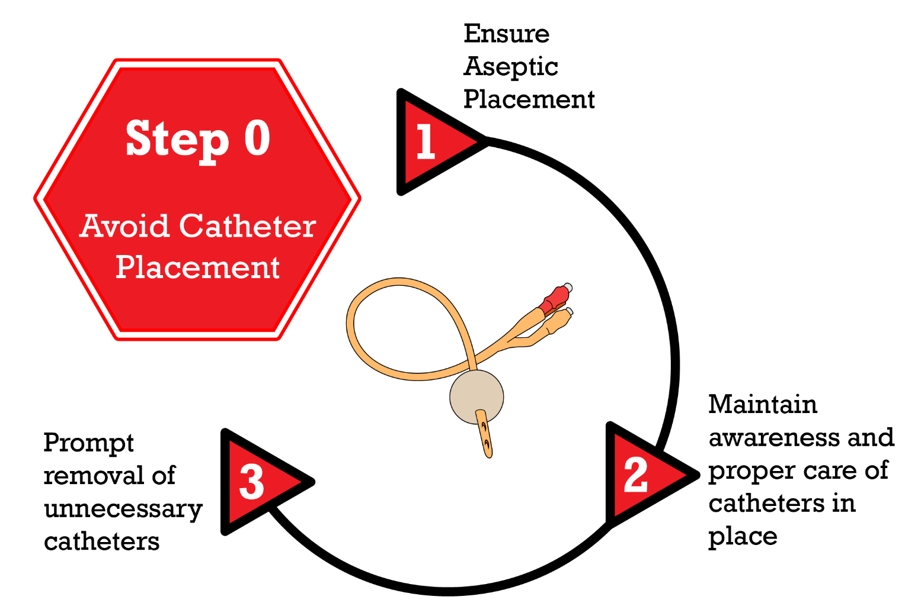
Disrupting the Lifecycle of a Urinary Catheter⁴
Patel PK, Gupta A, Vaughn VM, et al. Review of strategies to reduce central line-associated bloodstream infection (CLABSI) and catheter-associated urinary tract infection (CAUTI) in adult ICUs. J Hosp Med. 2018 Feb 1;13(2):105-16. Epub 2017 Nov 8. PMID: 29154382. Used with permission of Journal of Hospital Medicine.
AHRQ Safety Program for ICUs: Preventing CLABSI and CAUTI
IUC Insertion ׀ 3

Slide 4
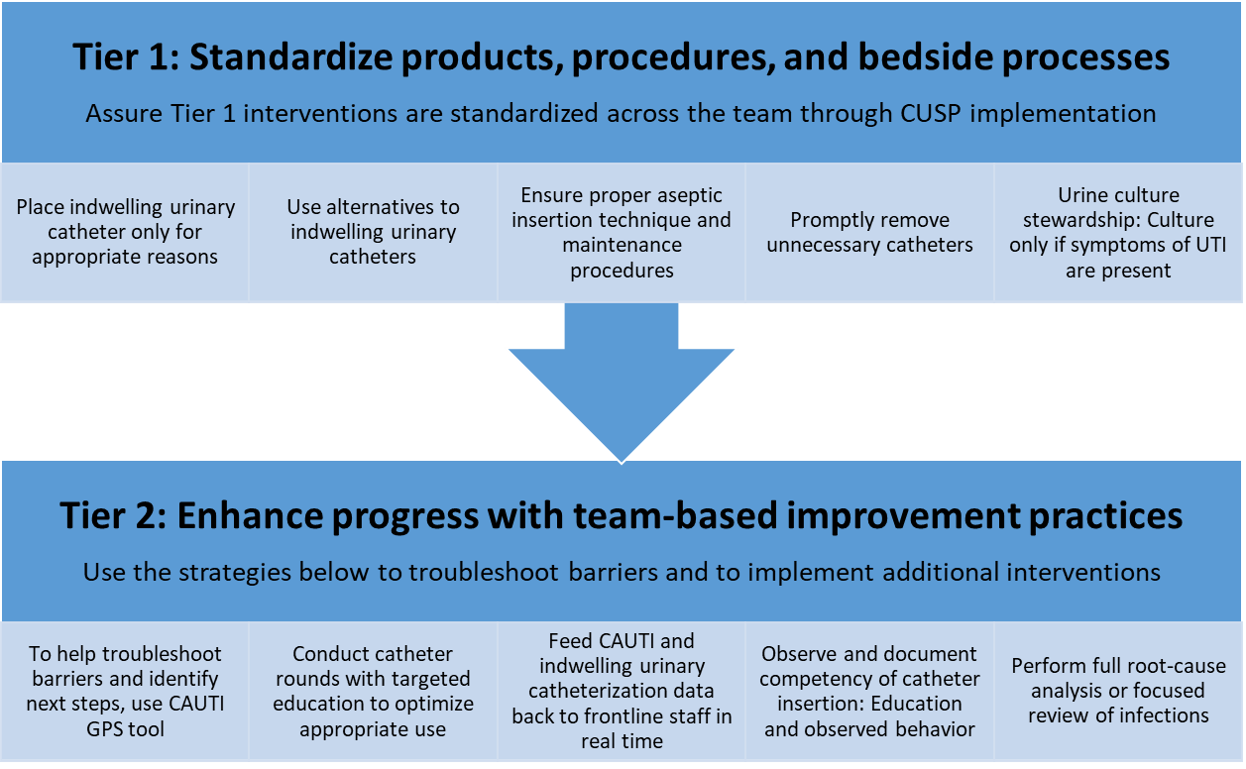
CAUTI Tiers⁵
Abbreviations: CAUTI = catheter-associated urinary tract infection; GPS = Guide to Patient Safety; UTI = urinary tract infection
These materials were expanded, enhanced, and adapted from tiered interventions implemented in cohorts 1 and 2 of AHRQ Safety Program for ICUs: Preventing CLABSI and CAUTI from materials developed for CAUTI prevention by faculty and staff at the Department of Veterans Affairs and the University of Michigan.
AHRQ Safety Program for ICUs: Preventing CLABSI and CAUTI
IUC Insertion ׀ 4

Slide 5
Components of the Indwelling Urinary Catheter Insertion Bundle^{6,7}
1. Assess for the necessity of an indwelling urinary catheter
2. Encourage the use of alternatives
3. Use a standard indwelling urinary catheter kit
4. Ensure proper insertion technique
AHRQ Safety Program for ICUs: Preventing CLABSI and CAUTI
IUC Insertion ׀ 5

Slide 6
Use a Standard Indwelling Urinary Catheter Kit⁸
Tier 1 interventions start with a standardized kit or cart
Several different types of kits available
Closed-system catheter insertion kits are recommended
Supplies in each kit are organized by order of use
Remove individual catheters from patient care units – except some specialty catheters that may be rarely used
AHRQ Safety Program for ICUs: Preventing CLABSI and CAUTI
IUC Insertion ׀ 6

Slide 7
Ensure Proper Insertion Technique⁹
Aseptic insertion technique is recommended
Many nurses and other clinicians have to relearn “proper” technique
Working environment does not resemble learning environment
Checklists can often help assure that insertion is done aseptically
Consider use of two-person insertion to maintain the sterile field
AHRQ Safety Program for ICUs: Preventing CLABSI and CAUTI
IUC Insertion ׀ 7

Slide 8
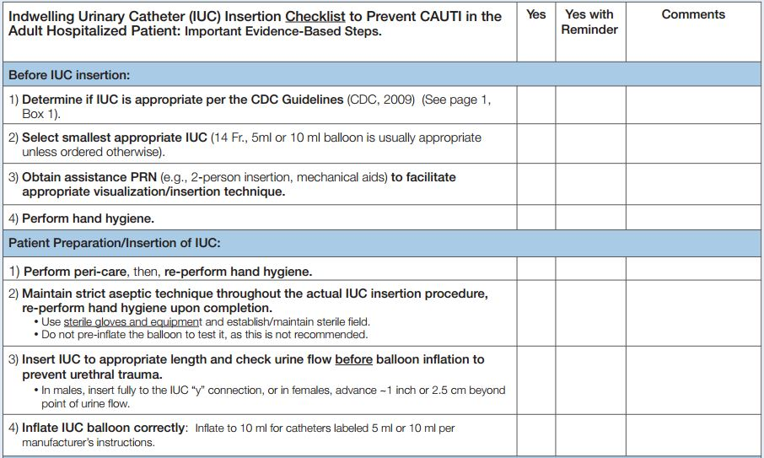
ANA Tool: Algorithm and Checklist¹⁰
©2019 American Nurses Association. Used with permission.
AHRQ Safety Program for ICUs: Preventing CLABSI and CAUTI
IUC Insertion ׀ 8

Slide 9
Another Type of Checklist
Procedural Steps | Yes | No | NA
Place patient in supine position
Inspect the sterile catheterization kit and remove it from its outer packaging
Open the inner paper wrapping to form a sterile field
Form sterile field on bedside table or other flat surface but not patient bed
With washed hands carefully retrieve the absorbent pad from the top of the kit
Place absorbent pad beneath patient’s buttocks, with plastic side down
Don sterile gloves
Cover patient’s abdomen and superior pubic region with fenestrated drape
Organize contents of the tray on the sterile field
Pour antiseptic solution over the preparation swabs in the tray compartment
Squeeze some sterile catheter lubricant onto the tray to lubricate the catheter tip
Using gloved nondominant hand, identify the urethra by spreading labia majora and minora
Use the thumb and index finger to spread the inner labia with gentle traction, pulling upward towards patient’s head
Nondominant hand is not removed from this position
Use an expanding circular motion to clean the opening with remaining swabs
Lubricate distal end of the catheter with the sterile jelly
Holding the catheter in the dominant hand, gently introduce the catheter tip into meatus
Slowly advance catheter through the urethra into the bladder
If catheter is accidentally contaminated, it is discarded, and a new sterile catheter is obtained
*If catheter is accidentally inserted into the vagina, it is left in place until a new sterile catheter is obtained and inserted correctly
Once urine is observed in tubing, the catheter is advanced another 3-5 cm
Balloon is inflated with entire contents of 10cc. syringe of sterile water only after urine is observed in tubing
AHRQ Safety Program for ICUs: Preventing CLABSI and CAUTI
IUC Insertion ׀ 9

Slide 10
Strategies To Use With Checklists
Require oversight for catheter insertion by a licensed provider
If possible, when catheter insertion is necessary, use two people to maintain the sterile field.
AHRQ Safety Program for ICUs: Preventing CLABSI and CAUTI
IUC Insertion ׀ 10

Slide 11
Aseptic Insertion Essentials
Set up a sterile field
Perform hand hygiene immediately before and after insertion
Use sterile gloves, drapes, sponges
Use appropriate antiseptic or sterile solution for peri-urethral cleaning, and a single-use packet of lubricant jelly for catheter tip
If catheter is accidentally contaminated, discard it and obtain a new sterile catheter
AHRQ Safety Program for ICUs: Preventing CLABSI and CAUTI
IUC Insertion ׀ 11

Slide 12
Major Breaks in Aseptic Insertion Technique¹¹
Case study in an emergency department
Prospectively observed urinary catheter insertion attempts
81 observed insertion attempts
Number of patients = 65
Location: Emergency department (ED) of a level 1 trauma center
Timeframe: 1/29 – 6/30
59% of the attempts had at least 1 major break in aseptic insertion technique
AHRQ Safety Program for ICUs: Preventing CLABSI and CAUTI
IUC Insertion ׀ 12

Slide 13
Categories and Frequencies of
Major Breaks in Sterility^{12,13}
Category | Frequency (%) | Examples
Contamination of sterile field | 22 (27%) | Nurse touched items on sterile field with bare nonsterile hands. Stethoscope/garment/torso touched sterile field.
Contamination of the catheter | 25 (31%) | Patient’s labia closed over the catheter during insertion and contaminated the catheter; nurse did not get a new one. Catheter tip touched genitalia before being introduced into urethra.
Breach of sterile barrier | 31 (38%) | Sterile gloved hand used to swab genitalia (without tongs); same hand used to insert catheter. Nurse inserting catheter ripped sterile gloves, did not get new ones.
AHRQ Safety Program for ICUs: Preventing CLABSI and CAUTI
IUC Insertion ׀ 13

Slide 14
Competency¹⁴
Competency involves the “knowledge, skills, abilities, and behaviors to perform a task correctly and skillfully”
Develop a process to observe a return demonstration of expected skills of employee’s role (e.g., urinary catheter insertions)
When to observe:
Upon hire
Periodically – this should be a minimum of annually, whenever new products or processes are introduced or when adverse outcomes may identify a performance gap
Define specific skills for type of employee and their role in CAUTI prevention
AHRQ Safety Program for ICUs: Preventing CLABSI and CAUTI
IUC Insertion ׀ 14

Slide 15
Tier 2 Interventions
Identify key practices to observe or check during planned rounds and specific goal(s) of rounds. This will vary over time as barriers or needs are identified and may vary by ICU.
Identify nurse experts to round and a nurse champion to lead the rounds.
Targeted education can occur during multidisciplinary catheter rounds as opportunities are identified (sometimes referred to as “just-in-time education”)
Consider combining CAUTI and CLABSI rounds
AHRQ Safety Program for ICUs: Preventing CLABSI and CAUTI
IUC Insertion ׀ 15

Slide 16
Barriers to Aseptic Insertion
Supplies are not readily available
Supplies are not designed to facilitate aseptic insertion
Wisps from cotton balls tend to cling to tongs in some kits
Work space is not aligned with workflow
Inconsistent or inconvenient locations for hand gel
Inconvenient location of sinks
Little room to set up sterile field
AHRQ Safety Program for ICUs: Preventing CLABSI and CAUTI
IUC Insertion ׀ 16

Slide 17
Strategies To Overcome Barriers
Ensure availability of standard catheter insertion kits as well as special kits designed specifically for the population ( e.g., pediatric kits in emergency department or surgical services)
Other necessary supplies
Over-the-bed tables
Hand sanitizers
Sterile gloves
Adequate facilities for hand hygiene
Accessibility/location of kits
Where are kits located in relation to where the procedure is to take place?
AHRQ Safety Program for ICUs: Preventing CLABSI and CAUTI
IUC Insertion ׀ 17

Slide 18
One More Strategy: Mindfulness¹⁵
Mindfulness in catheter insertion:
Mindfulness is the process of carefully assessing the task at hand. There can be potential harm involved when an invasive device is inserted, and a mindful approach can be used to help prevent that harm.
Urinary catheterization is often seen as a task. However, the inserter needs to be mindful that any invasive device can cause harm.
Consider multiple steps in the insertion process, as something can go wrong at any point in the process
AHRQ Safety Program for ICUs: Preventing CLABSI and CAUTI
IUC Insertion ׀ 18

Slide 19
Take-Home Points
Use judgement and critical thinking
Consider a change in practice
Delay catheter insertion
Use checklists and mindfulness
AHRQ Safety Program for ICUs: Preventing CLABSI and CAUTI
IUC Insertion ׀ 19

Slide 20
References
Saint S, Greene MT, Krein SL, et al. A program to prevent catheter-associated urinary tract infection in acute care. New Engl J Med. 2016;374(22):2111-9. PMID: 27248619.
Centers for Disease Control and Prevention. 2019 National and State Healthcare-Associated Infections Progress Report. https://www.cdc.gov/hai/data/portal/progress-report.html. Accessed on October 11, 2021.
Fakih MG, Bufalino A, Sturm L, et al. Coronavirus disease 2019 (COVID-19) pandemic, central-line-associated bloodstream infection (CLABSI), and catheter-associated urinary tract infection (CAUTI): The urgent need to refocus on hardwiring prevention efforts Infect Control Hosp Epidemiol. 2021;1-6. doi:10.1017/ice.2021.70. PMID: 33602361.
Meddings J, Saint S. Disrupting the life cycle of the urinary catheter. Clin Infect Dis. 2011 Jun;52(11):1291-3. PMID: 21596672.
Meddings J, Manojlovich M, Fowler KE, et al. A tiered approach for preventing cather-associated urinary tract infections. Ann Intern Med. 2019 Oct 1;171(7_Supple):S30-S37. PMID: 31569226.
Patel PK, Gupta A, Vaughn VM, et al. Review of strategies to reduce central line-associated bloodstream infection (CLABSI) and catheter-associated urinary tract infection (CAUTI) in adult ICUs. J Hosp Med. 2018 Feb 1;13(2):105-16. Epub 2017 Nov 8. PMID: 29154382.
Centers for Disease Control and Prevention. Catheter-Associated Urinary Tract Infections (CAUTI). https://www.cdc.gov/HAI/ca_uti/uti.html. Accessed October 11, 2021.
Agency for Healthcare Research and Quality. Appendix G. Indwelling Urinary Catheter Insertion Checklist. https://www.ahrq.gov/hai/quality/tools/cauti-ltc/modules/resources/tools/prevent/insertion-checklist.html. Accessed on October 11, 2021.
Fletcher-Gutowski S, Cecil J. Is 2-person urinary catheter insertion effective in reducing CAUTI? Am J Infect Control. 2019;47(12):1508-9. PMID: 31324489.
American Nurses Association. Streamlined Evidence-Based RN Tool: Catheter Associated Urinary Tract Infection (CAUTI) Prevention. https://www.nursingworld.org/~4aede8/globalassets/practiceandpolicy/innovation--evidence/clinical-practice-material/cauti-prevention-tool/anacautipreventiontool-final-19dec2014.pdf. Accessed October 1, 2021.
Manojlovich M, Saint S, Meddings J, et al. Indwelling urinary catheter insertion practices in the emergency department: an observational study. Infect Control Hosp Epidemiol. 2016;37(1):117-9. PMID: 26434781.
Lo E, Nicolle L, Coffin S, et al. Strategies to prevent catheter-associated urinary tract infections in acute care hospitals: 2014 update. Infect Control Hosp Epidemiol. 2014 May;35(5):464-79. doi: 10.1086/675718. PMID: 24709715.
Carter EJ, Pallin DJ, Mandel L, et al. Emergency department catheter-associated urinary tract infection prevention: multisite qualitative study of perceived risks and implemented strategies. Infect Control Hosp Epidemiol. 2016 Feb;37(2):56-62. PMID: 26526870.
Davila S, Cook M, Manojlovich M. Competency-Based Training for Infection Prevention. Health Research & Educational Trust and U.S. Centers for Disease Control and Prevention. https://www.cdc.gov/infectioncontrol/pdf/strive/CBT101-508.pdf. Accessed February 7, 2022.
Kiyoshi-Teo H, Krein S, Saint S. Applying mindful evidence-based practice at the bedside: using catheter-associated urinary tract infection as a model. Infect Control Hosp Epidemiol. 2013 Oct;34(10):1099-1101. doi: 10.1086/673147. PMID: 24018928.
AHRQ Safety Program for ICUs: Preventing CLABSI and CAUTI
IUC Insertion ׀ 20

