Slide 1
Indwelling Urinary Catheter Maintenance
AHRQ Safety Program for Intensive Care Units: Preventing CLABSI and CAUTI
Maintaining Awareness and Proper Care of Catheters in Place
AHRQ Pub. No. 17(22)-0019
April 2022

Slide 2
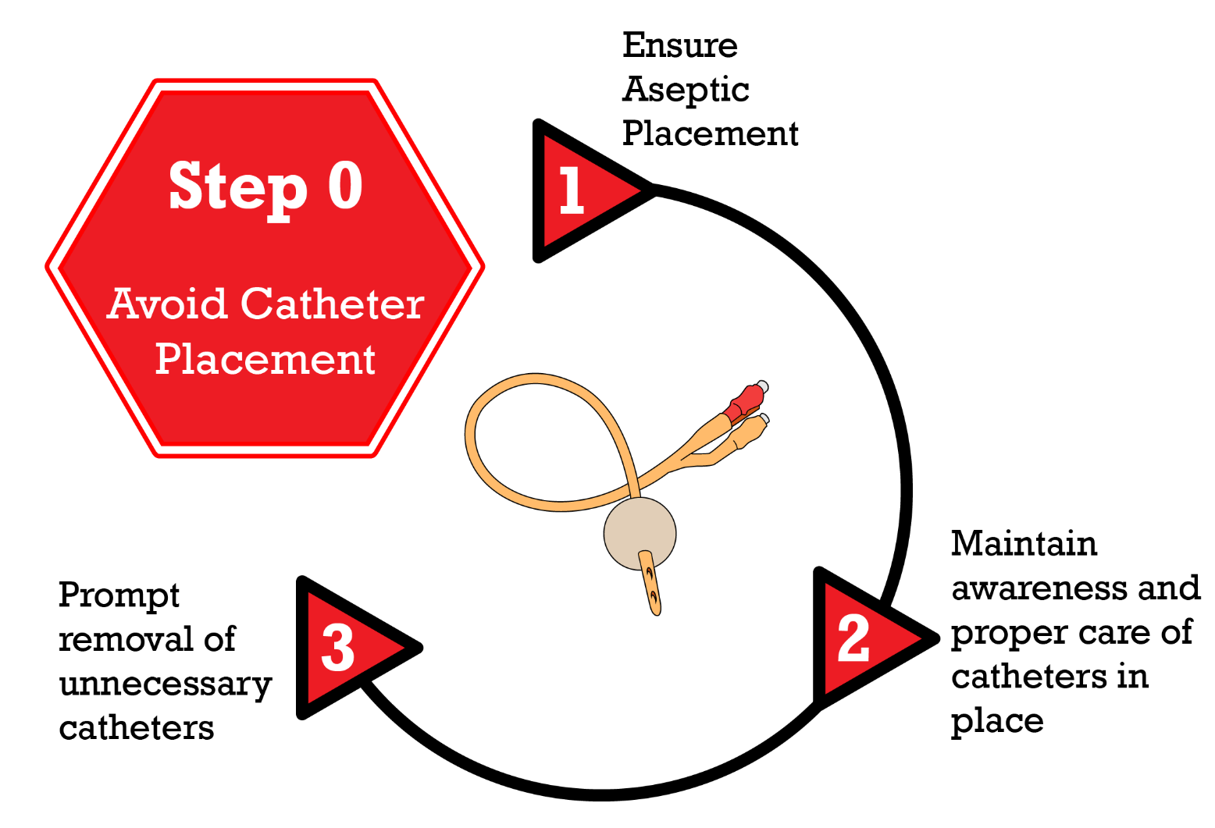
Disrupting the Life Cycle of a Catheter Device
Disrupting the Life Cycle of a Catheter Device^{1,2}
Patel PK, Gupta A, Vaughn VM, et al. Review of strategies to reduce central line-associated bloodstream infection (CLABSI) and catheter-associated urinary tract infection (CAUTI) in adult ICUs. J Hosp Med. 2018 Feb 1;13(2):105-16. Epub 2017 Nov 8. Used with permission of Journal of Hospital Medicine.
AHRQ Safety Program for ICUs: Preventing CLABSI and CAUTI
IUC Maintenance ׀ 2

Slide 3
Why Is Maintenance Important?^{3,4}
Risk of catheter-associated urinary tract infection (CAUTI) increases by 3–7% each day that a catheter is in place
Up to 50% of patients with an indwelling urinary catheter for 5 days or more will have asymptomatic bacteriuria (ASB) or fungus in their urine, and 100% will have bacteriuria by day 30
Contamination can occur due to breaks in the closed drainage system or from the drainage bag
From patient (meatal, rectal, or vaginal)
From hands of healthcare worker during insertion or manipulation of catheter and collection system
AHRQ Safety Program for ICUs: Preventing CLABSI and CAUTI
IUC Maintenance ׀ 3

Slide 4
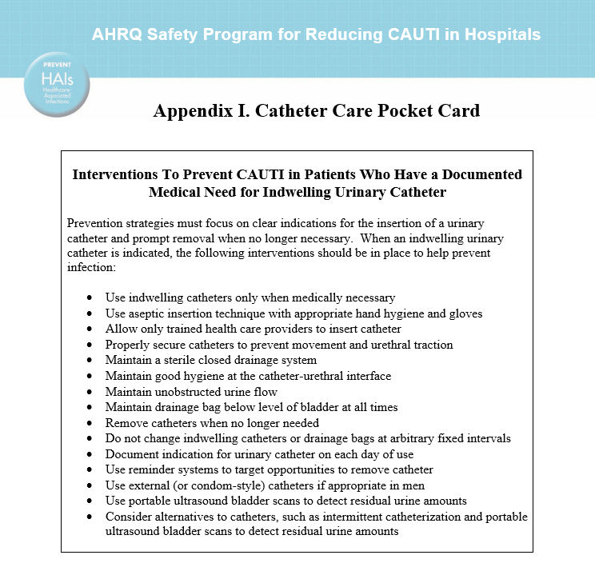
Indwelling Urinary Catheter Care Essentials⁵
Use appropriate hand hygiene and gloves
Properly secure catheters to prevent movement and urethral traction
Maintain a sterile closed drainage system
Maintain good hygiene at the catheter-urethral interface
Maintain unobstructed urine flow
Maintain drainage bag below bladder level at all times
Do not change catheters or drainage bags at arbitrary fixed intervals
Document indication for catheter on each day of use
AHRQ Safety Program for ICUs: Preventing CLABSI and CAUTI
IUC Maintenance ׀ 4

Slide 5
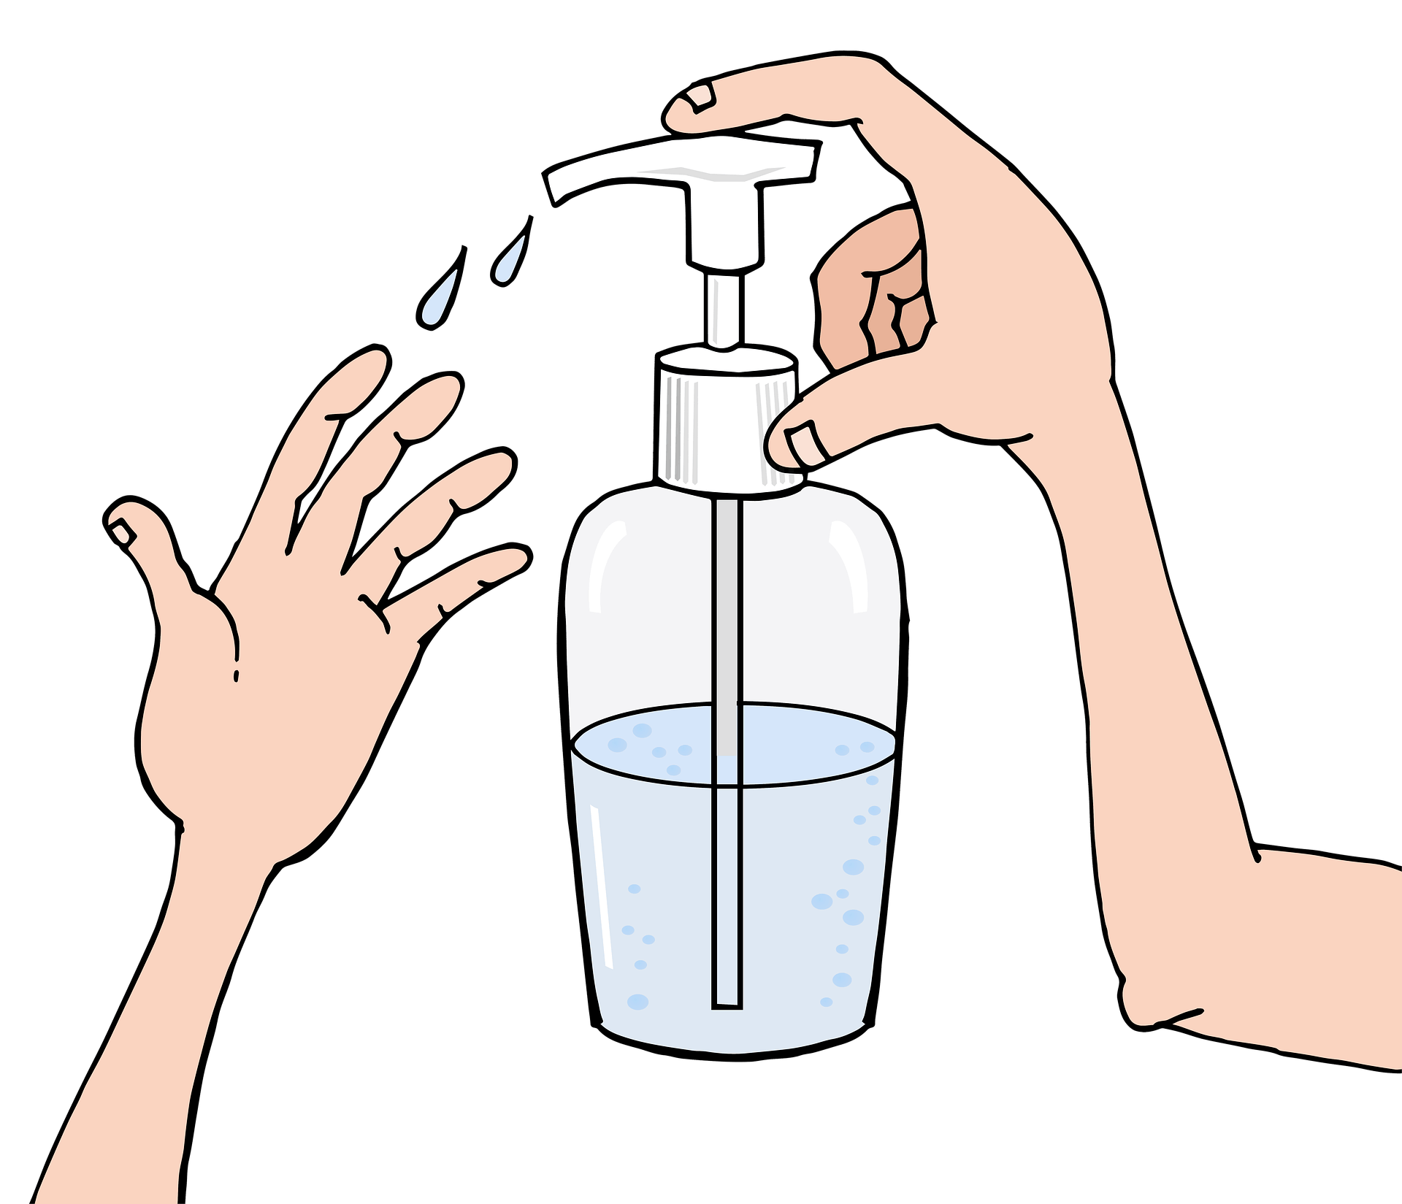
Infection Prevention and IUC Maintenance⁶⁻⁷
Hand Hygiene
Hand hygiene is performed before each and every patient contact and before any manipulation of the catheter device or site
Standard Precautions
Including wearing gloves and gowns, as appropriate, during any manipulation of the catheter or collecting system
AHRQ Safety Program for ICUs: Preventing CLABSI and CAUTI
IUC Maintenance ׀ 5

Slide 6
Strategies To Improve Hand Hygiene^{6,7}
Challenges | Strategies
Hand hygiene products not available or close to point of care Multiple tasks performed without hand hygiene in between | Education related to specific aspects of indwelling urinary catheter care and appropriate setting for placement Audit and feedback
AHRQ Safety Program for ICUs: Preventing CLABSI and CAUTI
IUC Maintenance ׀ 6

Slide 7
Maintain a Closed System⁶
If breaks in aseptic technique, disconnection, or leakage occur, replace the catheter using aseptic technique and sterile equipment
Consider using indwelling urinary catheters with preconnected, sealed catheter tubing junctions
AHRQ Safety Program for ICUs: Preventing CLABSI and CAUTI
IUC Maintenance ׀ 7

Slide 8
Assessment—Urinary Catheter Rounding
Checklist | Yes or No
Does the patient still need the urinary catheter?
Is the tamper resistant seal intact?
Is the catheter secured?
Is the bag below the level of the bladder?
Is the bag off the floor?
AHRQ Safety Program for ICUs: Preventing CLABSI and CAUTI
IUC Maintenance ׀ 8

Slide 9
Barriers to Maintaining a Closed System⁷
Barriers | Strategies
Need to change urinary collection device to a urimeter | Work with the ED and OR to require that all patients who may go to the ICU have an indwelling urinary catheter that is preconnected to a urimeter If the patient arrives with an indwelling urinary catheter already connected to a regular bag, change the catheter and urinary drainage system
Need for specialized catheter that is not preconnected | Work with your supply chain to request that vendors supply preconnected indwelling specialized urinary catheters
AHRQ Safety Program for ICUs: Preventing CLABSI and CAUTI
IUC Maintenance ׀ 9

Slide 10
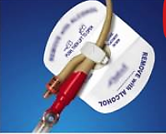
Maintain Unobstructed Urine Flow
Use an indwelling urinary catheter securement device to anchor the catheter
Ensure the bag is below the level of the bladder and keep it off the floor
Make sure the bag is emptied prior to transport
Example of securement device
AHRQ Safety Program for ICUs: Preventing CLABSI and CAUTI
IUC Maintenance ׀ 10

Slide 11
Unobstructed Urine Flow: Barriers and Strategies
Barriers | Strategies
Transfer of patients from the ICU to diagnostic or other treatment areas. | Incorporate observation of indwelling urinary catheter and bag into routine rounds. Observe ancillary services such as transport.
Indwelling urinary catheter bags placed on the patient’s bed during diagnostic tests. | Perform a simple check prior to transport to ensure that the catheter is patent and the urinary drainage bag is below the level of the bladder.
Indwelling urinary catheter bags that become full during procedures. | Empty indwelling urinary catheter drainage bags prior to transport.
AHRQ Safety Program for ICUs: Preventing CLABSI and CAUTI
IUC Maintenance ׀ 11

Slide 12
Other Maintenance Strategies⁷⁻⁹
Perform routine meatal care
Daily with the bath and after a bowel movement – soap and water recommended in the guidelines
Avoid irrigation unless bladder obstruction is anticipated
Obtain specimens aseptically
Do not routinely change catheters
If a catheter has been in place for greater than 2 weeks, change catheter before inserting obtaining a urine specimen or starting antibiotics.
AHRQ Safety Program for ICUs: Preventing CLABSI and CAUTI
IUC Maintenance ׀ 12

Slide 13
References
Meddings J, Saint S. Disrupting the life cycle of the urinary catheter. Clin Infect Dis. 2011 Jun;52(11):1291-3. PMID: 21596672.
Patel PK, Gupta A, Vaughn VM, et al. Review of strategies to reduce central line-associated bloodstream infection (CLABSI) and catheter-associated urinary tract infection (CAUTI) in adult ICUs. J Hosp Med. 2018 Feb;13(2):105-16. Epub 2017 Nov 8. PMID: 29154382.
Nicolle LE. Catheter associated urinary tract infections. Antimicrob Resist Infect Control. 2014 Jul 25;3:23. doi: 10.1186/2047-2994-3-23. PMID: + 25075308; PMCID: PMC4114799
Lo E, Nicolle L, Coffin S, et al. Strategies to prevent catheter-associated urinary tract infections in acute care hospitals: 2014 update. Infect Control Hosp Epidemiol. 2014 May;35(5):464-79. doi: 10.1086/675718. PMID: 24709715.
Agency for Healthcare Research and Quality. Appendix J. Urinary Catheter Brochure. http://www.ahrq.gov/professionals/quality-patient-safety/hais/cauti-tools/impl-guide/implementation-guide-appendix-j.html. Accessed October 11, 2021.
Gould CV, Umscheid CA, Agarwal RK, et al. Guideline for prevention of catheter-associated urinary tract infections 2009. Infect Control Hosp Epidemiol 2010 Apr; 31(4):319-26. PMID: 20156062.
Association for Professionals in Infection Control and Epidemiology. Guide to Preventing Catheter-Associated Urinary Tract Infections. 2014. https://apic.org/Professional-Practice/Implementation-guides/#implementaion-guide-7454. Accessed October 11, 2021.
Mitchell B, Curryer C, Holliday E, et al. Effectiveness of meatal cleaning in the prevention of catheter-associated urinary tract infections and bacteriuria: an updated systematic review and meta-analysis. BMJ Open 2021;11:e046817. doi:10.1136/ bmjopen-2020-046817. PMID: 34103320.
Agency for Healthcare Research and Quality. Information for Specialty Audiences. http://www.ahrq.gov/professionals/quality-patient-safety/hais/tools/cauti-hospitals/toolkit-info.html. Accessed on October 11, 2021.
AHRQ Safety Program for ICUs: Preventing CLABSI and CAUTI
IUC Maintenance ׀ 13

